Slide 1
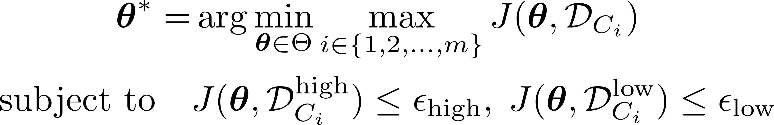
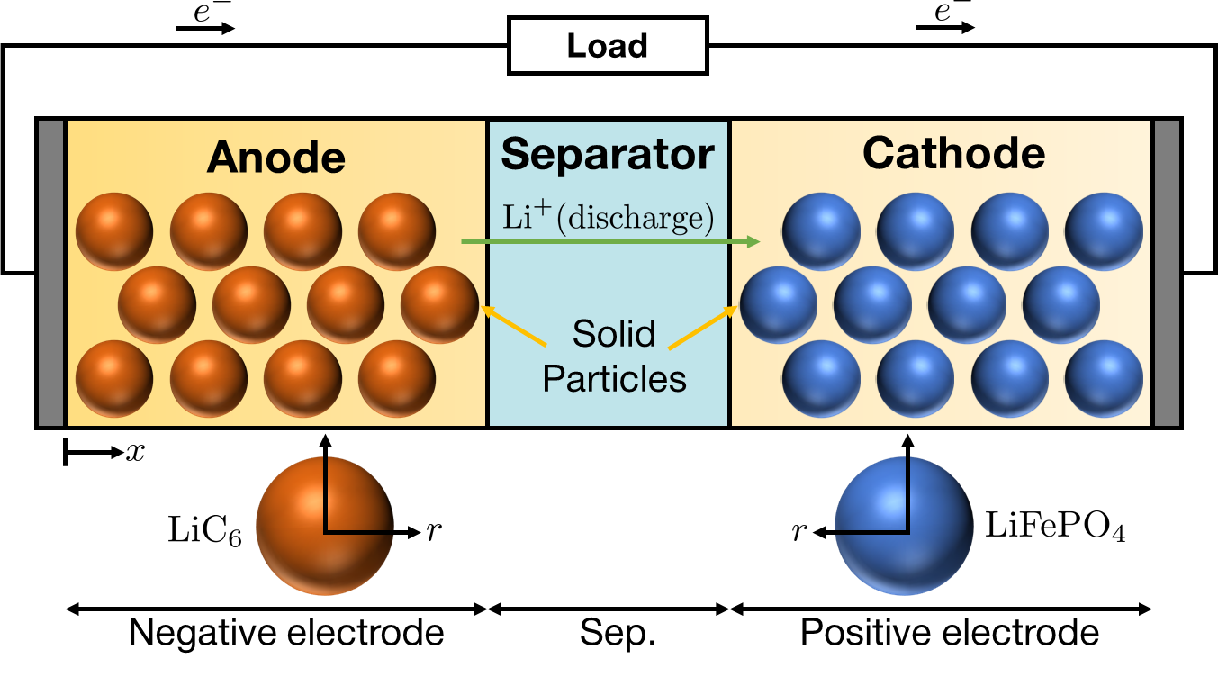
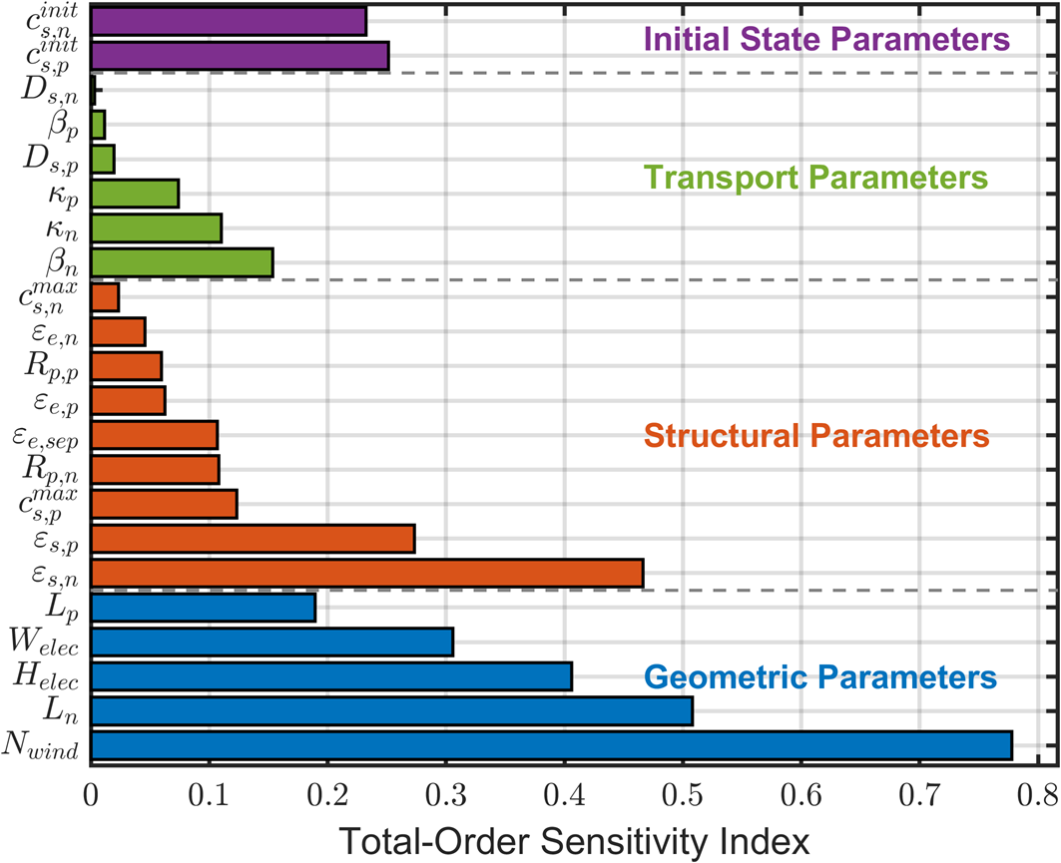
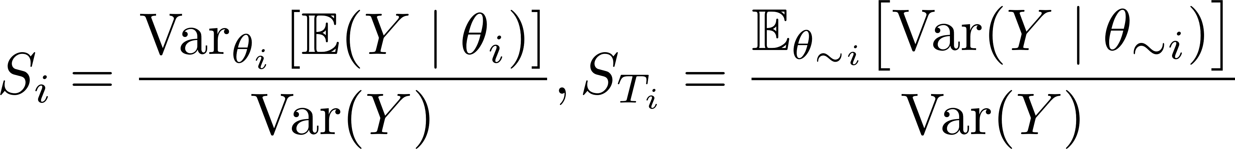


DFN Battery Modeling with Real Discharge Data
Region-Aware Min-Max Formulation
Experiment
Simulation
Large-format Battery
DFN Modeling
Low-SOC Region
Voltage (V)
High-SOC Region
Data
Time (s)
280 Ah
Trust Region based Constrained Bayesian Optimization
Gaussian Process Regression
Cross-condition Sensitivity Analysis
Trust Region Management
Sobol Indices
Granular-Adaptive Local Search
SEARCH Stage
IF FAIL
FINALIZE Stage
Weighted Error Criterion

