Slide 1
Sky Segmentation
SGVINS
Sky Image
Sky
Border
Topological Structure
Analysis
Satellite
Visibility
Satellite
Filtration
GVINS
3D Satellite
Coordinate
2D Distorted
Coordinate
2D
Coordinate
GNSS
Distortion
GNSS/VIO
Aligning
Extrinsic
Calibration
Intrinsic
Calibration
Back Projection

Slide 2
Sky Segmentation
SGVINS
Sky Image
Sky
Border
Topological Structure
Analysis
Satellite
Visibility
Satellite
Filtration
GVINS
3D Satellite
Coordinate
2D Distorted
Coordinate
2D
Coordinate
GNSS
Distortion
GNSS/VIO
Aligning
Extrinsic
Calibration
Intrinsic
Calibration
Back Projection

Slide 3
Sky Segmentation
SGVINS
Sky Image
Sky
Border
Topological Structure
Analysis
Satellite
Visibility
Satellite
Filtration
GVINS
3D Satellite
Coordinate
2D Distorted
Coordinate
2D
Coordinate
GNSS
Distortion
GNSS/VIO
Aligning
Extrinsic
Calibration
Intrinsic
Calibration
Back Projection

Slide 4
Sky Segmentation
SGVINS
Topological Structure
Analysis
Sky Image
Sky
Border
GNSS
Satellite
Filtration
Back Projection
Satellite Visibility
2D
Coordinate
Intrinsic
Calibration
2D Distorted
Coordinate
Detection
&Tracking
Optimization
Forward
Image
Distortion
Pre-integration
3D Satellite
Coordinate
Extrinsic
Calibration
Yaw
Alignment
VI
Alignment
IMU

Slide 5
Sky Segmentation
Sky-GVINS
GNSS
Sky Image
Image Segmentation
Sky Region
Satellite
Visibility
Satellite
Filtration
Back Projection
2D
Coordinate
Intrinsic
Calibration
2D Distorted
Coordinate
Distortion
Detection
&Tracking
Forward
Image
Optimization
Output
3D Satellite
Coordinate
Extrinsic
Calibration
Yaw
Alignment
Pre-integration
VI Alignment
IMU

Slide 6
Sky Segmentation
Sky-GVINS
Image Segmentation
GNSS
Sky Image
Sky Region
Satellite
Filtration
Satellite Visibility
Back Projection
2D
Coordinate
Camera
Calibration
2D Distorted
Coordinate
Detection
&Tracking
Forward
Image
Optimization
3D Satellite
Coordinate
Pre-integration
Cam-IMU
Extrinsic
Yaw
Alignment
VI Alignment
IMU

Slide 7
Sky Segmentation
Image Segmentation
Sky-GVINS
GNSS
Sky Image
Sky Region
Satellite Visibility
Satellite
Filtration
Back Projection
2D
Coordinate
Intrinsic
Calibration
Distortion
2D Distorted
Coordinate
Detection
&Tracking
Forward
Image
Optimization
3D Satellite
Coordinate
Extrinsic
Calibration
Yaw
Alignment
Pre-integration
VI Alignment
IMU

Slide 8
Measurement Processing
RGB Camera
Feature Detection and Tracking
Depth Camera
IMU
Pre-integration
Wheel Encoder
Pose
Initialization
Dense Mapping
Visual-inertial
Alignment
SFM
Global Optimization
Local Visual-Inertial-Wheel Odometry
Map Filter
Optimization-based Odometry
Sliding Window
Triangulate

Slide 9
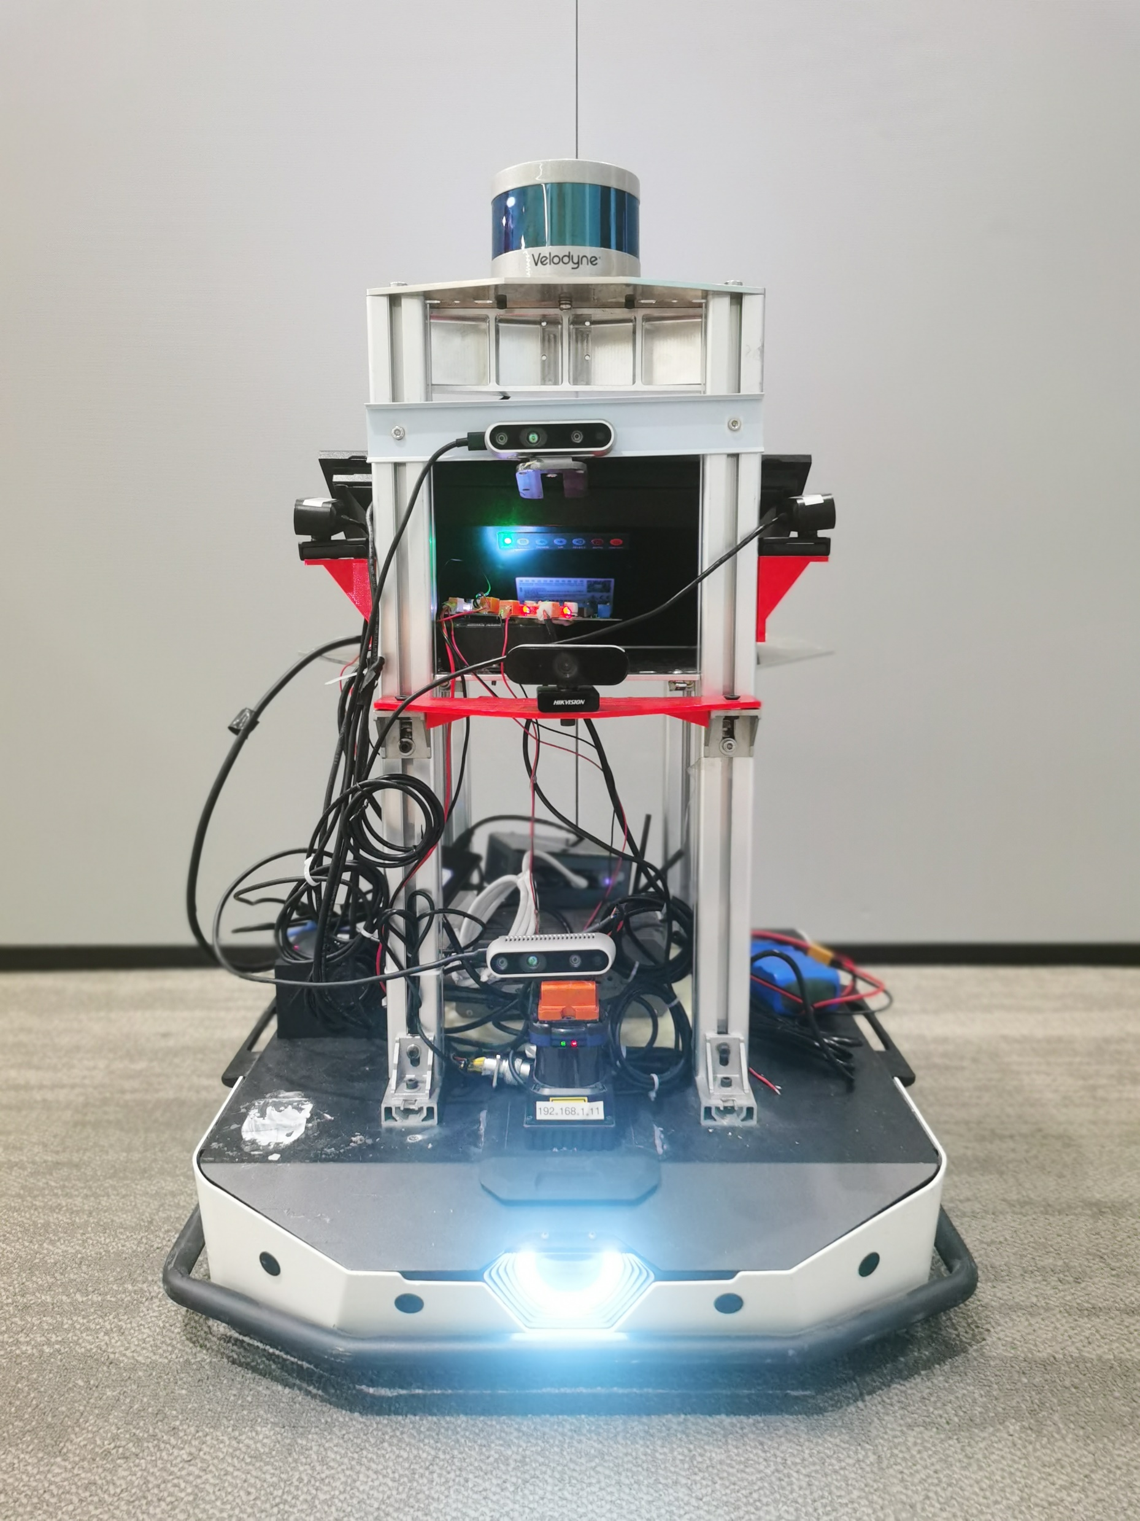
3D LiDAR
RGB-D Camera
&IMU
IMU
Light

