Slide 1
EEG Data Analysis
Sprint: 3/26
Allison & Elizabeth

Slide 2
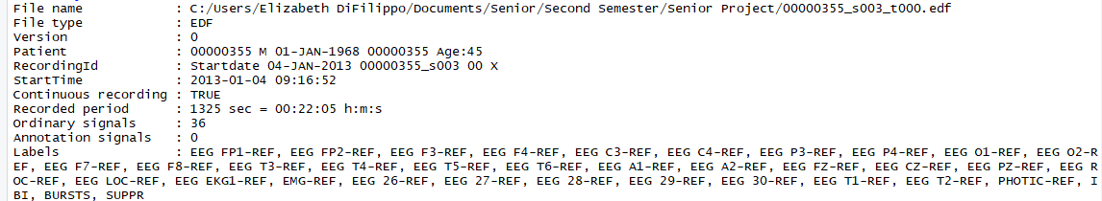
Package: EdfReader
Reads EDF and BDF file types.
read the header: dataSP1= readEdfHeader("C:/Users/Elizabeth DiFilippo/Documents/Senior/Second Semester/Senior Project/00000355_s003_t000.edf")
read in signals: sig = readEdfSignals(dataSP)
Gives information about all 36 (ordinary signals: labels)

Slide 3
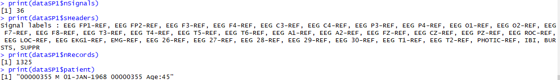
Package: EdfReader
Use print(), to retrieve specific information about the data as shown below:
$ symbol is used to select specific pieces of data to print, such as the patient information ($patient)

Slide 4
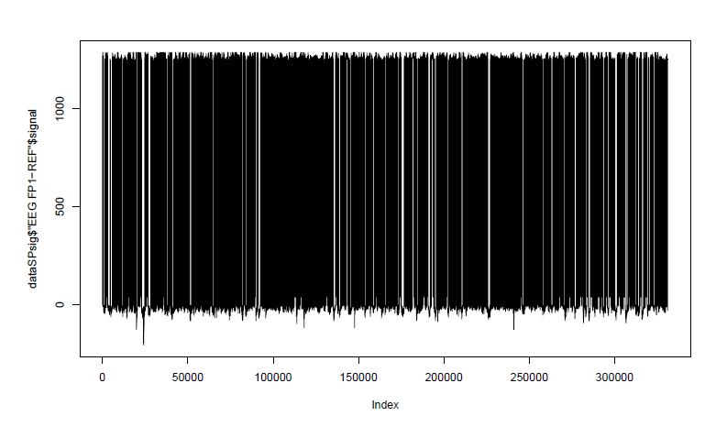
Plot a signal
plot(dataSPsig$'EEG FP1-REF'$signal, type = "l")
Graph of one signal (FP1)in one patient
type = “l” : parameter of plot function to change style of plot i.e. “p” for points, “h” for histogram,” “s” for steps → we chose “l” for a line plot

Slide 5
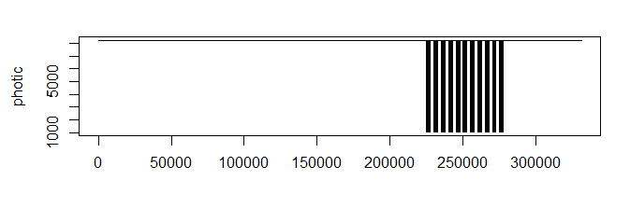
PLOT
par(): Create a multi-paneled plotting window.
mfrow : vector of length 2; first argument = # rows and second = # columns
ylab param adds a String label to the y-axis
(xlab param does the same for x-axis)

Slide 6
Compute Correlation between Signals
>cor( dataSPsig$`EEG FP1-REF`$signal, dataSPsig$`EEG FP2-REF`$signal, method="pearson" )
[1] 0.7954568
>cor( dataSPsig$`EEG FP1-REF`$signal, dataSPsig$`PHOTIC-REF`$signal, method="pearson" )
[1] 0.001461139
The cor() function allows us to compare two signals tand calculate the covariance between them.
Measure the relationship between the signals in a patient
*If the behavior is the same, then covariance is possible
Would like to take signals from multiple patients with or without epilepsy to measure behavior
PROBLEM: Incompatible dimensions

Slide 7
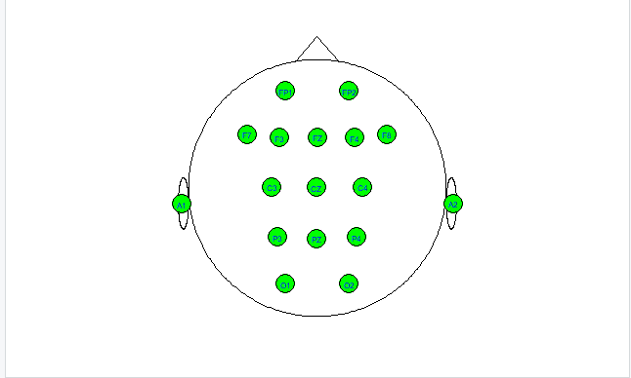
Declare electrodes & eegcap()
electrodes <- c("FP1", "FP2", "F3", "F4", "C3", "C4", "P3", "P4", "O1", "O2", "F7", "F8", "T3","T4", "T5", "T6", "A1", "A2", "FZ", "CZ", "Pz", "ROC", "LOC", "EKG1","EMG", "26", "27", "28", "29", "30", "T1", "T2", "PHOTIC", "IBI", "BURSTS", "SUPPR")
>eegcap(electrodes)

Slide 8
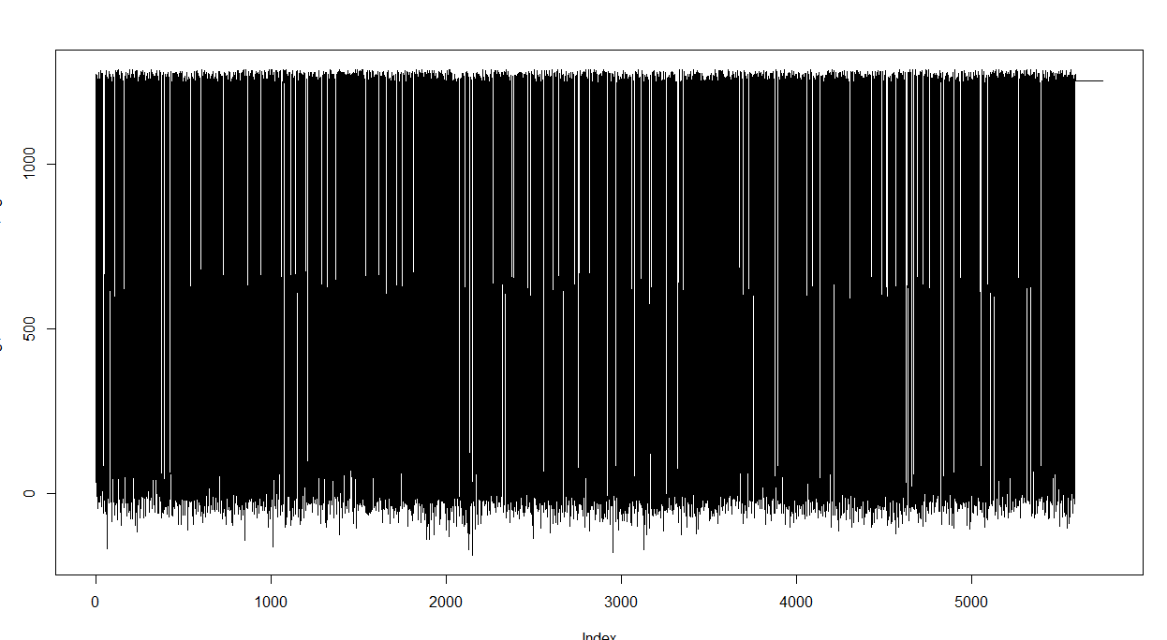
Patient without Epilepsy
plot(dataSPNOEsig$`EEG FP1-REF`$signal, type ="l")

Slide 9
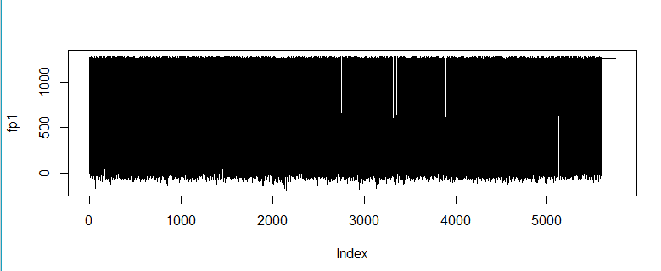
Segmented Plot
par(mfrow=c(2,1))
> plot(dataSPNOEsig$`PHOTIC-REF`$signal, type = "l", ylab = "photic"
> plot(dataSPNOEsig$`EEG FP1-REF`$signal,type = "l", ylab = "fp1")

Slide 10
Compute Correlation between Signals
cor( dataSPNOEsig$`EEG FP1-REF`$signal, dataSPNOEsig$`EEG FP2-REF`$signal, method="pearson" )
[1] 0.1297484

Slide 11
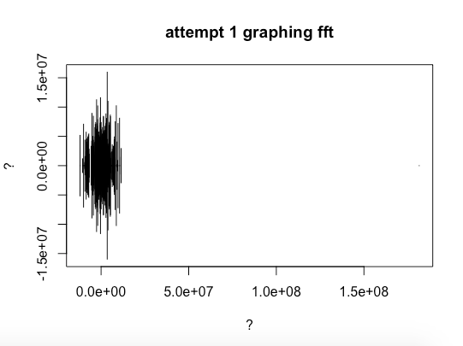
Next Week: 4/2
fft() - understanding function for frequency domain(Fourier) analysis of EEG data
Analyze more patients with/without epilepsy
f <- fft(sig$`EEG FP1-REF`$signal, inverse=FALSE)
plot(f, type = "h", main = "attempt 1 graphing fft", ylab = "?", xlab = "?")

