Slide 1
QUAD ORIENTATION Shape Parameters & Jacobian Analysis

Slide 2
Coordinate Orientation
A graph has four quadrants. I (top right), II (top left), III (bot left), IV (bot right).
The centroid of the quad is calculated, thus becoming the origin reference point to decipher where the other points lie.
(x1 + x2 + x3 + x4) / 4 (y1 + y2 + y3 + y4) / 4
Once the centroid is calculated, cases are used to check:
To the right and above the centroid (I)
To the left and above the centroid (II)
To the left and below the centroid (III)
To the right and below the centroid (IV)
II
I
III
IV

Slide 3
Coordinate Orientation
If there exists only one point in each quadrant, then:
Point in I is P3
Point in II is P4
Point in III is P1
Point in IV is P2
P4
P3
II
I
III
IV
P1
P2

Slide 4
Coordinate Orientation
This is not always the case, however, because two points could exist in one quadrant, while the other two are in other quadrants. One quadrant might even hold three points!
Variations include:
P4
P3
P3
II
I
II
I
II
I
P3
P4
P2
P4
P1
III
IV
III
IV
III
IV
P1
P1
P2
P2

Slide 5
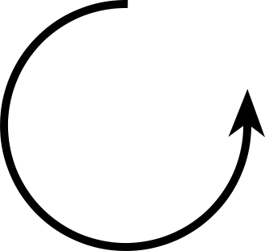
Coordinate Orientation
P4
II
I
P3
As a result, multiple cases need to be checked.
Four sub sections of if statements are used, each for the four quadrants.
Start by checking the bottom left most quadrant (III aka p1vals) and work your way around COUNTER CLOCKWISE.
Check to see if there are three points in this quadrant (two quadrants missing).
If so, you will save these points in an ArrayList, set a Boolean to indicate there are three points, continue counter clockwise to find the lone point, set that as it’s respective quadrant’s point (previous slide), and then later decipher the correct order of the three points using the line method described later.
Check to see if there are two points in this quadrant.
If so, decipher what other quadrants are missing points.
After this step, you can decipher which of the two points is which in the current quadrant. For example, if Quadrant III were populated with two points, they are either P1 and P4 OR P1 and P2. (Adjacent quadrants)
You need to check if there are two points in the opposite quadrant. If so, follow with the line method described later.
Check to see if there is only one point in this quadrant. If so, the point is that respective quadrant's point (see previous slide).
P1
III
IV
P2

Slide 6
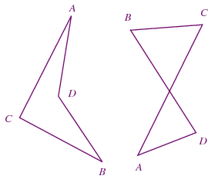
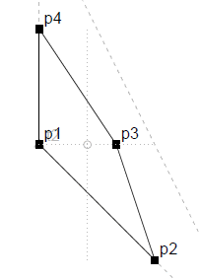
Assumptions
Concave
Crossed
Four points are used at all times
Not concave, but convex
Not three or four collinear points
Three would be a triangle, four would be a line
No points are overlapping / have both the same x and y value
Same X & Y as Centroid
Features / Capabilities
Order input does not matter / line method works with arbitrary points
Allows for both clockwise and counterclockwise
Corrects “crossed” quads, which has lines that intersect
Works with points that are the same x or y value as the centroid

Slide 7
Line Method, 3 Points
NOTE: .get(0) is always the arbitrary point that is being drawn to. The value it holds depends on the input.
For three points in one quadrant, one in other:
Once all of the main four if statements (one for each quadrant) are finished, four separate if statements check to see if there are three points in a given quadrant using the set Boolean.
If true for any quadrant, a line is calculated from the lone point (which will be deciphered by this point) to one of the three points using the y = mx + b formula.
p1val is an array that contains X [arr index 0] and Y [arr index 1] of the three pts ArrayList index of 0, which is one of the points, is arbitrarily chosen. The point chosen does not matter. slope = (p1val.get(0)[1] - p3[1]) / (p1val.get(0)[0] - p3[0]);
b = p3[1] - (slope * p3[0]);
We currently have m and b for the formula
P3
II
I
P4
III
IV
Arbitrarily chosen point
P1
P2

Slide 8
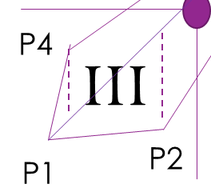
Line Method, 3 Points (Continued)
The two points that were NOT chosen are projected onto the line (plug x values in the equation)
The y values of the two points are compared to their y value on the line.
If the y value on the line is greater than a point’s y value, it is below the line like P2.
If the y value on the line is less than a point’s y value, it is above the line like P4.
y = m * x + b
tempy1 = (slope * p1val.get(1)[0]) + b;
tempy2 = (slope * p1val.get(2)[0]) + b;

Slide 9
Line Method, 3 Points (Continued)
If the line is above the other two points
if(p1val.get(1)[1] < tempy1 && p1val.get(2)[1] < tempy2){
You need to repeat the line method again, but this time you’re comparing the two points below the line to figure out their coordination. If you project p1val.get(2)[0] on the line…
if(p1val.get(2)[1] > tempy1Bot2){
p4 = p1val.get(0);
p1 = p1val.get(2);
p2 = p1val.get(1);
else if(p1val.get(2)[1] < tempy1Bot2){
p4 = p1val.get(0);
p1 = p1val.get(1);
p2 = p1val.get(2);

Slide 10
Line Method, 3 Points (Continued)
If the line is in-between the other two points
else if(p1val.get(1)[1] > tempy1 && p1val.get(2)[1] < tempy2){
p4 = p1val.get(1);
p1 = p1val.get(0);
p2 = p1val.get(2);
or
else if(p1val.get(1)[1] < tempy1 && p1val.get(2)[1] > tempy2){
p4 = p1val.get(2);
p1 = p1val.get(0);
p2 = p1val.get(1);

Slide 11
Line Method, 3 Points (Continued)
If the line is below the other two points
else if(p1val.get(1)[1] > tempy1 && p1val.get(2)[1] > tempy2){
You need to repeat the line method again, but this time you’re comparing the two points above the line to figure out their coordination. If you project p1val.get(2)[0] on the line…
if(p1val.get(2)[1] > tempy1Top2){
p4 = p1val.get(2);
p1 = p1val.get(1);
p2 = p1val.get(0);
else if(p1val.get(2)[1] < tempy1Top2){
p4 = p1val.get(1);
p1 = p1val.get(2);
p2 = p1val.get(0);

Slide 12
Line Method 2 & 2
NOTE: .get(0) is always the arbitrary point that is being drawn to. The value it holds depends on the input.
For two points in one quadrant, two in other:
y = mx + b formula used to create a line from the second point p2 (will have been decided) to one of the points on the opposite, diagonal quadrant. The point is chosen arbitrarily. Opposite / diagonal quadrant means the quadrant that is NOT touching the current quadrant to either the left or right. Opposite / diagonal quadrant pairs are III & I, and IV & II
p3val.get(0) is the arbitrarily chosen point tempSlope1 = (p3val.get(0)[1] - p2[1]) / (p3val.get(0)[0] - p2[0]);
double tempB1 = p2[1] - (tempSlope1 * p2[0]);
We currently have m and b for the formula
Arbitrarily chosen point
P4
II
I
P3
P1
III
IV
P2

Slide 13
Line Method 2 & 2 (Continued)
P4
II
I
P3
Project the x value of the point that was not chosen on the calculated line. If the y value of the point on the line is less than the actual point, then this is good. This means that a point was not left out of the shape. This is p3, the other point not chosen is p4. (See top right figure)
If the y value of the point on the line is greater than the actual point, then this is not good. This means that a point was left out of the shape. This is p4, the other point not chosen is p3. (See bottom right figure)
P1
III
IV
P2
P4
II
I
P3
P1
III
IV
P2

Slide 14
Line Method 2 & 2
P4
II
I
P3
Use the y = mx + b formula to calculate the line from p4 to p1 in the opposite quadrant.
The second point p2 is then placed on the line by its x value.
If the y value of the point on the line is greater than the actual point, then this is good. This means that the second point is not above the line from p4 to p1. (See top right figure)
If the y value of the point on the line is not greater than the actual point, then this is not good. This means that the second point is above the line from p4 to p1. (See bottom right figure)
P1
III
IV
P2
P4
II
I
P3
P2
III
IV
P1

