Slide 1
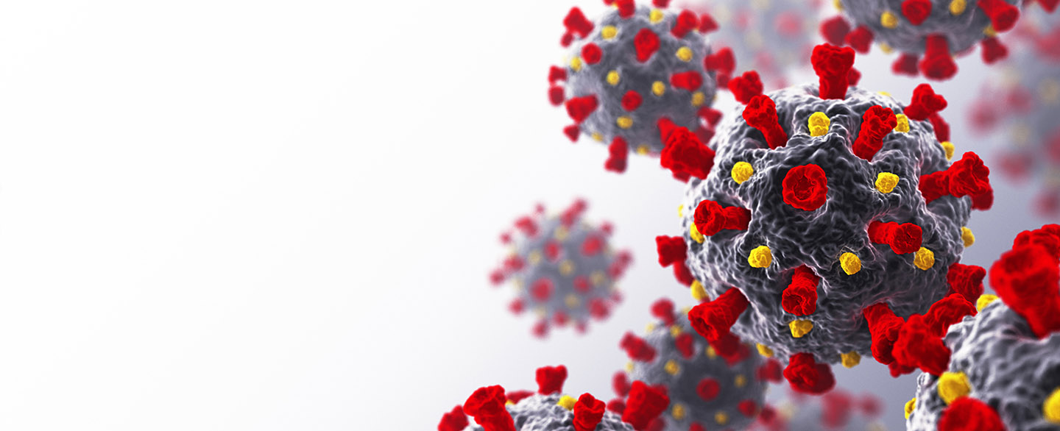
COVID-19
Countries Wealth, Cases, Deaths and Vaccines

Slide 2
COVID-19
Countries Wealth, Cases, Deaths and Vaccines
💲🦠⚰💉

