Slide 1
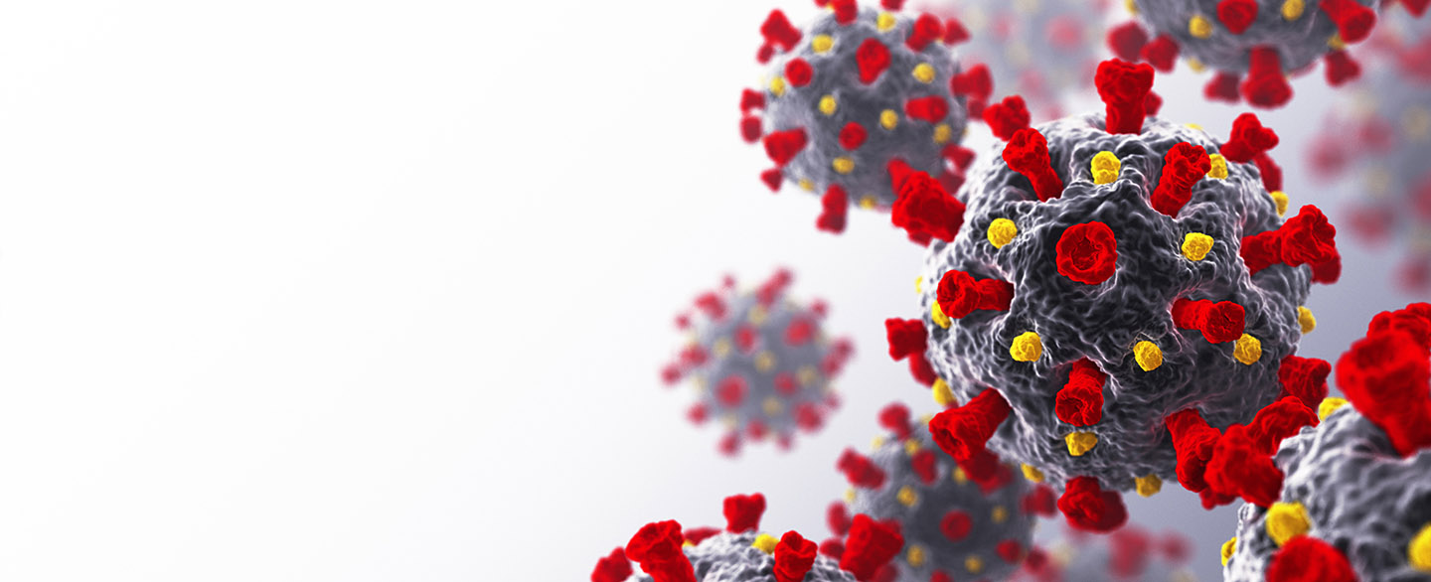
COVID-19
Countries Wealth, Cases, Deaths and Vaccines

