Slide 1

Introduction to Buying & Selling Online
A practical digital literacy lesson deck for safer online shopping, payments, privacy, and marketplace confidence.
mtc FutureReady
MTC FutureReady | Digital literacy classroom resource

Slide 2
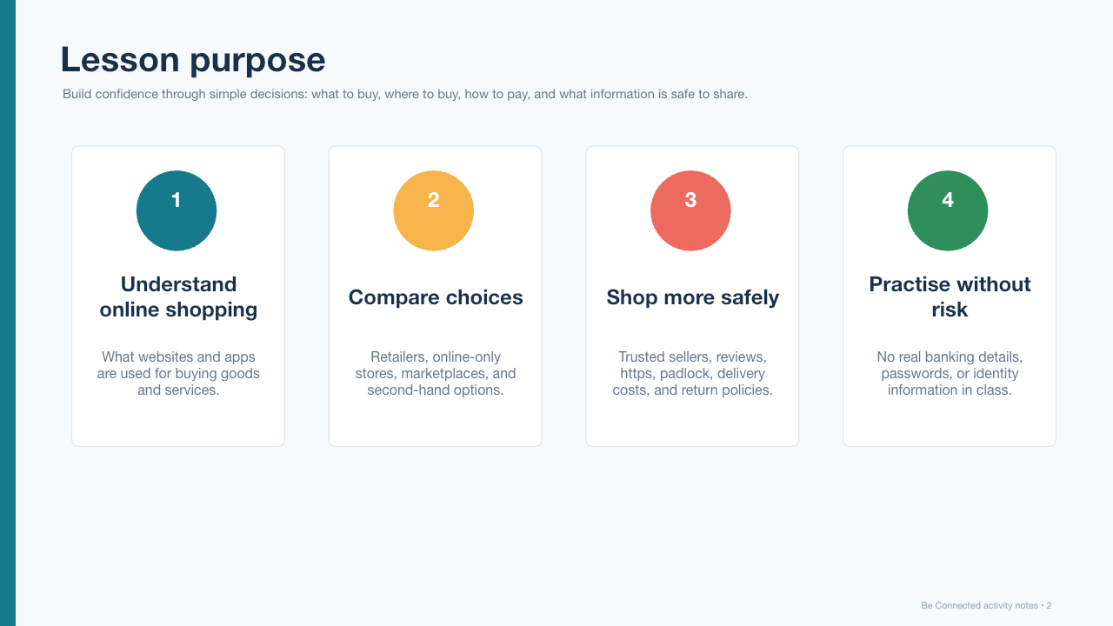
Lesson purpose
Build confidence through simple decisions: what to buy, where to buy, how to pay, and what information is safe to share.
Be Connected | Buying and Selling Online
2

Slide 3
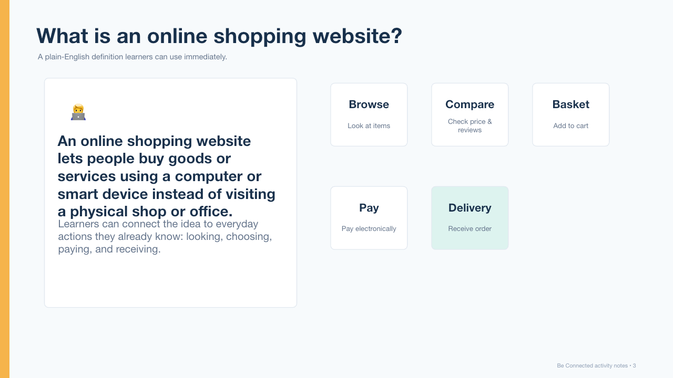
What is an online shopping website?
A plain-English definition learners can use immediately.
Be Connected | Buying and Selling Online
3

Slide 4
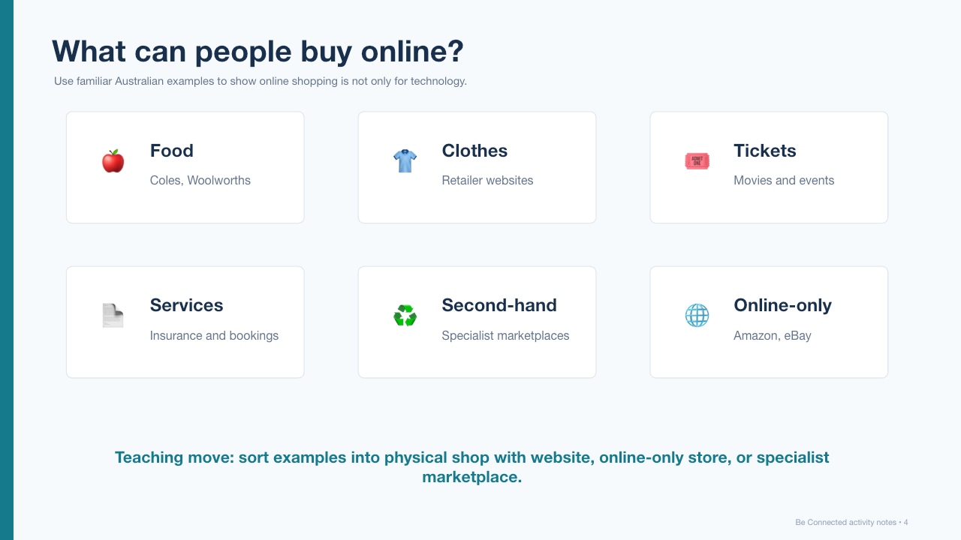
What can people buy online?
Use familiar Australian examples to show online shopping is not only for technology.
Be Connected | Buying and Selling Online
4

Slide 5
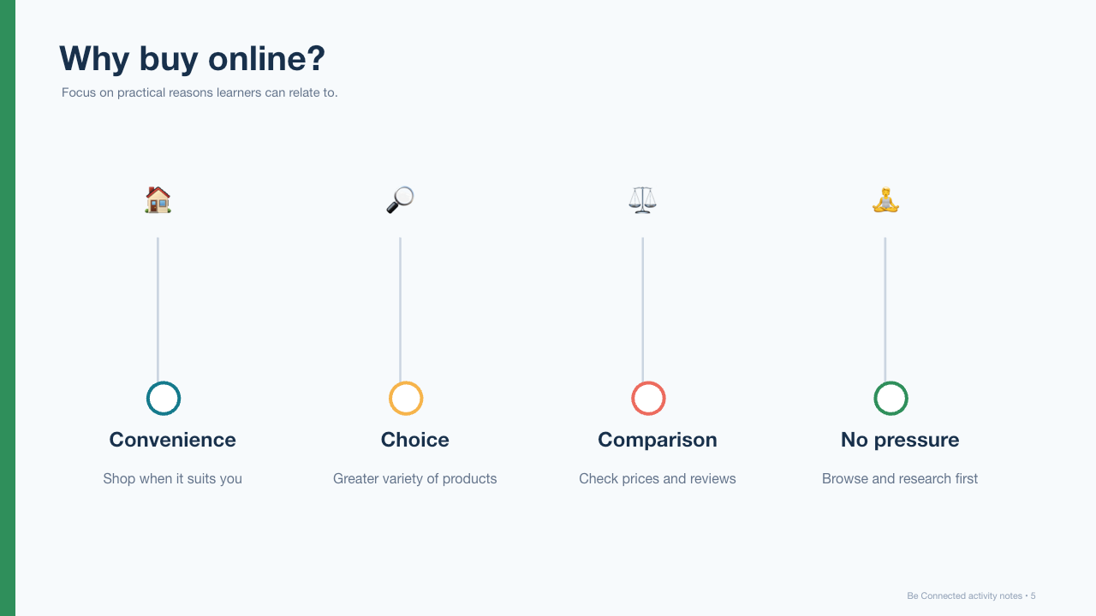
Why buy online?
Focus on practical reasons learners can relate to.
Be Connected | Buying and Selling Online
5

Slide 6
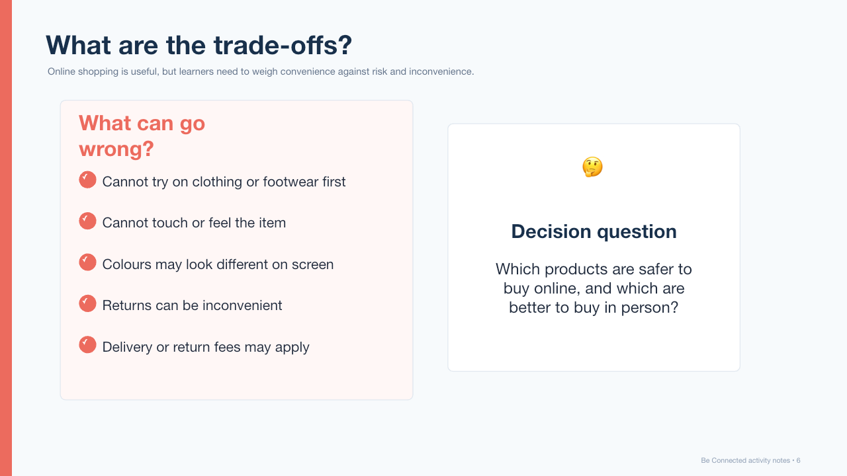
What are the trade-offs?
Online shopping is useful, but learners need to weigh convenience against risk and inconvenience.
Be Connected | Buying and Selling Online
6

Slide 7
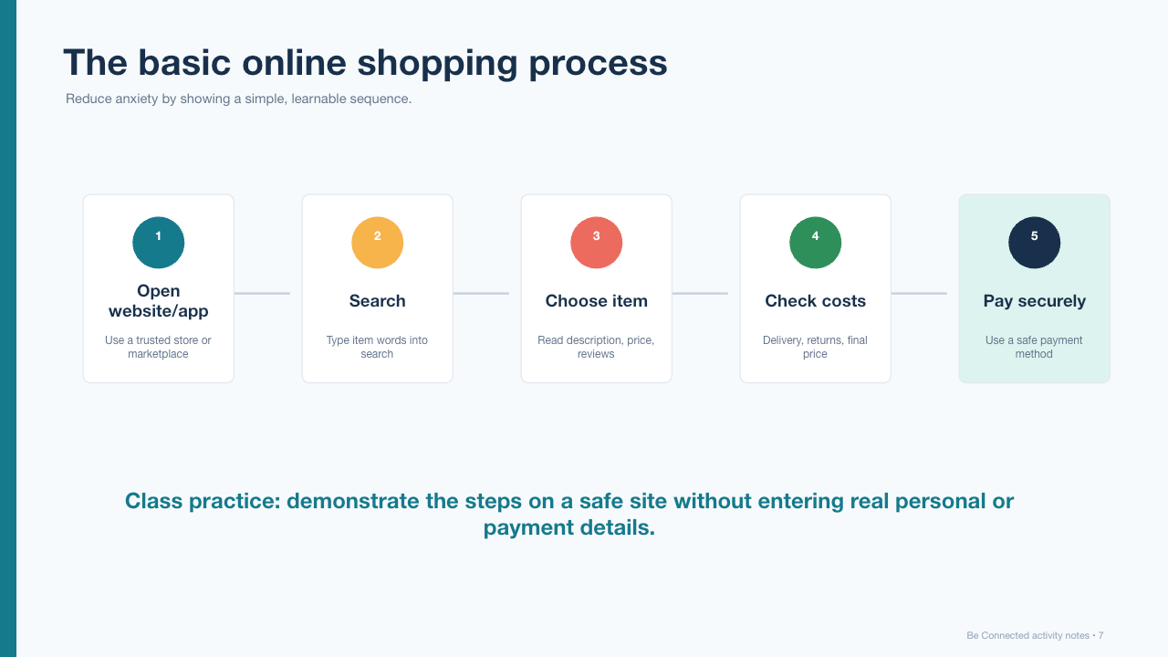
The basic online shopping process
Reduce anxiety by showing a simple, learnable sequence.
Be Connected | Buying and Selling Online
7

Slide 8
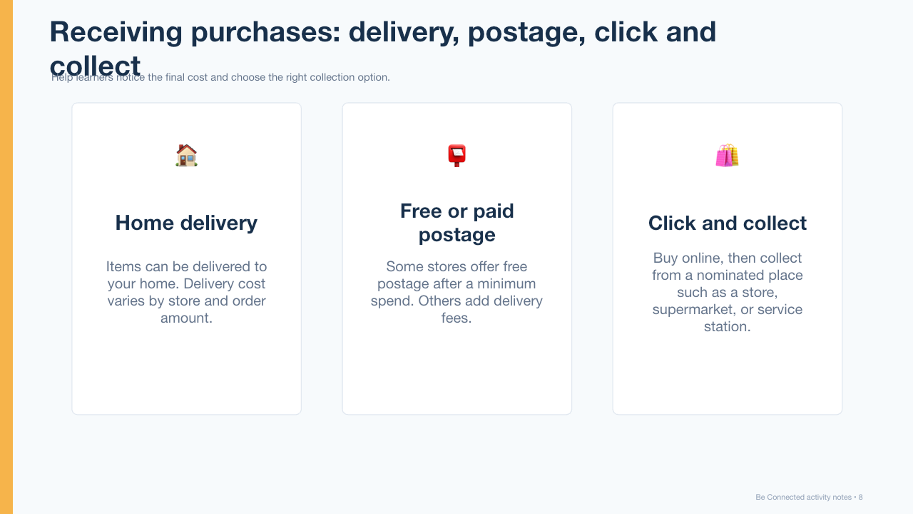
Receiving purchases: delivery, postage, click and collect
Help learners notice the final cost and choose the right collection option.
Be Connected | Buying and Selling Online
8

Slide 9
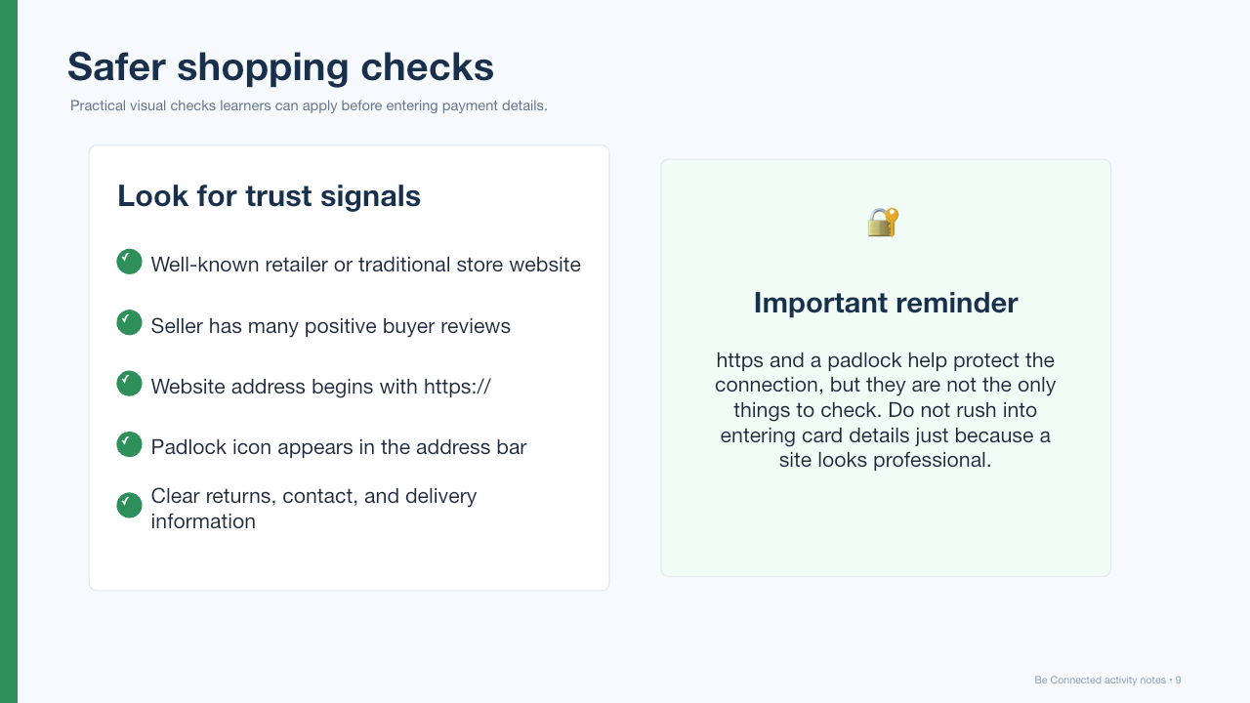
Safer shopping checks
Practical visual checks learners can apply before entering payment details.
Be Connected | Buying and Selling Online
9

Slide 10
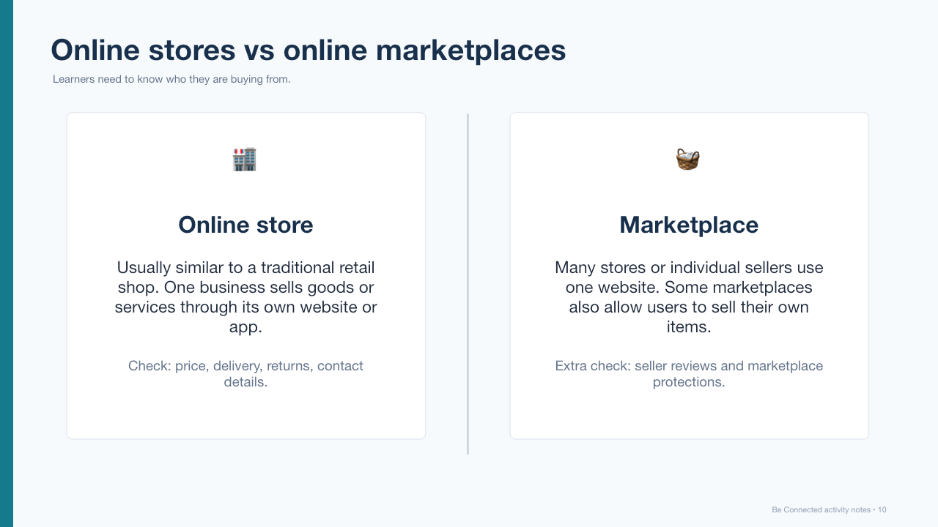
Online stores vs online marketplaces
Learners need to know who they are buying from.
Be Connected | Buying and Selling Online
10

Slide 11
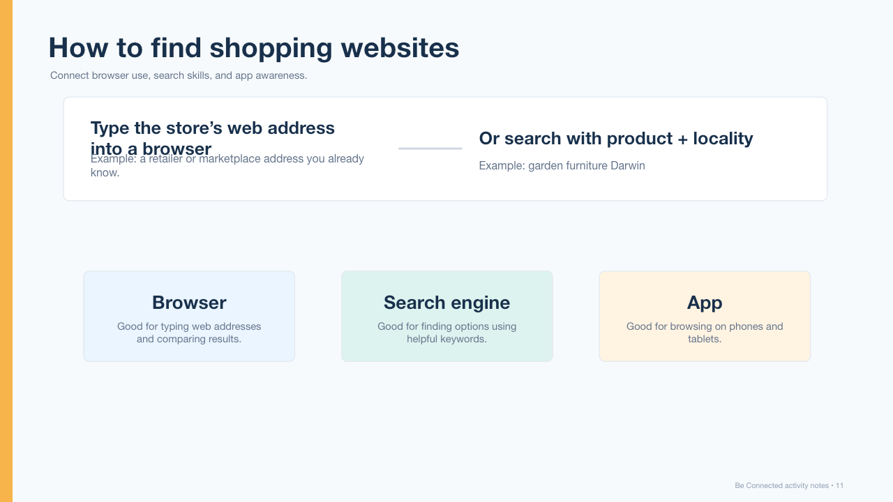
How to find shopping websites
Connect browser use, search skills, and app awareness.
Be Connected | Buying and Selling Online
11

Slide 12
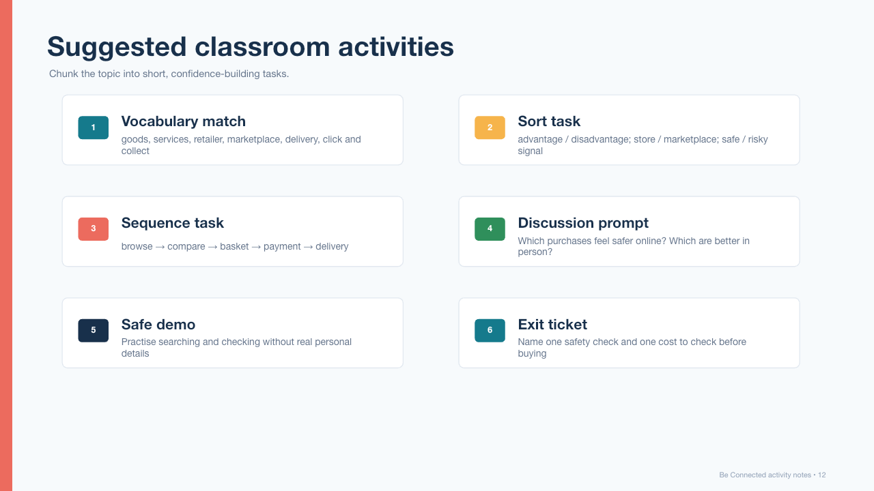
Suggested classroom activities
Chunk the topic into short, confidence-building tasks.
Be Connected | Buying and Selling Online
12

Slide 13
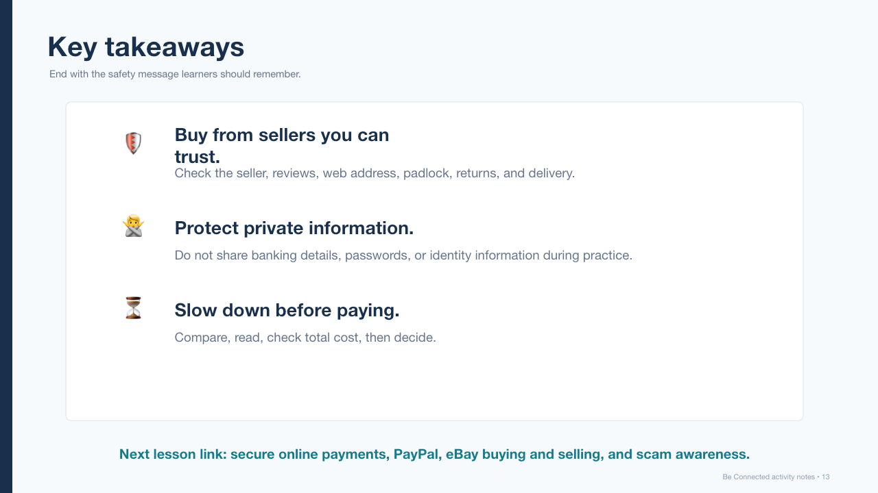
Key takeaways
End with the safety message learners should remember.
Be Connected | Buying and Selling Online
13

