Slide 1

Groovy In The Cloud
Jim Driscoll
JR Smiljanic

Slide 2
The following is intended to outline our general product direction. It is intended for information purposes only,
and may not be incorporated into any contract. It is
not a commitment to deliver any material, code, or functionality, and should not be relied upon in making purchasing decisions.
The development, release, and timing of any features or functionality described for Oracle’s products remains at the sole discretion of Oracle.

Slide 3
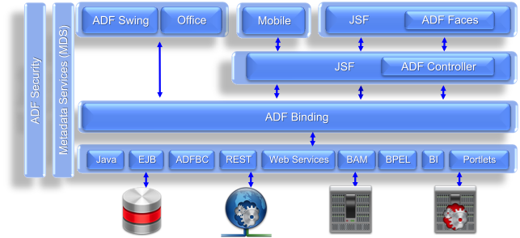
Oracle Application Developer Framework (ADF)
View (ADFv)
Controller (ADFc)
Model (ADFm)

Slide 4
Background
ADFm
  Part of Oracle's ADF Framework
  Provides data binding and database access
  Provides ways to customize data views via Groovy
Heavy use of Groovy
  But all framework extensions are written in Java
Goal – make customizations modifiable by end users
  On the web, in the cloud

Slide 5
ADFm Groovy usages
Default values for fields
Field or row level validators
Triggers
Defining new Groovy functions
Whether a field is updateable or mandatory
Creating new fields based on Groovy scripts
And many more...

Slide 6
Groovy Development in the Cloud
Groovy expressions can be developed in 2 ways:
  In development, via an IDE such as JDeveloper (traditional)
  During app runtime via an admin web interface (Cloud-based)
In the cloud, users need...
  a secure environment to execute/debug Groovy expressions
  a productive development environment (edit/debug)
  performant environment to develop and run scripts

Slide 7
A Secure Environment
Incorrectly written scripts should be protected against
Static validation
  It can only take you so far in a dynamic language
  Undefined types are listed as Object in the parser
Timeout (cpu resource protection)
Security
  Post-hoc security is required, no changes to the underlying security model of ADFm
  Runtime validation required

Slide 8
A Productive Development Environment
Static Validation
Visual editor
Good exception reporting
Logging
Debugging

Slide 9
A Performant Environment
10K+ scripts embedded in many applications
Compiling scripts is expensive
Caching becomes critical
Classloading issues also become a bottleneck

Slide 10
Implementation Details
Originally built on Groovy 1.6
  Some restrictions on AST Capabilities
  Upgraded to Groovy 2.0
Few DSL modifications
  Fields available as binding variables
    So def num = DeptNo is valid
  ScriptBaseClass provides some convenience methods
    e.g. round(), floor()
  But, also allows most of Groovy expressiveness

Slide 11
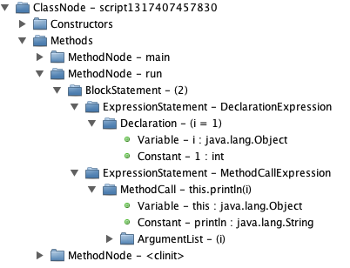
AST Transforms
def i = 1
println i

Slide 12
AST Transforms
Abstract Syntax Tree
Most of what we do is with Custom AST Transforms
Uses Visitor Pattern
public void visitMethodPointerExpression(MethodPointerExpression pointer)
throw new RuntimeExpression(“Not allowed”);
}

Slide 13


A Productive Development Environment

Slide 14
Development Tools for the ADF DSL
CODE EDITOR | DEBUGGER
Support ADF language extensions | Visualization consistent with the code editor
Implement logical code management | Hide the Groovy execution stack
Restrict access to variables/methods | Hide Groovy execution state/variables
Limit language expressiveness
Notes:
ADF CodeEditor component is implemented using CodeMirror. CodeMirror is an open source JavaScript library that provides web-based source editing capabilities. ADF wraps CodeMirror in a JSF component.

Slide 15
Challenges with Debugging in the Cloud
Existing Groovy debuggers are good for desktop development…
- Single user debugging
- Single user executing a test program

Slide 16
Challenges with Debugging in the Cloud
Existing Groovy debuggers are good for desktop development…
- Single user debugging
- Single user executing a test program
...but not a good fit for debugging in the cloud
- Many users debugging
cannot share breakpoints
- Many users executing many programs
cannot suspend the machine
Notes:
Breakpont islation – In a standard desktop development environment breakpoints are defined for the development project, not the user session. An example of how desktop environments are designed for a single session.
Machine suspensions – Debuggers typically suspend the entire machine. Even if the debugger supports thread level breaks, how do I identify which thread is associated with the debug users session?
Object/Type insulation – Difficult to filter GPL platform detail.
Source code mapping – GPL platform debuggers require developer knowledge of the physical storage of the source code.

Slide 17
Attempts at Debugging in the Cloud
PRINT STATEMENTS | SYSTEM DUMPS
Require code changes! | Dump system data at breakpoints
Tedious to implement | Developer analyzes dumps with debugger like tool
Must know what you are looking for | Better than print statements, can be implemented by the DSL platform
 | Storage considerations
 | Must also know what you are looking for

Slide 18
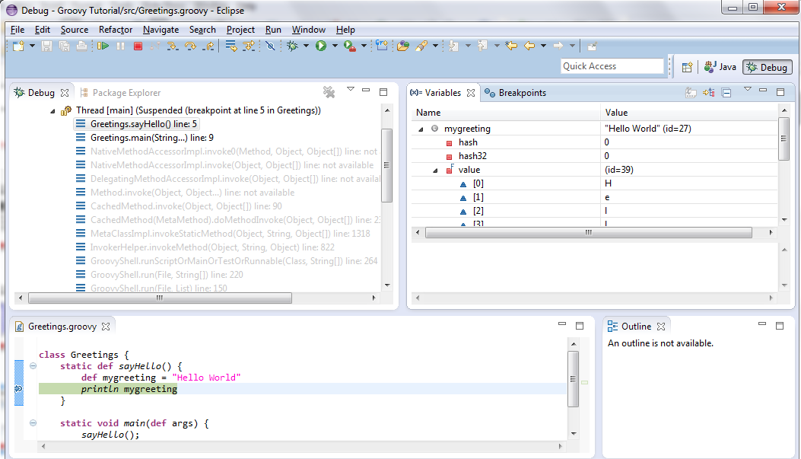
Example: Groovy Eclipse Debugger
Notes:
Point out that we only really care about the transient expression call in our stack. Even that contains the physical script name that we elected to use and that we don’t want to expose to the developer.
I’m aware that the desktop debugger does have a way of filtering this stuff, but that is not very DSL-like!

Slide 19
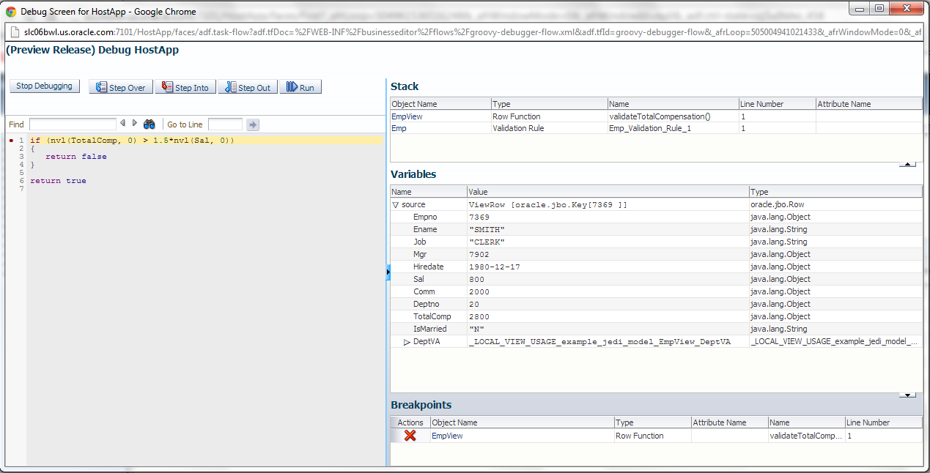
Example: ADF Debugger

Slide 20
Debugger Architecture
Debugger Frontend
Debugger Backend
Debugger
UI
JDI Debug
Client
Request
Listener
Debug State
Machine
ADF/Groovy
Script
Execution
Engine
JDWP
Debug
Transform
Event
Processor
Debug Session
Notes:
Script execution is performed in a separate thread than the threads that are used to handle Debugger UI requests.

Slide 21
AST Visualization – Program Counters
1: def validateBonus() {
2: methodEntry()
3: try {
4: if (bonus >
5: endExpression(startExpression(2), salary * 0.50)) {
6: return endExpression(startExpression(3), false)
7: }
8: return endExpression(startExpression(5), true)
9: } finally {
10: methodExit()
11: }
12: }
1: def validateBonus() {
2: if (bonus > (salary * 0.50)) {
3: return false
4: }
5: return true
6: }

Slide 22
AST Visualization – Variable Assignment
before_update_trigger
1: // Calculate a discount for the customer
2: def discount = endExpression(
3: startExpression(2),
4: assignment(‘discount’, calculateDiscount(Customer))
before_update_trigger
1: // Calculate a discount for the customer
2: def discount = calculateDiscount(Customer)
Notes:
Similar technique is applied for variable expressions in order to track variable assignments.
Discuss variable tables/variable assignments

Slide 23
Very Groovy!
Groovy AST transformations enable ADF to deliver a debugger to the cloud
  “GroovyTI” enables the development of custom tooling
  Debug transform enables isolation between sessions
  Debug transform exposes Groovy context only
  Technique could be applied to any Groovy DSL
Notes:
Breakpont islation – In a standard desktop development environment breakpoints are defined for the development project, not the user session. An example of how desktop environments are designed for a single session.
Machine suspensions – Debuggers typically suspend the entire machine. Even if the debugger supports thread level breaks, how do I identify which thread is associated with the debug users session?
Object/Type insulation – Difficult to filter GPL platform detail.
Source code mapping – GPL platform debuggers require developer knowledge of the physical storage of the source code.

Slide 24
A Performant Environment

Slide 25
Just in Time Groovy Compilation is Expensive
ADF developers often define 10K+ of Groovy scripts in an ADF application
ADF compiles each business rule as a separate script
Dynamic language adds compilation overhead
  Lots of BeanInfo ClassLoader misses on MetaClass instantiation (execute).
  e.g. oracle.jbo.common.BaseScriptGroovyBeanInfo
  Lots of Script class ClassLoader misses on compile.
  e.g. java.lang.oracle$jbo$common$BaseScriptGroovy
Notes:
MetaClass instantiation triggers BeanInfo lookup.
BeanInfos are weakly referenced

Slide 26
Speeding up Just In Time Groovy Compilation
Cache frequently used script classes/instances
  Script class cache avoids compilation overhead
  Script instance cache avoids instantiation overhead
  Must be careful to ensure that script instances are not invoked concurrently
Define negative classloader cache for known misses
Future: Combine user scripts into single, physical script
Notes:
30% increase in system throughput

Slide 27
A Secure Environment

Slide 28
Timeout Protection
Inadvertent runaway processes
  Tie up cpu
  Tie up Threads
Groovy provides standard ASTTransforms
  groovy.transform.TimedInterrupt
  groovy.transform.ThreadInterrupt
  groovy.transform.ConditionalInterrupt

Slide 29
Security
Java Security Manager
  (Almost) air-tight
  Requires instrumentation of existing code (checkPermission)
  Best choice, if you can instrument your code
Groovy Security – SecureASTCustomizer
  Static analysis
  Good choice for limited DSLs
Custom ClassLoader

Slide 30
Static Analysis Issues
How many ways can you System.exit?
  System.exit(0)
  Eval.me("System.exit(0)")
  evaluate("System.exit(0)")
  (new GroovyShell()).evaluate("System.exit(0)")
  Class.forName("java.lang.System").exit(0)
  System.&exit.call(0)
  System.getMetaClass().invokeMethod("exit",0)
  def s = System; s.exit(0)
  Script t = this; t.evaluate("System.exit(0)")
  def s = “exit”; System.”$s”(0)

Slide 31
Static Analysis Issues
You need to blacklist Script, Class, Object (yikes!)
That means you can't say stuff like:
  println “test”
  def s = "test" ; s.count("t")
Conclusion:
  Static checks aren't sufficient for open ended use

Slide 32
Security via AST wrapping
Requirements:
  Post-hoc security (eliminates Security Manager solution)
  Dynamic calls required (eliminates static analysis)
  Fully configurable
  Performant
Solution:
  Use AST rewriting to wrap all calls to route through a security checker

Slide 33
Secure Wrapping Methods
instance.method(param)
SecurityChecker.checkMethod(instance,”method”,params)
SecurityChecker.checkMethod returns Object
Inside checkMethod, check for permission, then execute
You can check some static methods at compile

Slide 34
Secure Wrapping Properties
instance.property
  SecurityChecker.checkProperty(instance,”property”)
checkProperty returns Object
Inside checkProperty, check permissions, then get prop

Slide 35
Secure Wrapping Constructors
new Class(params)
  SecurityChecker.checkConstructor(Class,params)
  new Class(params)
Static check – since you can determine class at compile

Slide 36
Permissions
Whitelist
  Basic list of whitelisted classes/methods held in memory
  Annotation based extensions
  Configuration file base extensions
A few hardcoded blacklist items
  Restricted to those that bypass security
  Method pointers, reflection, etc

Slide 37
Q&A

Slide 38

<Insert Picture Here>
Appendix

Slide 39
AST Technique
Create a new ASTTransform
@GroovyASTTransformation(phase = CompilePhase.SEMANTIC_ANALYSIS)
class ExprASTScan implements ASTTransformation {
public void visit(ASTNode[] nodes, SourceUnit sourceUnit) {
…
ClassNode node = (ClassNode)nodes[1];
Parameter[] params = { };
MethodNode methodNode = node.getMethod("run", params);
GroovyCodeVisitor visitor = new ExprASTScanningVisitor(sourceUnit);
Statement mcontent = methodNode.getCode();
String content = mcontent.getText();
mcontent.visit(visitor);
...

Slide 40
AST Technique (2)
Create a new ASTVisitor
class ExprASTScanningVisitor extends ClassCodeVisitorSupport
{
…
public void visitMethodPointerExpression(MethodPointerExpression pointer) {
throw new RuntimeExpression(“Not allowed”);
}
...

Slide 41
AST Technique (3)
Create a new AST Annotation
@Retention(RetentionPolicy.SOURCE)
@Target(ElementType.TYPE)
@GroovyASTTransformationClass("oracle.jbo.script.ExprASTScan")
public @interface ExprScan {}

Slide 42
AST Technique (4)
Apply the AST Annotation
CompilerConfiguration configuration = new CompilerConfiguration(CompilerConfiguration.DEFAULT);
configuration.addCompilationCustomizers(
new ASTTransformationCustomizer(
oracle.jbo.script.ExprScan.class));
shell = new GroovyShell(classloader, new Binding(), configuration);

