Slide 1
War
Stable peace
The Conflict continuum
Degrees of intensity/complexity
Military readiness
Degrees of stress /complexity

Slide 2
War
Stable peace
The Conflict continuum
3.
Degrees of intensity/complexity
2.
1.
Degrees of stress /complexity

Slide 3
War
War
Stable peace
The Conflict continuum
Stable peace
The Conflict continuum
Sleep deprivation
Duration
War
Degrees of intensity/complexity
Stable peace
The Conflict continuum
War
Recovery deficit
Stable peace
The Conflict continuum
War
Duration
Stable peace
The Conflict continuum
Energy deficit

Slide 4
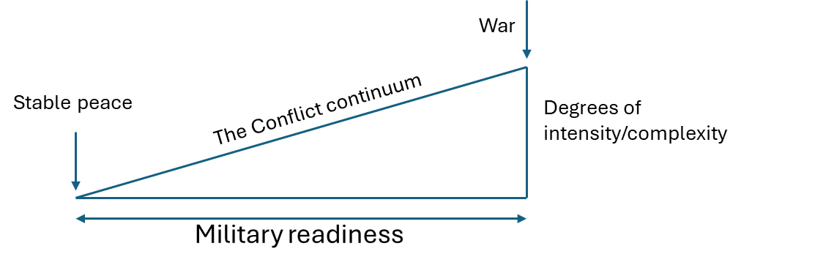
War
Stable peace
The Conflict continuum
Sleep deprivation
Demand of physical fitness
Energy deficit
Recovery deficit
Physical strenous activitites

Slide 5
Demand of physical fitness

Slide 6
War
Stable peace
The Conflict continuum
Sleep deprivation
Demand of physical fitness
Energy deficit
Recovery deficit
Duration

Slide 8
War
Environmental factors
Body composition
Stable peace
The Conflict continuum
Sleep deprivation
Energy deficit
Recovery deficit
Duration
Prolonged- activity /physical activity
Strength-power /physical activity
Initial fitness level

Slide 9
War
Stable peace
The Conflict continuum
Environmental factors
Sleep deprivation
Climate, terrain
Energy deficit
Recovery deficit
Fitness level
Duration
Body composition
Endurance- activity /physical activity
Strength-power /physical activity

Slide 10
+ Heavy tasks
Demand of physical fitness

Slide 11
+ Load carried
+ Heavy tasks
Demand of physical fitness

Slide 12
+ Anaerobic capacity
+ Load carried
+ Heavy tasks
Demand of physical fitness

Slide 13
+ Anaerobic capacity
++ Stressors
+ Load carried
+ Heavy tasks
Demand of physical fitness

Slide 14
+ Anaerobic capacity
++ Stressors
+ Load carried
+ Heavy tasks
Demand of physical fitness
Decline in physical fitness

Slide 15
Demand
Decline in physical fitness

Slide 16
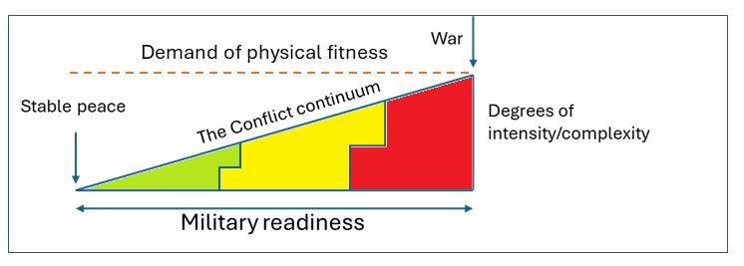
+ Load carried

Slide 17
+ Anaerobic capacity
+ Load carried

Slide 18
+ Anaerobic capacity
+ Load carried

Slide 19
+ Anaerobic capacity
+ Load carried
+ Heavy tasks

Slide 23
+ Anaerobic capacity
++ Stressors
+ Load carried
+ Heavy tasks
Decline in physical fitness

Slide 24
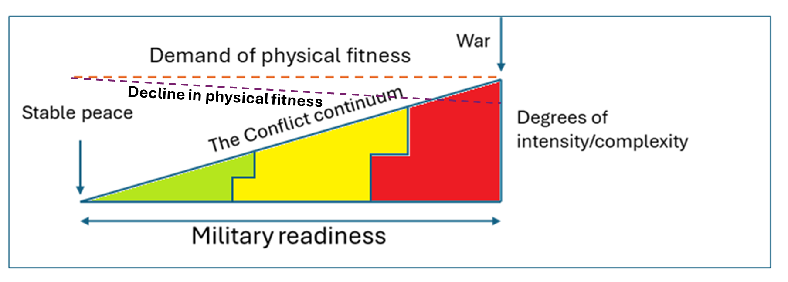
+ Anaerobic capacity
+ Load carried
+ Heavy tasks

Slide 25
3.
2.
1.

Slide 29
3.
2.
1.

Slide 30
Endurance
Strength-power
Body composition

Slide 31
Endurance
Strength-power

Slide 32
Overload
Specificity
Periodization
Endurance
Strength-power

Slide 33
Overload
Specificity
Periodization
Endurance
Strength-power

Slide 34
Minimal dose
Endurance
Strength-power

Slide 35
Stress factors
War
Stable peace
The Conflict continuum
Sleep deprivation
Energy deficit
Recovery deficit
Duration
Physical strenous activitites

Slide 37
Stress factors
War
Stable peace
The Conflict continuum
Sleep deprivation
Energy deficit
Recovery deficit
Duration
Physical strenous activitites

Slide 38
Stress factors
War
Environmental factors
Climate, terrain
Stable peace
The Conflict continuum
Sleep deprivation
Energy deficit
Recovery deficit
Duration
Physical strenous activitites

Slide 39
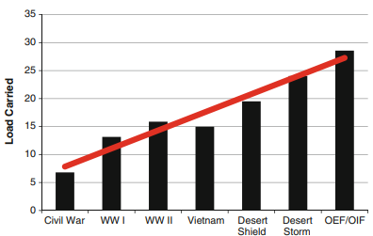
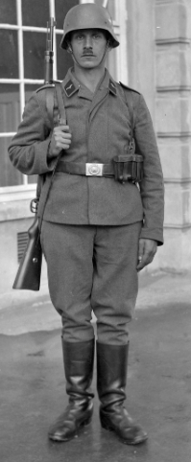
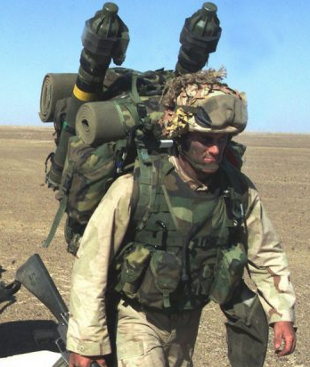
1900
>2000

Slide 40
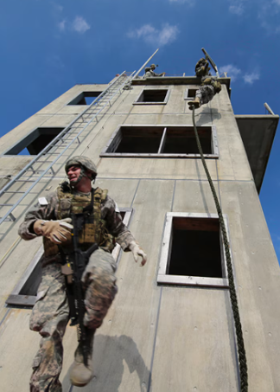
+ Anaerobic capacity
+ Load carried

Slide 42
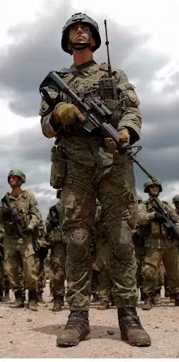
Changes in Anabolic / Catabolic state
theconversation.com

Slide 43
Changes in Anabolic / Catabolic state
Cognitive function
Risk of injury
Loss of bone density
Loss of skeletal muscle
Loss of body mass
Loss of muscle function
Loss if fat mass
theconversation.com

Slide 45
Minimize drop
Decline in physical fitness

Slide 46
Decline in physical fitness

Slide 47

War
Environmental factors
Climate, terrain
Stable peace
The Conflict continuum
Sleep deprivation
Energy deficit
Recovery deficit
Duration
Physical strenous activitites

Slide 48
Minimize drop
Decline in physical fitness

Slide 49
Decline in physical fitness

Slide 50
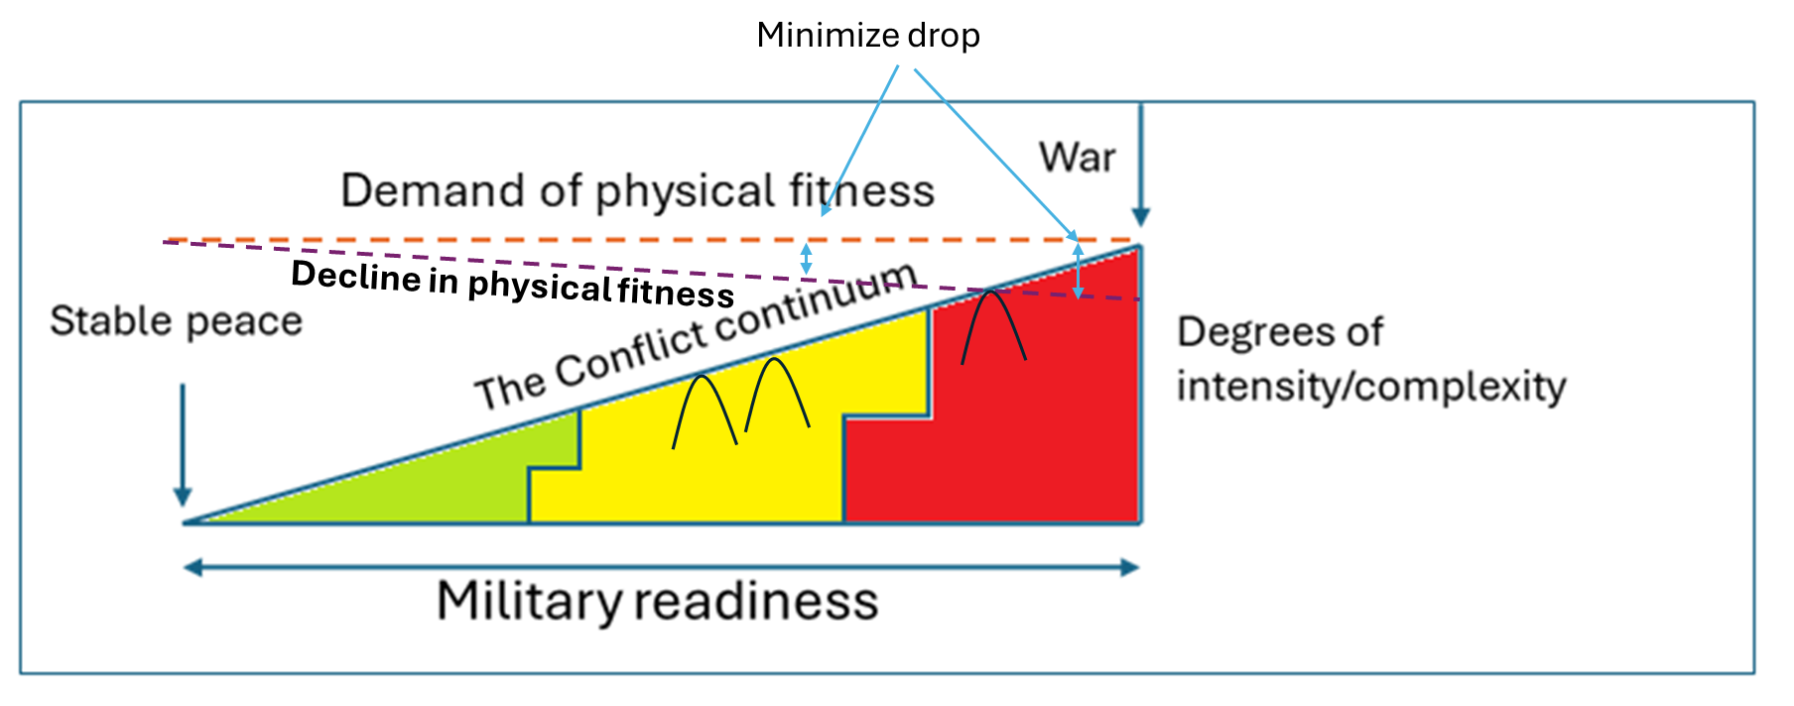
Stress factors
War
Stable peace
The Conflict continuum
Sleep deprivation
Energy deficit
Recovery deficit
Duration
Physical strenous activitites

Slide 52
Stress factors
War
Stable peace
The Conflict continuum
Sleep deprivation
Energy deficit
Recovery deficit
Duration
Physical strenous activitites

Slide 53
Stress factors
War
Stable peace
The Conflict continuum
Sleep deprivation
Energy deficit
Recovery deficit
Duration
Physical strenous activitites

Slide 54
Stress factors
War
Stable peace
The Conflict continuum
Sleep deprivation
Energy deficit
Recovery deficit
Duration
Physical strenous activitites

Slide 55
Deployment period

Slide 56
Operations – higher intensity
Deployment period

Slide 57
Operations – higher intensity

Slide 58
Deployment period

Slide 59
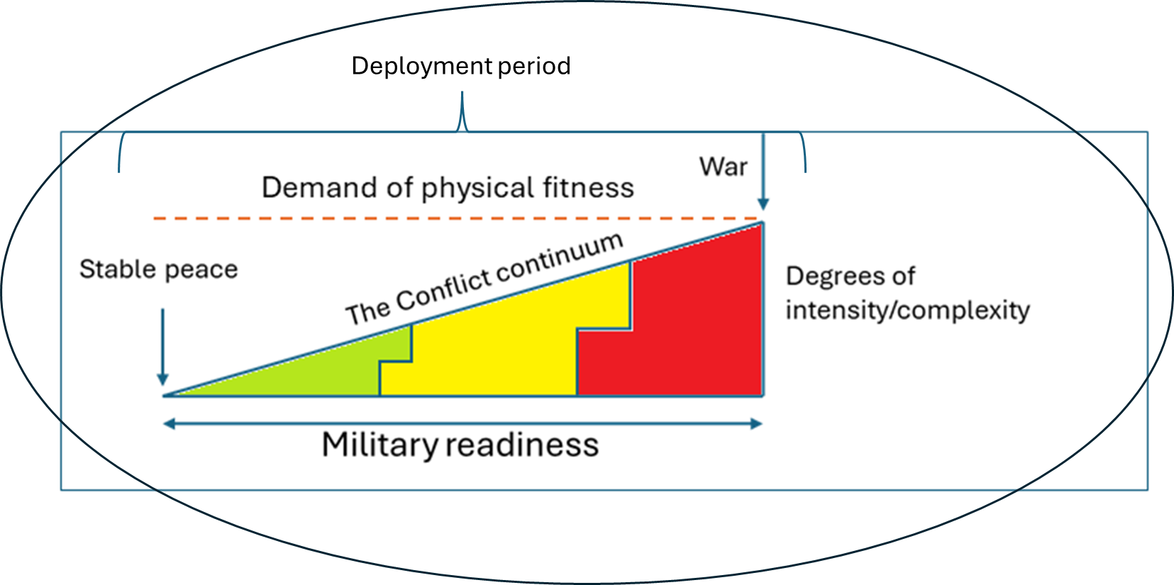
Stress factors
War
Stable peace
The Conflict continuum
Sleep deprivation
Energy deficit
Recovery deficit
Duration
Physical strenous activitites

Slide 60
Short term
Long term
Benefit
1
2
Operations
Time
During deployment
Post-deployment

Slide 61
Physical and mental resilience
Benefit
1
Time
During deployment
Post-deployment

Slide 62
Physical and mental resilience
Physical readiness
Benefit
1
Time
During deployment
Post-deployment

Slide 63
Physical and mental resilience
Physical readiness
Better cope with heavy occputaional task
Benefit
1
Time
During deployment
Post-deployment

Slide 64
Physical and mental resilience
Physical readiness
Better cope with heavy occputaional task
Stress resilience
1
Benefit continuum
Time
During deployment
Post-deployment

Slide 65
Physical and mental resilience
Physical readiness
Better cope with heavy occputaional task
Stress resilience
1
Cognitive function and memory
Benefit continuum
Time
During deployment
Post-deployment

Slide 66
Physical and mental resilience
Physical readiness
Better cope with heavy occputaional task
Stress resilience
1
Cognitive function and memory
Reduced risk of injury
Benefit continuum
Time
During deployment
Post-deployment

Slide 67
Physical and mental resilience
Physical readiness
Better cope with heavy occputaional task
Stress resilience
1
Cognitive function and memory
Reduced risk of injury
Benefit continuum
Recover faster from operational stress
Time
During deployment
Post-deployment

Slide 68
Better cope with longer periods with physical/mental stress
1
2
Benefit continuum
Time
During deployment
Post-deployment

Slide 69
Better cope with longer periods with physical/mental stress
Well being – long term health
Disease
Infection
1
2
Benefit continuum
Time
During deployment
Post-deployment

Slide 70
Benefit continuum
Time
Deployed
Post-deployed

Slide 71
Physical and mental resilience
Short term benefit
1
Benefit
Time
During deployment
Post-deployment

Slide 72
Physical and mental resilience
Physical readiness
Short term benefit
1
Benefit
Time
During deployment
Post-deployment

Slide 73
Physical and mental resilience
Physical readiness
Short term benefit
Better cope with heavy occputaional task
1
Benefit
Time
During deployment
Post-deployment

Slide 74
Physical and mental resilience
Physical readiness
Short term benefit
Better cope with heavy occputaional task
Stress resilience
1
Benefit
Time
During deployment
Post-deployment

Slide 75
Physical and mental resilience
Physical readiness
Short term benefit
Better cope with heavy occputaional task
Stress resilience
Cognitive function and memory
1
Benefit
Time
During deployment
Post-deployment

Slide 76
Physical and mental resilience
Physical readiness
Short term benefit
Better cope with heavy occputaional task
Stress resilience
Cognitive function and memory
Reduced risk of injury
1
Benefit
Time
During deployment
Post-deployment

Slide 77
Physical and mental resilience
Physical readiness
Short term benefit
Better cope with heavy occputaional task
Stress resilience
Cognitive function and memory
Reduced risk of injury
1
Recover faster from operational stress
Benefit
Time
During deployment
Post-deployment

Slide 78
Physical and mental resilience
Physical readiness
Short term benefit
Better cope with heavy occputaional task
Stress resilience
Cognitive function and memory
Reduced risk of injury
1
Recover faster from operational stress
Benefit
Environment resilience (heat, cold, altitude)
Time
During deployment
Post-deployment

Slide 79
Long term benefit
Better cope with longer periods with physical/mental stress
2
1
Benefit
Time
During deployment
Post-deployment

Slide 80
Long term benefit
Better cope with longer periods with physical/mental stress
Well being – long term health
Risk of disease
Risk of infection
2
1
Benefit
Time
During deployment
Post-deployment

Slide 81
Long term benefit
Better cope with longer periods with physical/mental stress
Well being – long term health
Risk of disease
Risk of infection
2
1
Benefit
Reduce risk of post-traumatic stress
Time
During deployment
Post-deployment

Slide 82
Overload
Specificity
Periodization

Slide 83
War
Stable peace
The Conflict continuum
Environmental factors
Sleep deprivation
Climate, terrain
Energy deficit
Recovery deficit
Fitness level
Duration
Body composition
Endurance- activity /physical activity
Strength-power /physical activity

Slide 84
Pre-deployment
Deployment period

Slide 85
Pre-deployment
Deployment period
Reserve capacity

Slide 86
Physical fitness level
Deployment period
Baseline
Soldier 1
Military readiness
Soldier 2
Duration operation

Slide 87
Deployment period
operations

Slide 88
Deployment period

Slide 89
Deployment period

Slide 90
Operations – higher intensity
Deployment period
Possible for micro sessions?
Flexible sessions

Slide 91
Operations – higher intensity
Deployment period
Flexible sessions

Slide 92
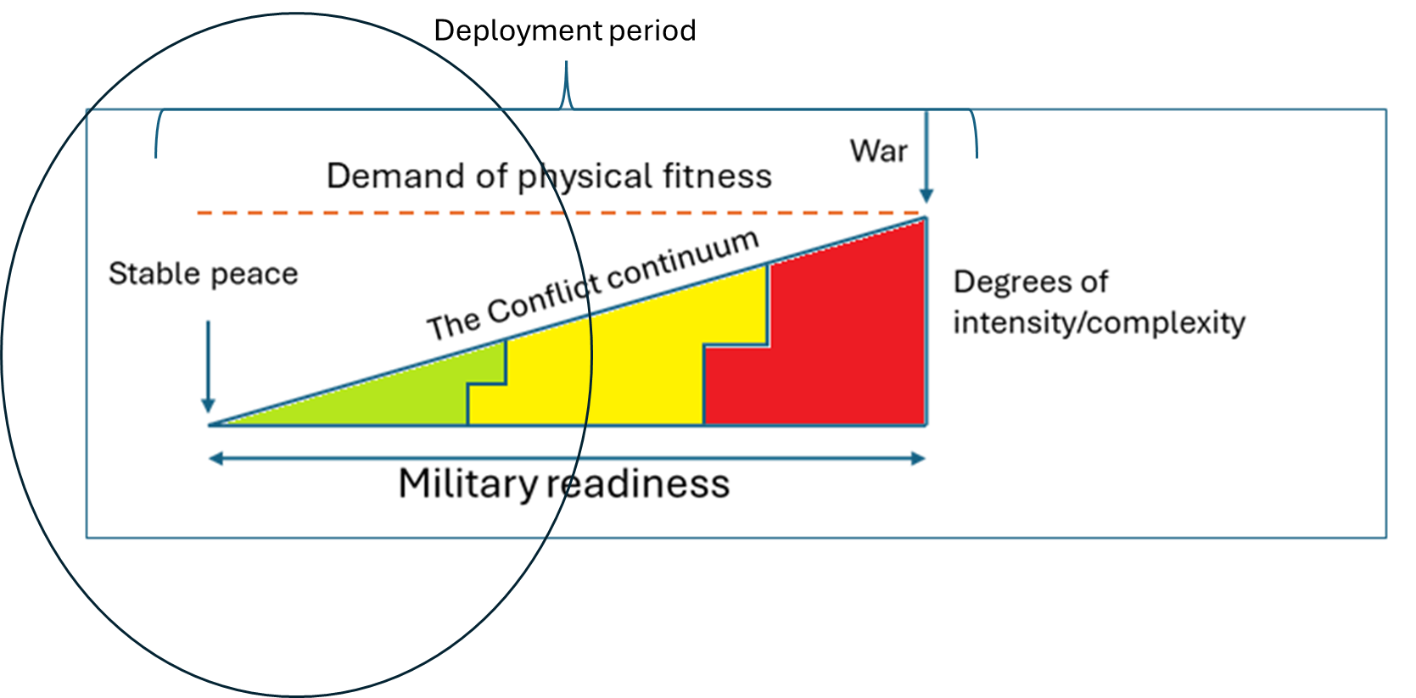
Stress intensity
Time 30 days

Slide 93
Operations – higher intensity
Deployment period

Slide 94
Flexible model
Session choice
Easy
Tired after long-loaded marches in the field
Easy
Moderate
Soldier
Focus UB-strength
Fatigue?
Recoverd?
Hard
Mesocycle ~ 6 weeks

Slide 95
Physical fitness level
pre-deployment
Soldier 1
Military readiness
Soldier 2
Duration operation

Slide 96
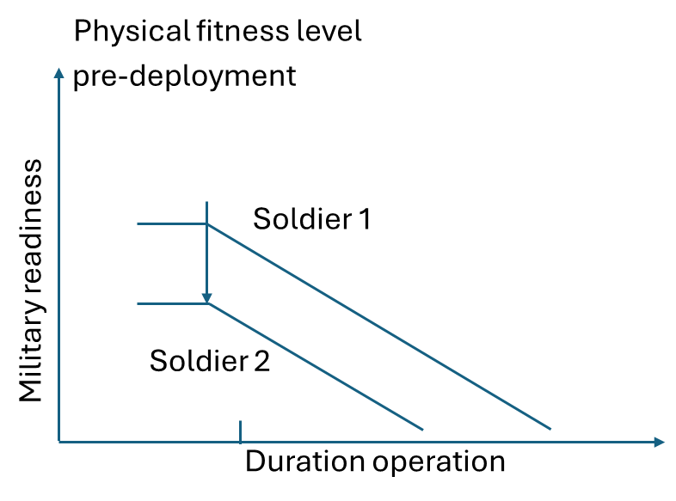

Slide 97
Minimize drop
Demand
Decline in ability

Slide 98
Minimize drop
Demand
Decline in ability

Slide 99
Support and reconnaissance
Field exercise
Decline in physical fitness

Slide 100
Soldier 2
Soldier 1
Demand
Decline in physical fitness

Slide 101
Operation
Stress intensity
Time window
Time window
Time

Slide 102
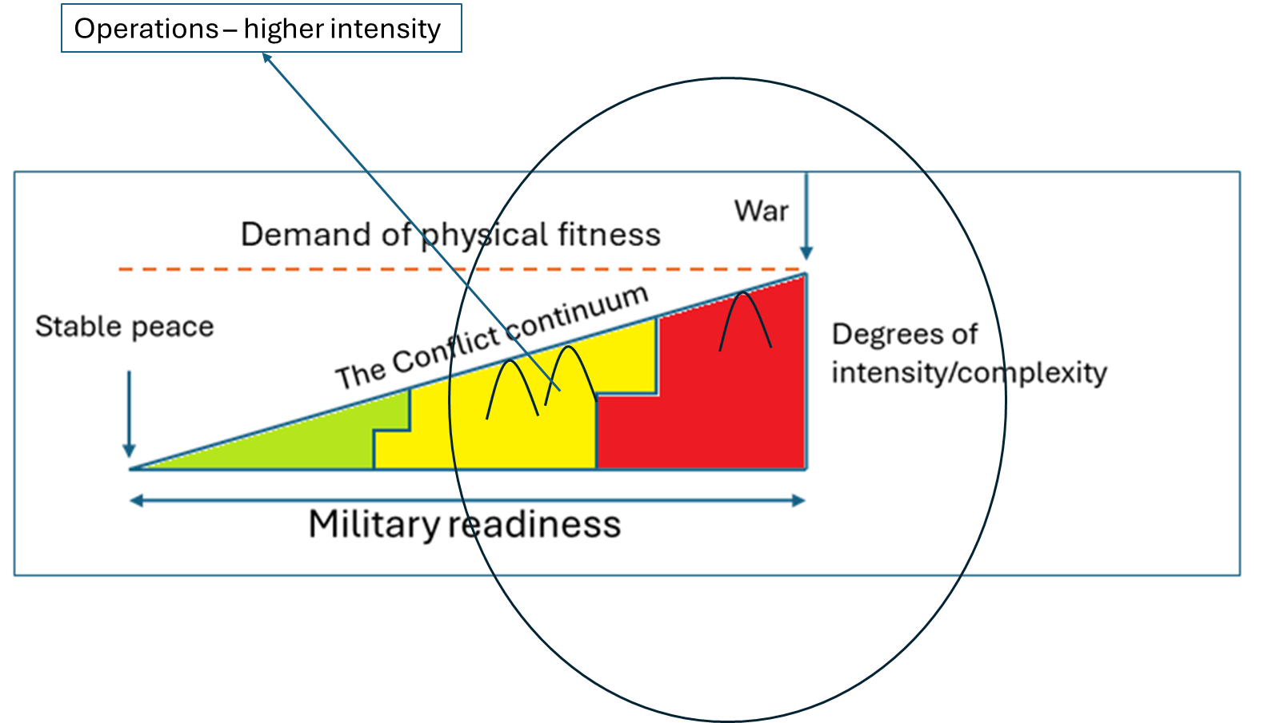
Operation
Stress intensity
Time window
Time window
Time

Slide 103
Stress intensity
Training
Recovery
Training
Recovery
Time

Slide 104
Physical performance
Stress intensity
Recovery
Training
Recovery
Training
Time 30 days

Slide 105
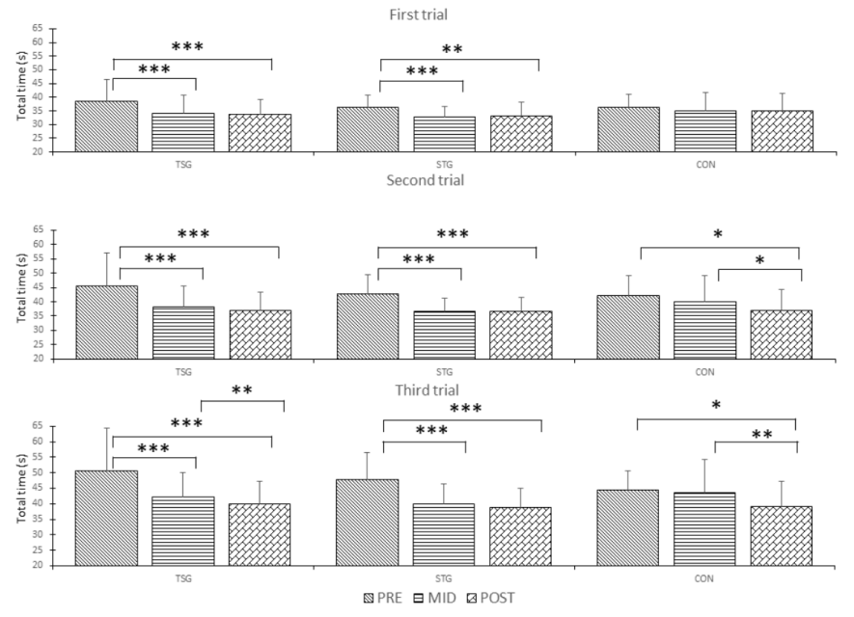
Task specific training
Control group
Strength group

Slide 106
Task specific training
Control group
Strength group

Slide 107
Task specific training
Control group
Strength group

