Slide 1
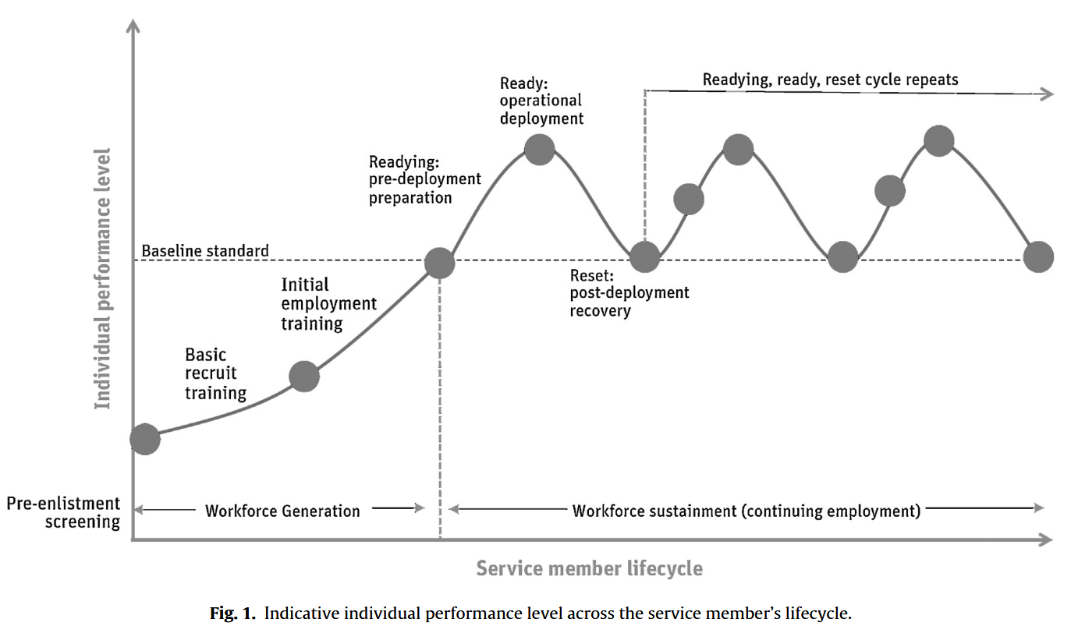
Mission ready / Role standard
Deployment Ready
Occupational Standard
Emplyoment Progression

Slide 2
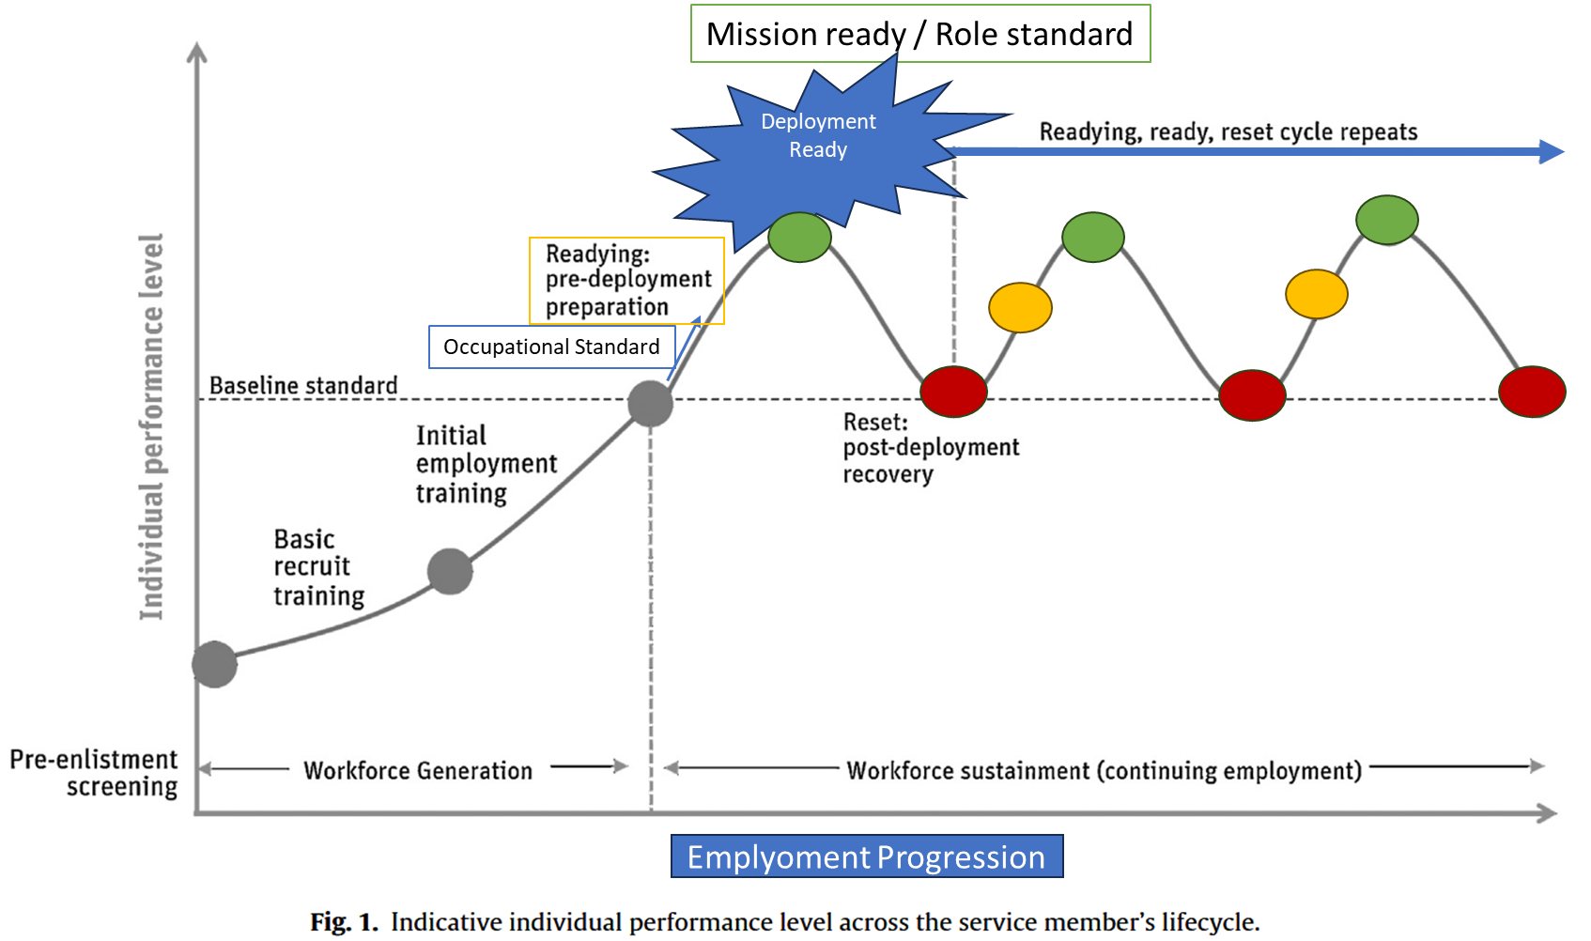

Slide 3

