Slide 1
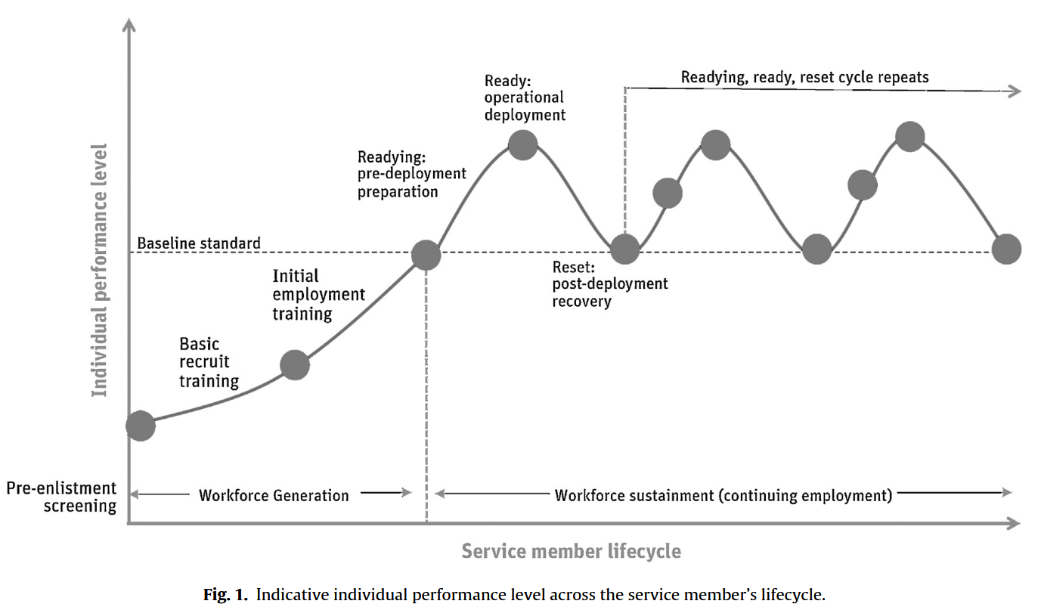
Mission ready / Role standard
Deployment Ready
Occupational Standard
Academy training
Emplyoment Progression

Slide 2
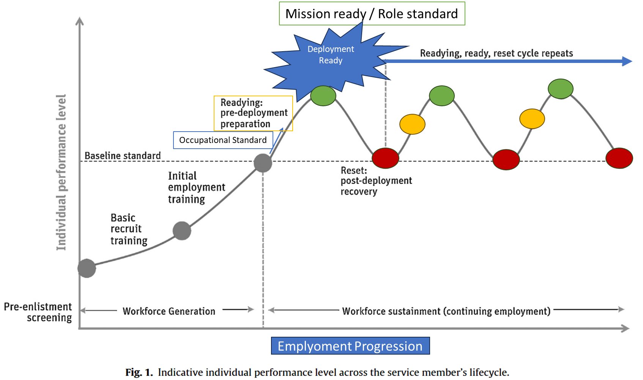
Academy training

Slide 3
