Slide 1
Mediation through cross-lag panel models
CLPM regress variables at wave N on all three variables at wave N-1
Parameters constrained to be equivalent across time
For example, effect of material hardship on caregiver well-being is the same between all weeks.
Calculate indirect effect by multiplying pathway from predictor at Wave 1 to mediator at Wave 2 by path from mediator at Wave 2 to outcome at Wave 3.
Full Information Maximum Likelihood: any caregiver contributes information to the model so long as they have at least two timepoints with relevant data.
Equality constraints ensure model has enough information to converge

Slide 2
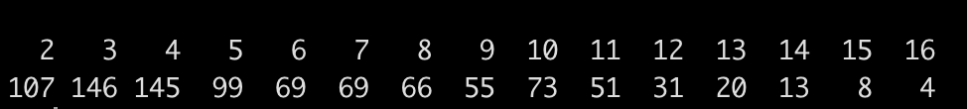
For example, there are 99 caregivers who completed the assessment 5 different times
Number of waves
Number of caregivers

Slide 3
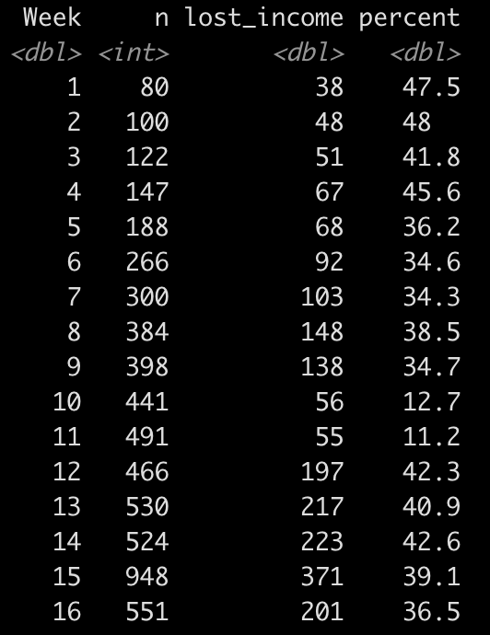
We have more data at later timepoints.
Loss of income follows a U-shaped curve over time
n = number of data points
lost_income = how many caregivers report having lost income since beginning of pandemic
Percent = what percent of that week’s sample has lost income

Slide 4
Income
Decreased
i1
Income
Decreased
i1
Income
Decreased
i2
i2
i3
i3
c1
c1
Caregiver
Wellbeing
c2
Caregiver
Wellbeing
c2
Caregiver
Wellbeing
c3
c3
h1
h1
h2
h2
Child
Wellbeing
Child
Wellbeing
Child
Wellbeing
h3
h3

Slide 5
Income
Decreased
.68
Income
Decreased
.68
Income
Decreased
-.02
-.02
.00
.00
-.12
-.04
-.04
Caregiver
Wellbeing
.83
Caregiver
Wellbeing
.83
Caregiver
Wellbeing
-.08
.14
.14
.53
.08
.00
.00
.07
.07
Child
Wellbeing
Child
Wellbeing
Child
Wellbeing
.66
.66

Slide 6
Income
Decreased
i1
Income
Decreased
TOTAL:
i1*i3 + i2*c3 + i3*h3
INDIRECT (through Caregiver):
i2*c3
i2
-.001 (ns)
i3
i3
-.003 (p < .001)
Caregiver
Wellbeing
c3
Child
Wellbeing
Child
Wellbeing
h3

Slide 7
High social support
Low social support
Income
Decreased
.77
Income
Decreased
TOTAL:
i1*i3 + i2*c3 + i3*h3
INDIRECT (through Caregiver):
i2*c3
Income
Decreased
.90
Income
Decreased
TOTAL:
i1*i3 + i2*c3 + i3*h3
INDIRECT (through Caregiver):
i2*c3
-.02
-.008 (ns)
.00
-.001 (ns)
.00
.00
-.30
-.30
-.003 (p = .007)
-.000 (ns)
Caregiver
Wellbeing
Caregiver
Wellbeing
.13
.10
Child
Wellbeing
Child
Wellbeing
Child
Wellbeing
Child
Wellbeing
.71
.78

Slide 8
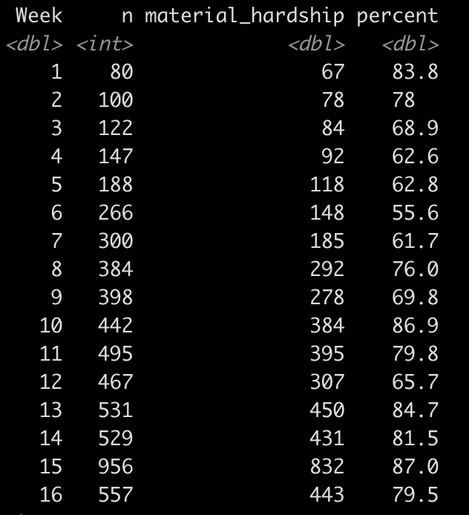
A vast majority of our caregivers report having trouble paying for 1 or more basic needs

Slide 9
Material
Hardship
.83
Material
Hardship
.83
Material
Hardship
-.05
-.05
-.02
-.02
-.30
-.09
-.04
-.04
Caregiver
Wellbeing
.80
Caregiver
Wellbeing
.80
Caregiver
Wellbeing
-.23
.14
.14
.53
.08
.00
.00
.07
.07
Child
Wellbeing
Child
Wellbeing
Child
Wellbeing
.66
.66

Slide 10
Material
Hardship
i1
Material
Hardship
TOTAL:
i1*i3 + i2*c3 + i3*h3
INDIRECT (through Caregiver):
i2*c3
i2
-.039 (p < .001)
i3
i3
-.008 (p < .001)
Caregiver
Wellbeing
c3
Child
Wellbeing
Child
Wellbeing
h3

Slide 11
High social support
Low social support
Material Hardship
.79
Material Hardship
TOTAL:
i1*i3 + i2*c3 + i3*h3
INDIRECT (through Caregiver):
i2*c3
Material Hardship
.86
Material Hardship
TOTAL:
i1*i3 + i2*c3 + i3*h3
INDIRECT (through Caregiver):
i2*c3
.01
0.10 (ns)
-.05
.006 (ns)
.01
.01
-.19
-.19
-.001 (ns)
-.005 (p < .001)
Caregiver
Wellbeing
Caregiver
Wellbeing
.01
.10
Child
Wellbeing
Child
Wellbeing
Child
Wellbeing
Child
Wellbeing
.71
.73

Slide 12
Food
Insecurity
.87
Food
Insecurity
.87
Food
Insecurity
-.04
-.04
-.04
-.04
-.32
-.16
-.04
-.04
Caregiver
Wellbeing
.80
Caregiver
Wellbeing
.80
Caregiver
Wellbeing
-.22
.09
.09
.43
.08
.08
Child
Wellbeing
Child
Wellbeing
Child
Wellbeing
.72
.72

Slide 13
Food
Insecurity
i1
Food
Insecurity
TOTAL:
i1*i3 + i2*c3 + i3*h3
INDIRECT (through Caregiver):
i2*c3
i2
-.073 (p = .001)
i3
i3
-.004 (p = .004)
Caregiver
Wellbeing
c3
Child
Wellbeing
Child
Wellbeing
h3

