Slide 1
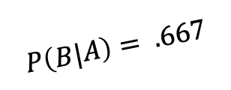


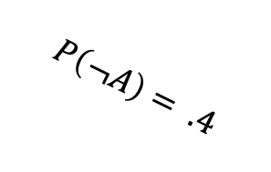


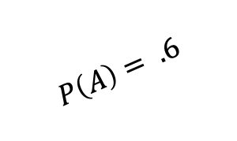
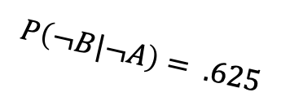


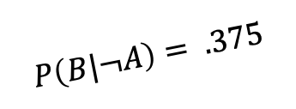

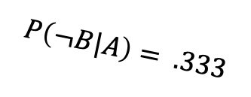

A,B
$$P\left(A,B\right)= .40$$
$$P\left(B|A\right)= .667$$
A
$$P\left(A\right)= .6$$
$$P\left(¬B|A\right)= .333$$
A, $¬$B
$$P\left(A,¬B\right)= .20$$
Start
$¬$A, B
$$P\left(¬A,B\right)= .15$$
$$P\left(¬A\right)= .4$$
$$P\left(B|¬A\right)= .375$$
$¬$A
$$P\left(¬B|¬A\right)= .625$$
$¬$A, $¬$B
$$P\left(¬A,¬B\right)= .25$$

Slide 2
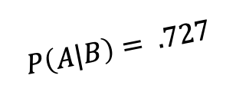


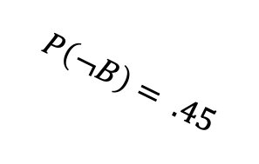


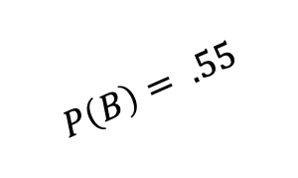
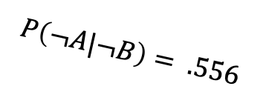


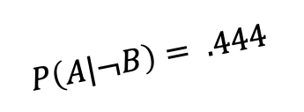

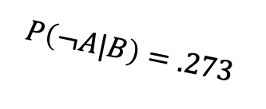

B,A
$$P\left(B,A\right)= .40$$
$$P\left(A|B\right)= .727$$
B
$$P\left(B\right)= .55$$
$$P\left(¬A|B\right)=.273$$
B, $¬$A
$P\left(B,¬A\right)= .15$
Start
$¬$B, A
$$P\left(¬B,A\right)= .20$$
$$P\left(¬B\right)= .45$$
$$P\left(A|¬B\right)= .444$$
$¬$B
$$P\left(¬A|¬B\right)= .556$$
$¬$B, $¬$A
$$P\left(¬B,¬A\right)= .25$$

Slide 3
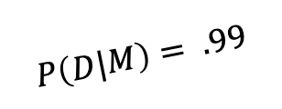


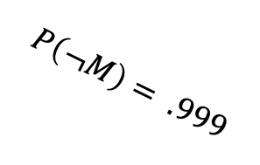


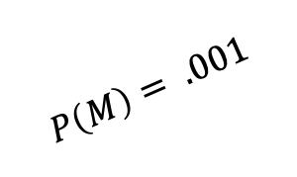
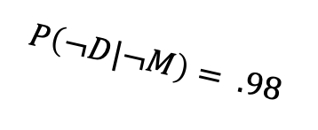


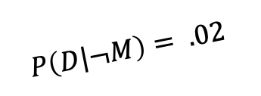

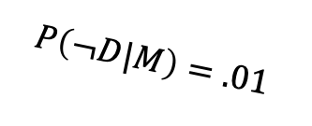

M,D
$$P\left(M,D\right)= .00099$$
$$P\left(D|M\right)= .99$$
M
$$P\left(M\right)= .001$$
$$P\left(¬D|M\right)=.01$$
M, $¬$D
$P\left(M,¬D\right)= .00001$
Start
$¬$M, D
$$P\left(¬B,A\right)= .01998$$
$$P\left(¬M\right)= .999$$
$$P\left(D|¬M\right)= .02$$
$¬$M
$$P\left(¬D|¬M\right)= .98$$
$¬$M, $¬$D
$$P\left(¬B,¬A\right)= .97902$$

