Slide 1
Roots of European exceptionalism
Liberty, entrepreneurship and economic growth
Witold Kwasnicki
University of Wroclaw

Slide 2
Timeline
 | years
Age of the universe (13.799±0.021)×10⁹ years | 13 799 000 000
Age of the Earth (4.54 ± 0.05 )×10⁹ years | 4 540 000 000
Origin of life on the Earth (3.8×10⁹ years) | 3 800 000 000
Homo sapiens (2.0×10⁵ years) | 200 000
First human civilisations (5.0×10³ years) | 5 000
Capitalism (5.0×10² years) | 500
Industrial revolution (2.5×10² years) | 250
Day has 86,400 seconds, 500 years in the timescale of the age of the universe means 0.0031 seconds, i.e., 3 milliseconds.
The blink of an eye takes about 100-400 milliseconds.

Slide 3
http://www.ted.com/talks/niall_ferguson_the_6_killer_apps_of_prosperity.html
“I want to explain to you that there were six killer apps that set the West apart from the rest. … There are six which I think explain the Great Divergence. One, competition. Two, the scientific revolution. Three, property rights. Four, modern medicine. Five, the consumer society. And six, the work ethic.”
You can read also: Kwasnicki W. ‚Logistic growth of the global economy and competitiveness of nations‚, Technological Forecasting & Social Change 80 (2013) 50–76.

Slide 4
Literature
North,D.C., Thomas,R. P., 1973, The rise of the western world: A new economic history, Cambridge, Cambridge University Press.
North, Douglass C., 1976, The Rise of the Western World: A New Economic History
Landes,D. 1999, The wealth and poverty of nations: Why some are so rich and some so poor, Harvard: Harvard University Press.
Mokyr, J.,1990, The lever of riches: Technological creativity and economic progress, New York: Oxford University Press.
Mokyr, J. (2002). The Gifts of Athena: Historical Origins of the Knowledge Economy. Princeton, NJ: Princeton University Press.
Mokyr, J. (2005a). Long-Term Economic Growth and the History of Technology. Volume 1 of Handbook of Economic Growth, pp. 1113–80. Elsevier, Amsterdam.
Mokyr, J. (2010). The Enlightened Economy: An Economic History of Britain 1700-1850. Yale University Press.
Acemoglu Daron, Simon Johnson, James A. Robinson, 2005, Institutions as a fundamental cause of long-run growth, w: Handbook of Economic Gmwth, Volume IA. Edited by Philippe Aghion and Steven N. Durlauf
Daron Acemoglu, James A. Robins, 2013, Why Nations Fail: The Origins of Power, Prosperity and Poverty.

Slide 5
Literature
Fogel, Robert William, 2004, The Escape from Hunger and Premature Death, 1700–2100, Europe, America, and the Third World, Cambridge: Cambridge University Press.
Ferguson Niall, 2011, Civilization: The West and the Rest, The Penguin Press,
Ferguson, Niall, 2013, The Great Degeneration: How Institutions Decay and Economies Die, The Penguin Books.
Morris, Ian, 2010, Why the West Rules - for Now: The Patterns of History, and What They Reveal About the Future, Profile Books.
McNeill William H., Bela Petheo, 1992 (1963), The Rise of the West: A History of the Human Community with a Retrospective Essay, University Of Chicago Press.
Bairoch Paul, 1993, Economics and World History: Myths and Paradoxes, The University of Chicago Press.
Sandra Halperin, Sandy Halperin,1997, In the Mirror of the Third World. Capitalist Development in Modern Europe, Cornell University Press.

Slide 6
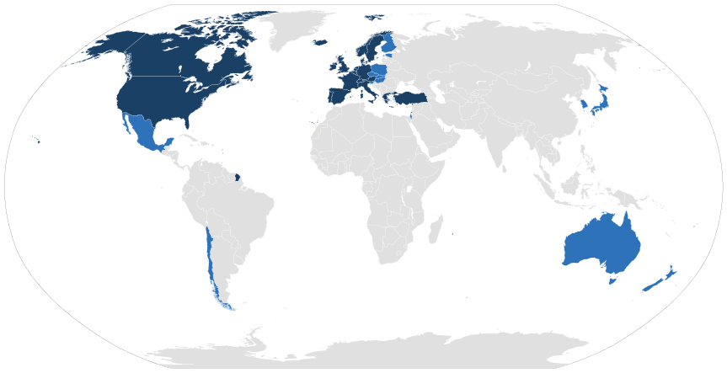
The Organisation for Economic Co-operation and Development (OECD) 30 September 1961

Slide 7
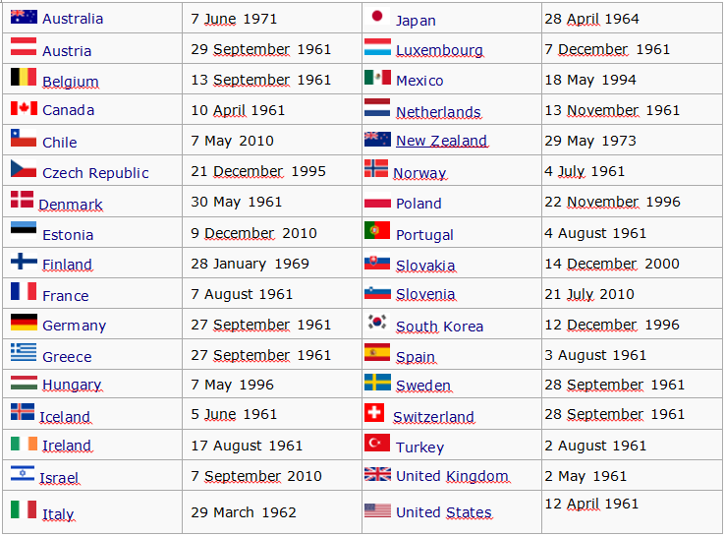
OECD member states

Slide 8
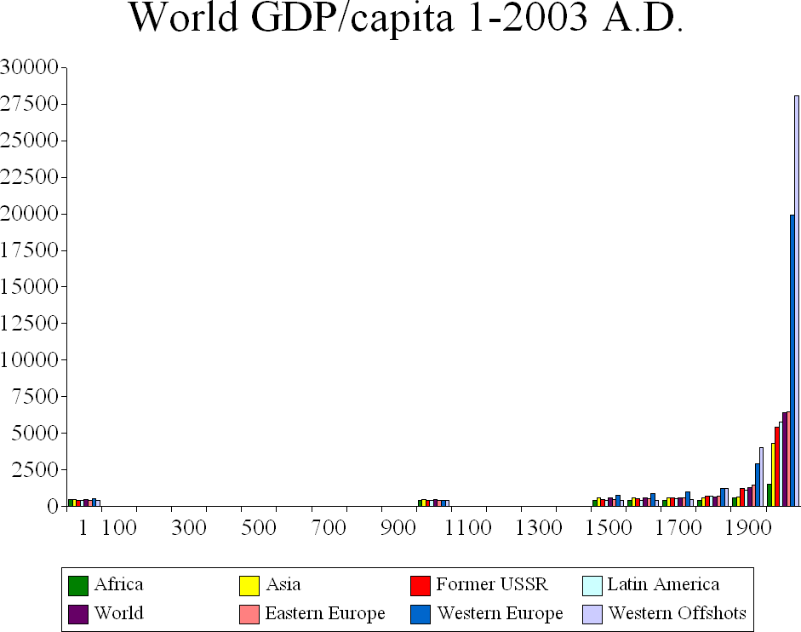
World GDP per capita; 1-2003 A.D.

Slide 9
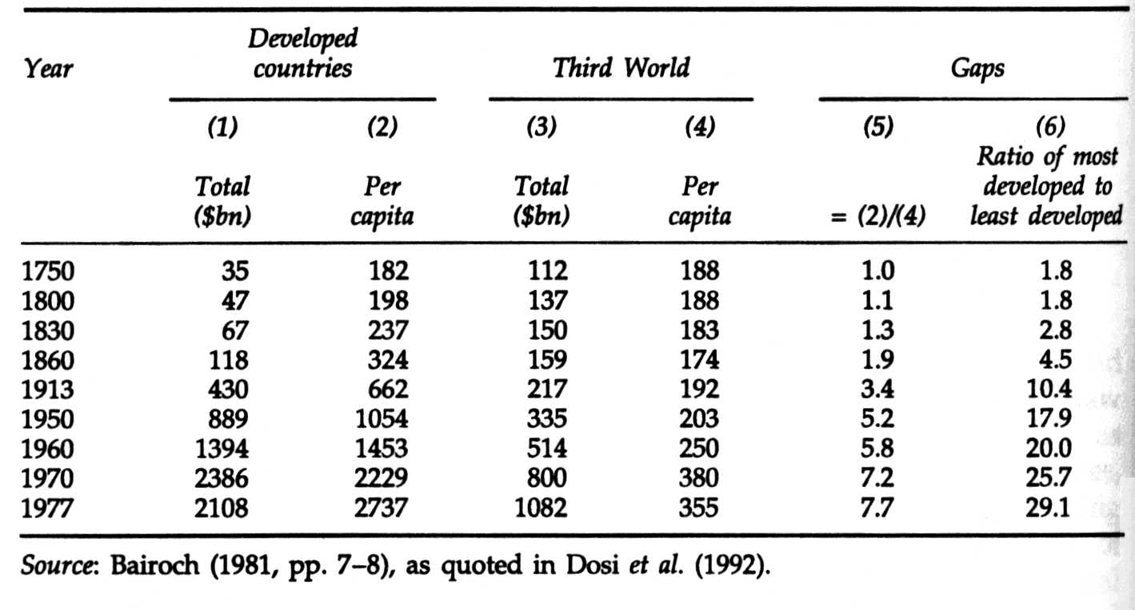
National Income ($ USA 1960 r.)
Notes:
The Economics of Industrial Innovation
Autorzy Chris Freeman Luc Soete
http://books.google.pl/books?id=Ovs5T__m4hAC&printsec=frontcover&hl=pl&source=gbs_ge_summary_r&cad=0#v=onepage&q&f=false
http://books.google.pl/books?id=EeWrAgAAQBAJ&printsec=frontcover&hl=pl&source=gbs_ge_summary_r&cad=0#v=onepage&q&f=false

Slide 10
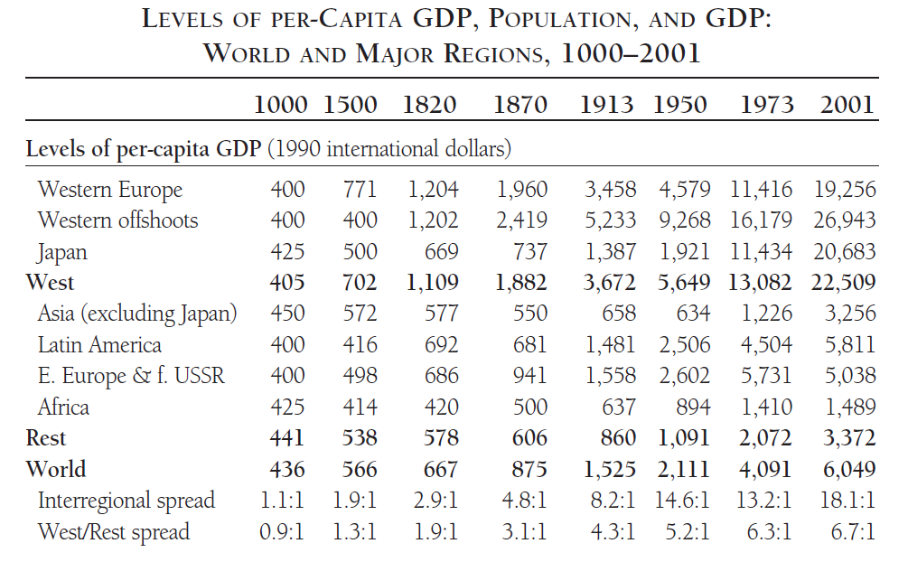
Per capita GDP, 1000-2001
Notes:
Angus Maddison-The World Economy_ A Millennial Perspective_ Historical Statistics-O E C D (2007).pdf

Slide 11
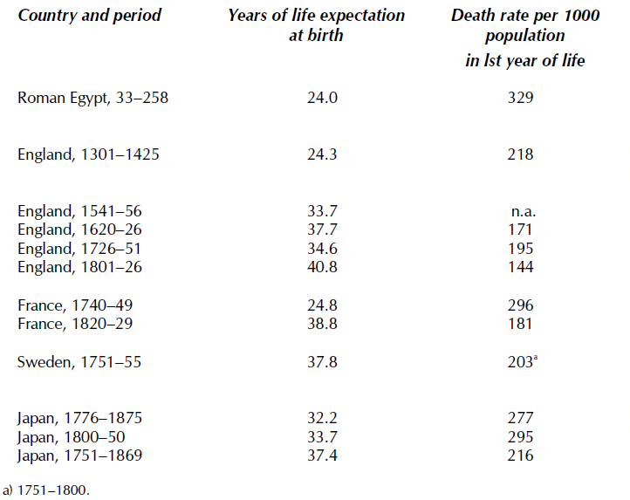
Life expectation and infant mortality, Both sexes combined, 33-1875 A.D.
Notes:
Angus Maddison-The World Economy_ A Millennial Perspective_ Historical Statistics-O E C D (2007).pdf

Slide 12
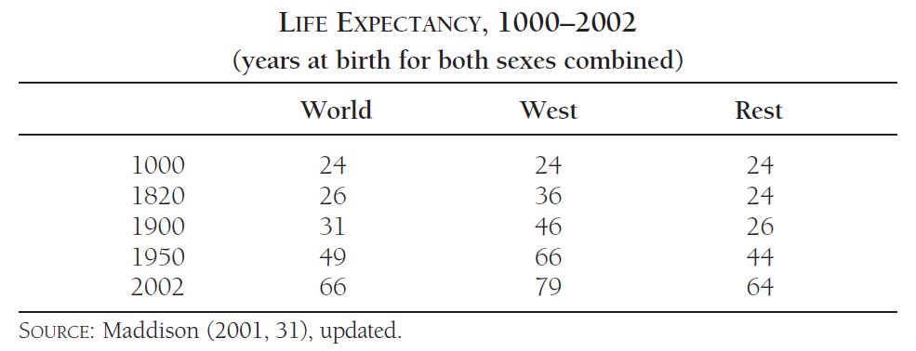
Life expectancy, (years at birth for both sexes combined) 1000-2002
Notes:
Angus Maddison-The World Economy_ A Millennial Perspective_ Historical Statistics-O E C D (2007).pdf

Slide 13
GDP per Capita: China & Western Europe THE WORLD ECONOMY: A MILLENNIAL PERSPECTIVE by Angus Maddison
Textile innovation 1 2 3 4
– the second half of
the 18th century
10000
5000
2000
1000
450
Steam machine – 1763
Declaration of Independence - 1776
Nihil novi nisi commune consensu - 1505
Horse-collar – the 10th cent. + horseshoe
Compas – XI w.
Spectacles – XII w.
Magna Carta – 1215
Banks – XIII w. 1 2 3 3a 4 5 6
Printing press – 1454
Movable metal types
Bill of Rights - 1689
Western Europe
China
400 700 1000 1250 1500 1750 2000

Slide 14
European exceptionalism Ideas have consequences
Liberty, rule of law and private property rights, individualism;
Competition between states, towns, sovereigns, and corporations (decentralization of power and its diversity);
Critical discussion and development of science
Practical application of scientific research (ars sine scientia nihil est - practice is worthless without theory)
Urban development, guilds, and craftsmanship (role of profit and entrepreneurship)
Emergence of capitalism!

Slide 15
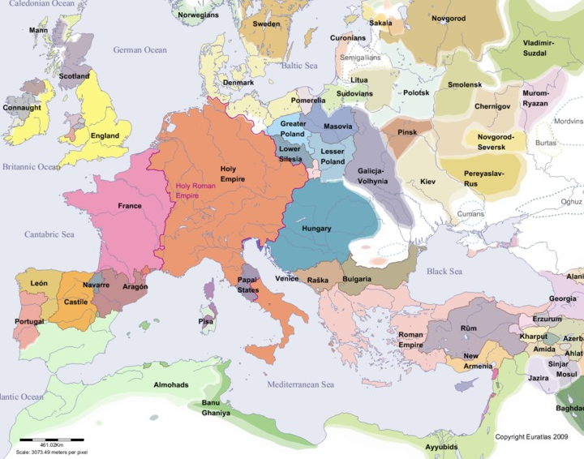
Europe in year 1200

Slide 16
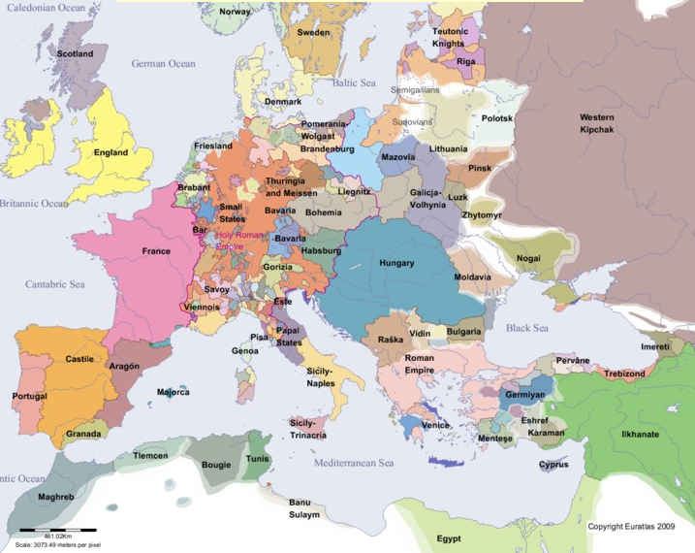
Europe in year 1300

Slide 17
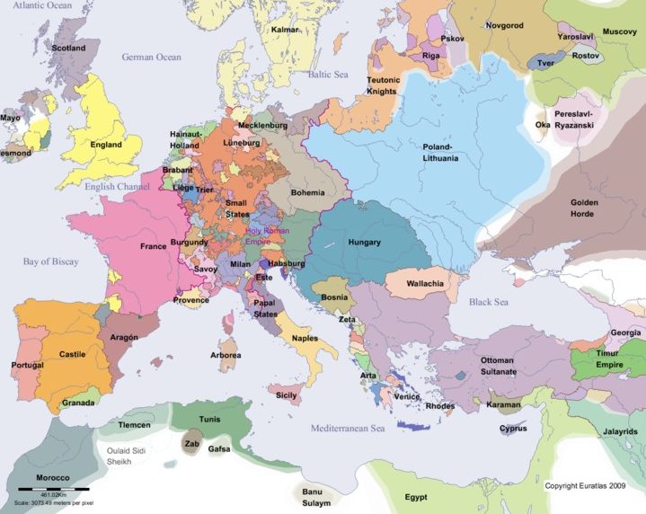
Europe in year 1400
Notes:
https://pl.wikipedia.org/wiki/Europejski_banan
https://en.wikipedia.org/wiki/Blue_Banana

Slide 18
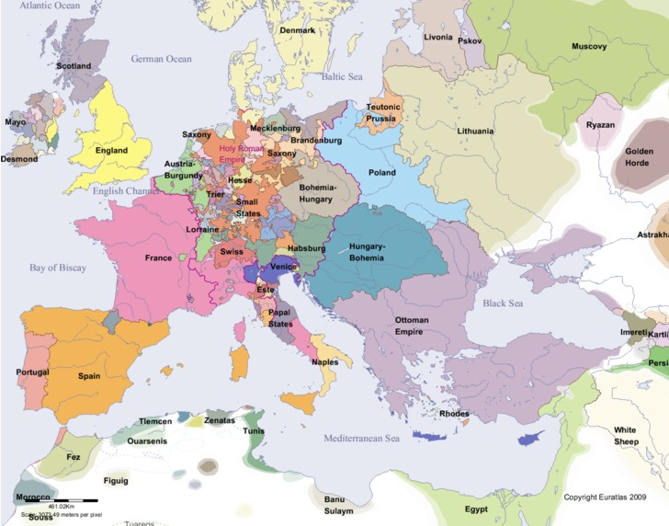
Europe in year 1500

Slide 19
Diversity and development
Margaret Thatcher's Last Shot at the Socialists
Share of people with given income
low diversity in T+50
r=2%
low diversity in T
high diversity in T
high diversity in T+50
r=3%
100
200
300
400
500
Income per capita

Slide 20
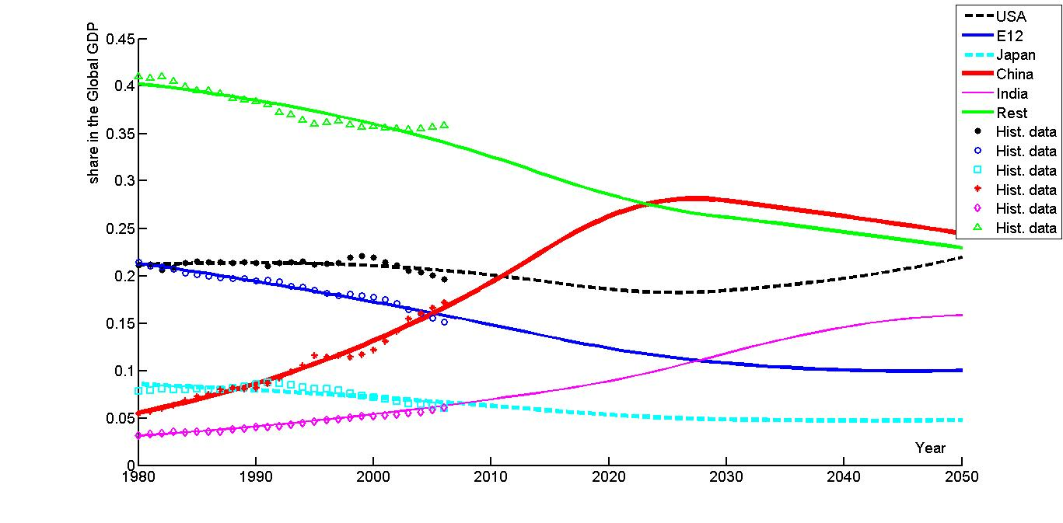
Scenario of development of future structure of the global GDP – the six regions/countries: USA, E12, Japan, China, India and the Rest of the World

Slide 21
Is it our future?
Self-organizing market economics
Sharing market economics
Mercantylism
Classical economics
Welfare economics
Market economics
100%
statism
liberalism
Social acceptance
liberalism
statism
1700
1800
1900
2000

Slide 22
Thomas E. Woods Jr. (2004), The Politically Incorrect Guide to American History
In 1842 Judge Mellen Chamberlain interviewed ninety-one-year-old Captain Preston, a veteran of the Battle of concord in 1775, to understand why Preston fought against the British.
Judge Chamberlain: Did you take up arms against intolerable oppressions?
Captain Preston replied that he had never felt any oppressions.
Judge Chamberlain: Was it the Stamp act?
Captain Preston: No, I never saw one of those stamps.
Judge Chamberlain: Was it the tea tax?
Captain Preston said no again.
Judge Chamberlain: Were you reading John Locke and other theorists of liberty?
Captain Preston: Never heard of ’em. We read only the Bible, the Catechism, Watts’ Psalms and Hymns, and the Almanac.
Judge Chamberlain: Why, then, did you fight?
Captain Preston: Young man, what we mean in going for those redcoats was this: We always had governed ourselves, and we always meant to. They didn’t mean we should.

Slide 23

Thank you

