Slide 1
Vision for a Better Future The economist’s view
Witold Kwasnicki
Institute of Economic Sciences
University of Wroclaw, Poland
e-mail: witold.kwasnicki@uwr.edu.pl
http://kwasnicki.prawo.uni.wroc.pl/
„What makes it [economics] most fascinating is that its fundamental principles are so simple that they can be written on one page, that anyone can understand them, and yet very few do.”
Milton Friedman
Quoted in interview, Lives of the Laureates, William Breit and Roger W. Spencer, eds. (Cambridge, Mass.: MIT Press, 1986), p.91.

Slide 2
"Don't be afraid to speak up. Remember, whatever you say about the subject and however wrong it might be, the same thing has already been said by some eminent economist.”
Ludwig von Mises

Slide 3
Ludwig von Mises Human Action (1949) The first paragragraph:
„ECONOMICS Is the youngest of all sciences. In the last two hundred years, it is true, many new sciences have emerged from the disciplines familiar to the ancient Greeks. … But economics opened to human science a domain previously inaccessible and never thought of. The discovery of a regularity in the sequence and interdependence of market phenomena went beyond the limits of the traditional system of learning. It conveyed knowledge which could be regarded neither as logic, mathematics, psychology, physics, nor biology.”

Slide 4
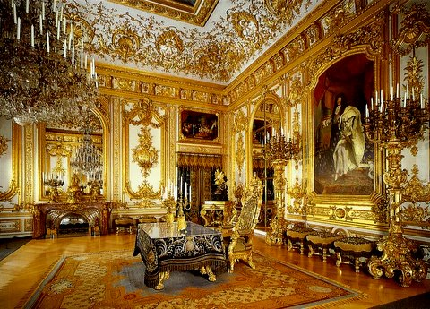

Experiment: Let me ask you a question.
Would you rather be:
fabulously wealthy 400 years ago
normal worker with average salary or even making minimum wage in the present?

Slide 5
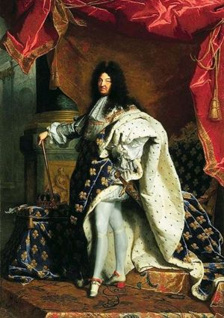
Louis XIV (1638-1715), Louis the Great (Louis le Grand) or the Sun King (le Roi-Soleil)
The King's mornings 7.30-8 am "Sire, it is time", the first Valet de Chambre awakens the King. The First Levee begins. Doctors, familiars and a few favourites who enjoyed the privilege of the Grand Entries followed in succession into the bedchamber of the King who was washed, combed and shaved (every other day). The officers of the Chamber and the Wardrobe then entered for the Grand Levee during which the King was dressed and breakfasted on a bowl of broth….The number of attendants is estimated at around a hundred, all male.
Notes:
http://en.chateauversailles.fr/history/versailles-during-the-centuries/living-at-the-court/a-day-in-the-life-of-louis-xiv

Slide 6
Experiment
Let’s list some advantages to being rich four centuries in the past that are not available to most workers today:
servants, palaces, huge lands with serfs, …
Now let’s list benefits accessible to entry-level workers that did not even exist 400 years ago.
flushing toilets, electric lighting, … and smartphones, the internet, modern medicine, … .
raise your hand if you’d rather be rich 400 years ago; raise your hand if you’d rather be an entry-level worker today.

Slide 7

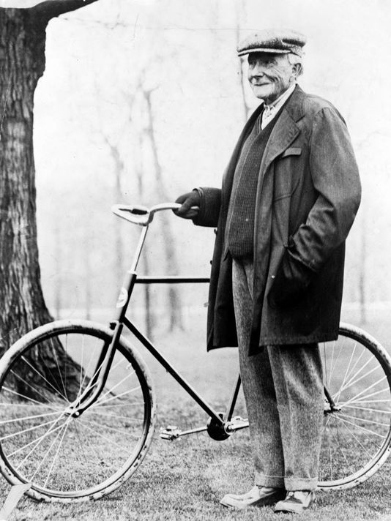
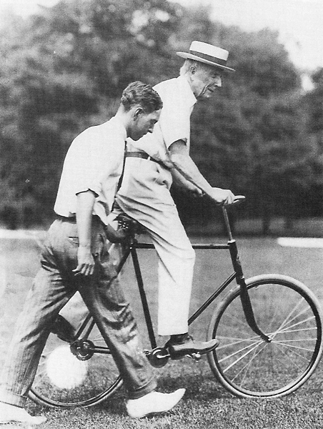
John D. Rockefeller (1839-1937)
Begining of the 20th century

Slide 8
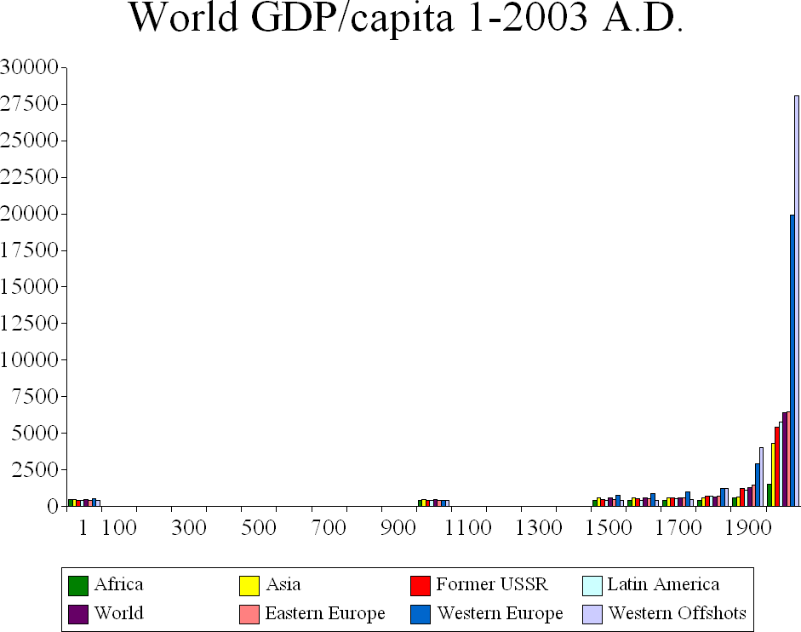
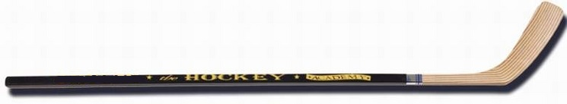
World GDP per capita; 1-2003 A.D.

Slide 9
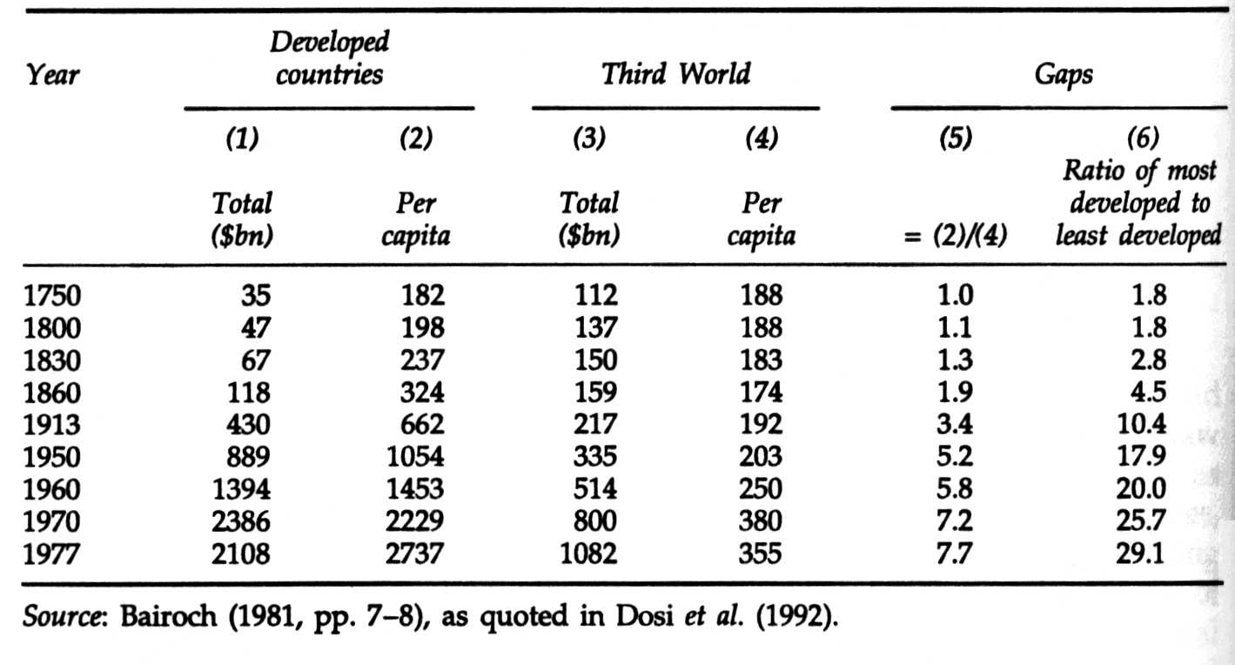
National Income ($ USA 1960 r.)
Notes:
The Economics of Industrial Innovation
Autorzy Chris Freeman Luc Soete
http://books.google.pl/books?id=Ovs5T__m4hAC&printsec=frontcover&hl=pl&source=gbs_ge_summary_r&cad=0#v=onepage&q&f=false
http://books.google.pl/books?id=EeWrAgAAQBAJ&printsec=frontcover&hl=pl&source=gbs_ge_summary_r&cad=0#v=onepage&q&f=false

Slide 10
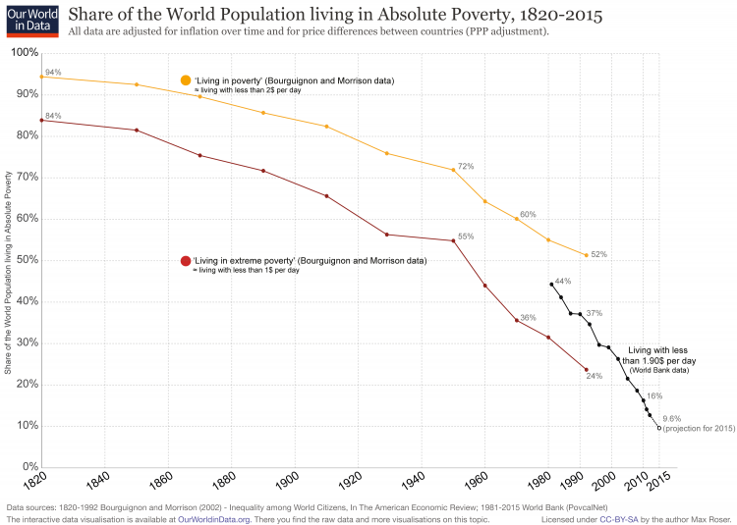

Slide 11
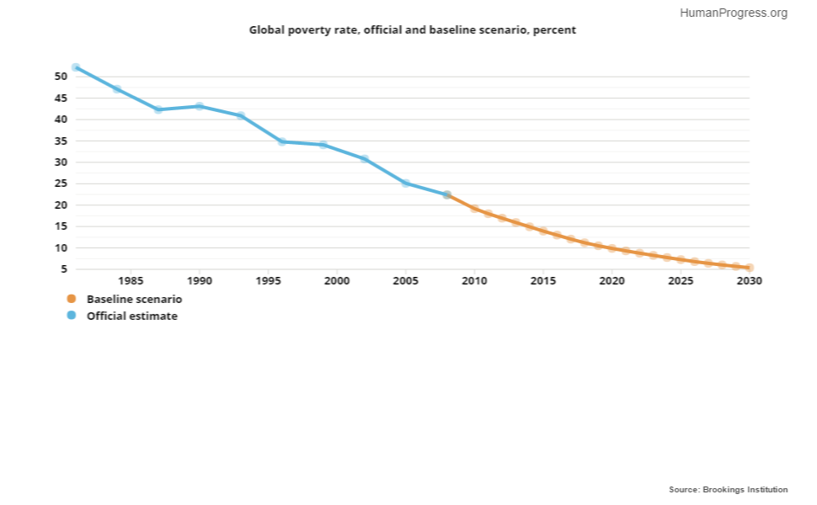
Global poverty rate (official and baseline scenario, in percent)

Slide 12
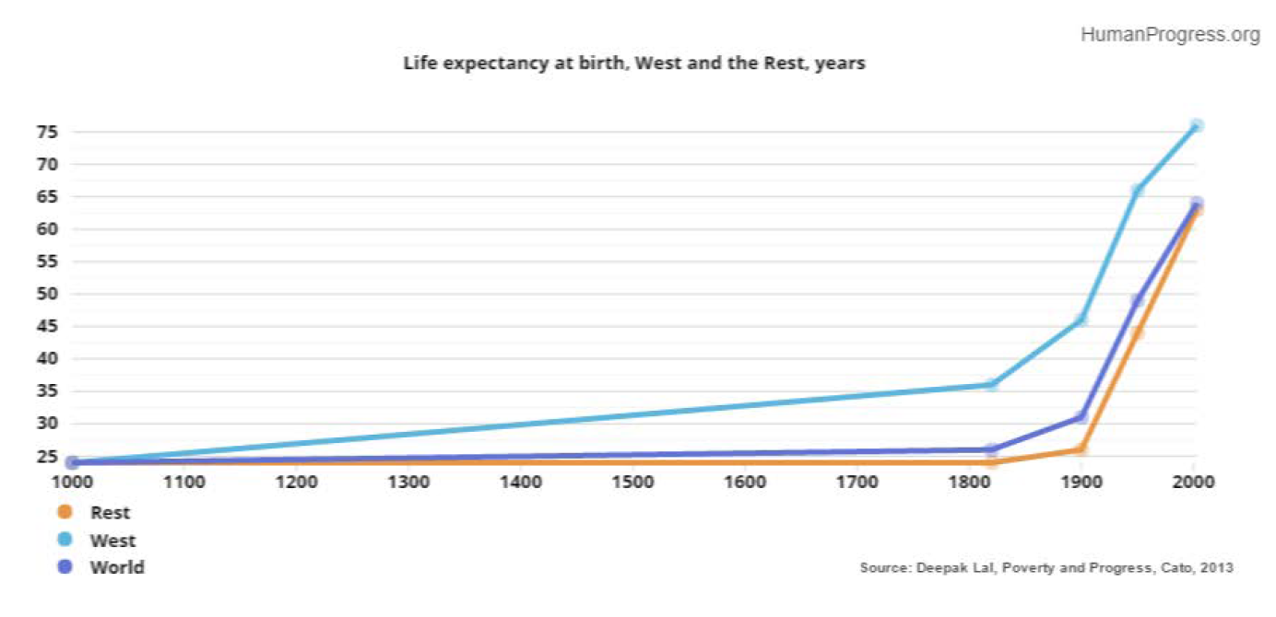
Life expectancy at birth (West, the Rest)

Slide 13
Human Action, Ludvig von Mises
“The natural sciences have achieved amazing results in the last two or three hundred years, and the practical utilization of these results has succeeded in improving the general standard of living to an unprecedented extent. But, say these critics, the social sciences have utterly failed in the task of rendering social conditions more satisfactory. … These grumblers do not realize that the tremendous progress of technological methods of production and the resulting increase in wealth and welfare were feasible only through the pursuit of those liberal policies which were the practical application of the teachings of economics. … What is commonly called the “industrial revolution” was an offspring of the ideological revolution brought about by the doctrines of the economists. … What is wrong with our age is precisely the widespread ignorance of the role which these policies of economic freedom played in the technological evolution of the last two hundred years. …”

Slide 14
Fundamental Concepts
Individual Action
Scarcity
Choice
Subjective value
Tradeoffs and Opportunity Costs
Incentives

Slide 15
!
unlimited human desire (unlimited human needs to be fulfilled) vs. limited resources (scarce resources).
resources:
material (natural: coal, water, forest, …)
artificial (artefacts); (raw materials, tools, machines, food, cloths, flats, transport means, …)
human resources (human knowledge, practical knowledge, experience, theoretical knowledge).

Slide 16
Is economy a science?
Thomas Carlyle (1795-1881), Scottish historian, writer, critics: "Teach a parrot the terms supply-and-demand and you've got an economist".
his term: ‘dismal science’ (on economics)
Winston Churchill: „If you put two economists in a room, you get two opinions, unless one of them is Lord Keynes, in which case you get three opinions.”
Harry Truman: „A totalitarian head of state asked for an economist with one arm to advise the government. Why? Because he was tired of economists who say: "Well on one hand ... But on the other hand ...„
„Give me a one armed economist and an adviser who wouldn’t waffle”

Slide 17
Political economy
Antione de Montchrétien (1576-1621) w Traité de l’économie politique (1615).
First economic theories → the second half of the 18th century:
Richard Cantillon (1730 (1755)), Essai sur la Nature du Commerce en Général,
François Quesnay (1694-1774), Tableau Economique 1758 (1766 wyd. uzupełnione),
James Steuart, (1767), Principles of Political Oeconomy,
Smith Adam, (1776), An inquiry into the nature and causes of the wealth of nations.

Slide 18

Cantillon: real founder of modern economic analysis
Richard Cantillon, 1734 (1755), Essay on the Nature of Commerce in General .
William Stanley Jevons, → "a systematic and connected treatise, going over in a concise manner nearly the whole field of economics. . . . It is thus the first treatise on economics." He dubbed the work "more emphatically than any other single work . . . the Cradle of Political Economy."
Joseph Schumpeter → „the first systematic penetration of the field of economics. It bears the stamp of a scientific spirit."
F.A. Hayek → Cantillon was "the first person to succeed in penetrating and surveying nearly the entire range of what today we call economics."

Slide 19
Magic year 1776
Publication of The wealth of nations by Adam Smith) → ‘the bible of modern economics’;
4th of July 1776 → Declaration of Independence
„We hold these truths to be self-evident, that all men are created equal, that they are endowed by their Creator with certain unalienable Rights, that among these are Life, Liberty, and the pursuit of Happiness.”
Publication of The Decline and Fall of the Roman Empire by Edward Gibbon → devastation effect of high taxes, trade barriers and bureaucratic burden on the development of ancient Rome (three volumes: 1776, 1781, 1788)

Slide 20
Friedrich von Hayek Constitution of liberty (1960, s. 4)
„I want to make it quite clear here that the economist can not claim special knowledge which qualifies him to co-ordinate the efforts of all the other specialists. What he may claim is that his professional occupation with the prevailing conflicts of aims has made him more aware then others of the fact that no human mind can comprehend all the knowledge which guides the actions of society and of the consequent need for an impersonal mechanism, not dependent on individual human judgments, which will co-ordinate the individual efforts.”

Slide 21
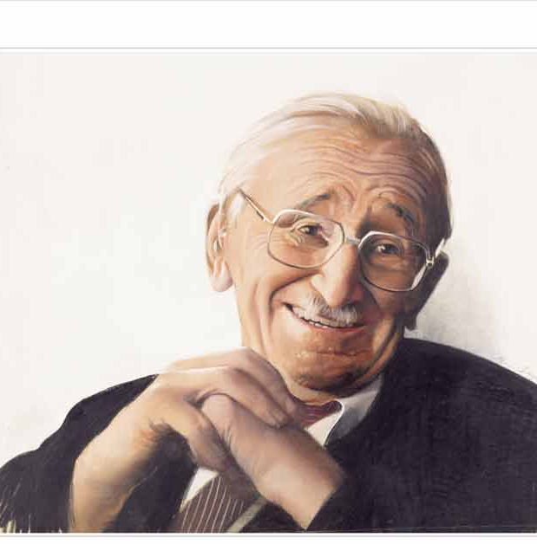
Friedrich von Hayek (1899-1992)
„The curious task of economics is to demonstrate to men how little they really know about what they image they can design.”
(Fatal Conceit, The Errors of Socialism, 1988, p. 76)

Slide 22
The Market Process
The market is not a thing. It is a process. The free market is the complex network of all the voluntary exchanges between individuals in an economy. It is the interaction of people exchanging value for value. We are participating in the market every time we buy, sell, or trade. In addition to increasing general wealth in society, the market promotes community and encourages social harmony.
To understand the market proces it is nesesery to explore the following concepts:
Voluntary Exchange,
Gains from Trade,
Specialization, and Division of Labor,
Emergent (or Spontaneous) Order,
Competition and Cooperation.

Slide 23
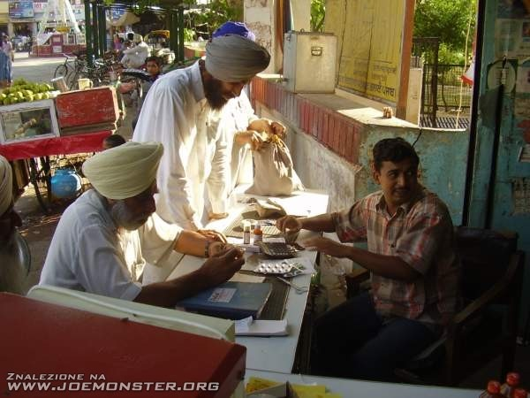
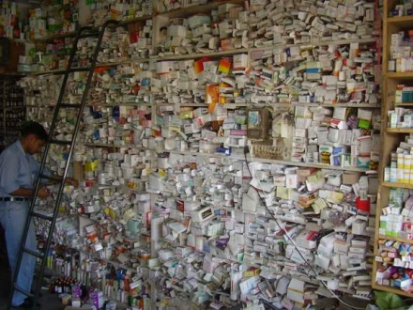

Indian pharmacy
Chaos?
?

Slide 24
Politics and Economics
‘‘This is not a dispute about whether planning is to be done or not. It is a dispute as to whether planning is to be done centrally, by one authority for the whole economic system, or is to be divided among many individuals.’’
F. A. HAYEK
Let’s take a look at government intervention in the market process. Government can intervene in the market to influence economic outcomes when it:
collects revenue – and discourages behawior – using taxes
encourages certain behaviors using subsidies
requires certain products or activities by mandates
prevents certain products and activities through prohibitions
attempts to control market activity through regulation

Slide 25



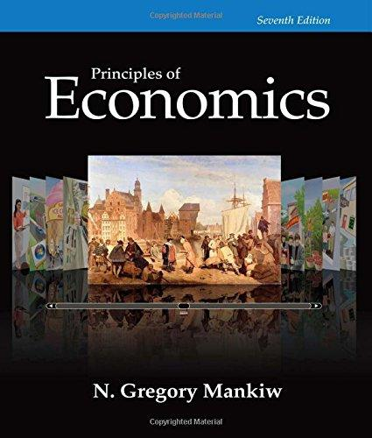
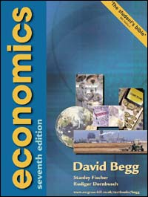
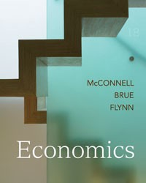
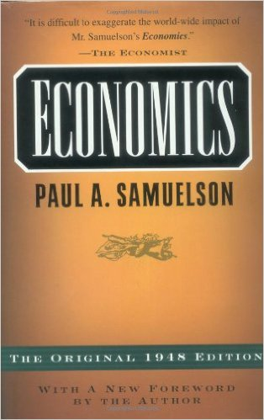
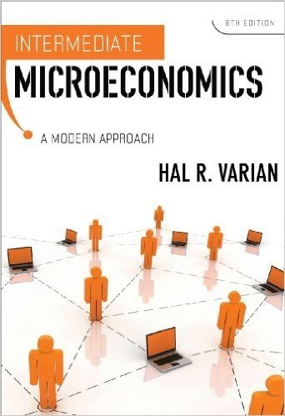

Orthodox Economics texbooks

Slide 26
Things Your Harvard Economics Textbook Won't Tell You
Only individuals choose, and only individuals act
Economic value is subjective
Knowledge Problem
The Seen and Unseen
Entrepreneurship
Government actors are not angels
Notes:
https://fee.org/articles/6-things-your-harvard-economics-textbook-wont-tell-you/

Slide 27

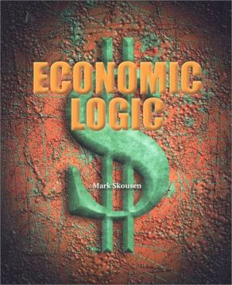
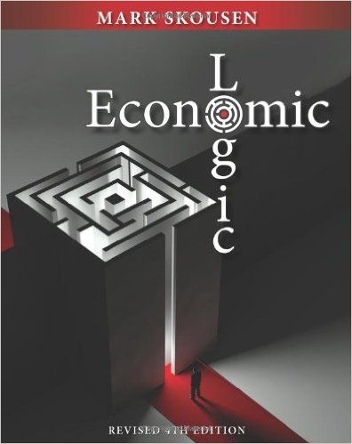
Another textbooks

Slide 28
„What is prudence in the conduct of every family, can scarce be folly in that of a great kingdom”
Adam Smith, The wealth of nations (1776)

Slide 29
Happiness and Success
"Economics is everywhere, and understanding economics can help you make better decisions and lead a happier life."
--- TYLER COWEN

