Slide 1
Optimized
Cleaning Program
High level goals
Spec.
Interface
Data Transform Lib
Quality Function Lib
Feature Lib
Data, Quality Function, Language
Tree
Search
Static Pruners
Dynamic Pruners
Parallelizer
Cleaning Program
Program
Optimizer
Loop Fusion
Literal Inlining
CodeGen

Slide 2
1. Result quality is low.
Compose quality func Q()
2. Modify pipeline / tune params
O₁
...
O_{n}
Data source
Cleaning pipeline/program
ML/SQL/analysis
application
Developer

Slide 3
i^{th} iteration
Priority
Queue
Candidate
Pipelines
Skewed
Global top γ
Balanced
Global top γ
Local top γ
Worker 1
Driver
Global best
Rebalance
Worker 2

Slide 4
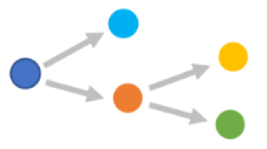
O₁
O₂
O_{N}
...
Library
Condition Assignments Pool
Params, R*
Searcher
Param. Sampler
Pipeline
Quality Evaluator
ML-based Pruner
Quality function
Depth limit

