Slide 1
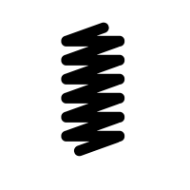
(A) 3D Fabric Mesh
(B) Model
z
n₄
v
n₂
y
x
n₃
n₁
Gravity

Slide 2
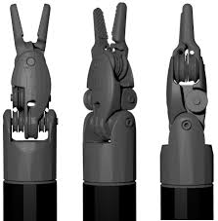
(A) No Tensioning
(B) Fixed
(C) Analytic
(D) Adaptive

