Slide 1

Name | Address | Category
Carl’s Junior | 2132 East Hayward. | Fast Food American
Peking Star | 102 Bayshore Dr…
Peking Star | 102 Bayshore Dr… | Chinese
Flag Cafe | 192 Courtyard Wy.. | Coffee Shop
Category 1 | Category 2
Fast Food | Fast Food American
French Bistro | Café Bistro
Chinese | China Cuisine
Italian | Italiano
100
75
50
25
0
Precision Recall

Slide 2
Data Source:
Yelp
Similarity Join:
Jaccard 0.8
Filtering
None
Data Source: Yelp
Similarity Join:
Jaccard: 0.8
Filter:
regex: (\w\d)+

Slide 3

Data Source:
Yelp
Similarity Join:
Jaccard 0.8
Filtering
None

Slide 4
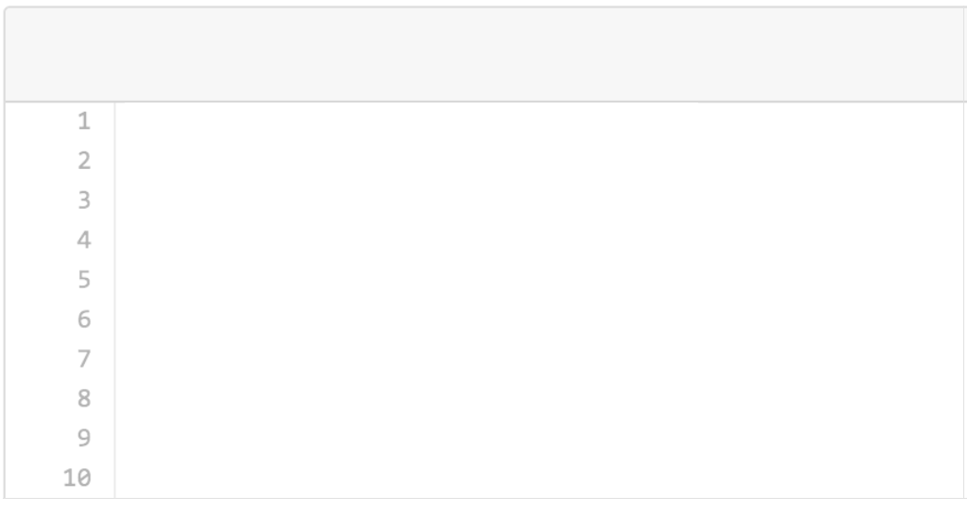
SimilarityJoin
ON (Yelp, Yelp)
WITH Jaccard, thresh=0.8

Slide 5
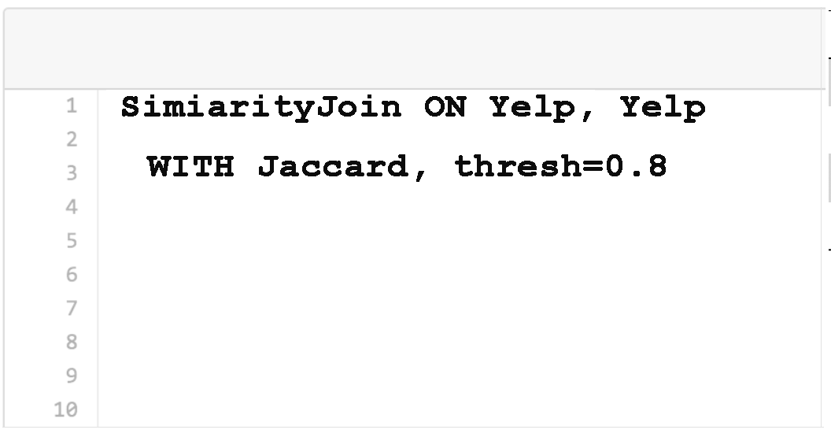
Data Cleaning Pipeline
Name | Address | Category
Carl’s Junior | 2132 E Hayward. | Fast Food American
Peking Star | 102 Bayshore Dr…
Peking Star | 102 Bayshore Dr… | Chinese
Flag Cafe | 192 Courtyard W.. | Coffee Shop
Zagat
dataset
Regex
(\w\d)+
Jaccard
0.8

Slide 6
Similarity Join
Current
Jaccard
Recommendation
Edit Distance
Join Impl
Broadcast
Similarity Func
Jaccard
Threshold
0.8
Tokenizer
\s+

Slide 7
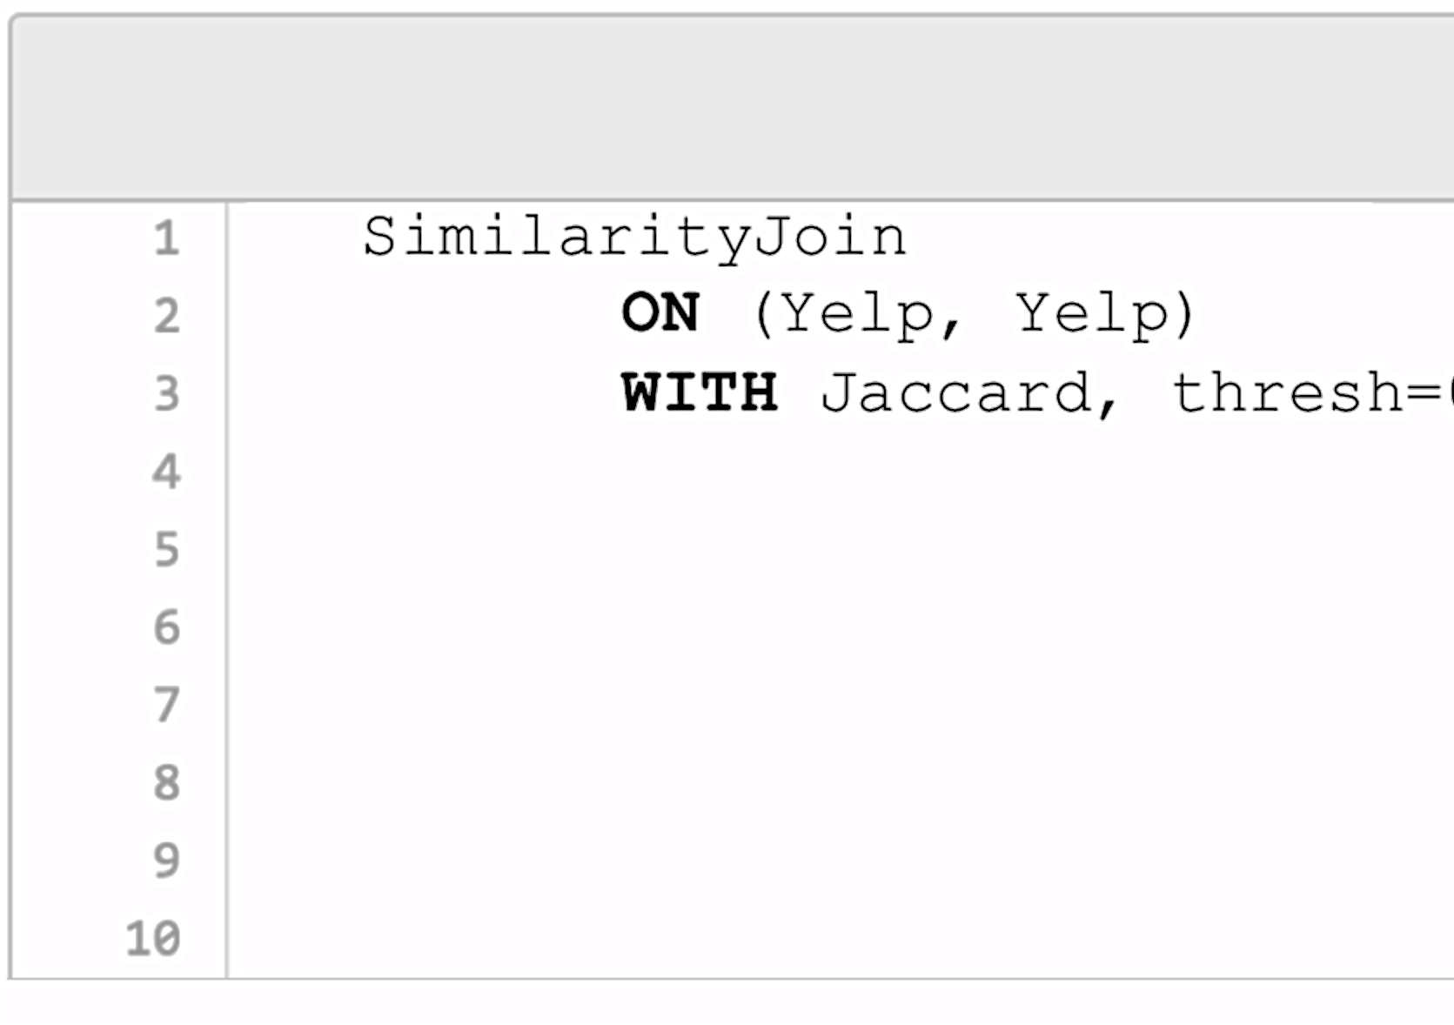
Data Cleaning Pipeline
Name | Address | Category
Carl’s Junior | 2132 E Hayward. | Fast Food American
Peking Star | 102 Bayshore Dr…
Peking Star | 102 Bayshore Dr… | Chinese
Flag Cafe | 192 Courtyard W.. | Coffee Shop
SimilarityJoin
ON (Zagat, Zagat)
WITH Jaccard, thresh=0.8
Zagat
dataset
Regex
(\w\d)+
Jaccard
0.8

