Slide 1


Introduction to Parallel Programming with OpenMP

Slide 2

Lets start with some motivation
#include <stdio.h>
#include <limits.h>
int main(int argc, char** argv) {
for (int i = INT_MIN; i < INT_MAX; i++) ;
printf("Done with first pass\n");
for (int i = INT_MIN; i < INT_MAX; i++) ;
printf("Done with second pass\n");
…
for (int i = INT_MIN; i < INT_MAX; i++) ;
printf("Done with eighth pass\n");
}

Slide 3
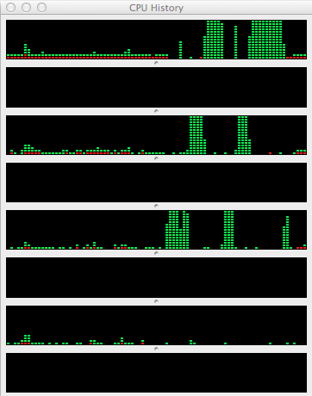
Serial Results (4-core laptop with hyperthreading...)
$ time ./Motivation
Done with first pass
Done with second pass
Done with third pass
Done with fourth pass
Done with fifth pass
Done with sixth pass
Done with seventh pass
Done with eighth pass
real 1m12.210s
user 1m12.017s
sys 0m0.020s$
This fancy computer seems 7/8 of it is on vacation - what gives?

Slide 4
Now, with some very simple mods
#include <stdio.h>
#include <limits.h>
#include <omp.h>
int main(int argc, char** argv) {
#pragma omp parallel num_threads(8)
{
for (int i = INT_MIN; i < INT_MAX; i++) ;
printf("Done with pass %d\n",omp_get_thread_num());
}
}

Slide 5
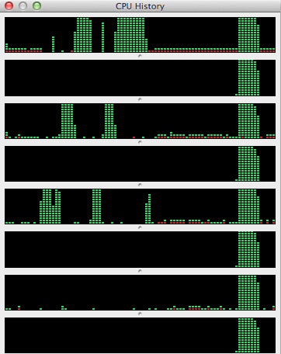
And running with OpenMP
$ time ./MotivationOMP
Done with pass 0
Done with pass 3
Done with pass 5
Done with pass 2
Done with pass 7
Done with pass 4
Done with pass 6
Done with pass 1
real 0m13.723s
user 1m43.803s
sys 0m0.114s

Slide 6
I don’t know about you, but...
I WANT THAT!!!!!

Slide 7
SCREEN basic command list
ssh guestNN@129.49.83.41
# Open new screen Session
screen -S S1
# Get today’s tutorial copy
git clone https://github.com/sjyoo/OpenMPTutorialBase
cd OpenMPTutorialBase; git pull # update to the latest copy
# Source environment
. OpenMPTutorialBase/setenv.bash
# detach current session
Ctrl+a d
# reatach to Session S1
screen –x S1 or screen –x # if there is only one session
# list all the Sessions
screen -ls

Slide 8
Parallel Programming
IS
Mainstream Programming!

Slide 9
Popular Parallel Programming Models
CPU-Intensive
  OpenMP
  MPI (Message Passing Interface)
  CUDA
Data-Intensive
  MapReduce (Hadoop)
  Storm

Slide 10

Agenda
Nomenclature & Core Concepts
  cores, threads (vs processes), hyperthreads
What is OpenMP
  Execution Model
  Memory Model
Programming with OpenMP
  Parallel Regions
  Loop-level Parallelism
  Synchronization & Cooperating Threads
  Work Sharing

Slide 11
Plus! Hands On Code Examples & Exercises!
Hello World/Parallel Independent Tasks
Map & Saxpy
Trapezoid Rule
Monte Carlo
Difference Eq.
We call these smallish toy programs, Programming Katas - the simple forms we follow to internalize a programming skill

Slide 12
Reference
I found “Using OpenMP - Portable Shared Memory Parallel Programming” by David J. Kuck to be quite useful - covers both C and Fortran)
“Patterns for Parallel Programming” by Matson, Sanders, Massingill - talks about parallel algorithms and has nice brief introductions to OpenMP and MPI.
“Structured Parallel Programming/Patterns for Efficient Computation” by McCool, Robison, and Reinders - also good for parallel algorithms
But don’t forget omp.org & formal spec:
  160 pages of specifications (10 pages of glossary!)
  160 pages of examples

Slide 13
What just happened in our example?
There are many ways to do 8 tasks - e.g., serially.
  Do the 0th task, then the 1st, then the 2nd, and finally the 7th.
  Nearly every loop you see in programs is an example of this way of thinking (and an opportunity to speed things up!)
Or, if you have the resources in parallel
  Get 4 processors that can work independently of each other and give each one a task.
In our code, the line
“#pragma omp parallel num_threads(8)”
asks the Compiler to please write the code necessary to create 8 threads and then ask each of those threads to execute the next statement or block, and when they finish, to wait for all
to complete.

Slide 14
OMP’s “Big Idea” - Execution Model
Simple “fork/join”
Initial or Master Thread
// serial code
#pragma omp parallel ...
{
// a block with regular C
// and perhaps some
// calls to omp functions
}
Magic
Team of Threads
Barrier

Slide 15
This is the “Big Idea” of OMP
The Fork/Join model is the only way to create threads
By default, the threads all independently execute the next statement/block
Everything else in OpenMP is focussed on getting some control of these threads in order to allow them to cooperate to accomplish some useful tasks.

Slide 16
Some History & Nomenclature
Cores and Threads
About 10 years ago, CPU manufacturers hit a brick wall that strictly limited how much faster they could drive their CPUs.
Moore’s law (transistor density doubling every 2 years) was still going strong, but they could no longer translate that into faster CPUs.
And so was born the Core and a whole class of new software technologies.

Slide 17
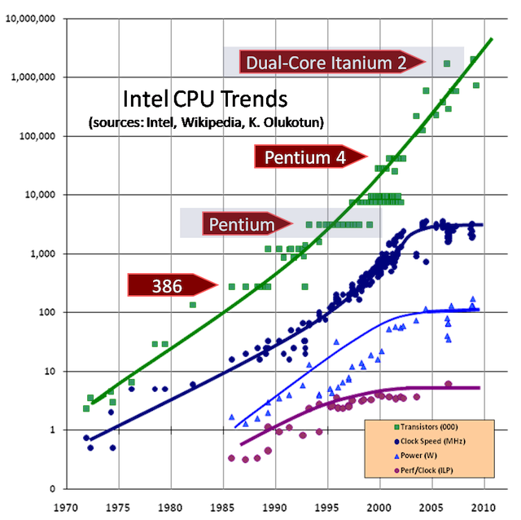

Classic (by now) Performance Graph
(Source: “The Free Lunch is Over: A Fundamental Turn Toward Concurrence in Software” by Herb Sutter (DDJ 3/2005))
Enough to toast a bagel in 2010.

Slide 18
Student Exercise 1
Work with the motivation example.
  Make sure you can
    edit
    compile or make
    time & run the programs on your computer. Does it indeed run faster? If not, why not?
  Remove or comment out the num_threads(8) and re-run. How many threads are created?
  Using my makefile, edit the line “#pragma omp parallel” so that you misspell omp (say, opm). What happens when you compile and/or run the code?
  Modify the makefile to remove the -Wall compiler option. Re-make the program. What happens when you compile and/or run the code?

Slide 19
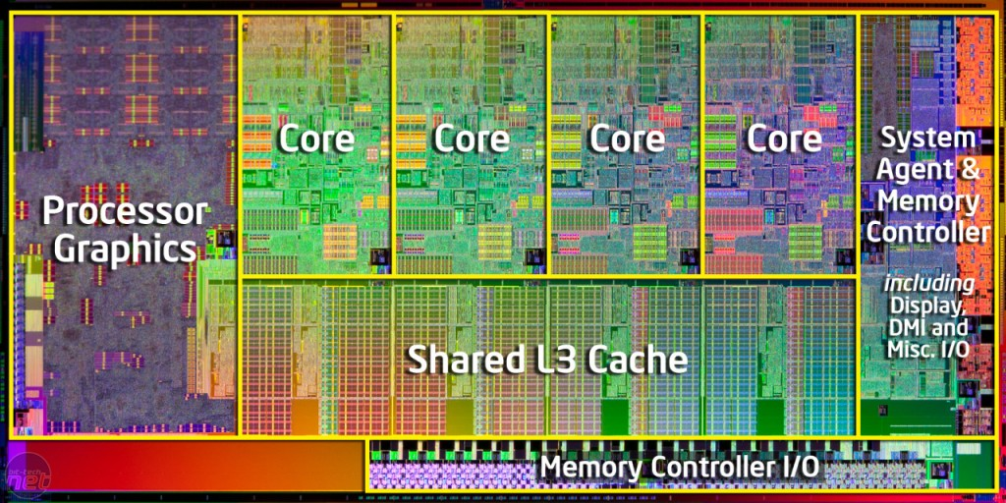
Intel Die Map

Slide 20
Cores with their Caches
Main Memory
Core 1
Data Cache
Shared Unified
Cache
Instr. Cache
Core 2
Data Cache
Instr. Cache
Processor

Slide 21
How to know what your computer has?
Linux systems
  Try lscpu
Mac
  Try “sysctl -n hw.ncpu” (also includes “hyper” threaded cores)
  Try “system_profiler SPHardwareDataType” to get the actual number of physical cores
PC
  ?

Slide 22
More on Cores
Now, each of these cores may operate independently
  separate ALU
  separate registers
  separate program counter
  separate stacks
  and maybe(!) even separate memory spaces etc.
Each core is running a “thread” (think program for now) within a process
  each process has an id
  processes are by default protected from each other (can’t see/modify each others data)
  If two cores are running processes with different IDs, they are protected from each other
  If two cores are running processes that the same ID then, ...

Slide 23
And so the concept of Threads
A thread is a run time entity that is able to independently execute a stream of instructions (think Robot)
Processes need a lot of information in order to protect themselves and behave rationally.
  Contents of all of the registers
  Contents of the memory map
  Data structures for external resources (files, network connections etc.)
  And so when you switch processes, there is a lot of stuff to save and restore.
A process can have any number of threads.
But threads (nee Light Weight Processes) share everything, except the register stack, with every other thread in the process..

Slide 24
One Definition
A thread is a run time entity that is able to independently execute a stream of instructions (think Robot)
double area = 0.0;
area += f(0.0)/2;
area += f(1.0)/2;
double dx = 1.0/n; // n??
for (int i = 1; i < n; i++) {
area += f(i*dx);
}
area *= dx;

Slide 25
But, imagine...
Imagine that you have a program that has 3 functions to perform - the functions are independent of each other and so, could be computed at the same time.
  So a process could create 3 threads and have each compute 1 integral using the same algorithm (function).
  If you are on a machine with 1 core, then they interleave their execution as if they were just “light-weight” processes
  But if you are on a machine with 2 or more cores, the computations will overlap and if the time to create the extra thread is less than the time to compute the integral - YOU WIN!

Slide 26
Furthermore
The big question with threads
  How do you create a new thread?
  What data do threads you create share?
  What data do thread your create hold private?
  How can the threads you create synchronize themselves?
Note - OpenMP doesn’t bring anything new to the threading table
  It uses the threading capabilities that it finds on the system
  It presents to the programmer a “simplified” model of thread execution and data sharing
  It brings a high degree of portability to threads

Slide 27
Processes and Threads
On Unix-like systems, processes are created with the “fork” system call (usually invoked as fork/exec).
  2 entities are created (processes) each of which are protected from each other
On Unix-like systems, threads are created ...
  Well, its complicated... not because their creation is hard, but working with them is complicated.

Slide 28
Final word on Threads
What a thread is, depends upon who is using the term
  To a Hardware designer, a thread is something that runs on a core. Intel says with a straight face that their processors run 4, 8, 16, ... threads. Yet one can write a program that uses hundreds of threads
  To a Software Engineer, a thread is what I’ve been talking about - a path through a program with an associated memory (some of which is shared)
  To a Systems Programmer - a thread is a unit of scheduling. If there are threads available to run and cores that aren’t doing anything, the connect the thread to the core. If all of the cores are busy with their own threads, then a running thread will eventually be swapped out for one ready to run.

Slide 29
Some programming!
In addition to directives (pragmas) OpenMP is also a collection of environment variables and library functions. Lets look at the most important of these. (These are on the cheat sheet)
Environment
  OMP_NUM_THREADS
    is used to set the number of threads that the parallel directive uses lacking any other direction
Library
  void omp_set_num_threads(int n)
    set number of threads for subsequent parallel regions
  int omp_get_num_threads()
    number of threads in the current team
  continued...

Slide 30
Some programming! (continued)
Library
  int omp_get_thread_num();
    the id of this thread (0 based)
  int omp_get_num_procs();
    how many processors (cores) are available
  double omp_get_wtime()
    returns elapsed wall time in seconds
  double omp_get_wtick()
    returns precision of timer used by omp_get_wtime

Slide 31
Serial Hello World
In C:
#include <stdio.h>
int main()
{
printf("hello world\n");
return 0;
}

Slide 32
Student Exercise 2 - Parallel Hello World Prerequisites
Environment:
  export OMP_NUM_THREADS=4
Includes
  #include <omp.h>
Directive:
  #pragma omp parallel
Function
  omp_get_thread_num() - returns int id for the thread in the team (0 is the master thread and the id increases by 1 for each additional thread in the team.) You must also include <omp.h> if you use OpenMP functions.
Compiler & compiler flags
  -fopenmp -Wall

Slide 33
Parallel Hello World: (don’t peek!)
#include <stdio.h>
#include <omp.h>
int main()
{
return 0;
}

Slide 34
Student Exercise 3
Start again with the motivational problem and using ONLY what we have discussed so far...
  Imagine that rather than having to perform the same task 8 times, we had to do 8 different and independent tasks - perhaps as part of initializing a larger program. They may include reading an input file, connecting to a remote database, etc. Since these tasks are independent of each other, they could be performed in parallel saving a lot of time. Write the code to do so. (create doTaskA(), doTaskB() etc. and call them so they run in parallel on different threads)
  Find out what omp_get_num_procs() returns on your computer. Can you justify that number?
  There are 3 ways to set the number of threads - env. var OMP_NUM_THREADS, omp_set_num_threads(int) and in the parallel directive itself.
    What happens when these numbers disagree. Try 16, 8, 4 and 2 for test values.

Slide 35
Other Directives - Sections/Section
In Example 3 - we had N tasks to perform and T threads available with which to perform them. You can be forgiven if you assumed that T >= N, but it may not be so! Enter the sections/section directive.
From inside a parallel region where a team of threads run:
#pragma omp sections
{
#pragma omp section
// structured block
#pragma omp section
// structured block
/// ...
}

Slide 36
Other Directives - Sections/Section
These directives have the compiler write the code necessary to have each individual segment to be given to an available thread for execution.
  If there are more threads than tasks, then some threads may go idle
  If there are more tasks than threads, then as threads complete some tasks, they will be assigned to another.
Alternative syntax - if the sections directive is the entire contents of the omp parallel directive, you can combine as:
#pragma omp parallel sections
{
#pragma omp section
structured block
...
}

Slide 37
Student Exercise 4
Redo Exercise 2 using the sections/section directives. Make sure you have more tasks to perform than threads available to accomplish them simultaneously.
  Which thread does which task?
  Is it always the same or does it seem to differ?
  Try to make the tasks take different times to execute.

Slide 38
Recapping some OpenMP Concepts
It is NOT a separate language
It is implemented inside the compiler from hints you give it via #pragma
Goals for the designers of OpenMP (not necessarily met nor religious about it...)
  Sequential Equivalence - the SAME program should work and produce the same answer with 1 thread as it does with N threads
  Incremental Parallelism - One should be able to start with a serial program and gradually parallelize it.
These goals often conflict with the goal of maximizing performance.

Slide 39
High Performance Computing Concepts
If you have to perform some task (e.g., think about digging a hole), then to do it faster you can
  work faster - this is a non-starter - see the slide on power
  do more with every step (i.e., get a bigger shovel) - this may work for a while, but think about how heavy that shovel gets
  have lots of friends help you out - but this ofter requires some sort of cooperation
OpenMP tries to do more with every step (utilizing extra cores running thread) and provide the means for the threads to cooperate with each other.

Slide 40

A Quick Reality Check
Amdahl’s Law:
  Let n be the number of threads
  Let f be the fraction of the program that can be parallelized
  T(n) be the time an algorithms takes to complete using n threads.
  Let S(n) be the speed-up one gets using n threads
Bottom line, no matter how many threads you have, you will never run more than 1/(1-f) times faster.

Slide 41
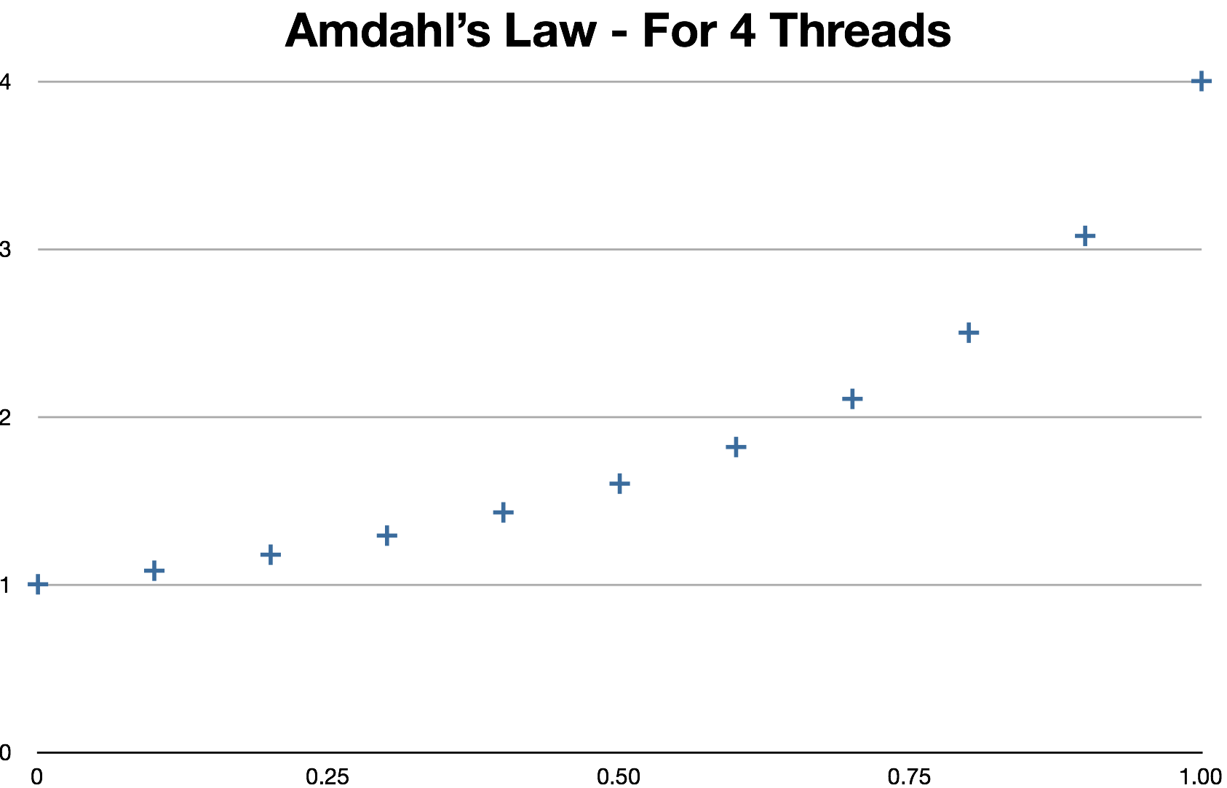
Speedup
Fraction of Code Parallelizable

Slide 42
Porting Code
You want to make sure you get the same answer!
  Preserve an initial copy of the code with test cases (input and output)
  Any changes you make, should produce the same output for the same input. (modulo ordering of operations)
You want it to be faster.
  time your runs
You want it to be WAAAAAY faster
  find a good profiler on your system, locate the hot spots and focus there.

Slide 43
OMP Directives
These are commands/suggestions to the compiler that may cause the compiler to generate some code or take some action.
  #pragma omp <keywords> <options>
If the compiler does not recognize a #pragma, it treats it like a comment - i.e., it silently IGNORES it.
  This is a problem - e.g., #pragma OMP, #pragma openmp, #pragma opm are all misspellings, and are simply ignored
  USE -Wall option of gcc to get warning about this. It is not an error - just a warning.
Programming tip
  If your compiler is handling OMP, it defines the macro _OPENMP to be the integer yyyymm. In your parallel programs, make sure it is defined!

Slide 44
Dependent vs Independent Iterations
for (int i = 0; i < n; i++) {
printf(“%d\n”,i);
}
Order dependent
for (int i = 1; i < n; i++) {
x[i] = x[i-1] + v[i]*dt;
v[i] = v[i-1] + g*dt/2;
}
Data Dependent
for (int i = 0; i < n; i++) {
// map!
y[i] = f(x[i]);
}
Independent (maybe!!!)

Slide 45
Sometimes you can easily convert
for (int i = 0; i < n; i++) {
double res;
res = lotsOfIndependentWork(i); // costly
dependentWork(res); // quick
}
double temp = malloc(n*sizeof(double));
for (int i = 0; i < n; i++) {
temp[i] =lotsOfIndependentWork(i); // costly
}
for (int i = 0; i < n; i++) {
dependentWork(temp[i]); // quick
}

Slide 46
So - how to get control of loops?
#pragma omp parallel for
  This also starts “n” threads (independent of the size of the for loop.
  Each thread is given a subset of the indices to run over
  At the end of the for loop is a barrier where the threads wait.
In OpenMP-speak, this is called “work sharing”, that is the work of the loop is shared among the threads.
Note - “#pragma omp parallel for” is short for
#pragma omp parallel
{
#pragma omp for
for (...) {
}
}

Slide 47
Simple Loop Parallelization
Parallel for/do directives
/* serial code */
#pragma omp parallel for
for(i = 0; i < N; i++)
!compute stuff

Slide 48

The Basic OMP for pragma
// serial code
#pragma omp parallel for
for (...) { // very standard for loop
/// time consuming computation
}
// serial code
Caveats
No breaks
No long jumps
No changing loop index/bounds inside the loop

Slide 49
Mapping Code Example
Take a vector of real numbers and map them to exp(x^2) using omp parallel for/do directive.
[x0, x1, ... xN-1]
to
[exp(x0²), exp(x1²), ..., exp(xN-1²)]
Perform this mapping 1000 times (to get a reasonable execution time). Use made up values for vector x, N=1,000,000 and print the sum of the mapping on the screen. Write a serial (or use my serial version) and parallel version and compare. Time your runs and make sure the answers agree!

Slide 50
Serial Version (1 of 2)
#include <stdio.h>
#include <stdlib.h>
#include <math.h>
int main()
{
const int N = 1000000;
float sum = 0.0f;
float *x, *z; // range and domain
x = (float*) malloc(N*sizeof(float));
z = (float*) malloc(N*sizeof(float));
int i;
/* populate x */
for(i = 0; i < N; i++)
x[i] = (i+1)*.000001;

Slide 51
Serial Version (2 of 2)
/* map code here */
for(i = 0; i < N; i++) {
z[i] = exp(x[i]*x[i]);
}
/* compute the sum */
for(i = 0; i < N; i++) {
sum += z[i];
}
printf("%f\n", sum);
return 0;
}

Slide 52
Simple Loop Parallelization MAPPING in C
#pragma omp parallel for
for(i = 0; i < N; i++)
x[i] = (i+1)*.000001;
/* map code here */
#pragma omp parallel for
for(i = 0; i < N; i++) {
z[i] = exp(x[i]*x[i]);
}
NOTE - we cannot parallelize the summation loop the same way! Try it! Why??? We will come back to this shortly.

Slide 53
Simple Loop Parallelization (saxpy)
Single Precision a*x+y or saxpy
z(i) = a*x(i) + y(i), (for i=1, n)
This loop has no dependences. The result of one loop iteration does not depend on the result of any other iteration. Iterations may be run simultaneously.
Practice your newly learned skill. Write a code that implements SAXPY in serial and then parallel using the parallel for/do directive. Use made up values to populate your vectors with a=.5 and N=1000. Sum over the vector z and print the final sum on the screen. Make sure that you are running OpenMP and make sure the answers match the serial version.

Slide 54
Simple Loop Parallelization (saxpy) in C
#include <stdio.h>
#include <omp.h>
int main()
{
const int N = 1000;
const float a = .5f;
float sum = 0.0f;
float z[N], x[N], y[N];
int i;
for(i = 0; i < N; i++)
{
x[i] = (i+1)*.15;
y[i] = (i+1)*.1;
}
#pragma omp parallel for
for(i = 0; i < N; i++)
{
z[i] = a*x[i] + y[i];
}
for(i = 0; i < N; i++)
{
sum += z[i];
}
printf("%f\n", sum);
return 0;
}

Slide 55
Back to the summation - Reduction
Using a loop to find the sum, product, max, min, ... most any associative operation is so common that there is a special syntax for the parallel for pragma
  #pragma omp parallel for reduction(op:list)
    will generate code after the loop to combine the values appearing in list with the given operator for the various loops.
/* compute the sum */
#pragma omp parallel for reduction(+:sum)
for(i = 0; i < N; i++) {
sum += z[i];
}
printf("%f\n", sum);

Slide 56
Quick Exercise
Modify your best parallel version of the mapping code to compute the sum of the values using reduction.
Time the serial, non-reduction and reduction version. Pleased?

Slide 57
Lets talk about Data
In modern C and C++, one can declare variables inside a block ({...}). (Old fashioned C, like Fortran required all data to be declared before any executable per function).
When a thread is running through the code in the block, it creates a local/private copy of that data that is NOT seen nor accessible by any other thread.
However, any data defined outside of the block is visible (hence shared) by all of the threads

Slide 58
How to modify the default behavior?
omp parallel pragmas have optional clauses
  private(list) - each thread executing the block will have a private copy of each variable in the list. (Note, parallel for loop indices are always private).
  shared(list) - each thread executing the block will use a single shared copy of each variable in the list.
  default(none) - does not use any default rules. Every variable should be in a private or shared list.
Two schools of thought here
  Just use the default rules
  Never use the default rules and always list the variables
My school of thought - always err on the side of clarity

Slide 59
Shared Data - the Big Problem
If two threads share data, and the data is always read, there is no problem. (And if this appeals to you, start studying languages with immutable data - e.g., Lisp, Clojure, Scala, F#, etc.)
However, when threads share data that they modify, the big question is who modified it last, and do each of the threads (remember the diagram with cache memories) agree on the value in any variable at a point in time?

Slide 60
Shared Data - The Big Advantage
Threads can communicate only if they have shared data - communication is a good thing!
This can be safely done if access to shared data is controlled so that only one thread at a time can modify the data. This is the purpose behind the “critical” directive.
Also threads can cooperate by waiting for one another to complete a task. This has been handled so far by an implicit “barrier”, but we can also use explicit barriers.

Slide 61
Synchronization in Simple Loop
int i;
#pragma omp parallel for
for(i = 0; i < N; i++)
{
z[i] = exp(x[i]*x[i]);
}
/* omp implied barrier
for(i = 0; i < N; i++)
{
Sum += z[i];
}
Sum depends on all z values having completed writing at the end of the parallel loop.
OpenMP has an implied barrier call at the end of the parallel for directive.
At the end of the first loop, the parent thread waits for all child threads to complete. Parent thread resumes serial execution after the implied barrier.

Slide 62
Shared and Private Clauses
Directives may have clauses to define data scope of variables.
Shared scope clause specifies that the named variables are shared by all threads in the parallel construct. Variables are shared by default.
Private scope clause specifies that the named variables are private to each thread in the parallel construct. Private variables are undefined upon entry and exit from parallel construct.
#pragma omp parallel private (private_sum)
{
private_sum = 0.0;
#pragma omp for
for(i = 0; i < N; i++)
{
private_sum += z[i];
}
}
In example above, private_sum is a private variable and z is shared.

Slide 63
Shared and Private Clauses cont.
and the Critical Directive
float sum = 0.0;
#pragma omp parallel private (private_sum) shared (sum)
{
private_sum = 0.0;
#pragma omp for
for(i = 0; i < N; i++)
{
private_sum += z[i];
}
#pragma critical
{
sum = sum + private_sum;
}
}
Parallel Reduction example.
critical directive restricts execution of block to one thread at a time.

Slide 64
Firstprivate and Lastprivate Clauses
float private_sum = 0.0;
#pragma omp parallel for firstprivate (private_sum) lastprivate (private_sum)
for(i = 0; i < N; i++)
{
private_sum += z[i];
}
firstprivate clause initializes the private variable with the value of the master thread's copy upon entry.
lastprivate clause saves the last iteration value of the variable to the master thread's copy upon exit.

Slide 65
OpenMP Runtime Library
omp_get_num_threads returns the number of threads executing in the parallel region.
omp_get_thread_num returns the thread ID of calling thread. Master thread has ID=0.
omp_set_num_threads(int) sets the number of threads to use. Must be called from a serial portion of the code.
omp_get_max_threads returns the maximum number of threads available to parallel regions.

Slide 66
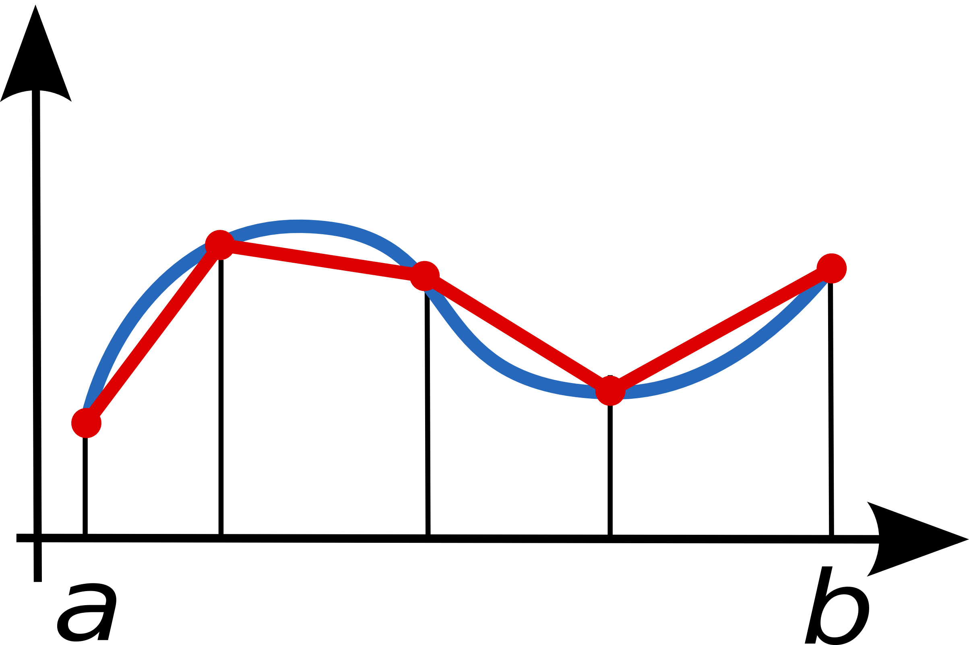
Trapezoid Rule
I = h*[f(x0)/2 + f(xn)/2 + f(x1) + … f(xn-1)]
Exercise - implement a parallel version of this using either a critical construct or a reduction - whichever you feel less comfortable with!

Slide 67
Trapezoid Rule Serial Code
#include <stdio.h>
#include <math.h>
double f(double x)
{
return exp(x*x);
}
int main()
{
double integral; /*definite integral*/
const double a=0.0; /*left end point*/
const double b=1.0; /*right end point*/
const int N=100000; /*subdivisions*/
double h; /*base width of subdivision*/
double x;
int i;
h = (b-a)/N;
integral = (f(a)+f(b))/2.0;
x = a;
for(i = 1; i <= N-1; i++)
{
x = x+h;
integral = integral + f(x);
}
integral = integral*h;
printf("%s%d%s%f\n", "WITH N=", N,
" TRAPEZOIDS, INTEGRAL=",
integral);
return 0;
}

Slide 68
Trapezoid Rule Parallel Code in C
#include <stdio.h>
#include <math.h>
#include <omp.h> /*openmp api*/
double f(double x)
{
return exp(x*x);
}
int main()
{
double integral; /*definite integral result*/
const double a=0.0; /*left end point*/
const double b=1.0; /*right end point*/
const int N=100000; /*number of subdivisions*/
double h; /*base width of subdivision*/
h = (b-a)/N;
integral = 0.0;

Slide 69
Trapezoid Rule Parallel Code in C
integral = (integral+(f(a)+f(b))/2.0)*h;
printf("%s%d%s%f\n", "WITH N=", N, " TRAPEZOIDS, INTEGRAL=", integral);

Slide 70
Trapezoid Rule Parallel Code in C
Using Reduction Clause
#pragma omp parallel reduction(+:integral)
{
}
printf("%s%d%s%f\n", "WITH N=", N, " TRAPEZOIDS, INTEGRAL=", integral);

Slide 71

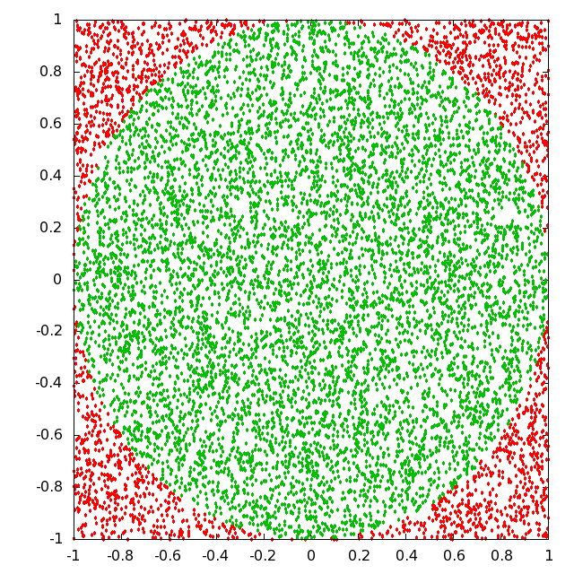
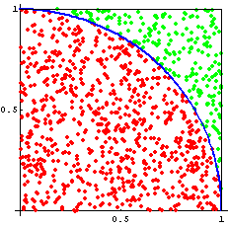
Monte Carlo to Calculate Pi
If we randomly assign points inside the unit square and take the ratio of points that fall inside the circle to the total number of points, we can calculate with the following formula:

Slide 72
We have a problem though...
The pseudo random number generator is NOT thread safe - the function has state - namely the last number generated (or the last “seed”).
So, we will write our own - starting with another non-thread safe version

Slide 73
Random Number Generator
#include <stdio.h>
unsigned int seed = 1; /* random number seed */
const unsigned int rand_max = 32768;
double rannum()
{
unsigned int rv;
seed = seed * 1103515245 + 12345;
rv = ((unsigned)(seed/65536) % rand_max);
return (double)rv/rand_max;
}
int main()
{
const int N = 10;
int i;
for(i = 0; i < N; i++)
{
printf("%g\n",rannum());
}
return;
}
Random number between 0 and 1
*seed must never be initialized to zero

Slide 74
Threadprivate Directive
The threadprivate directive identifies a global variable as being private to each thread. In essence, it's similar to the private clause except it applies to the entire program and not just a parallel region.
It gives us a way to declare global or static data to be private to every thread

Slide 75
Threadprivate Directive cont.
#include <stdio.h>
#include <omp.h>
unsigned int seed; /* random seed */
const unsigned int rand_max = 32768;
double rannum()
{
#pragma omp threadprivate(seed)
unsigned int rv;
seed = seed * 1103515245 + 12345;
rv = ((unsigned)(seed/65536) % rand_max);
return (double)rv/rand_max;
}

Slide 76
Threadprivate Directive cont.
#pragma omp for
for(i = 0; i < N; i++)
{
printf("%d\t%g\n",
omp_get_thread_num(),
rannum());
}
}
return;
}
int main()
{
const int N = 10; /*# of random numbers*/
int i;
#pragma omp threadprivate(seed)
#pragma omp parallel
{
seed = omp_get_thread_num()+1;

Slide 77
Serial Version 1/2
/* Monte Carlo simulation of pi*/
#include <stdio.h>
unsigned int seed = 1; /* random number seed */
const unsigned int rand_max = 32768;
double rannum()
{
unsigned int rv;
seed = seed * 1103515245 + 12345;
rv = ((unsigned)(seed/65536) % rand_max);
return (double)rv/rand_max;
}

Slide 78
Serial Version 2/2
int main()
{
const int N = 1000000000; /* number of random numbers */
const double r = 1.0; /* radius of unit circle */
double x, y; /* function inputs */
double sum = 0.0;
double Q = 0.0;
for(int i = 0; i < N; i++)
{
x = rannum();
y = rannum();
if((x*x + y*y) < r) sum = sum+1.0;
}
Q = 4.0*sum*1.0/N;
printf("%.9g\n", Q);

Slide 79
Monte Carlo - OpenMP version - 1/3
/* Monte Carlo simulation of pi*/
#include <stdio.h>
#include <omp.h>
unsigned int seed = 1; /* random number seed */
const unsigned int rand_max = 32768;
double rannum()
{
#pragma omp threadprivate(seed)
unsigned int rv;
seed = seed * 1103515245 + 12345;
rv = ((unsigned)(seed/65536) % rand_max);
return (double)rv/rand_max;
}

Slide 80
Monte Carlo - OpenMP version - 2/3
int main()
{
const int N = 1000000000; /* # of random numbers */
const double r = 1.0; /* radius of unit circle */
int i;
double x, y; /* function inputs */
double sum = 0.0;
double Q = 0.0;

Slide 81
Monte Carlo - OpenMP version - 3/3
printf("%.9g\n", Q);

Slide 82
Data Dependencies, Recurrences
for(i = 0; i < N-1; i++)
{
y[i] = y[i+1] – y[i];
}
For N=4 and 2 Threads …
Iteration Thread 1 Thread2
0 y[0]=y[1]-y[0] y[2]=y[3]-y[2]
1 y[1]=y[2]-y[1] no-op
In Iteration 1, Thread 1 reads y[2] which has already been written by Thread 2.
Add to this that we don’t really know the order in which instructions execute... We have a problem!

Slide 83
Final Project - getting down and dirty
We are given an array of double precision numbers - for our purposes, they represent the value of a function at equally placed points along the domain. The points are a distance “h” apart.
The goal is to compute the derivative without using 2x the memory!!!
In general (y[i+1]-y[i])/h is what we need to compute and to replace y[i] with that value.
A parallel uncontrolled group of threads won’t work, even a parallel for worksharing won’t help. You are going to have to work with individual threads.
Hint - draw a picture!!!

Slide 84
Forward Difference - Serial 1/2
/* Recurrence, finite differences */
#include <stdio.h>
#include <math.h>
int main()
{
const int N = 10000; // # of intervals
const double h = 0.001; // size of interval
double y[N]; // value of function
const int prune = 1; // print every...
for(int i = 0; i < N; i++) y[i] = sin(i*h);
for(int i = 0; i < N; i++){
if(i%prune == 0) printf("%g\t%g\n", i*h, y[i]);
}

Slide 85
Forward Difference - Serial 2/2
for(int i = 0; i < N - 1; i++) {
y[i] = (y[i+1]-y[i])/h; // forward difference
}
y[N-1] = y[N-2]; // kind of kluge
printf("\n\n");
for(int i = 0; i < N; i++) {
if(i%prune == 0)
  printf("%g\t%g\n", i*h, y[i]);
}
return 0;
}

Slide 86
Forward Difference - Parallel 1/5
/* Recurrence, finite differences */
#include <stdio.h>
#include <math.h>
#include <omp.h>
int main()
{
const int N = 10000; // # of points in domain
const double h = 0.001; // distance between points
double y[N]; // value of fn & later derivative
const int prune = 1; // print every...
// load up the function values

Slide 87
Forward Difference - Parallel 2/5

Slide 88
Forward Difference - Parallel 3/5

Slide 89
Forward Difference - Parallel 4/5

Slide 90
Forward Difference - Parallel 5/5
return 0;
}

Slide 91
Let’s wrap it up
Parallel programming IS mainstream programming. Every computer from phones to supercomputers has the capability.
  Lowest level - get a good compiler
  Next - OpenMP (1-5x speedup)
  Next - MPI (O(N) speedup where N = # of computers in cluster) - BUT - you can still use OpenMP on all of the distributed tasks
  Next - Intel/Phi - a strange mixup of the above 2
  Next - CUDA/OPEN-CL (10-1000 times speedup - but lots of programming required) And still you can make use of OpenMP and MPI
  But also - learn some parallel algorithms - program with threads at every opportunity - it is the future after all!

