Slide 1
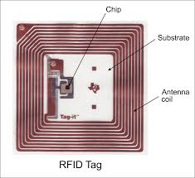
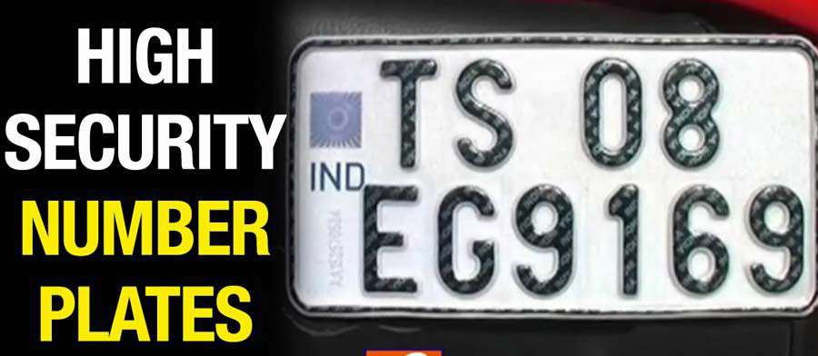
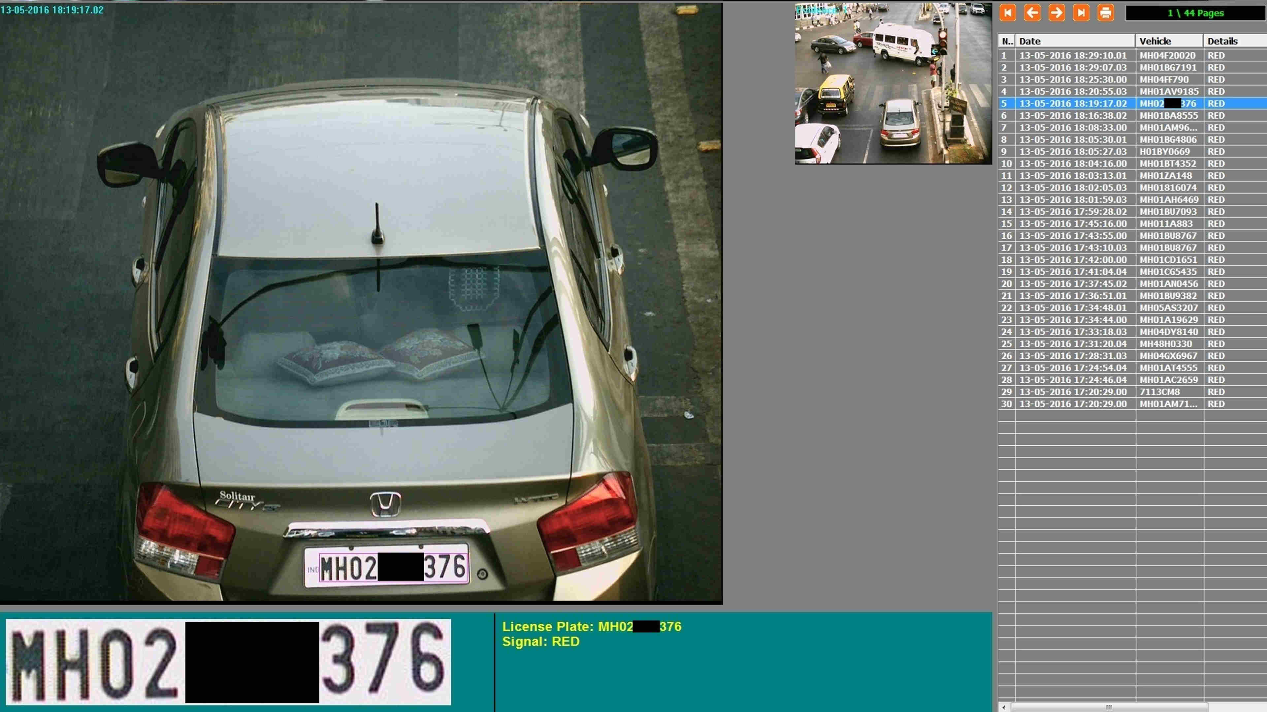
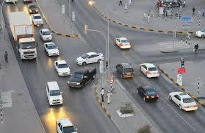
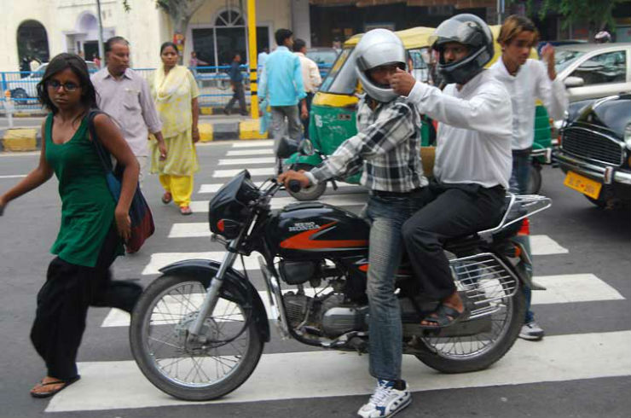

One Solution For
All These Problems
Present Day Traffic Problems :
2. Vehicles Parked on
Zebra Crossing
1. Signal Jumping
3.Morphing of Number Plates
Organization Name : MATLAB & SIMULINK
Problem Statement: Smart Traffic Monitoring And Controlling
Team Name : Delta
Team Leader : Yashwanth Kamatam
College Code:D4
Presently we are raising penalties through pictures captured by Police-men and CCTV photages
Vehicles parked on
Zebra-Crossing
Troubling Pedestrians

Slide 2
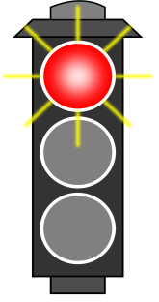
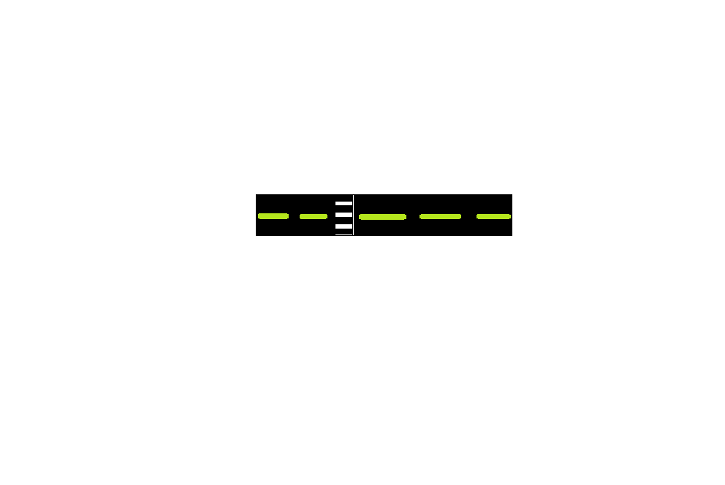
Signal Jumping
DETAILS
All the details of the intruder are instantly transferred to the traffic data base and penalty is raised instantly
SERVER(DB)
MESSAGE

Slide 3
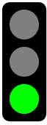

Vehicle tracking
All the travelling history of
Vehicles are stored in the traffic data base.
So now if your vehicle is lost ,the present location of the vehicle can be identified easily with vehicle number instantly.
Server

Slide 4
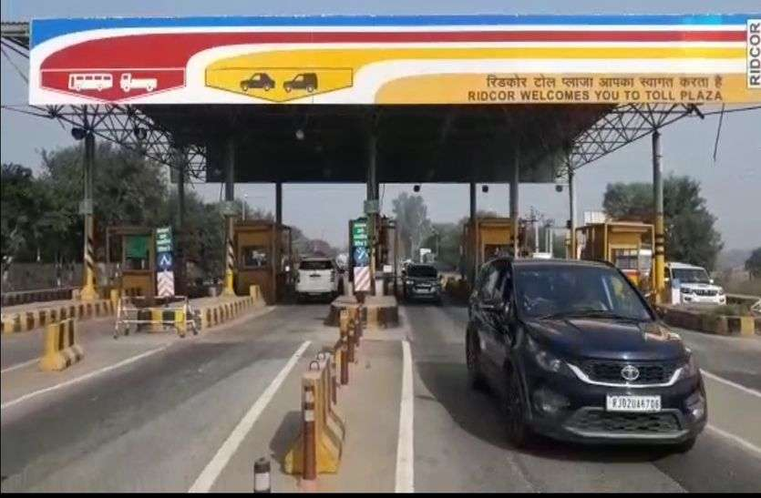
ADVANTAGES
1.Quickest Penalties for Signal Jumping.
2.Vehicle In & Out Data base can be maintained at priority places.
Thanking You
-Team Delta
3.Vehicle Tracking.
4.Zebra Crossing Is Free For Pedestrians.
5. Works 24/7

