Slide 1
TrafficTelligence-Advanced-Traffic-Volume-Estimation-With-Machine-Learning

Slide 2
Introduction to TrafficTelligence and Traffic Volume Estimation
TrafficTelligence is an advanced system designed to accurately estimate traffic volumes using machine learning techniques.
Accurate traffic volume data is essential for transportation planning, congestion management, and infrastructure development.
This presentation explores how machine learning enhances traffic volume estimation beyond traditional methods.
1
Notes:
Image source: https://www.slidemake.com

Slide 3
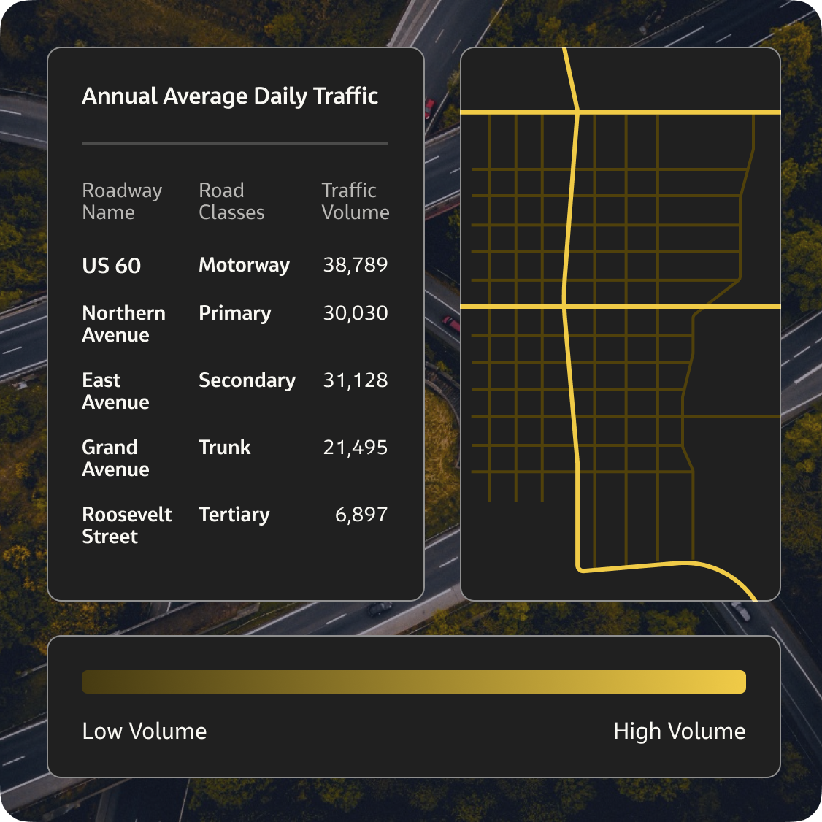
Importance of Traffic Volume Data
Precise traffic volume data helps optimize traffic flow and reduce congestion in urban areas.
It supports decision-making processes for policymakers and transportation agencies.
Improved data accuracy leads to better resource allocation and infrastructure investments.
2
Notes:
Image source: https://www.streetlightdata.com

Slide 4
Traditional Traffic Estimation Methods
Conventional methods include manual counts, inductive loop detectors, and camera-based systems.
These methods often face limitations such as high costs, limited coverage, and data inaccuracies.
They may also require extensive human intervention and maintenance.
3
Notes:
Image source: https://www.trafficcountsplus.com

Slide 5
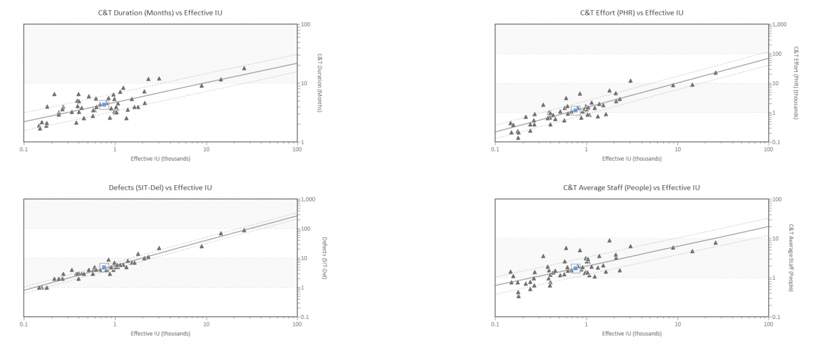
The Role of Machine Learning in Traffic Estimation
Machine learning models can analyze large datasets to identify complex traffic patterns.
They enable real-time traffic volume predictions with higher accuracy and adaptability.
These models can incorporate diverse data sources, such as GPS, weather, and social media.
4
Notes:
Image source: https://www.qsm.com

Slide 6
Data Sources Used in TrafficTelligence
The system integrates data from sensors, satellite imagery, traffic cameras, and mobile devices.
Historical traffic data helps train models to recognize typical flow patterns.
External factors like weather conditions and special events are also considered for better predictions.
5
Notes:
Image source: https://www.researchgate.net

Slide 7

Machine Learning Techniques Employed
Techniques such as Random Forests, Support Vector Machines, and Neural Networks are utilized.
These algorithms learn from data to predict traffic volumes under various conditions.
Model training involves feature selection, data preprocessing, and validation to improve accuracy.
6
Notes:
Image source: https://thumbs.dreamstime.com

Slide 8
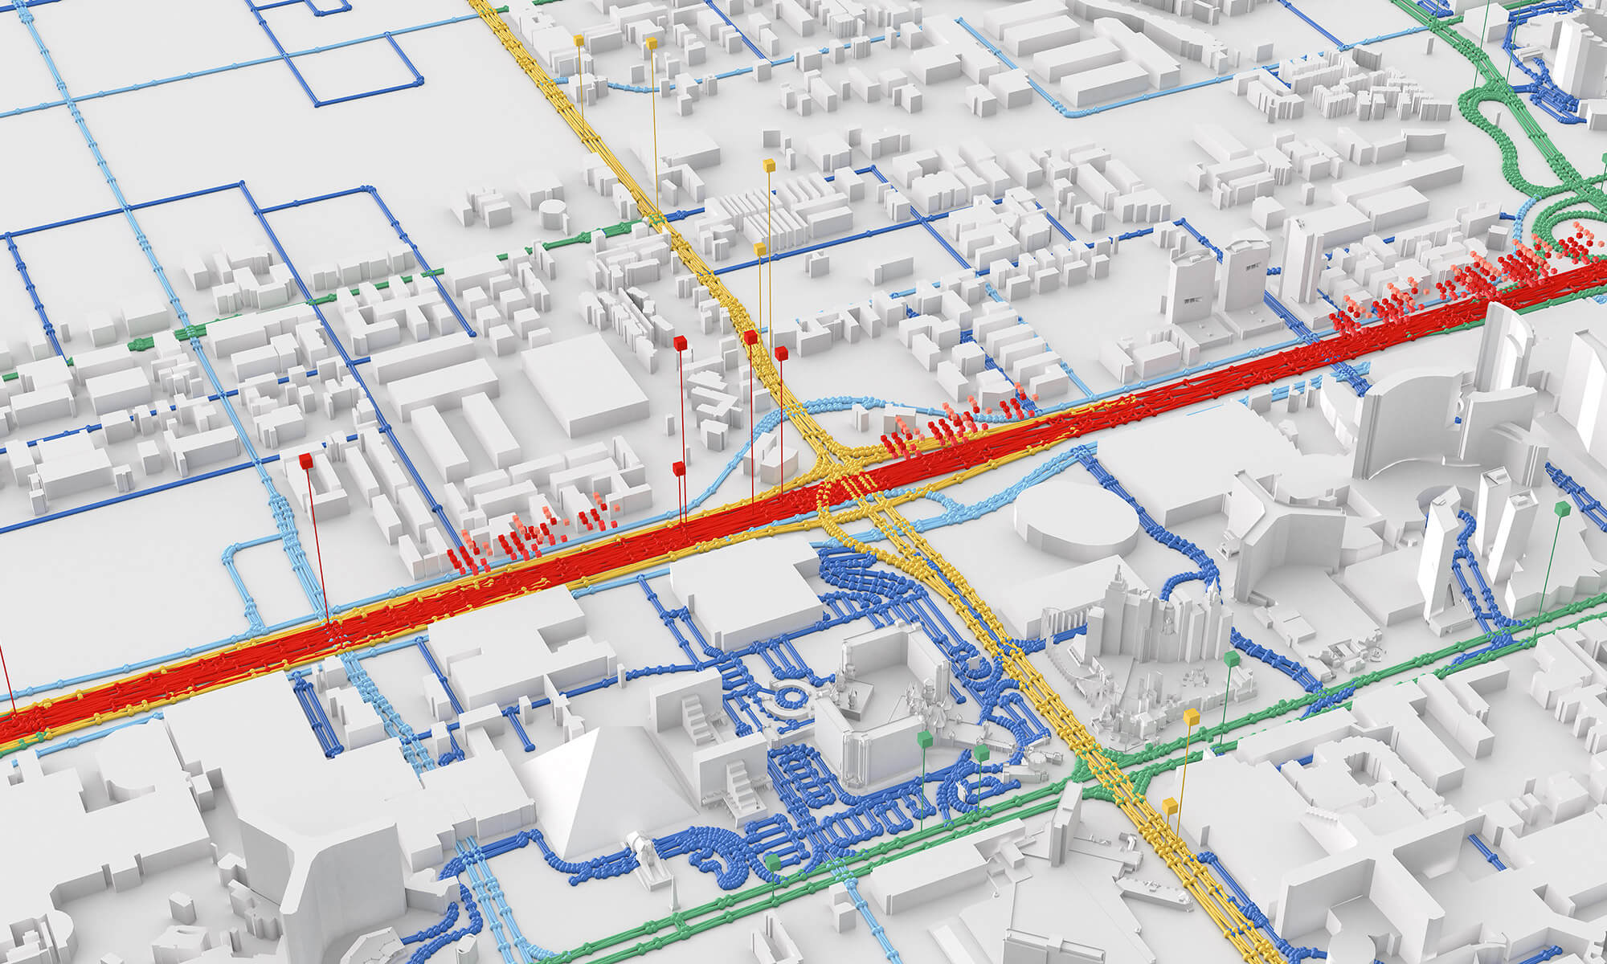
Advantages of TrafficTelligence System
The system offers real-time traffic volume estimates with high precision.
It reduces reliance on costly infrastructure and manual counting methods.
Adaptive learning allows the system to improve over time as more data becomes available.
7
Notes:
Image source: https://webassets.tomtom.com

Slide 9
Case Studies and Results
Deployment in urban areas demonstrated a significant improvement in traffic prediction accuracy.
The system helped reduce congestion by enabling dynamic traffic management strategies.
Results indicate increased efficiency and cost savings for transportation agencies.
8
Notes:
Image source: https://www.slidemake.com

Slide 10
Future Directions and Challenges
Integrating emerging data sources like connected vehicles and IoT devices is a future goal.
Ensuring data privacy and security remains a critical concern.
Ongoing research focuses on enhancing model robustness and scalability for larger networks.
9
Notes:
Image source: https://www.slidemake.com

