Slide 1
Introduction
The data are obtained from yahoo finance has a number of missing values. Those missing values were filled using mean method. After filling the missing values, machine learning methodology such as K-Nearest Neighbor (KNN), SVM and Decision Tree Classifier has been compared to check accuracy of the result.
Find the recommendation of the particular stock with the use of highest accuracy model.

Slide 2
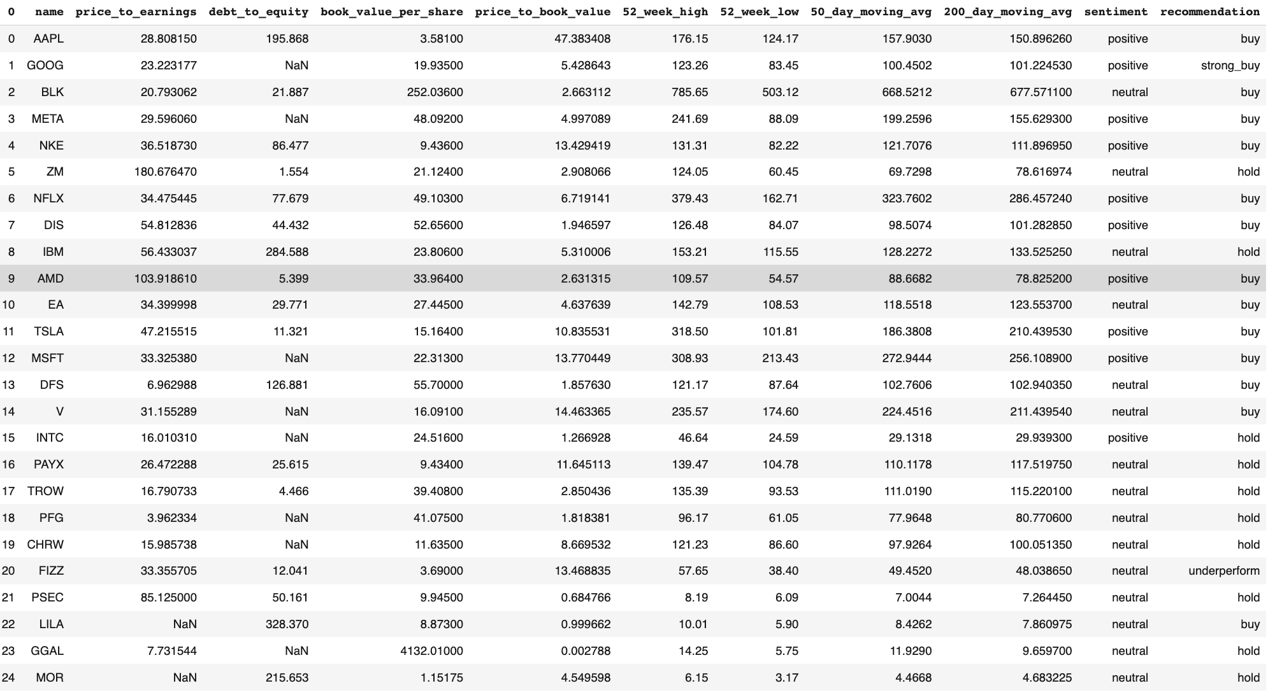
Data Set
We have used dataset with 10 attributes as mentioned in figure..
We used KNN to check the sentiment of the stock price
We describe the internal correlation between all attributes using visualization and mathematically.

Slide 3
Dataset Before Pre-Processing

Slide 4
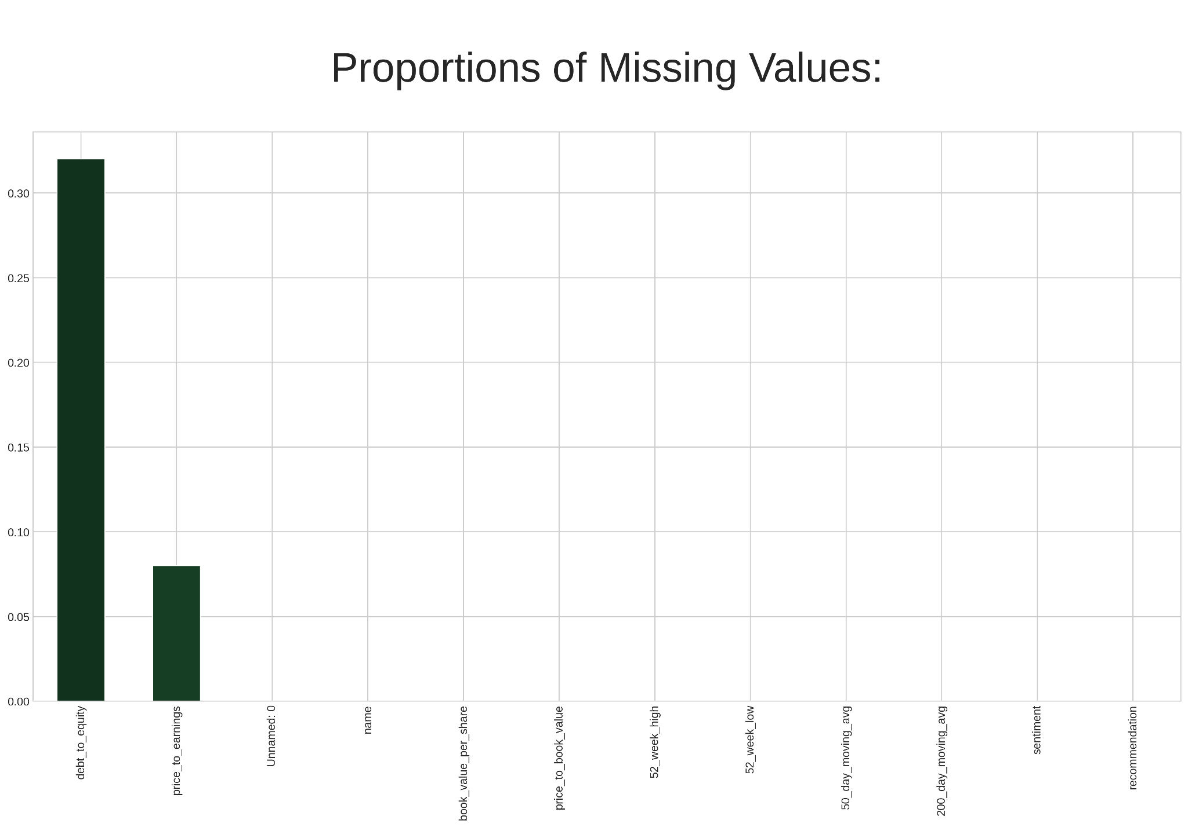
Pre-Processing Steps
First, We checked all Data types If any object, then rectify that field with appropriate method.
Check for null values in data set using df.isnull().sum()
Find unique values and correct the data set. Then null value is imputed with median and mode.
Dropping unnecessary columns.

Slide 5
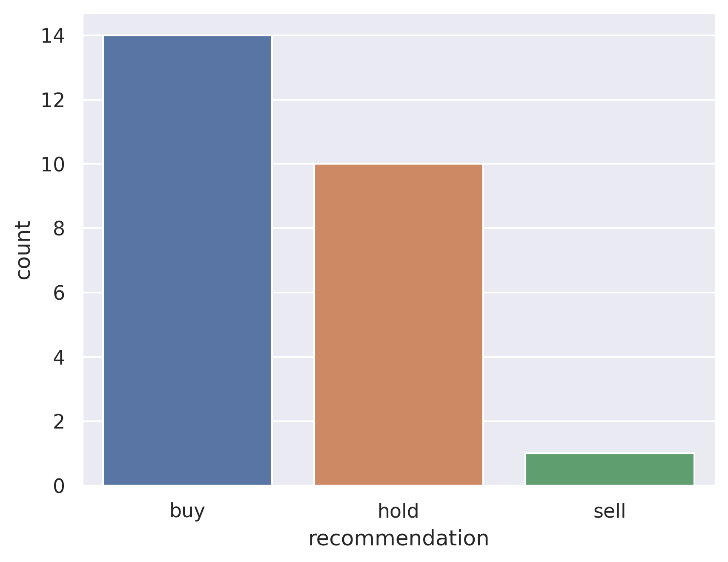
Count Plot of Buy / Hold / Sell

Slide 6
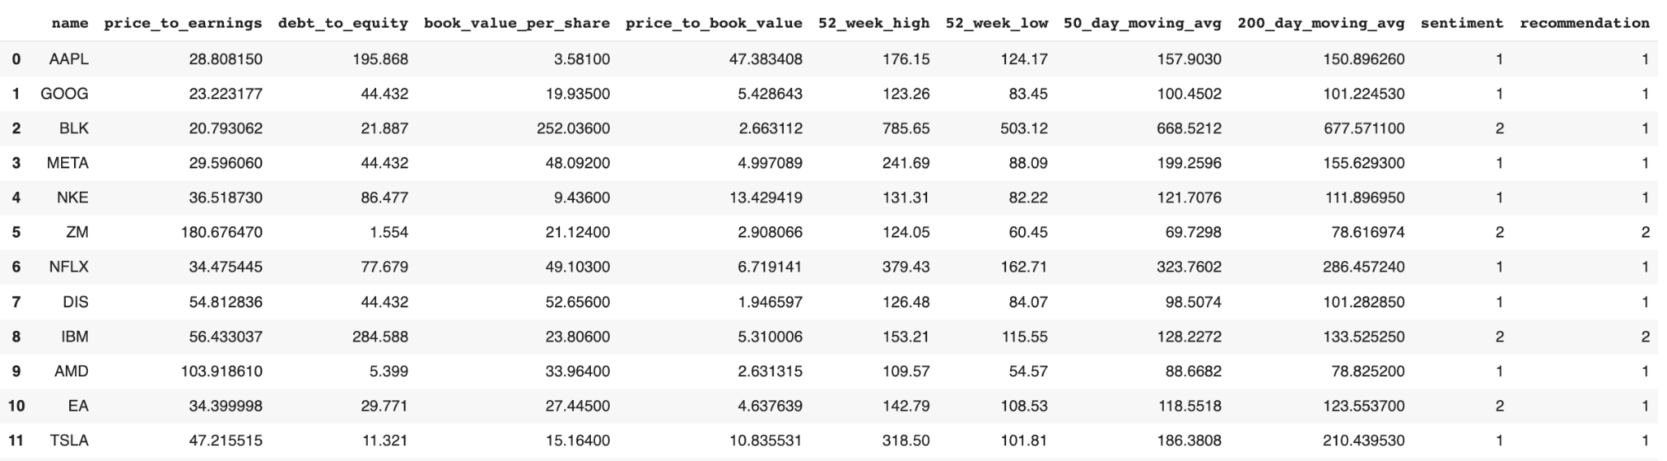
PROCESSED DATASET

Slide 7
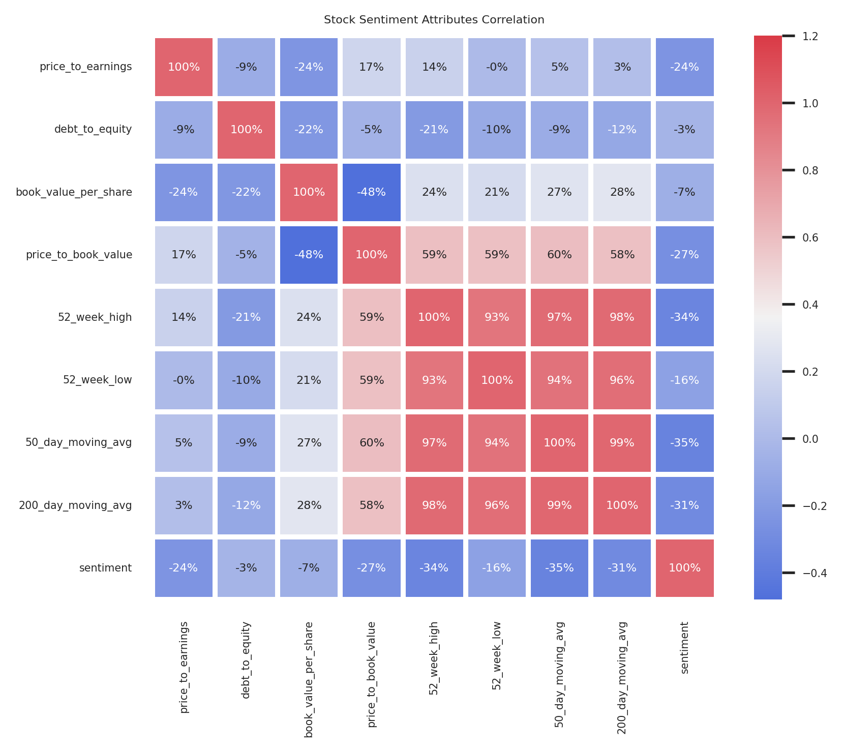
Attributes Correlation using Heatmap
Using Correlation matrix we created function to select highly correlated features.
After finding that, we can remove the field which is highly correlated with other attribute.

Slide 8
ENCODED DATASET

Slide 9
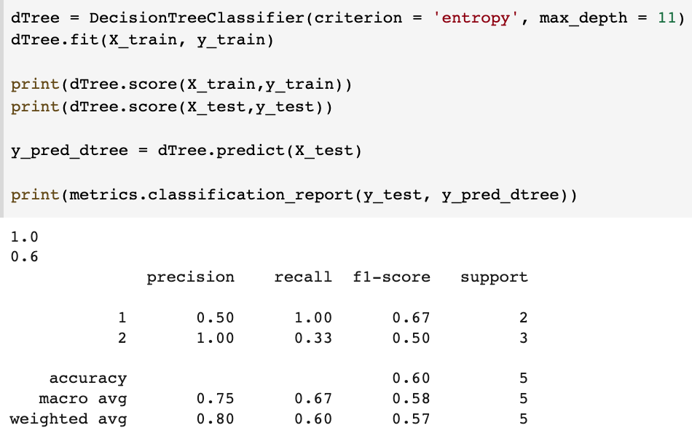
DECISION TREE CLASSIFIER

Slide 10
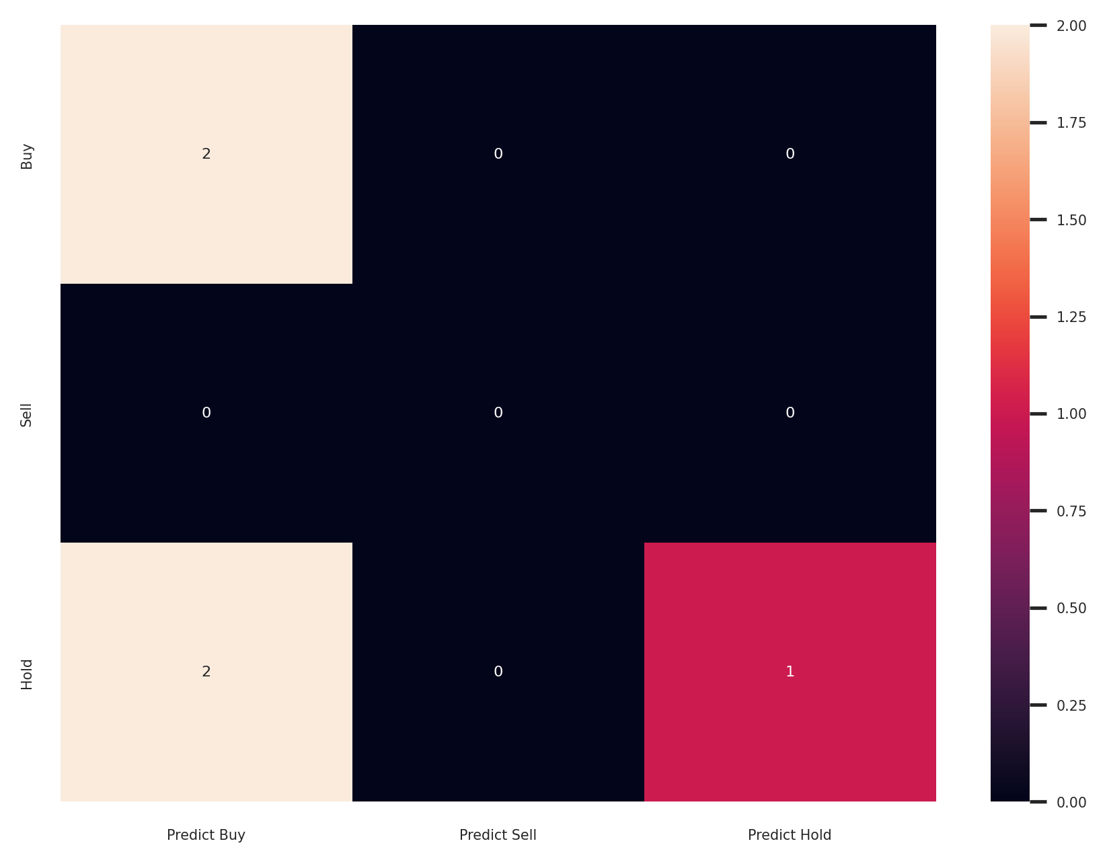
Confusion Matrix for Decision Tree Classifier

Slide 11
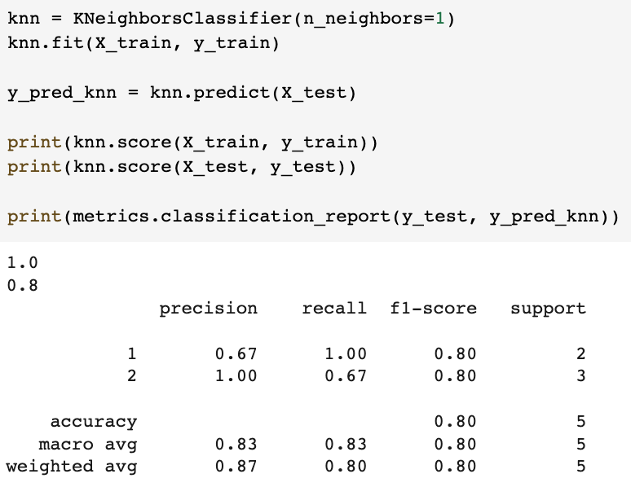
KNN KNEIGHBORSCLASSIFIER

Slide 12
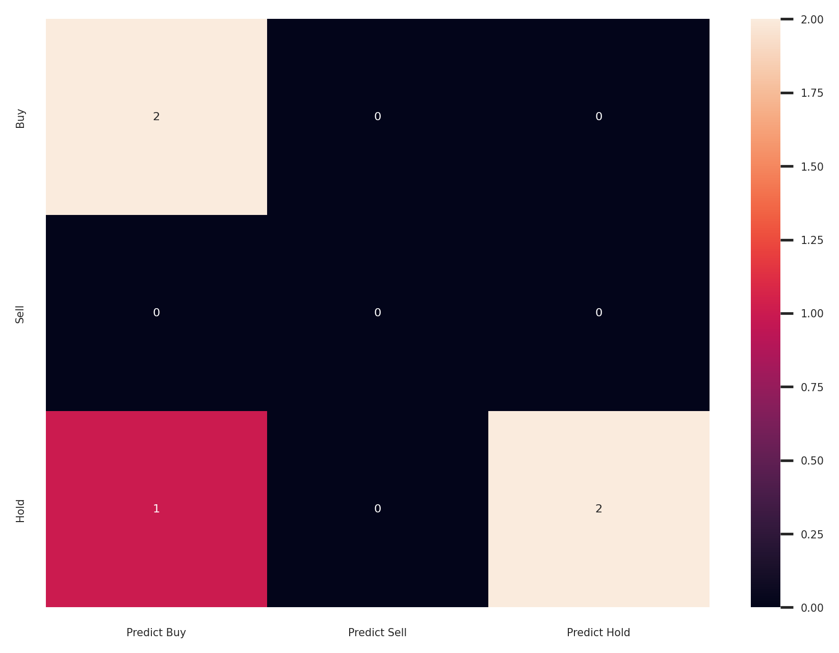
Confusion Matrix for KNN

Slide 13
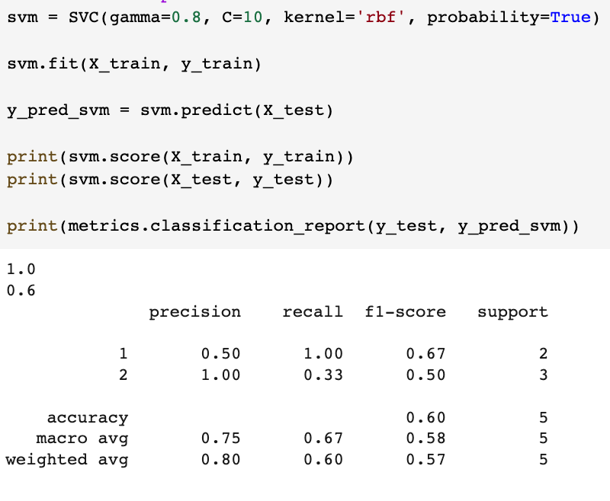
SVM

Slide 14

Confusion Matrix for SVM

Slide 15
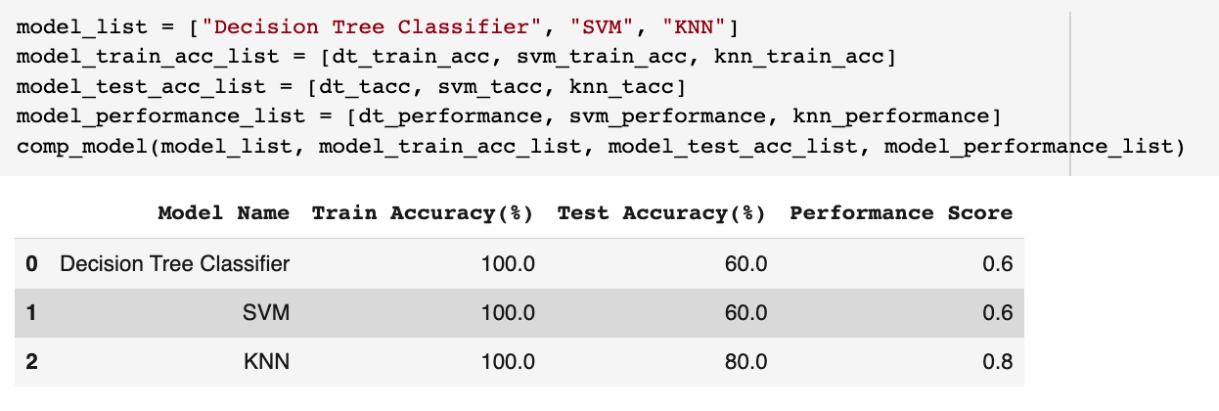
COMPARISON OF MODELS
KNN is giving highest accuracy

Slide 16
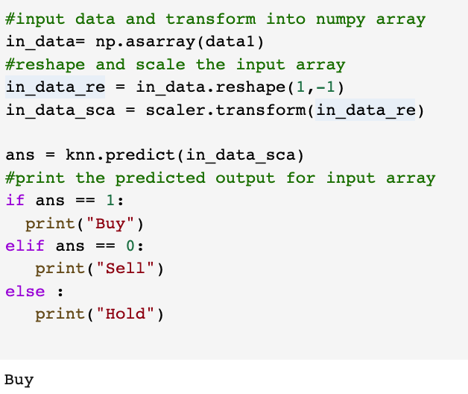
PREDICTION SYSTEM USING KNN

