Slide 1

FUTURE OF WORK CHALLENGES · AI/TECHNOLOGY TRACK
SkillAscend
Verify. Build. Learn. Connect. Get hired.
An AI-powered career path for people facing hardship: verify your skills, build your CV, close your skill gaps, learn, network with peers, and reach a stable job — private or government.
Verify’s skills
CV + skill gaps
Learn + peer network
Private & govt jobs
THE PROBLEM
Talent is everywhere. A path to stable work isn't.
1
Skills without proof
A mechanic, cook or tailor who learned by doing has no certificate or digital footprint, so employers can't verify what they can actually do.
~80%
2
No CV, no direction
of India's workforce works in the informal economy: largely undocumented, underemployed, and without a clear path to stable work.
Many have never written a CV, don't know which roles fit them, and can't see which missing skill is blocking the next job.
3
No guidance to stable work
Government exams are the most stable route, but eligibility rules, syllabi and deadlines are scattered and confusing.
4
No network to lean on
Referrals and mentors decide who gets hired, and people facing hardship rarely have anyone who can vouch for them or guide them.
02
Notes:
LIVE PITCH · ~30 sec. Open with the one-line promise: SkillAscend takes a person from unverified to employed. Name the five verbs on the tagline; the rest of the deck walks through them.
1

Slide 2
PUBLIC SERVICE CHALLENGES · AI/TECHNOLOGY TRACK
SkillAscend
Verify. Build. Learn. Connect. Get hired.
An AI-powered career path for people facing hardship: verify your skills, build your CV, close your skill gaps, learn, network with peers, and reach a stable job — private or government.
Verified skills
CV + skill gaps
Learn + peer network
Private & govt jobs
THE PROBLEM
Talent is everywhere. A path to stable work isn't.
1
Skills without proof
A mechanic, cook or tailor who learned by doing has no certificate or digital footprint, so employers can't verify what they can actually do.
~80%
2
No CV, no direction
of India's workforce works in the informal economy: largely undocumented, underemployed, and without a clear path to stable work.
Many have never written a CV, don't know which roles fit them, and can't see which missing skill is blocking the next job.
3
No guidance to stable work
Government exams are the most stable route, but eligibility rules, syllabi and deadlines are scattered and confusing.
4
No network to lean on
Referrals and mentors decide who gets hired, and people facing hardship rarely have anyone who can vouch for them or guide them.
02
Notes:
LIVE PITCH · ~60 sec. Four gaps, one theme: capable people can't prove skill, don't know their next step, can't navigate stable (government) routes, and have no network. Replace the ~80% framing figure with a sourced number before presenting.
2

Slide 3
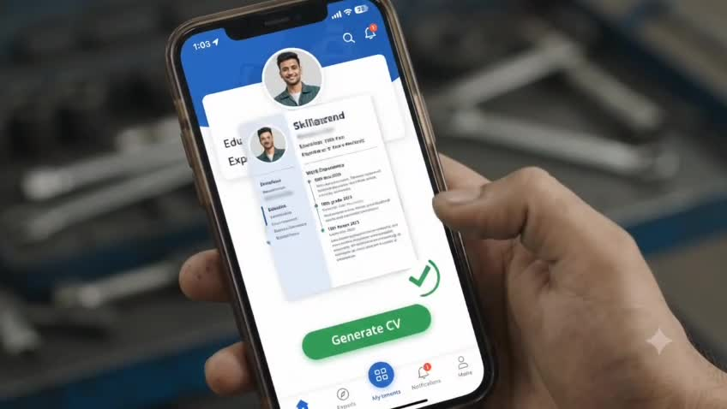
“I can fix almost any bike. But I have no certificate, no CV, and no idea what to do next to get a stable job.”
P
Pratik represents a huge, overlooked group: people with real, demonstrable skill and no digital way to prove it. SkillAscend is the CV Pratik never had to write, and the path that takes him to a stable job.
Pratik, 24
Self-taught two-wheeler mechanic
With SkillAscend (illustrative)
Today
✓ A verified skill profile from one 90-second voice note
Relies on a few regulars. No CV, no proof of skill, no idea which stable job or exam he's eligible for, and nobody to ask.
✓ A ready-made CV and the one skill gap holding him back
✓ A study plan for a government exam he's eligible for
✓ Peers and mentors who've made the same journey
04
Notes:
LIVE PITCH · ~60 sec. Make Pratik real. He is the persona you return to in the journey slide. Emphasise: real skill, no proof, no path, no network.
4

Slide 4
THE INSIGHT
This isn't a job-board problem.
It's a path problem.
Generic job & learning apps
SkillAscend
✕ Assume a CV and a network already exist
✓ Starts from a spoken description, not a CV
✕ Treat jobs, learning and exams as separate tools
✓ One path: verify → CV → gaps → learn → hired
✕ Can't verify skills learned informally
✓ Verifies skills with an AI micro-check
✕ Leave people to find peers on their own
✓ Connects peers and mentors on the same route
✕ Optimise for any job, not a stable one
✓ Aims for stable work, private or government
05
THE SOLUTION
Six steps, one path to a stable job
1
Verify
2
Build your CV
3
Find your gaps
A voice note plus a short AI micro-check confirm real skills. A light identity check keeps the peer network safe.
AI turns what you said and proved into a professional CV. No writing, no template hunting.
Your verified skills are compared with the roles you want, and what's missing is ranked by impact.
4
Learn
5
Connect
6
Get a stable job
Short, free, curated lessons aimed at your specific gaps, sequenced around your time.
Peer study groups and verified mentors who have walked the same route.
Private roles filtered for stability, plus government exams you're actually eligible for.
06
Notes:
LIVE PITCH · ~45 sec. The reframe: people don't lack ambition, they lack a connected path. Every existing tool solves one piece.
5

Slide 5
THE INSIGHT
This isn't a job-board problem.
It's a path problem.
Generic job & learning apps
SkillAscend
✕ Assume a CV and a network already exist
✓ Starts from a spoken description, not a CV
✕ Treat jobs, learning and exams as separate tools
✓ One path: verify → CV → gaps → learn → hired
✕ Can't verify skills learned informally
✓ Verifies skills with an AI micro-check
✕ Leave people to find peers on their own
✓ Connects peers and mentors on the same route
✕ Optimise for any job, not a stable one
✓ Aims for stable work, private or government
05
THE SOLUTION
Six steps, one path to a stable job
1
Verify
2
Build your CV
3
Find your gaps
A voice note plus a short AI micro-check confirm real skills. A light identity check keeps the peer network safe.
AI turns what you said and proved into a professional CV. No writing, no template hunting.
Your verified skills are compared with the roles you want, and what's missing is ranked by impact.
4
Learn
5
Connect
6
Get a stable job
Short, free, curated lessons aimed at your specific gaps, sequenced around your time.
Peer study groups and verified mentors who have walked the same route.
Private roles filtered for stability, plus government exams you're actually eligible for.
06
STEP 1 · DEEP DIVE
Verify: prove your skills, get a trust score
Why it matters
How the score is built
• Starts from a 30–90 second voice note. AI extracts skill tags, each with a confidence score.
AI verification task
40%
Completed-job feedback
40%
• A short AI-generated task per skill checks the claim. It's conversational, so it doesn't recreate the paperwork burden.
Recency of activity
20%
• A light identity check keeps peer connections safe. Skill verification is the real differentiator.
Sample verification task
“A scooter cranks but won't start. Walk me through your first three checks.”
• Framed as a confidence signal, never a certificate, and shareable by link or QR code.
07
Notes:
LIVE PITCH · ~60 sec. The whole product on one slide. Say the six steps out loud, then tell judges you'll go deep on the first five, then the government-exam route.
6

Slide 6
THE SOLUTION
Six steps, one path to a stable job
1
Verify
2
Build your CV
3
Find your gaps
A voice note plus a short AI micro-check confirm real skills. A light identity check keeps the peer network safe.
AI turns what you said and proved into a professional CV. No writing, no template hunting.
Your verified skills are compared with the roles you want, and what's missing is ranked by impact.
4
Learn
5
Connect
6
Get a stable job
Short, free, curated lessons aimed at your specific gaps, sequenced around your time.
Peer study groups and verified mentors who have walked the same route.
Private roles filtered for stability, plus government exams you're actually eligible for.
06
STEP 1 · DEEP DIVE
Verify: prove your skills, get a trust score
Why it matters
How the score is built
• Starts from a 30–90 second voice note. AI extracts skill tags, each with a confidence score.
AI verification task
40%
Completed-job feedback
40%
• A short AI-generated task per skill checks the claim. It's conversational, so it doesn't recreate the paperwork burden.
Recency of activity
20%
• A light identity check keeps peer connections safe. Skill verification is the real differentiator.
Sample verification task
“A scooter cranks but won't start. Walk me through your first three checks.”
• Framed as a confidence signal, never a certificate, and shareable by link or QR code.
07
STEPS 2–4 · DEEP DIVE
Build the CV, find the gap, learn the skill
1
CV builder
2
Gap finder
3
Learn
Turns the verified profile into a clean, professional CV, formatted for private roles or government applications.
Compares the verified profile with the target role and lists what's missing, ranked by impact.
Short, curated lessons aimed at exactly those gaps, sequenced around the time you have.
PRATIK · Two-wheeler technician
Target role: EV-scooter technician
Next: EV battery basics
8 yrs hands-on · clutch, brake, electricals
Missing: EV battery basics (high impact)
Three 20-minute lessons every day
Trust score 87 · verified
Missing: diagnostic tools (medium)
Progress feeds back into your CV
08
Notes:
LIVE PITCH · ~60 sec. Be upfront: this is a confidence signal, not a certificate. That honesty is what makes the next question (can it be gamed?) easier to answer.
7

Slide 7
STEP 1 · DEEP DIVE
Verify: prove your skills, get a trust score
Why it matters
How the score is built
• Starts from a 30–90 second voice note. AI extracts skill tags, each with a confidence score.
AI verification task
40%
Completed-job feedback
40%
• A short AI-generated task per skill checks the claim. It's conversational, so it doesn't recreate the paperwork burden.
Recency of activity
20%
• A light identity check keeps peer connections safe. Skill verification is the real differentiator.
Sample verification task
“A scooter cranks but won't start. Walk me through your first three checks.”
• Framed as a confidence signal, never a certificate, and shareable by link or QR code.
07
STEPS 2–4 · DEEP DIVE
Build the CV, find the gap, learn the skill
1
CV builder
2
Gap finder
3
Learn
Turns the verified profile into a clean, professional CV, formatted for private roles or government applications.
Compares the verified profile with the target role and lists what's missing, ranked by impact.
Short, curated lessons aimed at exactly those gaps, sequenced around the time you have.
PRATIK · Two-wheeler technician
Target role: EV-scooter technician
Next: EV battery basics
8 yrs hands-on · clutch, brake, electricals
Missing: EV battery basics (high impact)
Three 20-minute lessons every day
Trust score 87 · verified
Missing: diagnostic tools (medium)
Progress feeds back into your CV
08
STEP 5 · DEEP DIVE
Peer network: nobody walks the path alone
Why peer connection
What a member sees
• Groups form around a shared goal, such as the same exam or the same skill gap.
Peer study group
4 verified members preparing for the same exam
• Verified mentors who made the same journey give practical advice and referrals.
Mentor match
Someone who cleared it two years ago, verified
• Verification keeps it safe: only verified members can message, with reporting built in and no contact details shared by default.
Referral
A mentor vouches for you to a local employer
• Referrals and guidance decide who gets hired. This gives people without a network one.
Illustrative examples
09
Notes:
LIVE PITCH · ~60 sec. Show the chain: what he proved becomes his CV; the CV vs the target role reveals a gap; the gap drives the lessons. Mention that the examples are illustrative.
8

Slide 8
STEPS 2–4 · DEEP DIVE
Build the CV, find the gap, learn the skill
1
CV builder
2
Gap finder
3
Learn
Turns the verified profile into a clean, professional CV, formatted for private roles or government applications.
Compares the verified profile with the target role and lists what's missing, ranked by impact.
Short, curated lessons aimed at exactly those gaps, sequenced around the time you have.
PRATIK · Two-wheeler technician
Target role: EV-scooter technician
Next: EV battery basics
8 yrs hands-on · clutch, brake, electricals
Missing: EV battery basics (high impact)
Three 20-minute lessons every day
Trust score 87 · verified
Missing: diagnostic tools (medium)
Progress feeds back into your CV
08
STEP 5 · DEEP DIVE
Peer network: nobody walks the path alone
Why peer connection
What a member sees
• Groups form around a shared goal, such as the same exam or the same skill gap.
Peer study group
4 verified members preparing for the same exam
• Verified mentors who made the same journey give practical advice and referrals.
Mentor match
Someone who cleared it two years ago, verified
• Verification keeps it safe: only verified members can message, with reporting built in and no contact details shared by default.
Referral
A mentor vouches for you to a local employer
• Referrals and guidance decide who gets hired. This gives people without a network one.
Illustrative examples
09
STEP 6 · DEEP DIVE
Stable jobs: matched for stability, not just fit
How matching works
Our working definition of “stable”
• Private roles are ranked by skill match, distance, trust score and a stability filter.
✓ Fixed-term or permanent contract
✓ Employer verified by SkillAscend
• Local demand can post a need in plain language and be matched to nearby verified workers (reverse matching).
✓ Retained six months or more
✓ Government post
• Government routes appear alongside, based on eligibility. That's the next section.
Sample match
EV-scooter technician · fixed contract
• Success is measured by stable placements, not sign-ups.
Employer verified · 4.2 km away · matches 3 of Pratik's verified skills
10
Notes:
LIVE PITCH · ~45 sec. Say what P2P means concretely: study groups, mentors, referrals. Safety comes from verification. It's a later-phase feature, so say so.
9

Slide 9
STEP 5 · DEEP DIVE
Peer network: nobody walks the path alone
Why peer connection
What a member sees
• Groups form around a shared goal, such as the same exam or the same skill gap.
Peer study group
4 verified members preparing for the same exam
• Verified mentors who made the same journey give practical advice and referrals.
Mentor match
Someone who cleared it two years ago, verified
• Verification keeps it safe: only verified members can message, with reporting built in and no contact details shared by default.
Referral
A mentor vouches for you to a local employer
• Referrals and guidance decide who gets hired. This gives people without a network one.
Illustrative examples
09
STEP 6 · DEEP DIVE
Stable jobs: matched for stability, not just fit
How matching works
Our working definition of “stable”
• Private roles are ranked by skill match, distance, trust score and a stability filter.
✓ Fixed-term or permanent contract
✓ Employer verified by SkillAscend
• Local demand can post a need in plain language and be matched to nearby verified workers (reverse matching).
✓ Retained six months or more
✓ Government post
• Government routes appear alongside, based on eligibility. That's the next section.
Sample match
EV-scooter technician · fixed contract
• Success is measured by stable placements, not sign-ups.
Employer verified · 4.2 km away · matches 3 of Pratik's verified skills
10
GOVERNMENT JOB MODULE
Government exams: eligibility, study plan, apply
1
Check eligibility
2
Study smart
3
Apply with confidence
Enter qualification, age and category once. SkillAscend shows only the exams you can actually sit, including age limits, attempts and relaxations.
A personalised plan: official syllabus, weak topics from your gap finder, free resources, and a timeline to the exam date.
A step-by-step application guide, document checklist and deadline reminders, with a link to the official notification.
Accuracy first
Every exam shows its official source and a “last updated” date, and users are told to confirm on the official site before applying. A first release would cover a curated set of 5–8 real exams.
11
Notes:
LIVE PITCH · ~45 sec. Judges will ask what 'stable' means. Give the four-part working definition. Then hand over to the government module as the most stable route.
10

Slide 10
STEP 6 · DEEP DIVE
Stable jobs: matched for stability, not just fit
How matching works
Our working definition of “stable”
• Private roles are ranked by skill match, distance, trust score and a stability filter.
✓ Fixed-term or permanent contract
✓ Employer verified by SkillAscend
• Local demand can post a need in plain language and be matched to nearby verified workers (reverse matching).
✓ Retained six months or more
✓ Government post
• Government routes appear alongside, based on eligibility. That's the next section.
Sample match
EV-scooter technician · fixed contract
• Success is measured by stable placements, not sign-ups.
Employer verified · 4.2 km away · matches 3 of Pratik's verified skills
10
GOVERNMENT JOB MODULE
Government exams: eligibility, study plan, apply
1
Check eligibility
2
Study smart
3
Apply with confidence
Enter qualification, age and category once. SkillAscend shows only the exams you can actually sit, including age limits, attempts and relaxations.
A personalised plan: official syllabus, weak topics from your gap finder, free resources, and a timeline to the exam date.
A step-by-step application guide, document checklist and deadline reminders, with a link to the official notification.
Accuracy first
Every exam shows its official source and a “last updated” date, and users are told to confirm on the official site before applying. A first release would cover a curated set of 5–8 real exams.
11
UNDER THE HOOD
How the AI actually works, end to end
1
2
3
4
5
Capture
Verify
Build
Analyse
Guide
Speech-to-text plus an LLM turn a spoken description into confidence-scored skill tags.
Short AI-generated tasks are rubric-scored into a trust score for each claimed skill.
An LLM drafts the CV from verified skills, tailored to a role or an exam application.
Embeddings compare the profile with role requirements to find and rank skill gaps.
A rules engine on curated official data checks exam eligibility; AI drafts study plans and matches peers and jobs.
→
→
→
→
All steps run on off-the-shelf speech-to-text, embedding and LLM APIs plus a rules engine for exam eligibility. No custom model training is needed for a first release.
12
Notes:
LIVE PITCH · ~60 sec. This is the government route, presented after the core journey. Stress the eligibility check: it stops people spending a year on an exam they can't sit. Verify every rule against the current official notification before it goes on screen.
11

Slide 11
GOVERNMENT JOB MODULE
Government exams: eligibility, study plan, apply
1
Check eligibility
2
Study smart
3
Apply with confidence
Enter qualification, age and category once. SkillAscend shows only the exams you can actually sit, including age limits, attempts and relaxations.
A personalised plan: official syllabus, weak topics from your gap finder, free resources, and a timeline to the exam date.
A step-by-step application guide, document checklist and deadline reminders, with a link to the official notification.
Accuracy first
Every exam shows its official source and a “last updated” date, and users are told to confirm on the official site before applying. A first release would cover a curated set of 5–8 real exams.
11
UNDER THE HOOD
How the AI actually works, end to end
1
2
3
4
5
Capture
Verify
Build
Analyse
Guide
Speech-to-text plus an LLM turn a spoken description into confidence-scored skill tags.
Short AI-generated tasks are rubric-scored into a trust score for each claimed skill.
An LLM drafts the CV from verified skills, tailored to a role or an exam application.
Embeddings compare the profile with role requirements to find and rank skill gaps.
A rules engine on curated official data checks exam eligibility; AI drafts study plans and matches peers and jobs.
→
→
→
→
All steps run on off-the-shelf speech-to-text, embedding and LLM APIs plus a rules engine for exam eligibility. No custom model training is needed for a first release.
12
FEASIBILITY
How we would build it
Component
Approach
Readiness
Voice capture & skill extraction
Browser mic + speech-to-text API; LLM prompt → structured tags
Ready-made
Skill verification
LLM-generated task, rubric-scored by a second LLM pass
Ready-made
CV builder
LLM drafts the CV from the verified profile; export as PDF
Ready-made
Gap finder
Embedding similarity against role requirements
Ready-made
Exam eligibility
Rules engine on curated official notifications
Needs data
Learning & study plan
Curated free resources; LLM sequences the plan
Needs data
Peer network & job matching
Goal-based matching; employer and mentor onboarding
Needs partners
The core thread (voice → verified profile → CV → gap → exam eligibility) uses existing APIs. Peers and jobs need partners, so they come in later phases.
13
Notes:
BACKUP (or 30 sec if judges are technical). Answers 'is the AI doing real work?': three separate AI jobs plus a deterministic rules engine for exams.
12

Slide 12
UNDER THE HOOD
How the AI actually works, end to end
1
2
3
4
5
Capture
Verify
Build
Analyse
Guide
Speech-to-text plus an LLM turn a spoken description into confidence-scored skill tags.
Short AI-generated tasks are rubric-scored into a trust score for each claimed skill.
An LLM drafts the CV from verified skills, tailored to a role or an exam application.
Embeddings compare the profile with role requirements to find and rank skill gaps.
A rules engine on curated official data checks exam eligibility; AI drafts study plans and matches peers and jobs.
→
→
→
→
All steps run on off-the-shelf speech-to-text, embedding and LLM APIs plus a rules engine for exam eligibility. No custom model training is needed for a first release.
12
FEASIBILITY
How we would build it
Component
Approach
Readiness
Voice capture & skill extraction
Browser mic + speech-to-text API; LLM prompt → structured tags
Ready-made
Skill verification
LLM-generated task, rubric-scored by a second LLM pass
Ready-made
CV builder
LLM drafts the CV from the verified profile; export as PDF
Ready-made
Gap finder
Embedding similarity against role requirements
Ready-made
Exam eligibility
Rules engine on curated official notifications
Needs data
Learning & study plan
Curated free resources; LLM sequences the plan
Needs data
Peer network & job matching
Goal-based matching; employer and mentor onboarding
Needs partners
The core thread (voice → verified profile → CV → gap → exam eligibility) uses existing APIs. Peers and jobs need partners, so they come in later phases.
13
USER JOURNEY
One person, start to finish
1
Speaks a skill
Pratik describes his work aloud, and AI extracts his skill tags.
2
Gets verified
A one-question AI task runs and his trust score appears.
3
Gets his CV
A professional CV is generated from what he said and proved.
4
Sees his gap
AI shows the one missing skill and the first short lesson.
5
Checks exam eligibility
He enters qualification, age and category, and sees only the exams he can sit.
6
Gets the plan
A study timeline and an application checklist appear for one exam.
7
Meets peers
He joins a study group and is matched with a mentor who cleared the exam.
14
Notes:
BACKUP. Answers 'is this feasible?'. Point out that the core thread runs on existing speech, LLM and embedding APIs; only data and partnerships are missing.
13

Slide 13
FEASIBILITY
How we would build it
Component
Approach
Readiness
Voice capture & skill extraction
Browser mic + speech-to-text API; LLM prompt → structured tags
Ready-made
Skill verification
LLM-generated task, rubric-scored by a second LLM pass
Ready-made
CV builder
LLM drafts the CV from the verified profile; export as PDF
Ready-made
Gap finder
Embedding similarity against role requirements
Ready-made
Exam eligibility
Rules engine on curated official notifications
Needs data
Learning & study plan
Curated free resources; LLM sequences the plan
Needs data
Peer network & job matching
Goal-based matching; employer and mentor onboarding
Needs partners
The core thread (voice → verified profile → CV → gap → exam eligibility) uses existing APIs. Peers and jobs need partners, so they come in later phases.
13
USER JOURNEY
One person, start to finish
1
Speaks a skill
Pratik describes his work aloud, and AI extracts his skill tags.
2
Gets verified
A one-question AI task runs and his trust score appears.
3
Gets his CV
A professional CV is generated from what he said and proved.
4
Sees his gap
AI shows the one missing skill and the first short lesson.
5
Checks exam eligibility
He enters qualification, age and category, and sees only the exams he can sit.
6
Gets the plan
A study timeline and an application checklist appear for one exam.
7
Meets peers
He joins a study group and is matched with a mentor who cleared the exam.
14
COMPETITIVE LANDSCAPE
Why existing options fall short here
LinkedIn
Job boards
Exam-prep apps
SkillAscend
Works without an existing CV
✕
△
✓
✓
Verifies informally learned skills
△
✕
✕
✓
Builds your CV for you
△
△
✕
✓
Teaches the skills you're missing
△
✕
△
✓
Government exam eligibility + apply guide
✕
✕
△
✓
Peer and mentor network for first-generation job seekers
△
✕
△
✓
△ = partial, or varies by product. Simplified from general positioning; confirm current features before presenting.
15
Notes:
LIVE PITCH · ~60 sec. Tell this as a story, one sentence per step, ending with Pratik in a stable job. No app is needed: the story is the demo.
14

Slide 14
USER JOURNEY
One person, start to finish
1
Speaks a skill
Pratik describes his work aloud, and AI extracts his skill tags.
2
Gets verified
A one-question AI task runs and his trust score appears.
3
Gets his CV
A professional CV is generated from what he said and proved.
4
Sees his gap
AI shows the one missing skill and the first short lesson.
5
Checks exam eligibility
He enters qualification, age and category, and sees only the exams he can sit.
6
Gets the plan
A study timeline and an application checklist appear for one exam.
7
Meets peers
He joins a study group and is matched with a mentor who cleared the exam.
14
COMPETITIVE LANDSCAPE
Why existing options fall short here
LinkedIn
Job boards
Exam-prep apps
SkillAscend
Works without an existing CV
✕
△
✓
✓
Verifies informally learned skills
△
✕
✕
✓
Builds your CV for you
△
△
✕
✓
Teaches the skills you're missing
△
✕
△
✓
Government exam eligibility + apply guide
✕
✕
△
✓
Peer and mentor network for first-generation job seekers
△
✕
△
✓
△ = partial, or varies by product. Simplified from general positioning; confirm current features before presenting.
15
BEYOND THE HACKATHON
Who it serves, and how it grows
1
2
3
Job seekers
Employers & local demand
Partners
People facing hardship building a verified profile, CV and path. Free, always.
Small businesses and households posting real needs, and hiring verified, stable-minded workers.
Skilling missions, NGOs and college placement cells that bring users in and track placements.
Revenue path
Free for job seekers. Small placement or verification fees from employers, plus partnership pilots with skilling missions and municipal livelihood programmes.
How we measure success
Stable placement rate, six-month retention, and completed exam applications, not just sign-ups.
16
Notes:
BACKUP. Use for 'how is this different from LinkedIn / Naukri / Testbook?'. Never say competitors can't do something; say they weren't designed for this user. Check the marks against current products first.
15

Slide 15
COMPETITIVE LANDSCAPE
Why existing options fall short here
LinkedIn
Job boards
Exam-prep apps
SkillAscend
Works without an existing CV
✕
△
✓
✓
Verifies informally learned skills
△
✕
✕
✓
Builds your CV for you
△
△
✕
✓
Teaches the skills you're missing
△
✕
△
✓
Government exam eligibility + apply guide
✕
✕
△
✓
Peer and mentor network for first-generation job seekers
△
✕
△
✓
△ = partial, or varies by product. Simplified from general positioning; confirm current features before presenting.
15
BEYOND THE HACKATHON
Who it serves, and how it grows
1
2
3
Job seekers
Employers & local demand
Partners
People facing hardship building a verified profile, CV and path. Free, always.
Small businesses and households posting real needs, and hiring verified, stable-minded workers.
Skilling missions, NGOs and college placement cells that bring users in and track placements.
Revenue path
Free for job seekers. Small placement or verification fees from employers, plus partnership pilots with skilling missions and municipal livelihood programmes.
How we measure success
Stable placement rate, six-month retention, and completed exam applications, not just sign-ups.
16
ROADMAP
From idea to pilot to scale
Phase 1
Phase 2
Phase 3
Build the core
Local pilot
Scale via partnership
• Voice → verified profile → CV → gap
• Partner with one skilling mission, NGO or placement cell
• Multi-state rollout through skilling and NGO channels
• Eligibility check for 5–8 government exams
• Real users and a maintained exam-data pipeline
• Verified mentor network and employer partnerships
• Peers and jobs added once the core is validated
• Tune trust score and recommendations on real outcomes
• Wider exam coverage with official-source updates
17
Notes:
LIVE PITCH · ~45 sec. Free for the user is the point. Say plainly that unit economics are unproven and the first goal is a pilot.
16

Slide 16
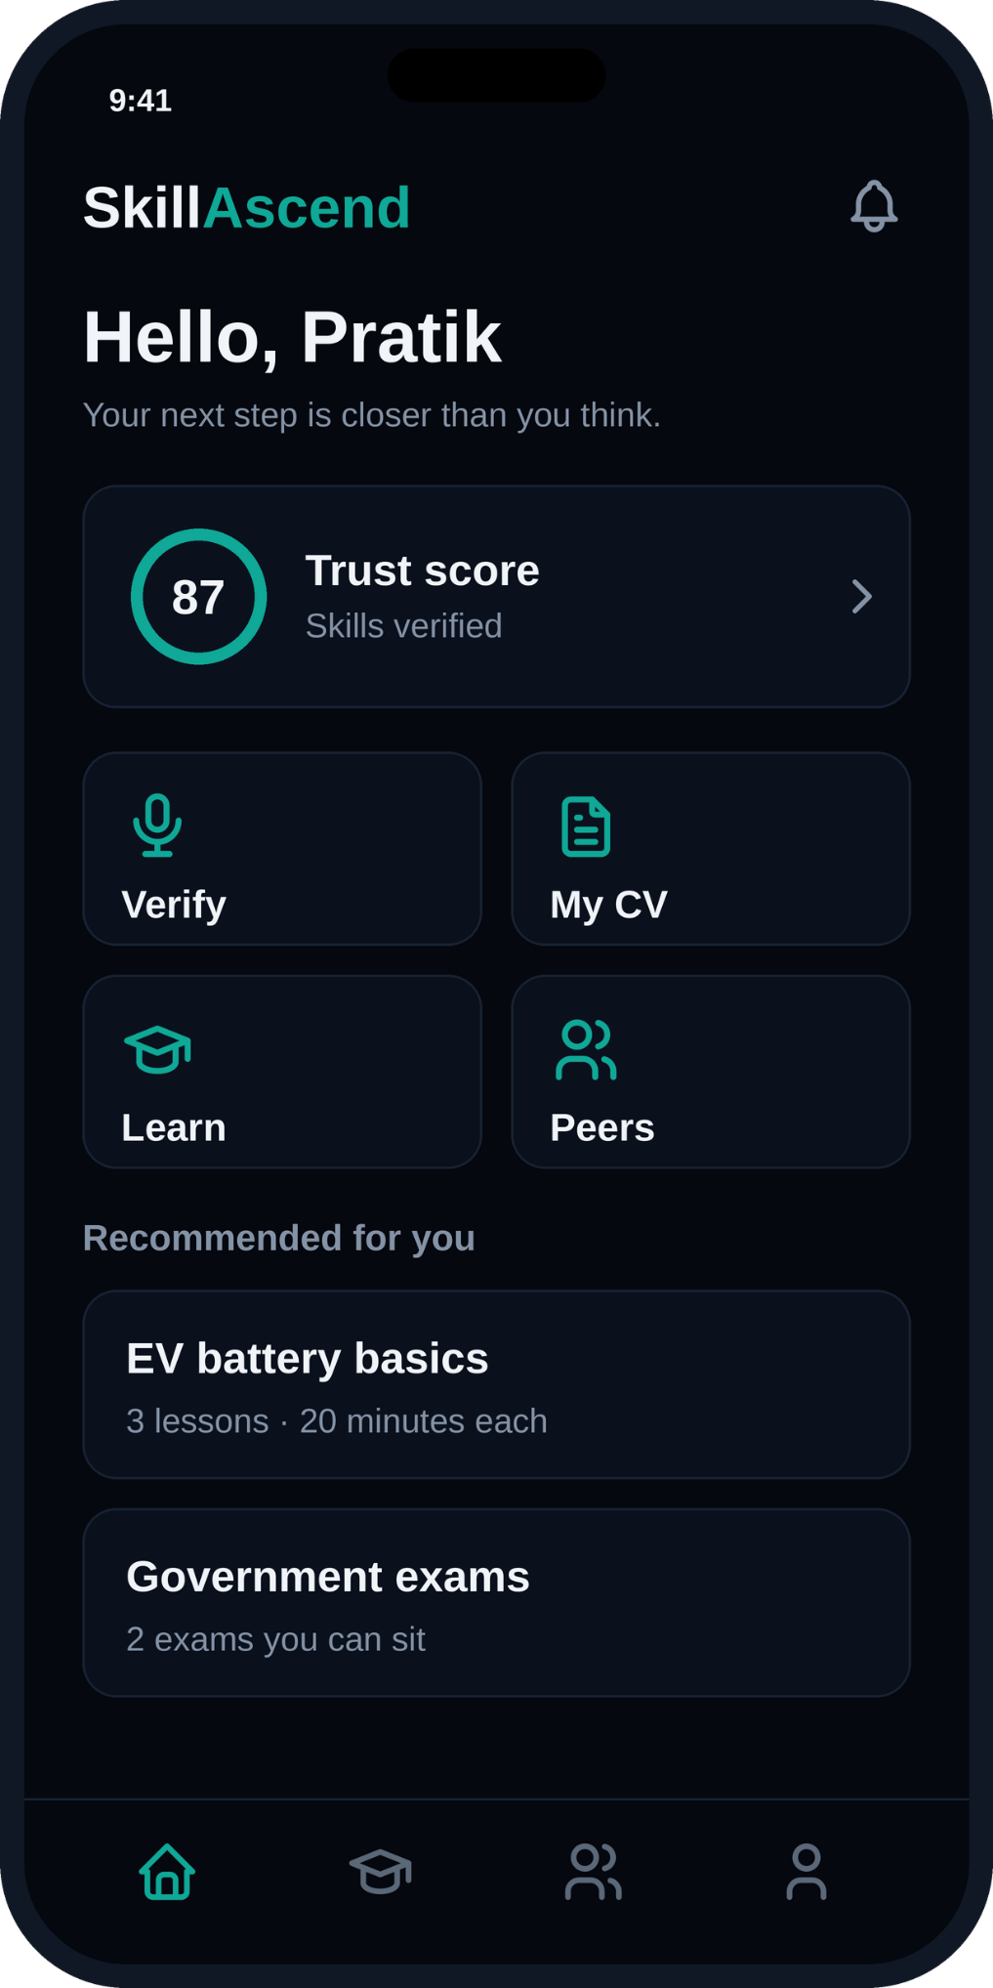
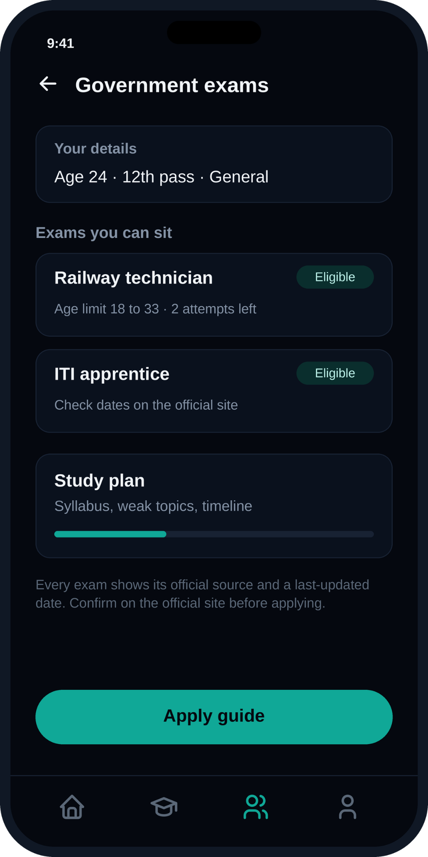
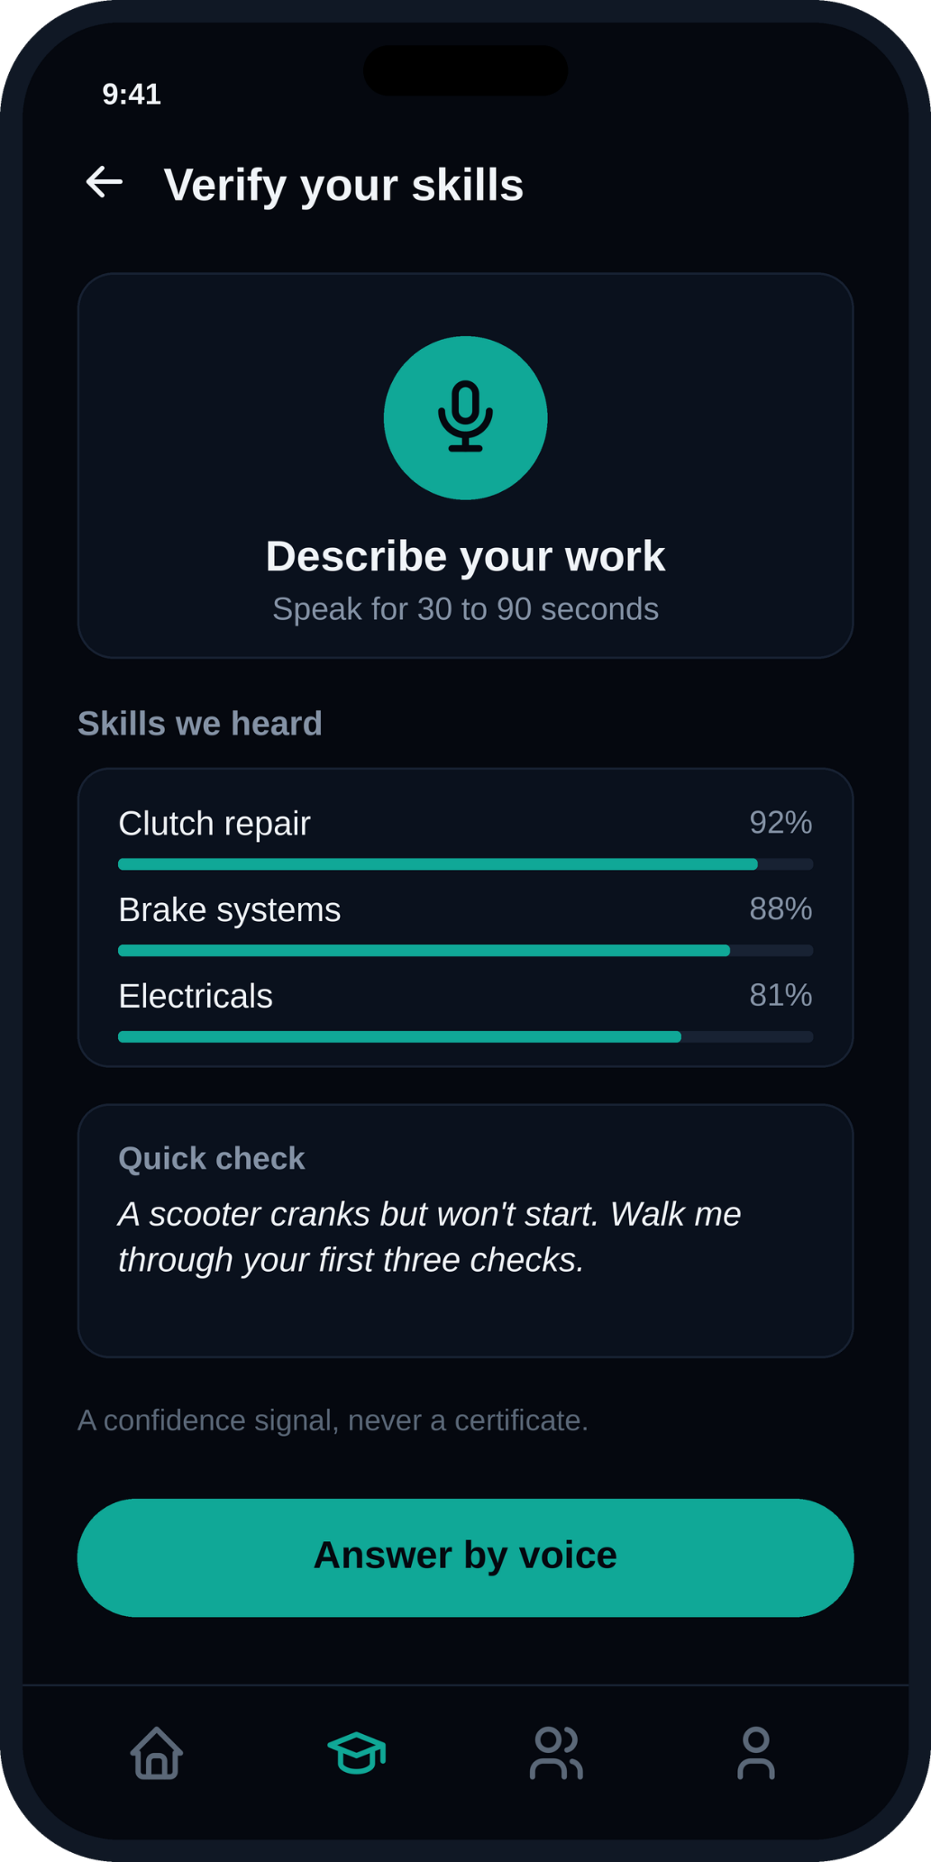
BEYOND THE HACKATHON
Who it serves, and how it grows
1
2
3
Job seekers
Employers & local demand
Partners
People facing hardship building a verified profile, CV and path. Free, always.
Small businesses and households posting real needs, and hiring verified, stable-minded workers.
Skilling missions, NGOs and college placement cells that bring users in and track placements.
Revenue path
Free for job seekers. Small placement or verification fees from employers, plus partnership pilots with skilling missions and municipal livelihood programmes.
How we measure success
Stable placement rate, six-month retention, and completed exam applications, not just sign-ups.
16
ROADMAP
From idea to pilot to scale
Phase 1
Phase 2
Phase 3
Build the core
Local pilot
Scale via partnership
• Voice → verified profile → CV → gap
• Partner with one skilling mission, NGO or placement cell
• Multi-state rollout through skilling and NGO channels
• Eligibility check for 5–8 government exams
• Real users and a maintained exam-data pipeline
• Verified mentor network and employer partnerships
• Peers and jobs added once the core is validated
• Tune trust score and recommendations on real outcomes
• Wider exam coverage with official-source updates
17
LOOK OF OUR APPLICATION:
Notes:
BACKUP (or 20 sec). Shows scope discipline: start with the core thread, add peers and jobs once it works.
17

Slide 17
ROADMAP
From idea to pilot to scale
Phase 1
Phase 2
Phase 3
Build the core
Local pilot
Scale via partnership
• Voice → verified profile → CV → gap
• Partner with one skilling mission, NGO or placement cell
• Multi-state rollout through skilling and NGO channels
• Eligibility check for 5–8 government exams
• Real users and a maintained exam-data pipeline
• Verified mentor network and employer partnerships
• Peers and jobs added once the core is validated
• Tune trust score and recommendations on real outcomes
• Wider exam coverage with official-source updates
17
LOOK OF OUR APPLICATION:
Thank you
SkillAscend: from unverified to employed.
Questions welcome.
20
Notes:
LIVE PITCH · ~15 sec. End on the promise, then invite questions.
18

Slide 18
LOOK OF OUR APPLICATION:
Thank you
SkillAscend: from unverified to employed.
Questions welcome.
20
Notes:
LIVE PITCH · ~15 sec. End on the promise, then invite questions.
18

