Slide 1
ML End-semester Project Submission
Ayushi Jain - 2019031
Darsh Parikh - 2020560
Gurmehak Kaur - 2020298
Sumit Kumar - 2020249

Slide 2
Motivation
In the current age of startups, there is a huge increase in the number of companies coming up. But not all companies manage to stay successful over time and burn out pretty fast.It is important for investors, so that they can decide if investing in the company is profitable or not.
Bankruptcy prediction is also significant for Better allocation of resources, Input to policy makers, Corrective action for business managers, Identification of sector wide problems and Signal to Investors.

Slide 3
Literature Review
The School of Expertness and Valuation, Institute of Technology and Business in Czech Republic used Support Vector Machine and artificial neural network(multilayer perceptron artificial neural networks and radial basis function artificial neural networks) to create a model for predicting potential bankruptcy of companies.
Machine learning models and bankruptcy prediction: In this study, Flavio Barboza, Herbert Kimura and Edward Altman have tested machine learning models such as support vector machines, bagging, boosting and random forest to predict bankruptcy one year prior to the event, and compare their performance with results from discriminant analysis, logistic regression, and neural networks.
Bankruptcy Prediction Using Machine Learning, by Nanxi Wang: In this paper, three relatively new methods have been proposed for predicting bankruptcy based on real-life data. The usage of the three models (support vector machine, neural network with dropout, autoencoder) in economics or finance is comparatively hard to find. So, the paper aims to find out if they work well in economic field, by predicting company bankruptcy.

Slide 4
Dataset Description
The data were collected from the Taiwan Economic Journal for the years 1999 to 2009. Company bankruptcy was defined based on the business regulations of the Taiwan Stock Exchange.
https://www.kaggle.com/datasets/fedesoriano/company-bankruptcy-prediction?datasetId=1111894&sortBy=dateRun&tab=bookmarked
96 columns in the dataset
Prediction of whether a company will go bankrupt or not, according to Taiwanese business regulations.

Slide 5
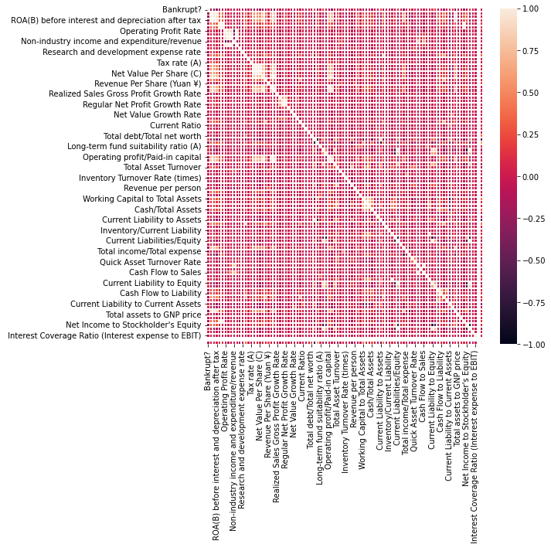
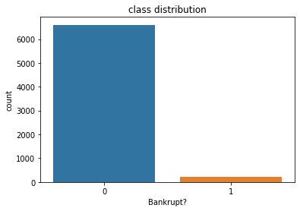
Exploratory Data Analysis Methodology and Results
Class Distribution
Correlation matrix

Slide 6
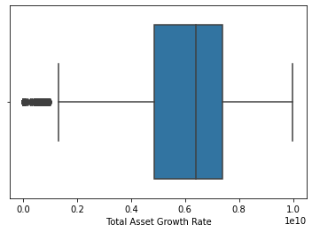
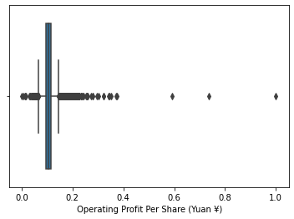
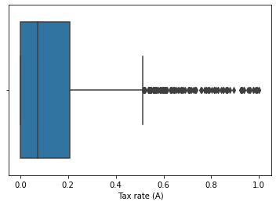
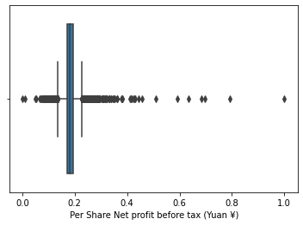
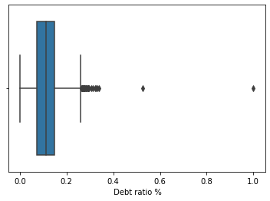
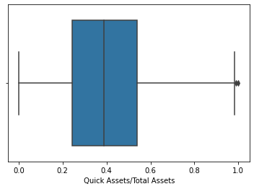
Box-plots of some features of raw data

Slide 7
Dataset Preprocessing
As the first step of Data Preprocessing, we first normalized our training and test data-set so that each of 96 feature values of our data-set were in the range of 0 - 1. Our Exploratory Data Analysis revealed some of the issues we needed to take care of before fitting, namely, data imbalance and existence of correlated features. We have used different sampling methods to handle the imbalanced data. For oversampling, we used SMOTE and ADASYN techniques respectively. For undersampling the data, we used Tomek links and CNN(Condensed nearest neighbors). In case of oversampling, ADASYN worked better and in the case of undersampling, CNN works better.

Slide 8
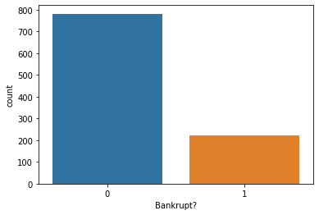
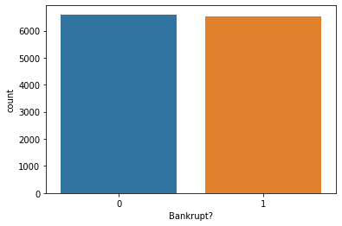
Re-sampling the Dataset
Class-distributions
Under-sampled
Over-sampled

Slide 9
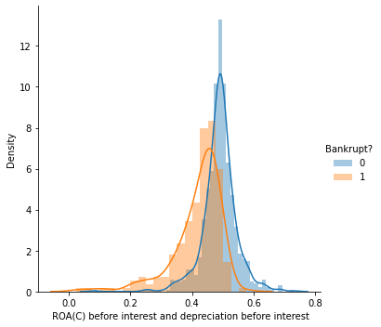
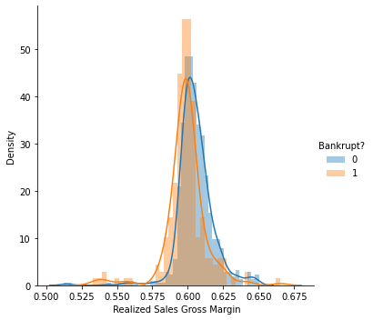
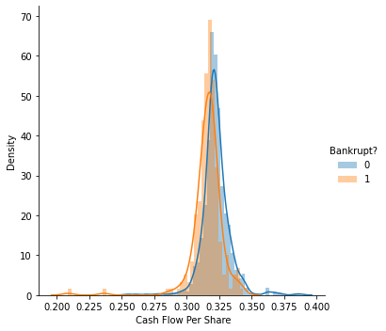
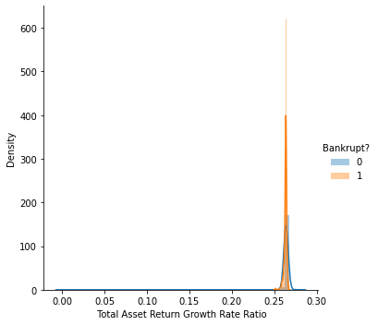
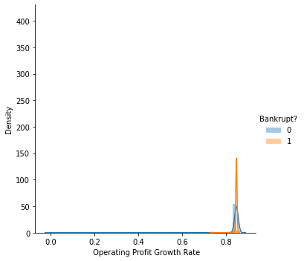
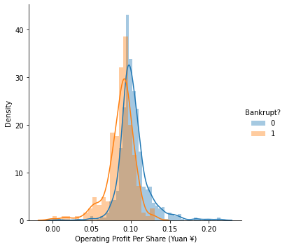
Univariate plots of some features

Slide 10
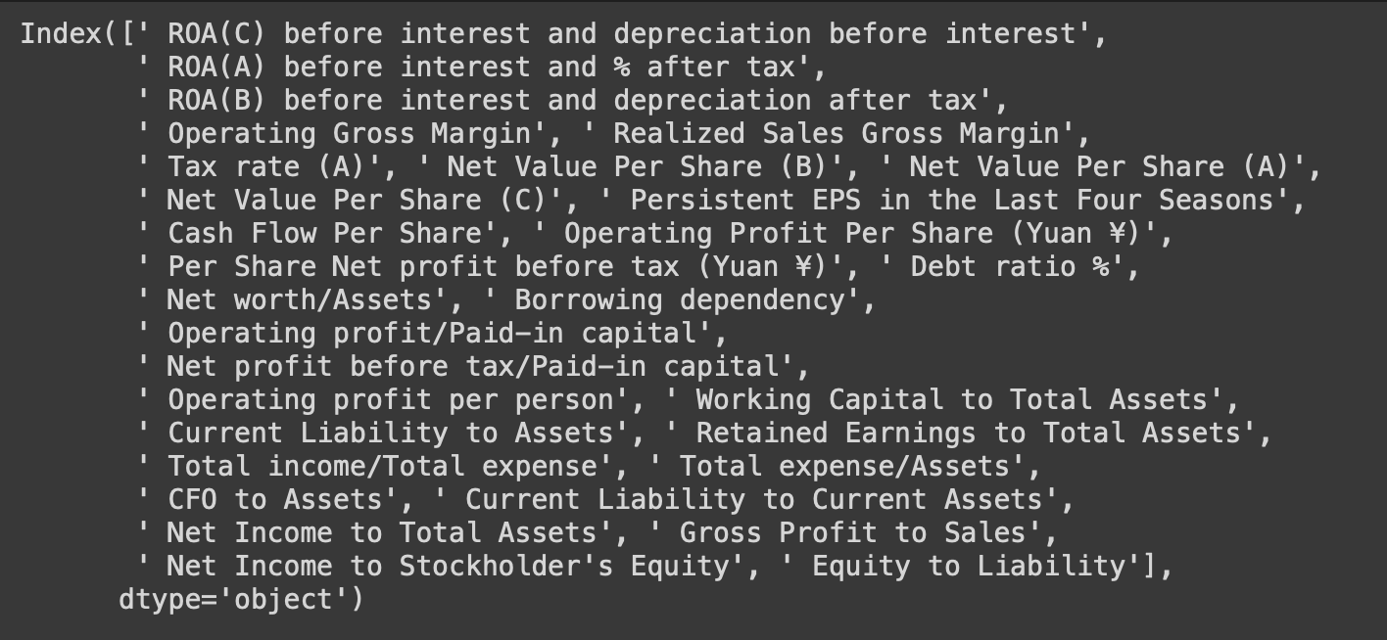
Feature Selection Method and Results
We have done feature selection to select the 30 best features according to the highest scores. The result is as shown below.

Slide 11
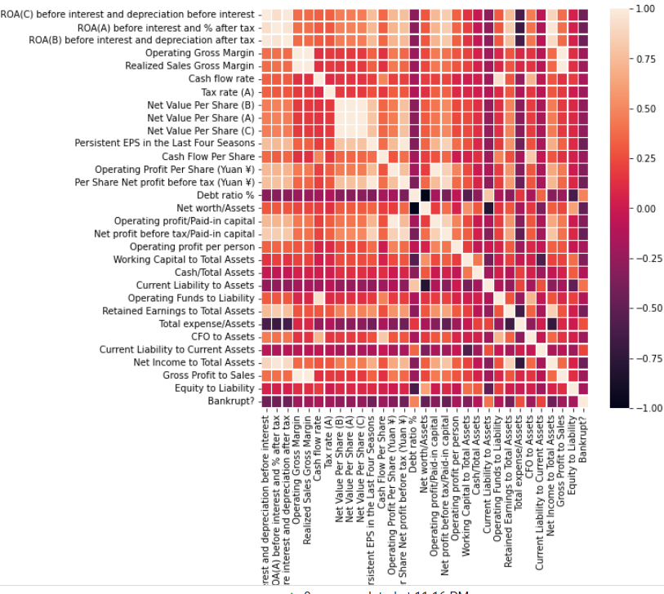
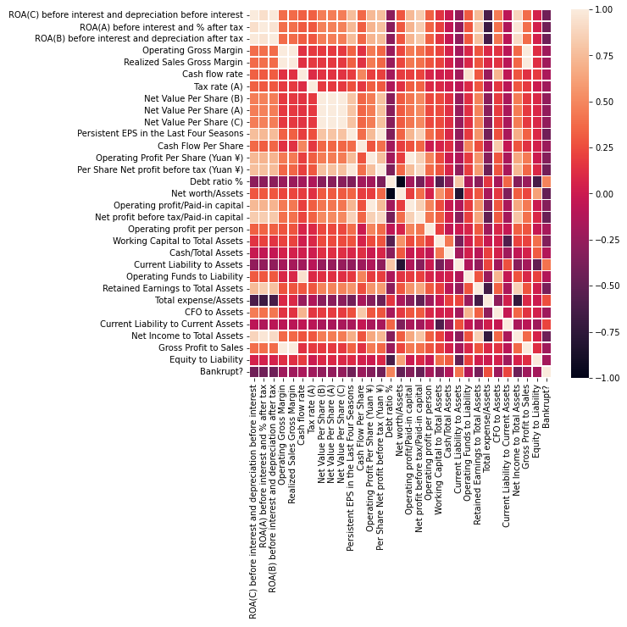
Correlation Heat-maps of selected features
Under-sampled
Over-sampled

Slide 12
Logistic Regression and Naive Bayes
OVERSAMPLING
Logistic Regression and Gaussian NB give better results for the oversampled data. But in case of Binomial NB, the results are different. Binomial NB gives better results for undersampled data.
UNDERSAMPLING
Model | Accuracy | Precision | Recall
Logistic Regression | 0.8407 | 0.7372 | 0.8407
Binomial NB | 0.8208 | 0.4104 | 0.8208
Gaussian NB | 0.8009 | 0.6690 | 0.8009
Model | Accuracy | Precision | Recall
Logistic Regression | 0.8792 | 0.8798 | 0.8792
Binomial NB | 0.4979 | 0.2489 | 0.4979
Gaussian NB | 0.8624 | 0.8656 | 0.8624

Slide 13
Dimensionality Reduction Techniques
List of techniques used:
PCA
Factor Analysis
Factor Analysis with Varimax rotation
Truncated SVD
LDA
Kernel PCA: linear, poly, rbf kernels
We tried each method on both undersampled and oversampled datasets.

Slide 14
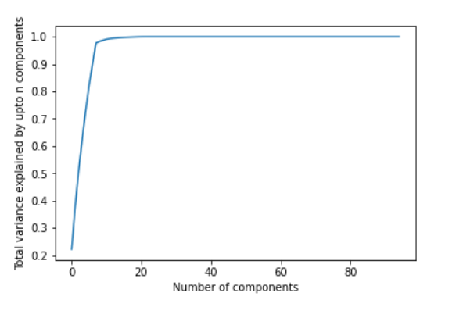
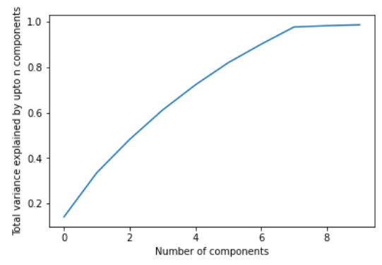
Beauty of Dimensionality Reduction
We find that out of 96 attributes, just 10 attributes can explain about 98 percent of the variance in the dataset through PCA and Truncated SVD techniques. First image shows for PCA, second for truncated SVD

Slide 15
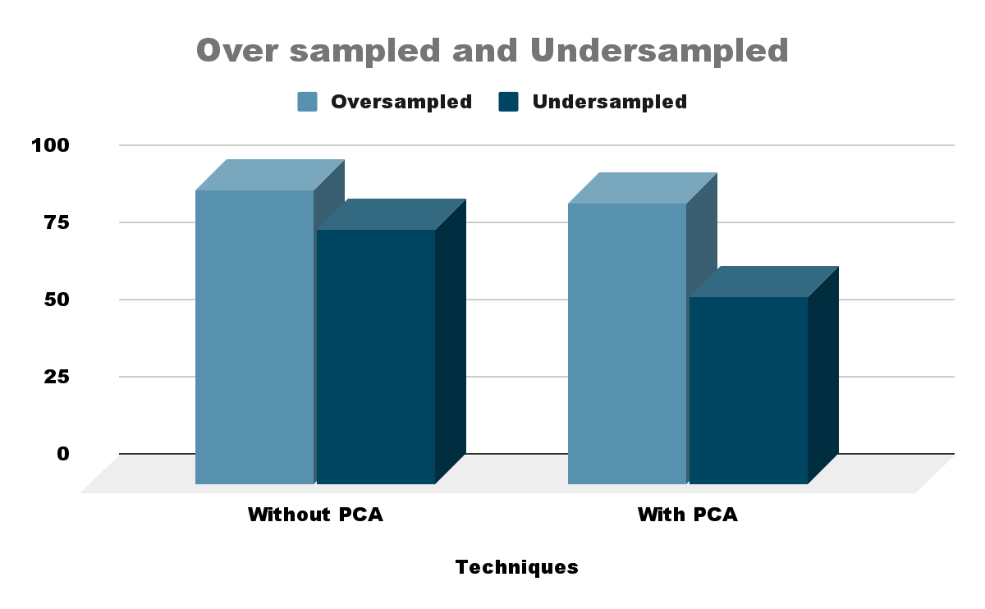
Decision Trees
With Oversampling the accuracy is much higher than with undersampling Accuracy with Undersampling entire dataset: 82.74 % Accuracy with Oversampling entire dataset: 95.504% In Oversampling, the PCA method (10 components ) has an accuracy of 91.16 percent In Undersampling, the PCA method (10 components) gives an accuracy of 61 percent.

Slide 16
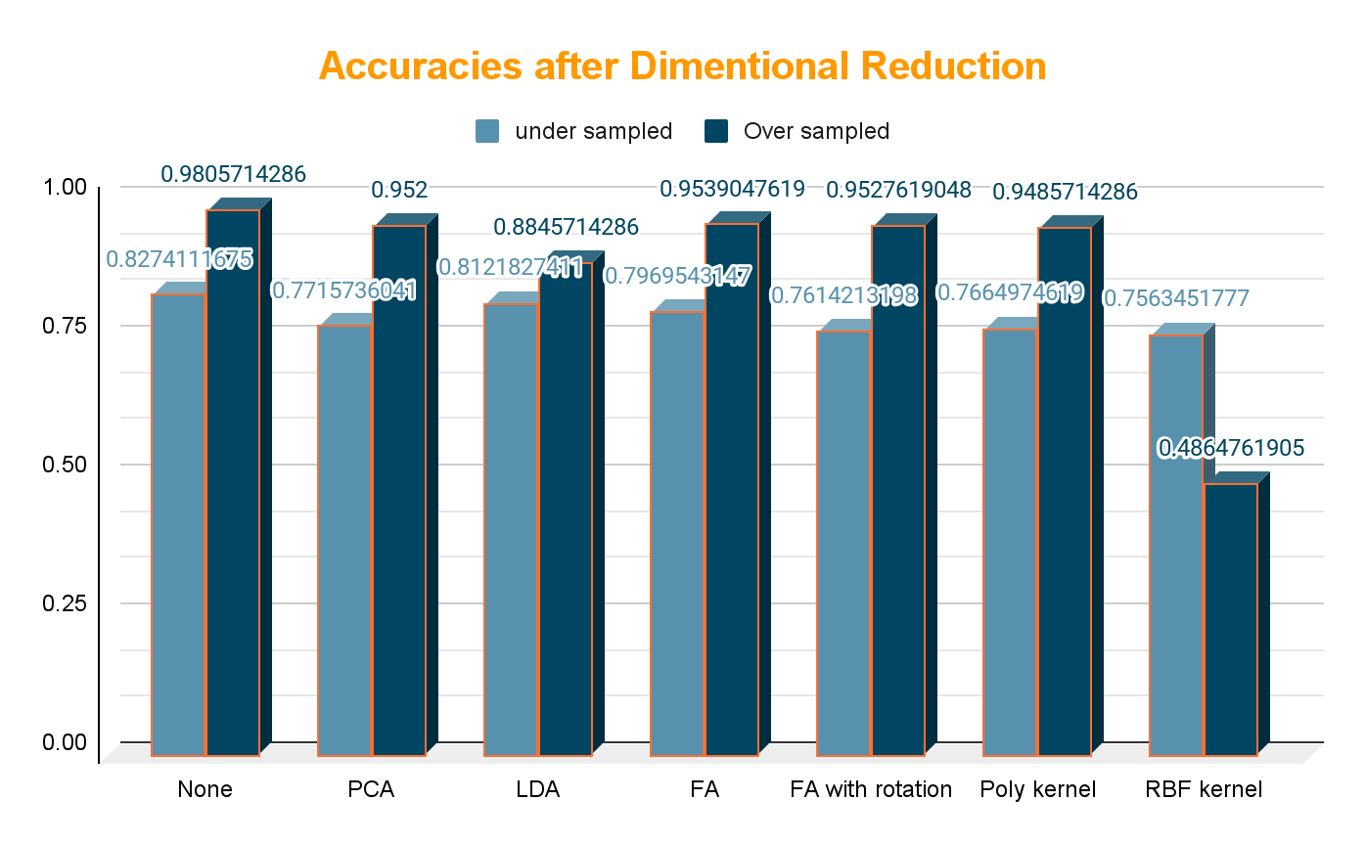
Results with Random Forests, Decision Trees and Dimensionality Reduction
According to our dataset, oversampled dataset performs better than undersampled dataset with same dimension reductionality techniques on Random Forests.

Slide 17
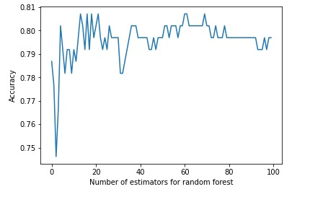
Random forest - Experiment with different parameters
We check the results for different number of estimators varying from 1 to 100.
We notice that the accuracy reached to 0.8 on average as the number of Estimators tend to 100.
We check the results for maximum depth
Vs allowing the tree to have as much depth as it requires.
Max depth = 5: 80.20 % Max depth not mentioned: 79 %

Slide 18
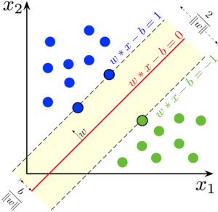
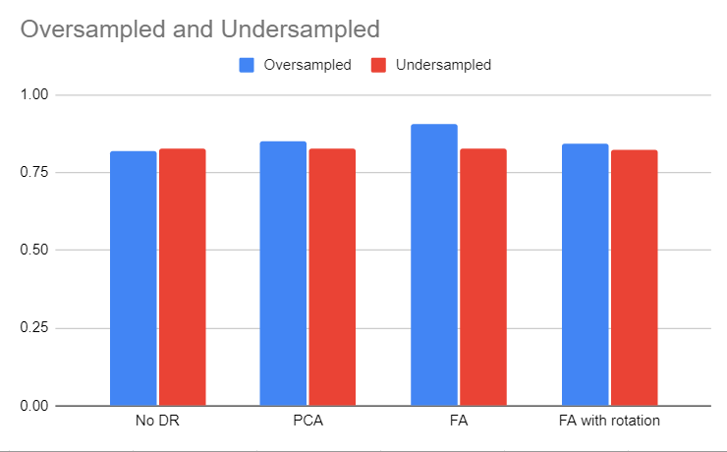
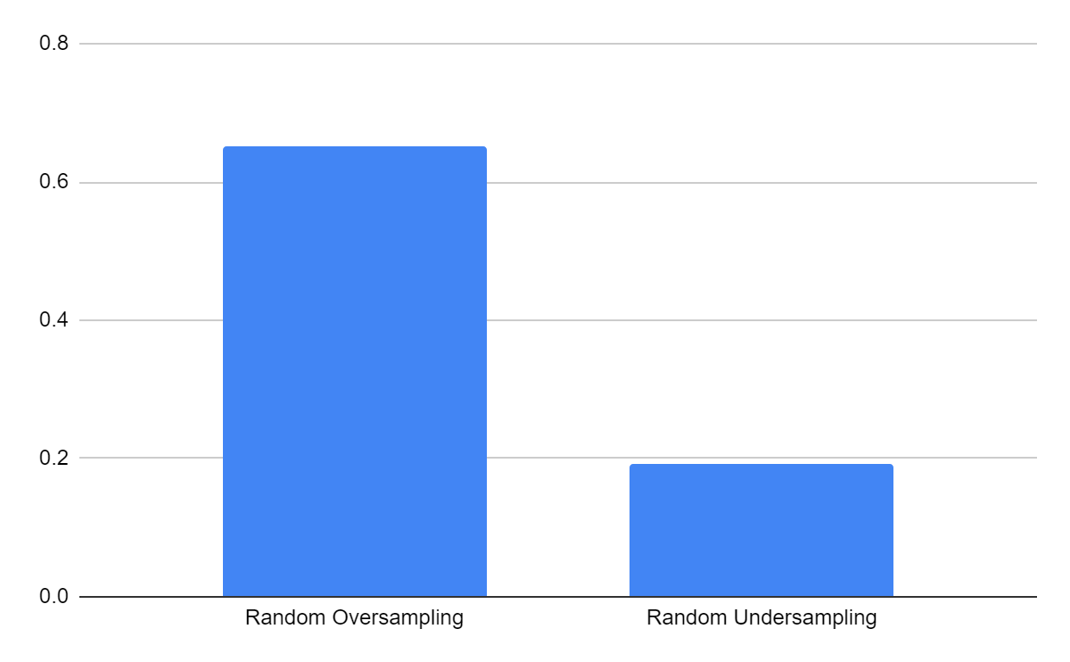
Support Vector Machines
We have applied Support Vector Machines on undersampled and oversampled data generated using SMOTE and ADASYN methods respectively, as well as on undersampled and oversampled data generated using simple random sampling We observe that with SVC works most effectively with Oversampled dataset with Factor Analysis. It works better when the oversampling and the undersampling techniques are sophisticated as compared to randomness in the same.

Slide 19
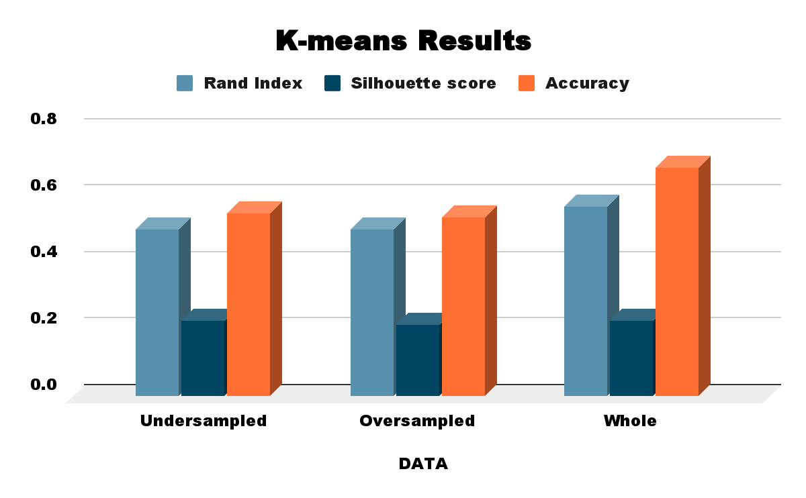
K-Means Clustering
For Clustering, we have used K-Means clustering algorithm. In this, the data points are grouped in k clusters, in our case 2. Since it is a centroid based clustering, the algorithm takes unlabeled input, and assigns it to the centroids and repeats this process until the euclidean distance between the centroid and data point is not minimized, hence forming clusters.

Slide 20
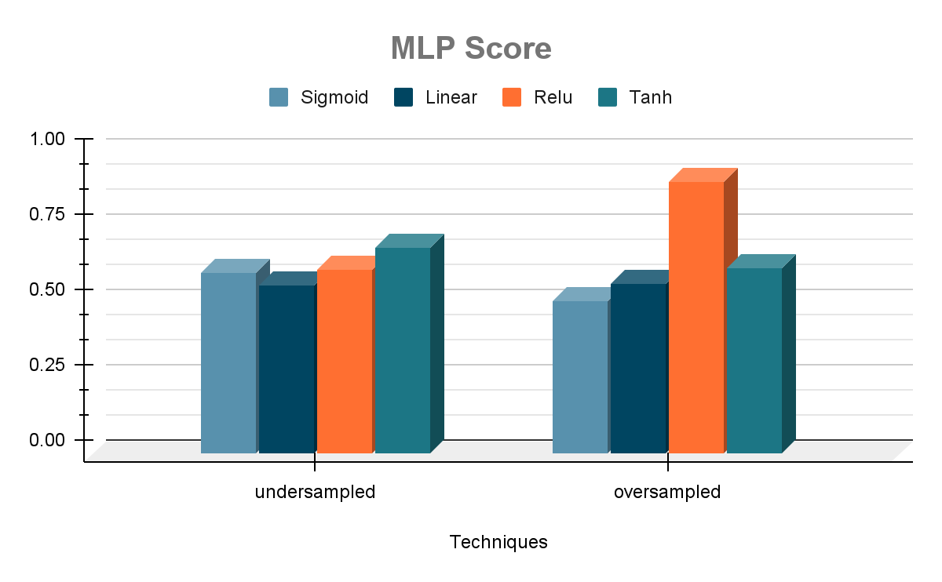
MultiLayer Perceptron
In a MLP, the inputs are multiplied with weights and fed to the activation function and in backpropagation, they are modified to reduce the loss. We have run the MLP classifier on the undersampled and oversampled data generated using simple random sampling. For a deeper analysis, we also changed the activation functions.

Slide 21
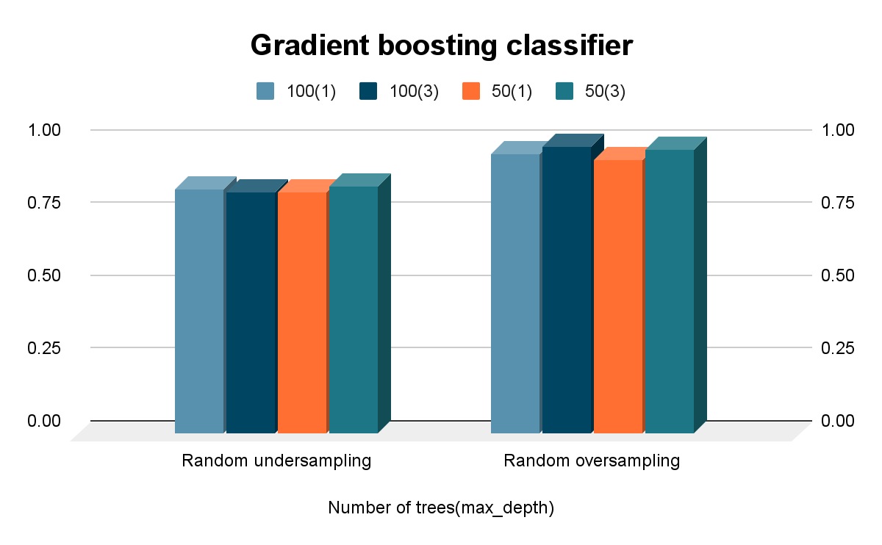
GradientBoostingClassifier
As we can see from the visualisation the Gradient Boosting classifier archives the maximum accuracy of 98% on oversampled data with number of iterator = 100 and max depth = 3

Slide 22
Conclusion
We were able to successfully illustrate how machine learning can be exploited in the field of economics.
We were able to follow the proposed timeline tentatively. As mentioned in our timeline, we trained several classification models.
Future Research subtopics can be configured by incorporating new types of data. For example, unstructured data for example the text of the annual reports of companies.
We could also extend this problem to giving companies personalized feedback that would be even more helpful in preventing bankruptcy.

Slide 23
References
For dimensionality reduction technique - ideas - https://towardsdatascience.com/11-dimensionality-reduction-techniques-you-should-know-in-2021-dcb9500d388b
For code in sklearn:
Sklearn documentation for each classifier used
For factor analysis with varimax decomposition https://scikit-learn.org/stable/auto_examples/decomposition/plot_varimax_fa.html#sphx-glr-auto-examples-decomposition-plot-varimax-fa-py
https://matplotlib.org/
https://www.sciencedirect.com/science/article/abs/pii/S0957417417302415
https://www.sciencedirect.com/science/article/abs/pii/S0957417417302415

