Slide 1

Project Report on Used Car Price Prediction
By:
Saikrishna Padamatinti

Slide 2
Background & Introduction
With the covid 19 impact in the market, a lot of changes happened in the car market. Now some cars are in demand hence making them costly and some are not in demand hence cheaper. So intuition is to build a machine learning model with the data gathered from car trading web sites.

Slide 3
Business Problem
The sample data is gathered from CarDekho.com using Web scraping with selenium for 3 different locations Hyderabad, Bangalore and Mumbai. A total of 4500 records is collected.
The goal here is to build a model which can be used to predict the price of used cars.

Slide 4
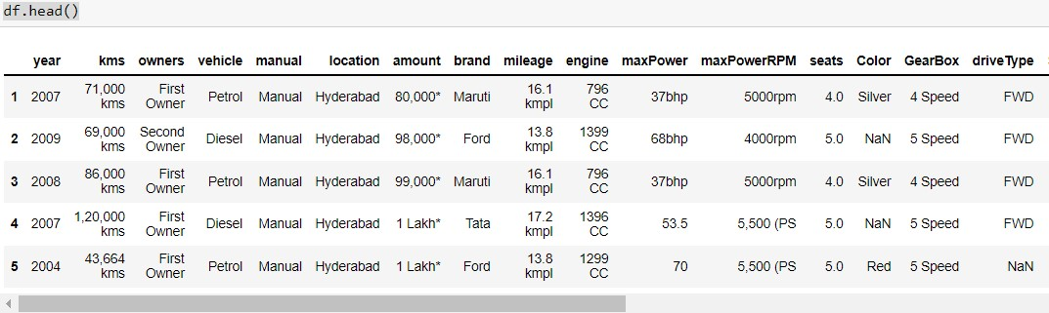
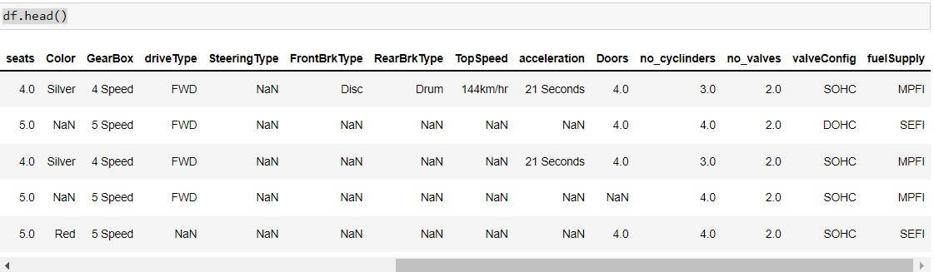
Feature Engineering

Slide 5
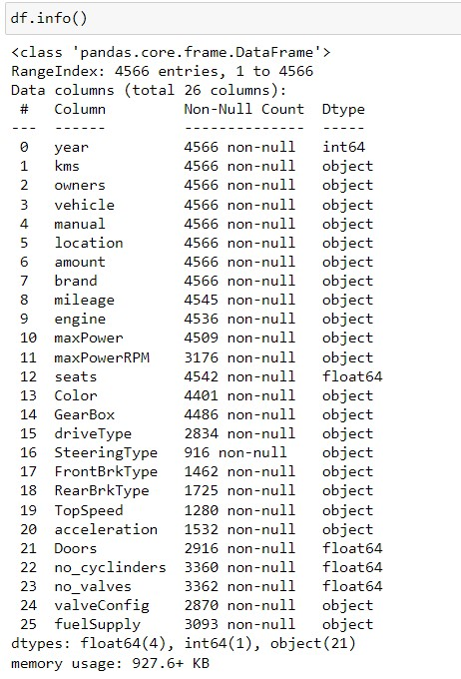
Feature Engineering (Cntd…)

Slide 6
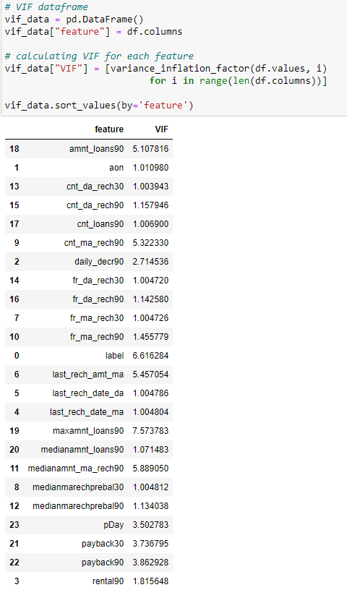

Slide 7
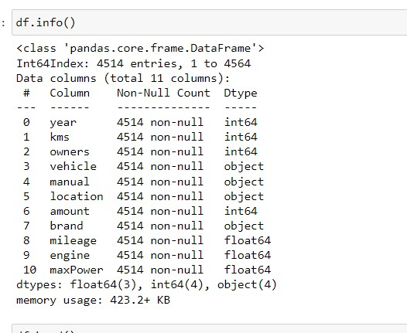
Feature Engineering (Cntd…)
* Most of the features have extra suffix like for example amount feature has lakh and cr as suffix while mileage has kms as suffix. All the features are transformed to remove unnecessary suffixes.

Slide 8
Modelling part
* using train_test_Split, split the data in to train and test part with 33% of test data.
* all the features values are not in the same range so fit standardScaler on the train data and transform the train and test data.
* Train the Linear Regression model, Support Vector Regressor and Random Forest Regressor on the training data and compared the root mean squared error values.
* Finally choosing Linear Regression as the best model for hyperparameter tuning.

Slide 9
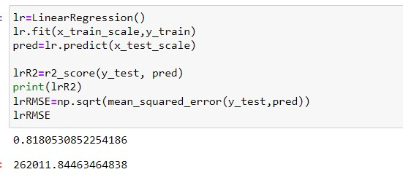
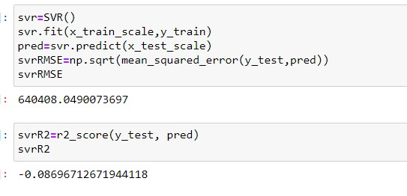
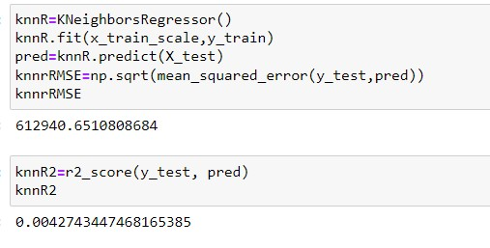
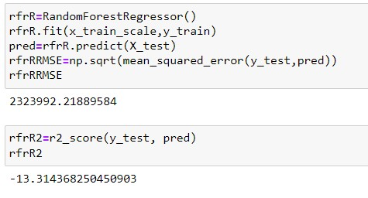
Modelling part

Slide 10
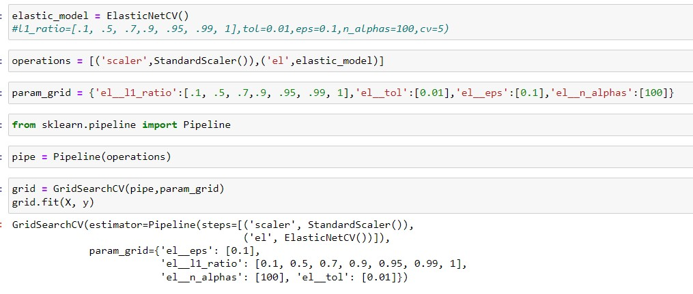
Modelling part

Slide 11
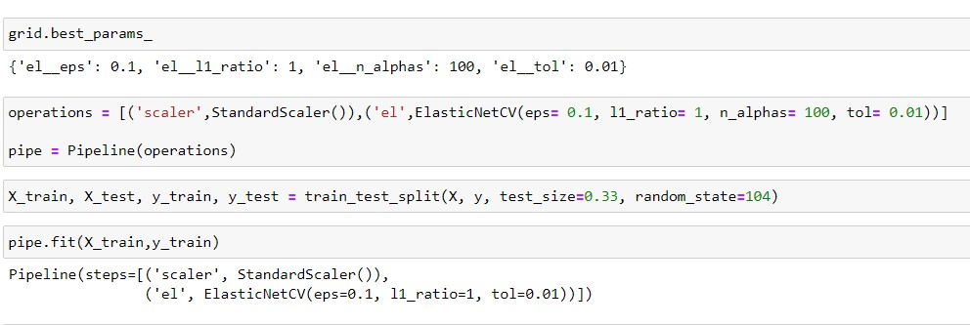
Modelling part

Slide 12
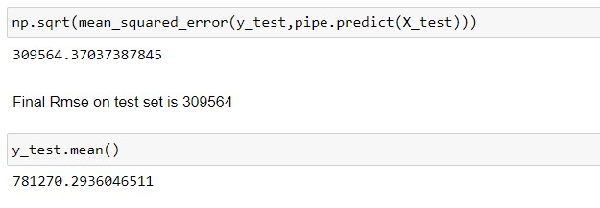

Modelling part

Slide 13
Conclusion
In Conclusion, the ElasticNet is chosen as the best model with Root mean squared error of 309564.

