Slide 1
TELUGU WORDS RECOGNITION USING CNN
Mentors:
Dr. V.SUBBA RAMAIAH
(Assistant Professor)
Mr. D.KOTESWARA RAO
(Assistant Professor)
Presented by:
P.Saikrishna (15261A0539)
N.Chandrashekar (16265A0510)

Slide 2
Abstract
The main aim of this project is to apply the segmentation algorithm for Telugu Document images to obtain regions of interest like graphics and text which can then be processed for training and testing.
On performing segmentation on telugu document images containing both text and graphics, the segmentation algorithm separates the text and graphics regions.
The next step is to use the words images along with their labels for training and text recognition by using a convolutional neural network.

Slide 3
Introduction
Page segmentation is the process by which a scanned page is divided into columns and blocks which are then classified as graphics (images) or text.
Telugu Words recognition is achieved by using a Convolutional neural network.
Some of the algorithms used for Page Segmentation are:
Run-Length Smearing Algorithm (RLSA).
Whitespace-cuts.
Voronoi Diagrams.
Telugu Words recognition is achieved by using a Convolutional neural network.

Slide 4
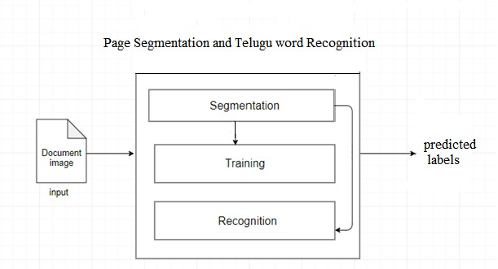
System Architecture

Slide 5
Modules
Page Segmentation
Binarization
Smearing
Connected Component Analysis
Noise Removal
Convolutional Neural Network
convolutional layer
Pooling
Fully-connected layer (Dense)
Activation Function
Softmax function

Slide 6
Run-Length Smearing Algorithm
The Run-Length Smearing Algorithm (RLSA) is a method that can be used for block segmentation.
Works only on binary images.
The method developed for the document analysis system consists of two steps.
First, a segmentation procedure subdivides the area of a document into regions (blocks).
Next, some basic features of these blocks are calculated.

Slide 7
How it works?
The algorithm transforms a binary sequence x into an output sequence y, according to the following rules:
1.0’s in x are changed to 1’s in y if the number of adjacent 0’s is less than or equal to a predefined limit C.
2. 1’s in x are unchanged in y .
For example, with C = 4 the sequence x is mapped into y as follows:
x : 0 0 0 1 0 0 0 0 0 1 0 1 0 0 0 0 1 0 0 0 0 0 0 0 1 1 0 0 0
y : 1 1 1 1 0 0 0 0 0 1 1 1 1 1 1 1 1 0 0 0 0 0 0 0 1 1 1 1 1

Slide 8
Initial image

Slide 9
On performing Smearing along x axis

Slide 10
On performing smearing along y axis

Slide 11
Logical and of Horizontal and Vertical smearing

Slide 12
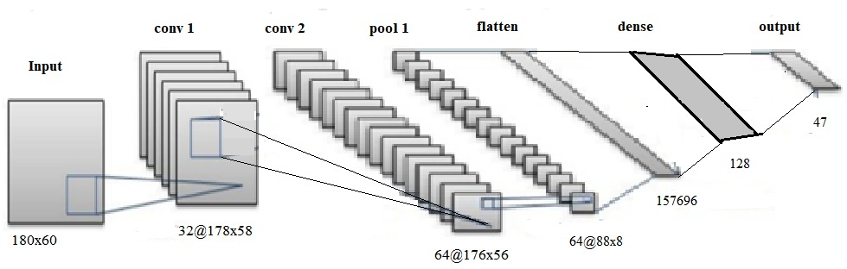
Convolutional neural network diagram

Slide 13
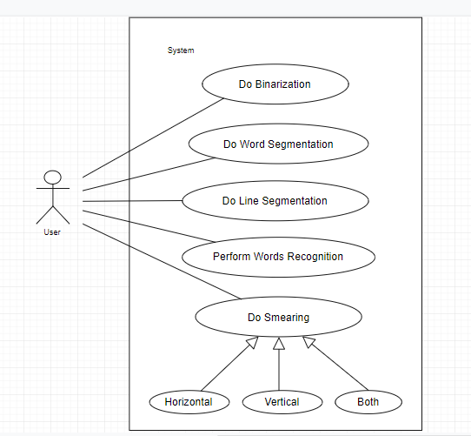
Use case diagram

Slide 14
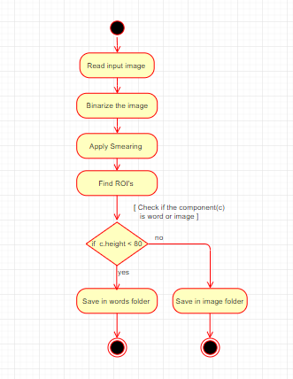
Activity Diagram

Slide 15
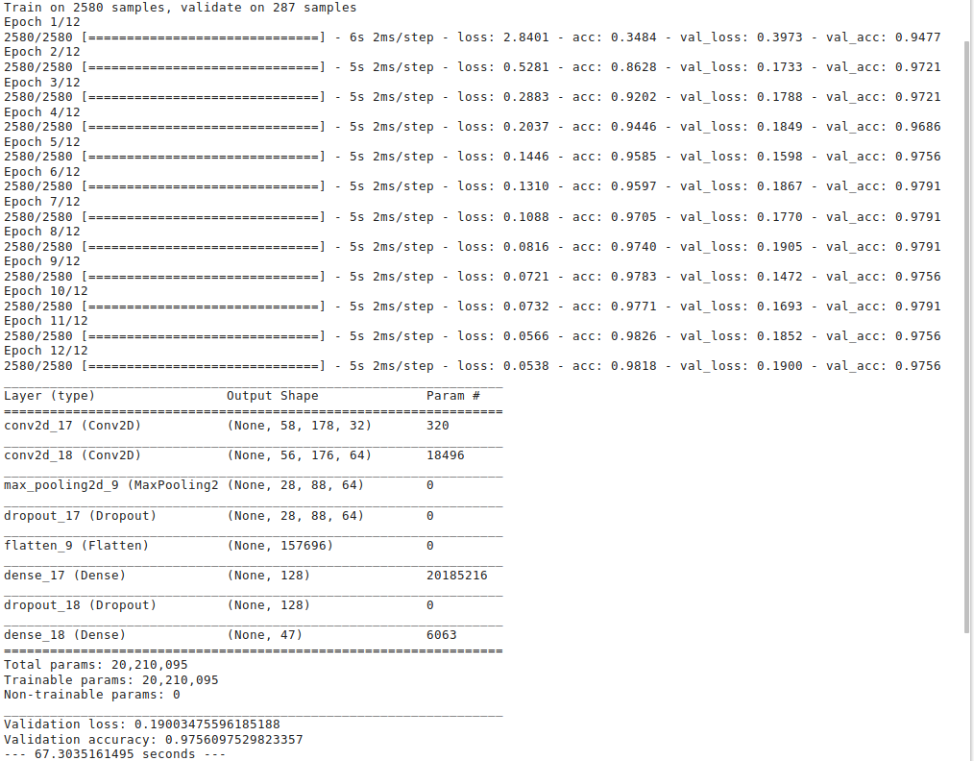

Slide 16
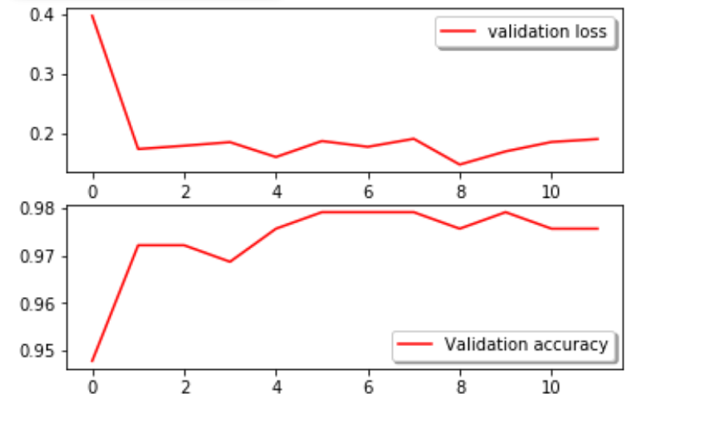

Slide 17
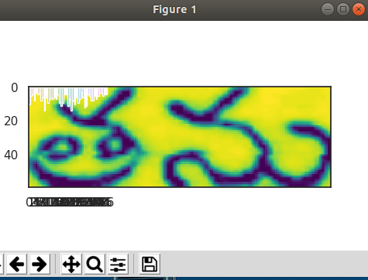
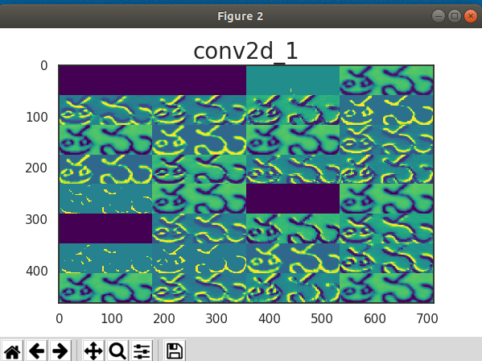
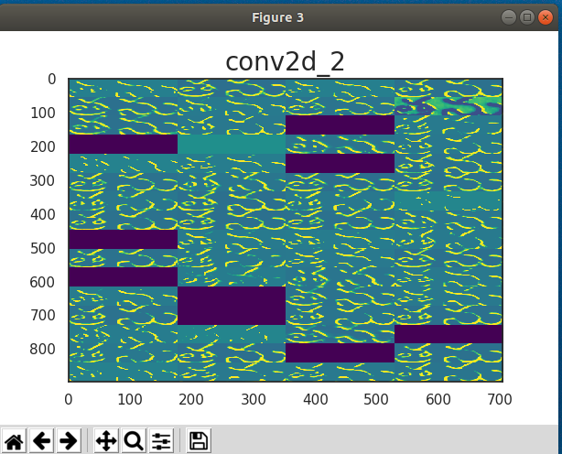
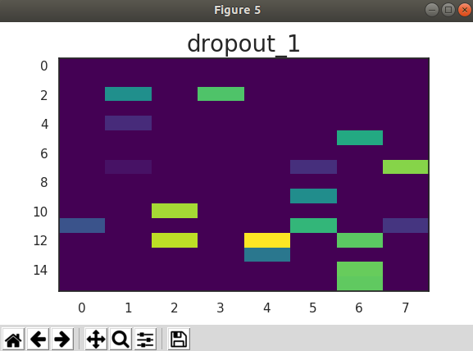
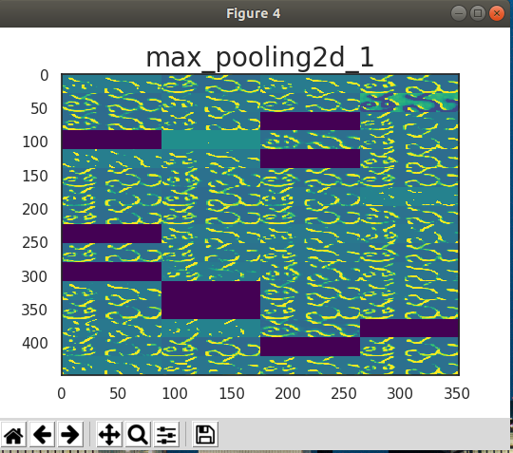

Slide 18
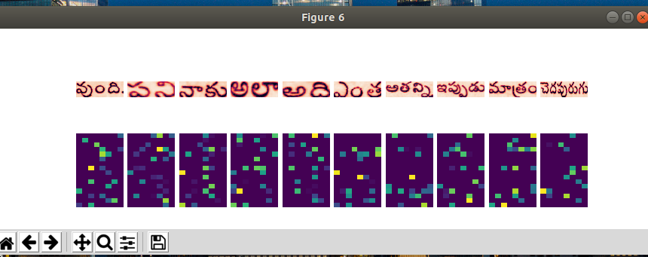

Slide 19
CONCLUSION AND FUTURESCOPE
Segmentation is achieved by using Run Line Smearing algorithm
Telugu word Recognition is achieved by training the Convolutional neural network with 2580 training samples and 287 validation samples containing 48 labels. The training is performed in 12 epochs achieving an accuracy of 97.5 on validation data.
This project can be extended by increasing the number of training samples with more number of labels and also can be used for hand-written character recognition when trained with images of hand-written document images.

Slide 20
References
[1] LeCun, Yann. “LeNet-5, convolutional neural networks”, 16 November2013
[2] Scott Leishman. “Shape-Free Statistical Information in Optical Character Recognition”, 2007.
[3] Oivind Due Trier and Anil K. Jain. “Goal-directed evaluation of binarization method”, December 1995.
[4] Viet Phuong Le, Nibal Nayef, Muriel Visani, Jean-Marc Ogier and Cao De Trant
“Text and Non-text Segmentation based on Connected Component Features”, 2015.
[5] B. Gatos and N. Papamarkos. “Applying Fast Segmentation Techniques at a Binary Image Represented by a Set of Non-Overlapping Blocks”, 2001.
[6] Saad ALBAWI , Tareq Abed MOHAMMED and Saad AL-ZAWI. “Understanding of
a Convolutional Neural Network”, 2017.
[7] Matusugu, Masakazu; Katsuhiko Mori; Yusuke Mitari; Yuji Kaneda. “Subject independent facial expression recognition with robust face detection using a convolutional neural network”, 17 November 2013.
[8] Ciresan, Dan; Ueli Meier; Jonathan Masci; Luca M. Gambardella; Jurgen Schmidhuber. “Flexible, High Performance Convolutional Neural Networks for Image Classification”, November 2013.
[9] https://towardsdatascience.com/a-comprehensive-guide-to-convolutional-neural-networks-the-eli5-way-3bd2b1164a53.

Slide 21
THANK YOU

