Slide 1
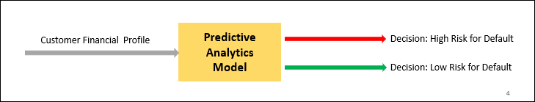
Objective : Build a predictive model to classify the risk of Default on loan based on customer information
Data Preparation and Cleaning
Handling missing values
Categorical and Text Features encoded to Numerical
Feature Selection considering Business and Statistical Analysis

Slide 2
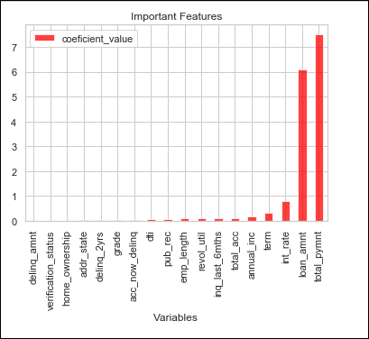
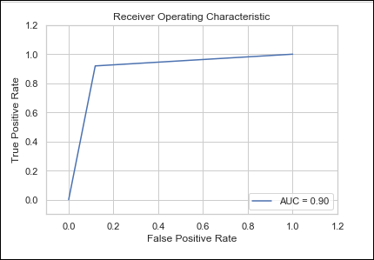
Model Results
Model | Without Sampling | Under-sampling | Over-sampling
Logistic Regression | 88.6% | 87.7% | 89.84%
Decision Tree | 87.7% | 89.84% | 88.4%

Slide 3
INSIGHS AND IMPACT ON BUSINESS:
More focus on customers posing High Payment, High Loan Amount, Annual Income, Term and Interest Rate
> Majority of the loan applications for debt consolidations and credit card purposes
> More Focus on Small Business Categories
Efficient while approving loan quickly and identifying defaults based on customers financial history with combination of human and machine intelligence
IMPROVEMENTS
Features such as ‘Subgrade’ and ‘Purpose‘ can be included in model for better prediction.
Segmented Analysis
Advanced Machine Learning Algorithms

