Slide 1
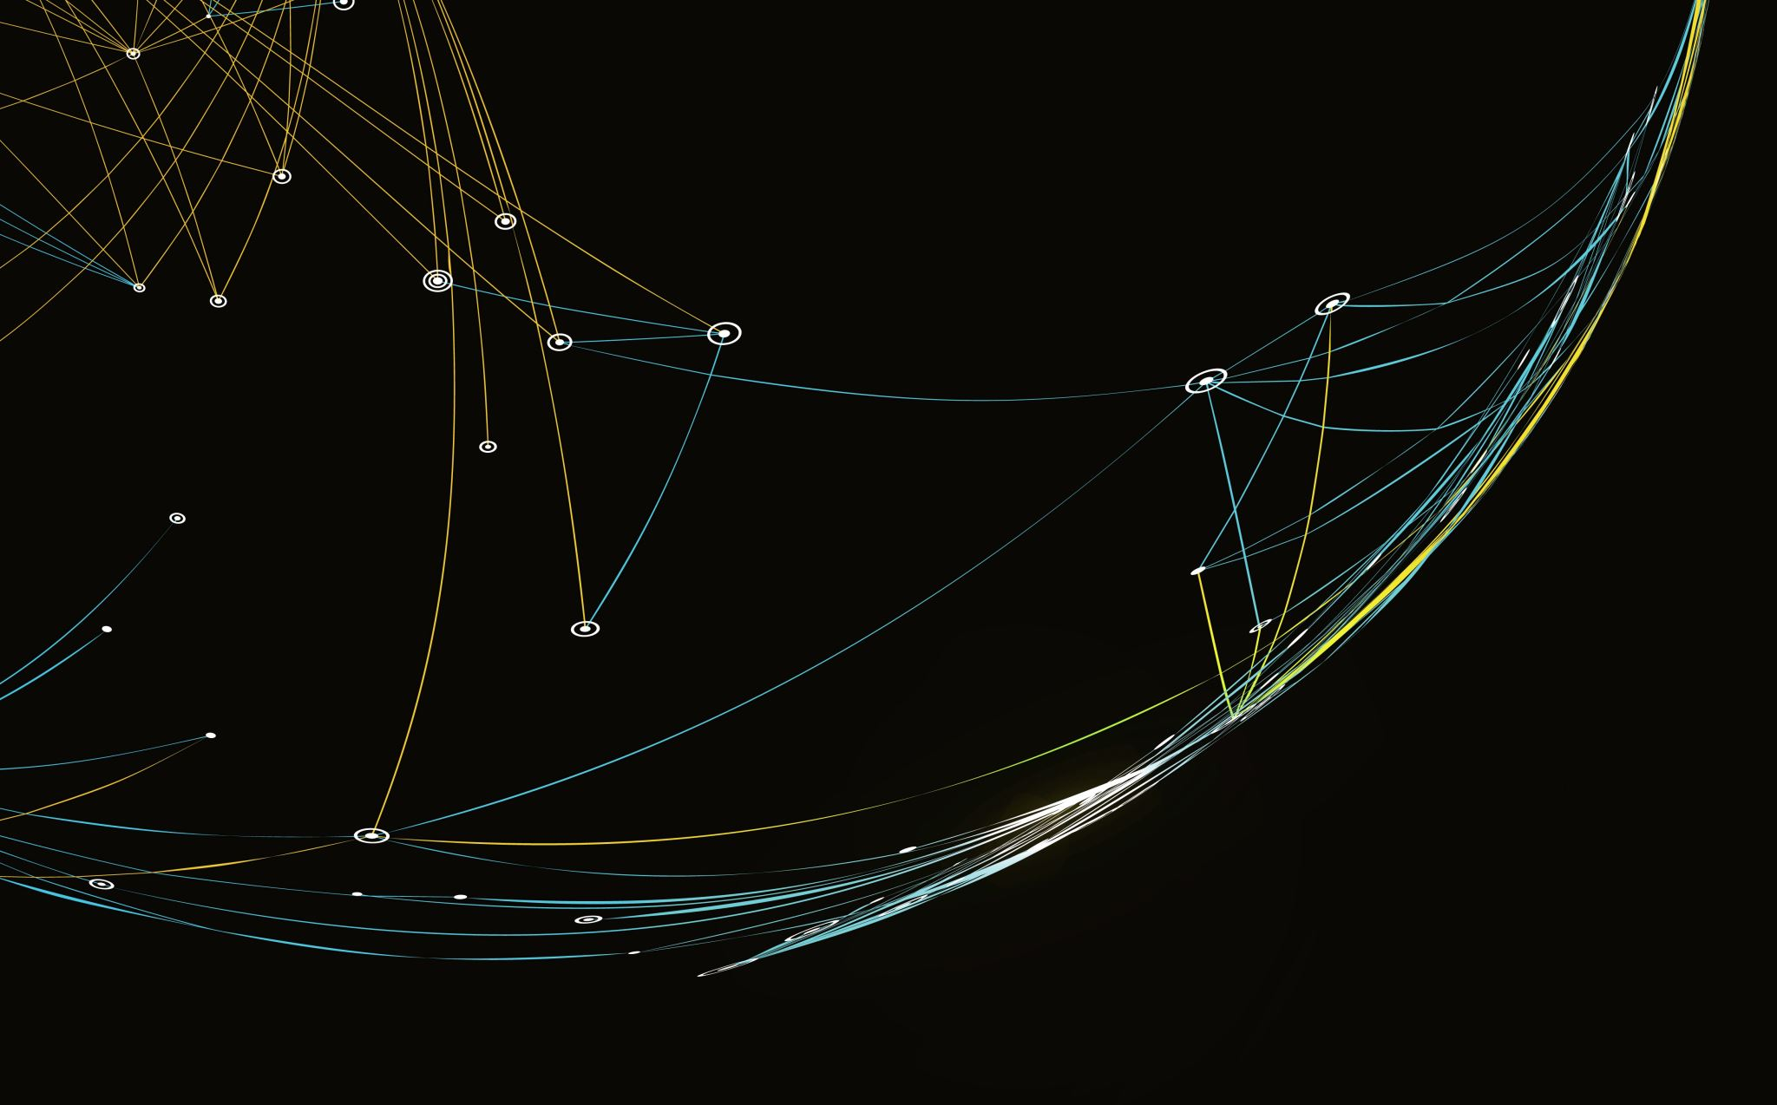
Inheritance
Name\Mohammed Abdullah Al Zahrani
StudentID\430913299
D.Yahya Khawaja
cc\140111102-4

Slide 2
Inheritance
It is what on real life the relationship between The Father and his son and we call it on the programing language Super Class and Sup Class . If the father have attributes and methods his son will get benefit and so on. This what Inheritance mean to pass attributes and methods from super class to sup classes

Slide 3
Exp:Without Inheritance
As you noitce on these two different classes for example have the same attributes
and methods . However, this type of classes will take more time for programmer
Sedan
Airbag = 6 No of Seats = 5 Type of Edition = 3
Colors() Price() Break()
Coupe
Driving wheels = 4wd Top speed =260 Km\h Engine = V8 , 5.0 Gear box = maunal/Auto
Colors() Price() Accelerate(speed) Break()
attributes
attributes
methods
methods

Slide 4
Exp: Inheritance
Main class
or
Father class
or
Super class
CAR
7 No Of Doors No of Seats No of Capsity
start()
Children class or sup class
Children class or sup class
Sedan
Airbag = 6 No of Seats = 5 Type of Edition = 3
Colors() Price() Edition()
Sport
Driving wheels = 4wd Top speed =260 Km\h Engine = V6 Gear box = manual
Colors() Accelerate() Gearbox() Break()
Different Attrubuits
Limtied Edition sport
Turbo Engine = v6 Accessors= lather seats
SizeWheels()
Difrrent Methods

Slide 5
The”Is a” Realtionship
The relationship btween a superclass and an unherited class is called an “is a “ Relationship.
A Car “is a” Vehical.
An Employe ”is a “ Person .
A specialized object has:
All of the characterisuric of general object , plus
additional characterisurics that make it special.
In object-oriented progrmming, inheritcr is used to create “is a” realtionship among classes.

