Slide 1

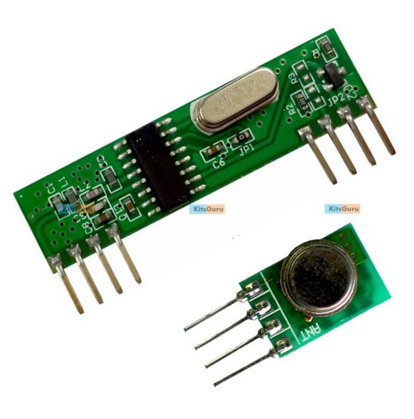
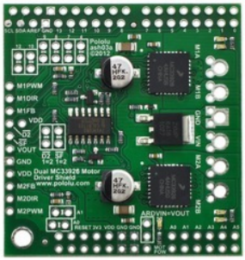
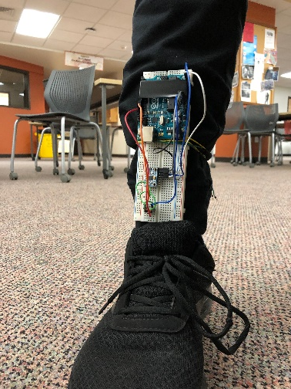
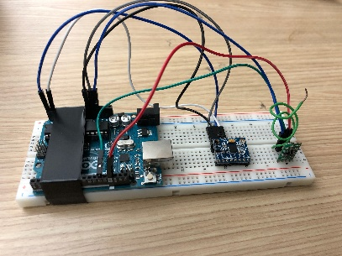
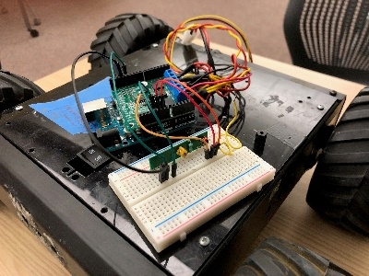
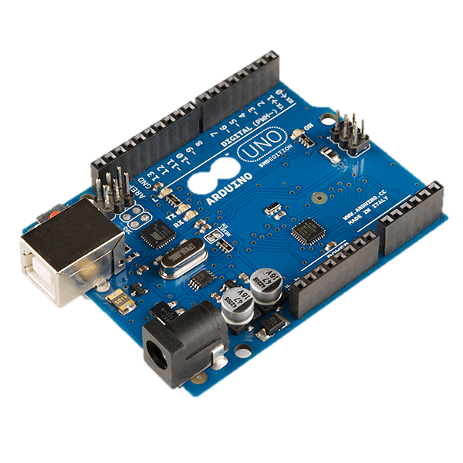
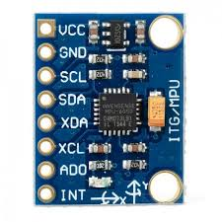
Rochester Institute of Technology
Principle of Robotics Project – Fall 2018
Telerobot
Mission Statement
Mobile Robot – RF module (434 Hz)
The Rf module consists of both RF transmitter and
and receiver , which helps for the data to be transmitted
and received serially , it is used as a communication channel through which the accelerometer values are sent at Tx and received at Rx. This is also powered up by Arduino.
Arduino coding steps for the project
The steps for the successful running of the mobile robot is same as combining both the hardware and software simulation .
The process follows the following steps:
Calibration of gyroscope
Reading gyroscope values
Converting integer values of X,Y and Z values into characters
Communicating the characters to other Arduino as PWM signals
Communication is done through RF module(434Mhz)
The receives the PWM signals and send it to motor driver
The motor driver shield fixed to Arduino acts as driver
the robot moves depending on the walking action of the user
Telerobotics is a field of robotics which mainly deals with controlling a semi-autonomous robot from a distance using a wireless network. This project presents a telerobot which has been realized using a four wheel differential drive robot. The robot is controlled by the walking action of the user. This can be brought about by attaching a gyroscope to a user’s leg and sending the values recorded from the gyroscope from the users end to the robot using an RF transmitter and receiver as a wireless network and an Aurdino-uno can be used as a microcontroller which controls the robot depending on the values received at the receiver end. This robot is intended to be controlled similarly to how the human body is controlled hence the robot should move forward when the user performs the forward walking action and the robot should move backward when the user performs the backward walking action and the robot should when the user stops and turn towards the appropriate direction in which the user is turning.
Pololu Motor Controller MC33926:
the Pololu motor driver shield is used to control two bidirectional, brushed dc motors with arduino. The board consists of a pair of freescale MC33928 motor drivers, which operate from 5v to 28v and can deliver a continuous 3 A per channel, and includes current sense circuitry, protection resistors, a FET for reverse battery protection , and logic gates to reduce the number of I/O pins.
People
Results
FACULTY ADVISOR
Dr. Ferat Sahin
The robot that is the four-wheel differential drive robot can be successfully controlled by the walking action of the user, care should be taken to use a battery with full charge in order to provide maximum power to the motors otherwise the motors won’t get enough power to perform the turning action.
Sometimes the accelerometer values in the x direction which is used as a reference for the forward and backward motion abruptly increases for the turn action hence the values from the gyroscope should be observed carefully for each action before applying thresholds for the appropriate action.
When the analog gyro values was sent from the transmitter to the receiver an offset was added to the gyro values when it was read at the receiving side hence the thresholds for the specific action was applied at the transmitting side and a character was assigned for each classified motion and was sent from the transmitter to the receiver. Depending on the character received by he receiver specific action related to the motion of the user was performed by the robot.
STUDENT
Shravan Bhoopasamudram Krishna, Suhasa Prabhu Kandikere, Charles Pinkerton
Hardware
The hardware in this project was the following :
1.Four wheeled differential Robot
2.Arduinos (2No’s)
3.MPU-6050
4.RF transmitter and RF receiver (434Mhz)
The Transmitter Part consists of RF transmitter and MPU 6050 sensor interfaced with Arduino Uno, Here I2C communication is used as a means of communication between MPU-6050 sensor and Arduino Uno, the threshold was set for various motions of the user and sent through the RF transmitter, RF transmitter used in this project operates at 434Mhz frequency and has a range of 500ft.
This part consisted of RF receiver and Pololu MC33926 motor controller interfaced with Arduino Uno to drive the servo motors connected to the wheels of the differential drive robot. According to the bits received from RF Transmitter, the robot performs the necessary action.
Depending on the values sent by the transmitter, the receiver was coded to perform corresponding action on the mobile robot
Software
Conclusion
Mobile Robot – Arduino
An Arduino Uno is used to receive serial strings sent from the Arduino program running on the Arduino over a USB connection. The Arduino will take this data and drive the appropriate servos using PWM signals
Arduino Code
An Arduino Uno is used to receive serial strings or characters sent from other Arduino code sent from Arduino. The Arduino is responsible for parsing the incoming string or character and assigning each of these values to drive the motor which is fixed to Arduino at the receiver. This motor values depends on the PWM signal the Arduino is sending. After the Arduino has completed receiving the string or character and driving the motors to the appropriate value and hence it receives the characters and as per the code it performs specific action as programmed by the user.
The robot was successfully controlled by the walking action of the user, and the future work involves interfacing the robot with the camera and a 3D printed arm which mimics the user’s arm. The video recorded from the camera will be directly streamed to the VR device worn by the use, which in turn provides an immersive experience for the user controlling the robot.
Mobile Robot – MPU-6050
An MPU-6050 is a 6- axis motion tracking device, it has 3-axis accelerometer and 3 – axis gyroscope with MEMs technology.
Gyroscope and accelerometer is calibrated before embedding it into the core of the program. Gyroscope values is used for forward and backward motion of the user, accelerometer values for right and left motion of the robot

