Slide 1
Foundations of Data Science & Analytics DSCI 633, Fall 2021
Lecture 4
Nidhi Rastogi
Assistant Professor, GCCIS, RIT
September 02, 2021

Slide 2
Course Information
GitHub link - https://github.com/aiforsec/RIT-DSCI-633-FDS
Assignment 2 will be uploaded by 5p mycourses
Submission due on Tuesday, 09/07/2021
Next week both classes will be via Zoom
Link will be Announced

Slide 3
Lecture Objective
Study and explore MNIST dataset
Train a binary classifier
Study and explore Performance Measures
Study and explore Error Analysis

Slide 4
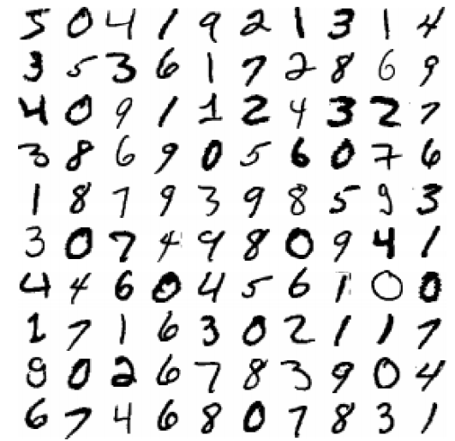
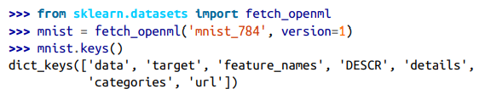
MNIST
70,000 small images of digits handwritten by high school students and employees of US Census Bureau
Each image labeled with the digit it represents
What kind of algorithm is this?
Baseline for new classification algorithms
Scikit-Learn provides helper functions to download
this dataset, and keys to describe it (shape, ..)
Notes:
Hello World of machine learning.

Slide 5
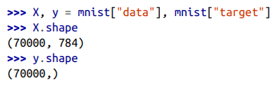
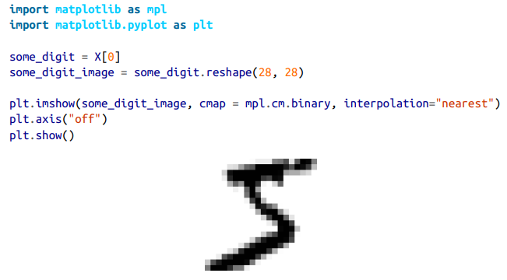

MNIST
Each image has 784 features: 28×28 pixels
Each feature represents one pixel’s intensity (0 (white) - 255 (black))

Slide 6
Training a binary classifier using MNIST
Binary classifier – distinguish between 2 classes
Example – “5” or “not-5”
Pick a classifier
say Stochastic Gradient Descent (SGD)
Let’s create it in colab
Target Vector

Slide 7


Steps to create an SGD binary classifer
using Scikit-Learn’s SGDClassifier class
Now you can use it to detect images of the number 5
5
When it detects a 5, it’s true
Notes:
Hello World of machine learning.

Slide 8
Performance Measures
Measuring Accuracy using Cross-Validation
Confusion Matrix
Precision and Recall
Precision/Recall Tradeoff
ROC Curve
Notes:
Hello World of machine learning.

Slide 9
Performance Measures
Measuring Accuracy using Cross-Validation
Confusion Matrix
Precision and Recall
Precision/Recall Tradeoff
ROC Curve
Notes:
Hello World of machine learning.

Slide 10
K-fold cross-validation
Randomly splitting training set into K distinct subsets called folds
Classification model trains and evaluates K times, picking a different fold for evaluation every time and training on the rest
Say K=3; it becomes 3-fold cross validation
Choose one fold for evaluation, and training on the other 2 folds
You don’t have to do anything manually
sci-kit has code that does it for you
But is it really a good measure of performance???
Notes:
Hello World of machine learning.

Slide 11
Performance Measures
Measuring Accuracy using Cross-Validation
Confusion Matrix
Precision and Recall
Precision/Recall Tradeoff
ROC Curve
Notes:
Hello World of machine learning.

Slide 12

Confusion Matrix
General idea: Count # of times instances of class A classified as class B.
Example – Class “5” was classified as “not-5” or “3”
How to compute
compare a set of predictions with actuals
Both come from cross validation of training dataset
REMEMBER: never touch the test dataset. Keep it aside after 80:20 and forget about it until you’ve a classifier ready.
K-fold cross validation
Performs k-fold predictions made on each test fold
Returns prediction for each instance in TRAINING dataset
Notes:
Hello World of machine learning.

Slide 13

Confusion Matrix contd…
Ready to get the confusion matrix
What are the various responses that the confusion matrix represents
2 options: True – “5” ; False – “non-5”
Each row – Actual Class ; Each column – Predicted Class
How would a perfect classifier look like?
 | Predicted Class | Predicted Class
Actual Class | 53,057 | 1522
Actual Class | 1325 | 4096
 | Predicted “non-5” | Predicted “5”
Actual “non-5” | 53,057 | 1522
Actual “5” | 1325 | 4096
Notes:
Hello World of machine learning.

Slide 14
Performance Measures
Measuring Accuracy using Cross-Validation
Confusion Matrix
Precision and Recall
Precision/Recall Tradeoff
ROC Curve
Notes:
Hello World of machine learning.

Slide 15

Precision
Confusion Matrix is useful, but…
We need a more concise metric: Precision
TP: #true positives, FP: #false positives.
4096 / (4096 + ?)
4096 / (4096 + 1522)
 | Predicted “non-5” | Predicted “5”
Actual “non-5” | 53,057 | 1522
Actual “5” | 1325 | 4096
 | Predicted “non-5” | Predicted “5”
Actual “non-5” | 53,057 (True -ve) | 1522 (False +ve)
Actual “5” | 1325 (False -ve) | 4096 (True +ve)
Notes:
Hello World of machine learning.

Slide 16


Recall
Let’s see what we get as precision and recall score
For convenience, F1 score can be used
What are some of the cases where you’d care about precision, or about recall?
 | Predicted “non-5” | Predicted “5”
Actual “non-5” | 53,057 (True -ve) | 1522 (False +ve)
Actual “5” | 1325 (False -ve) | 4096 (False +ve)
Notes:
Hello World of machine learning.

Slide 17
Performance Measures
Measuring Accuracy using Cross-Validation
Confusion Matrix
Precision and Recall
Precision/Recall Tradeoff
ROC Curve
Notes:
Hello World of machine learning.

Slide 18
Precision Recall tradeoff
Say you’re training a classifier to detect videos that are safe for kids. What would you prefer to use as a performance measure?
Classifier that rejects many good videos (low recall) but keeps only safe ones (high precision)
OR
Classifier that has a much higher recall but lets a few really bad videos show up in your product
Notes:
Hello World of machine learning.

Slide 19
Precision Recall tradeoff
Say you’re training a classifier to detect shoplifters on surveillance images?
Classifier that has high recall and low precision
OR
Classifier that has low recall and high precision
Notes:
Hello World of machine learning.

Slide 20
Performance Measures
Measuring Accuracy using Cross-Validation
Confusion Matrix
Precision and Recall
Precision/Recall Tradeoff
ROC Curve
Notes:
Hello World of machine learning.

Slide 21
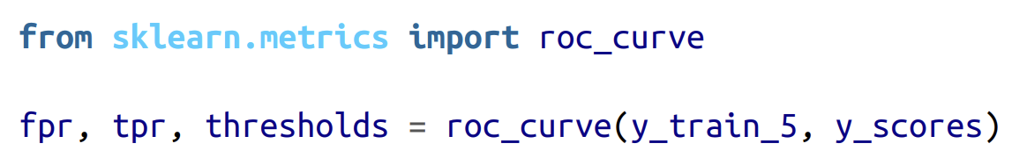
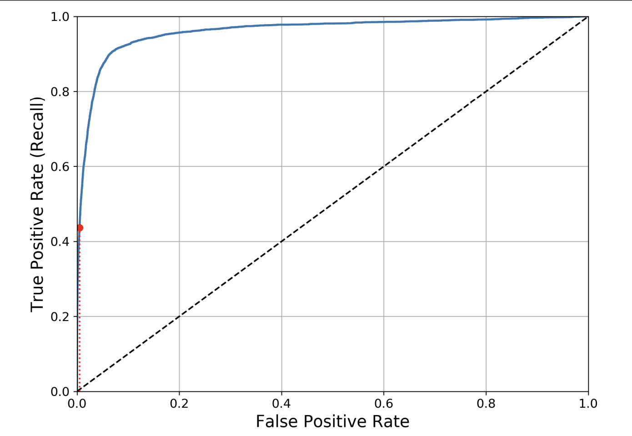
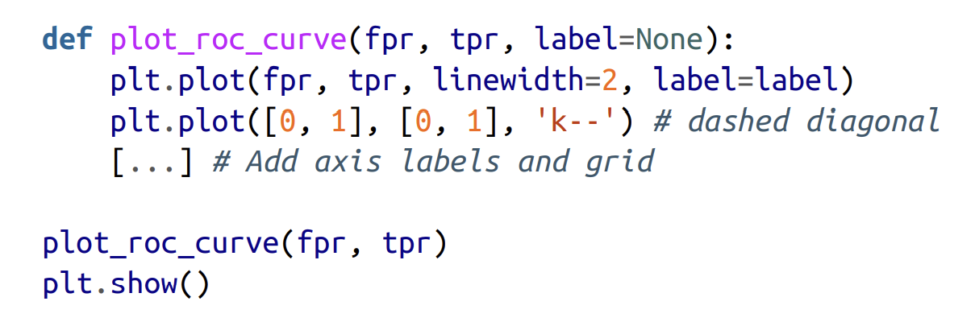
ROC Curve
ROC curve plots the TPR(also called recall) against FPR.
FPR: negative instances incorrectly classified as positive
How to plot ROC curve:
Compute TPR and FPR for various threshold values, using roc_curve()
Plot the FPR against the TPR using Matplotlib
ROC Curve
Notes:
Hello World of machine learning.

Slide 22
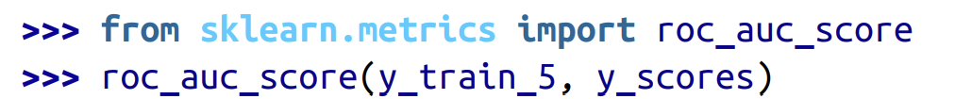
ROC Curve
Dotted line represents the ROC curve of a purely random classifier
A Good classifier stays as far away from dotted line (toward the top-left corner).
How to compare classifiers using ROC Curve?
By measuring area under the curve (AUC) and comparing it
Scikit-Learn function to compute the ROC AUC:
ROC Curve
Notes:
Hello World of machine learning.

Slide 23
Error Analysis
Comes after you have found a reasonably good model for your project
Next: Analyze types of errors it makes
Use Confusion Matrix
Notes:
Hello World of machine learning.

Slide 24
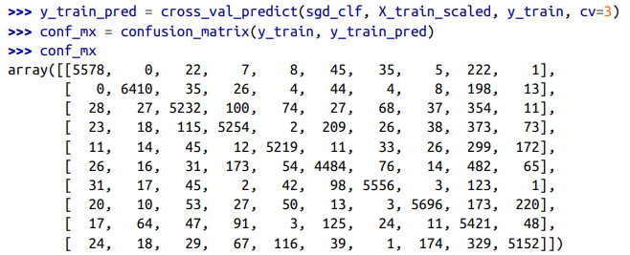

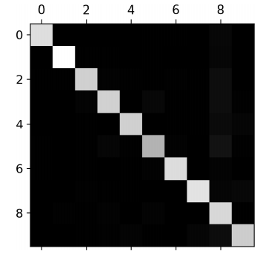
Error Analysis
Look at the main diagonal
5s looks darker than the other digits
Notes:
Hello World of machine learning.

Slide 25
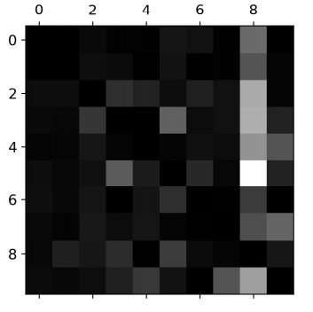
Error Analysis
Rows represent actual classes, columns represent predictions
Look at the bright square for number 8
8 row : actual classified pretty well
8 column: very light, other numbers get misclassified as 8
Where should you focus next?
Reducing false positives for 8s
Engineer new features that can improve classification of 8
Look at the bright square
8s look brighter than others
Notes:
Hello World of machine learning.

Slide 26
No Pop Quiz today

Slide 27
Open Floor

