Slide 1

Network Routing and Switching
Basic Switching Concepts and Configuration
Prepared By GAN.BS Sept 2025

Slide 2
Introduction
Switches are used to connect multiple devices together on the same network.
In a properly designed network, LAN switches are responsible for directing and controlling the data the flow at the access layer to networked resources.

Slide 3
Boot Sequence
After a Cisco switch is powered on, it goes through the following boot sequence:
First, the switch loads a power-on self-test (POST) program stored in ROM. POST checks the CPU subsystem. It tests the CPU, DRAM, and the portion of the flash device that makes up the flash file system.
Next, the switch loads the boot loader software. The boot loader is a small program stored in ROM and is run immediately after POST successfully completes.

Slide 4
The boot loader performs low-level CPU initialization. It initializes the CPU registers, which control where physical memory is mapped, the quantity of memory, and its speed.
The boot loader initializes the flash file system on the system board.
Finally, the boot loader locates and loads a default IOS operating system software image into memory and hands control of the switch over to the IOS.

Slide 5
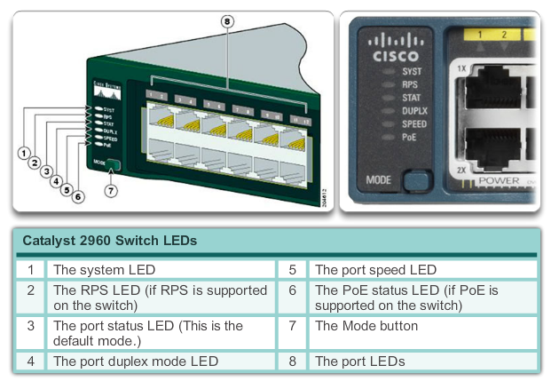
Switch LED

Slide 6
System LED - Shows whether the system is receiving power and is functioning properly. If the LED is off, it means the system is not powered on. If the LED is green, the system is operating normally. If the LED is amber, the system is receiving power but is not functioning properly.
Redundant Power System (RPS) LED - Shows the RPS status. If the LED is off, the RPS is off or not properly connected. If the LED is green, the RPS is connected and ready to provide back-up power. If the LED is blinking green, the RPS is connected but is unavailable because it is providing power to another device. If the LED is amber, the RPS is in standby mode or in a fault condition. If the LED is blinking amber, the internal power supply in the switch has failed, and the RPS is providing power.

Slide 7
Port Status LED - Indicates that the port status mode is selected when the LED is green. This is the default mode. When selected, the port LEDs will display colors with different meanings. If the LED is off, there is no link, or the port was administratively shut down. If the LED is green, a link is present. If the LED is blinking green, there is activity and the port is sending or receiving data. If the LED is alternating green-amber, there is a link fault. If the LED is amber, the port is blocked to ensure a loop does not exist in the forwarding domain and is not forwarding data (typically, ports will remain in this state for the first 30 seconds after being activated). If the LED is blinking amber, the port is blocked to prevent a possible loop in the forwarding domain.

Slide 8
Port Duplex LED - Indicates the port duplex mode is selected when the LED is green. When selected, port LEDs that are off are in half-duplex mode. If the port LED is green, the port is in full-duplex mode.
Port Speed LED - Indicates the port speed mode is selected. When selected, the port LEDs will display colors with different meanings. If the LED is off, the port is operating at 10 Mb/s. If the LED is green, the port is operating at 100 Mb/s. If the LED is blinking green, the port is operating at 1000 Mb/s.

Slide 9
Power over Ethernet (PoE) Mode LED - If PoE is supported; a PoE mode LED will be present. If the LED is off, it indicates the PoE mode is not selected and that none of the ports have been denied power or placed in a fault condition. If the LED is blinking amber, the PoE mode is not selected but at least one of the ports has been denied power, or has a PoE fault. If the LED is green, it indicates the PoE mode is selected and the port LEDs will display colors with different meanings. If the port LED is off, the PoE is off. If the port LED is green, the PoE is on. If the port LED is alternating green-amber, PoE is denied because providing power to the powered device will exceed the switch power capacity. If the LED is blinking amber, PoE is off due to a fault. If the LED is amber, PoE for the port has been disabled.

Slide 10
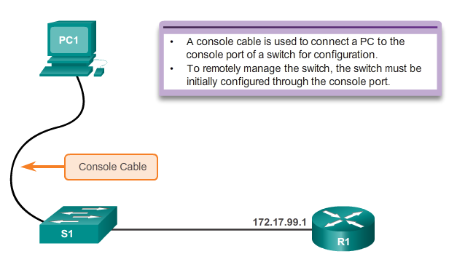
Configure a Switch with Initial Settings

Slide 11
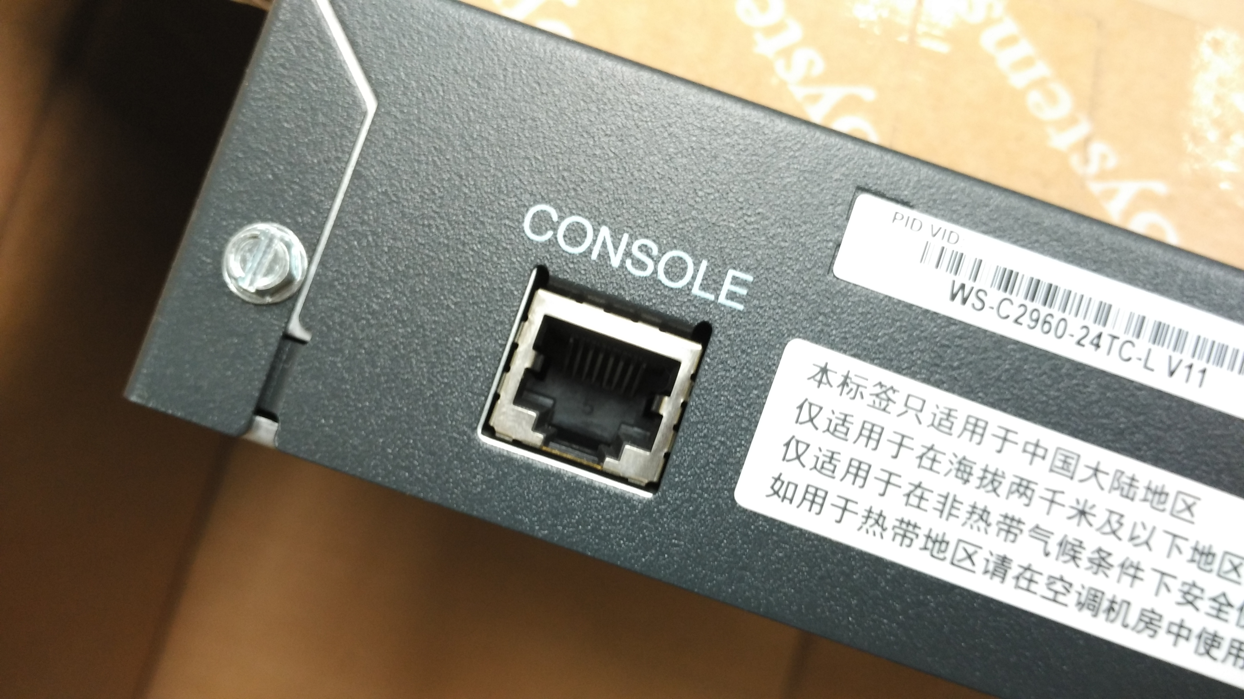

Slide 12
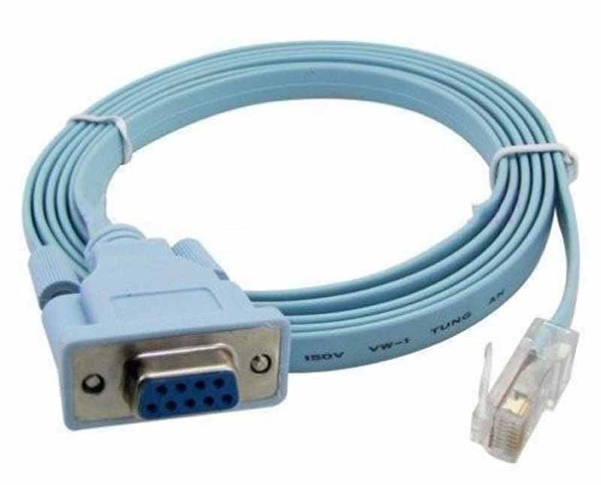

Slide 13
Basic Switch Configurations
configure terminal -- 进入配置模式
hostname -- 配置设备的名字
banner motd -- 配置开始进入设备时显示的信息
enable secret XXX -- 配置加密enable密码，XXX是你要配的密码
line console 0 / line vty 0 15
password YYY -- YYY是你要配的密码
login
--- console为使用console连接时需要输入的密码
--- vty为telnet连接需要输入的密码

Slide 14
service password-encryption ---屏蔽密码
interface vlan 1
ip address X.X.X.X Y.Y.Y.Y
ip default gateway X.X.X.X Y.Y.Y.Y
no shutdown
end
wr
copy running-config startup-config
show run ---显示目前运行的配置

Slide 15
Full-duplex
Full-duplex communication improves the performance of a switched LAN.
Full-duplex communication increases effective bandwidth by allowing both ends of a connection to transmit and receive data simultaneously.
This is also known as bidirectional.
This method of optimizing network performance requires micro-segmentation.
A micro-segmented LAN is created when a switch port has only one device connected and is operating at full-duplex.
This results in a micro size collision domain of a single device. Because there is only one device connected, a micro-segmented LAN is collision free.

Slide 16
Half-duplex
Unlike full-duplex communication, half-duplex communication is unidirectional.
Sending and receiving data does not occur at the same time.
Half-duplex communication creates performance issues because data can flow in only one direction at a time, often resulting in collisions.
Half-duplex connections are typically seen in older hardware, such as hubs.
Full-duplex communication has replaced half-duplex in most hardware.

Slide 17
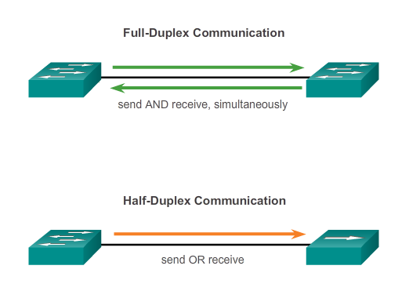

Slide 18
Full/Half Duplex configuration:
Switch(config)#int f0/1
Switch(config-if)#duplex ?
auto Enable AUTO duplex configuration
full Force full duplex operation
half Force half-duplex operation
Switch(config-if)#duplex full
Switch(config-if)#speed ?
10 Force 10 Mbps operation
100 Force 100 Mbps operation
auto Enable AUTO speed configuration
Switch(config-if)#speed 100

Slide 19
Cable Type
Certain cable types (straight-through or crossover) were required when connecting devices.
Switch-to-switch or switch-to-router connections required using different Ethernet cables.
Using the automatic medium-dependent interface crossover (auto-MDIX) feature on an interface eliminates this problem.
When auto-MDIX is enabled, the interface automatically detects the required cable connection type (straight- through or crossover) and configures the connection appropriately.

Slide 20
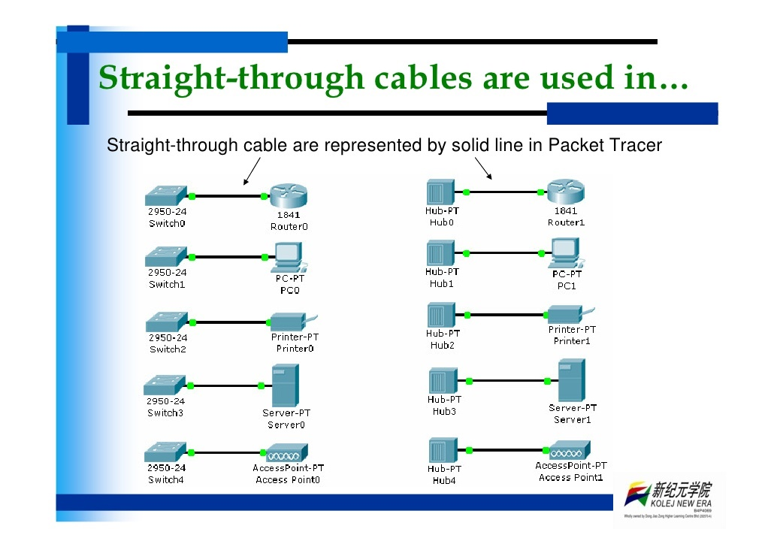

Slide 21
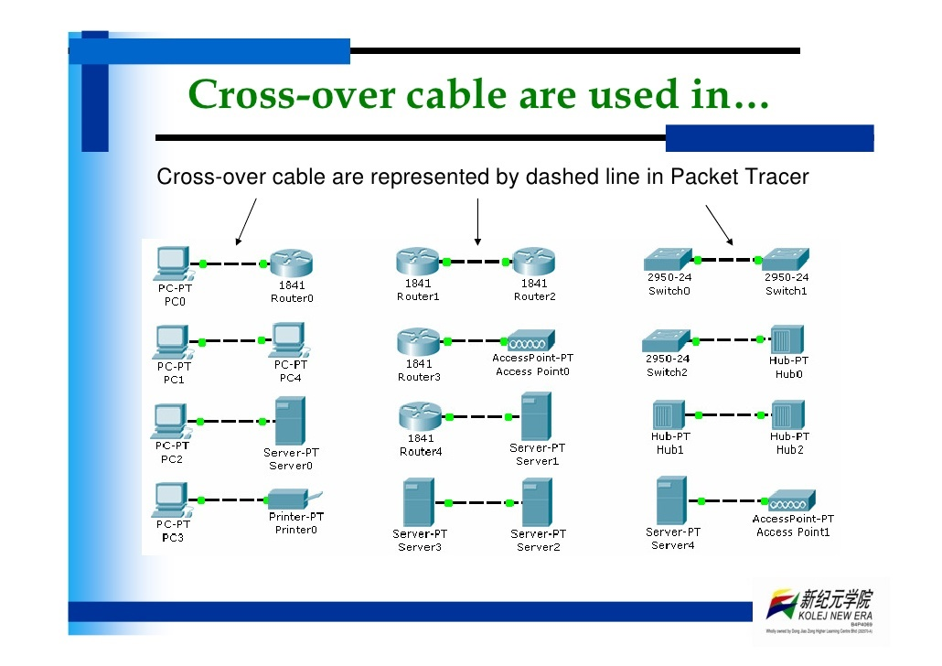

Slide 22
Switch port configuration to auto detect cable type:
Switch(config)#int f0/1
Switch(config-if)#mdix auto

Slide 23
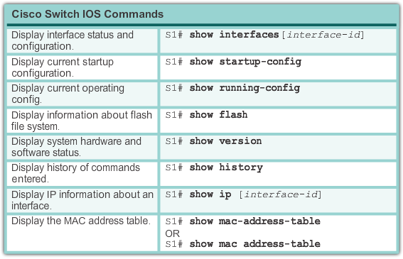
Verifying Switch Port Configuration

Slide 24
Security practice
Develop a written security policy for the organization.
Shut down unused services and ports.
Use strong passwords and change them often.
Control physical access to devices.
Avoid using standard insecure HTTP websites, especially for login screens; instead use the more secure HTTPS.
Perform backups and test the backed up files on a regular basis.

Slide 25
Educate employees about social engineering attacks, and develop policies to validate identities over the phone, via email, and in person.
Encrypt and password-protect sensitive data.
Implement security hardware and software, such as firewalls.
Keep software up-to-date by installing security patches weekly or daily, if possible.

Slide 26
Configure SSH to replace telnet
Switch(config)#ip domain-name cisco.com
Switch#conf t
Switch(config)#hostname ABC
ABC(config)#crypto key generate rsa
The name for the keys will be: ABC.cisco.com
Choose the size of the key modulus in the range of 360 to 2048 for your
General Purpose Keys. Choosing a key modulus greater than 512 may take a few minutes.
How many bits in the modulus [512]: 1024
% Generating 1024 bit RSA keys, keys will be non-exportable...[OK]
ABC(config)#username admin password ccna
ABC(config)#line vty 0 15
ABC(config-line)#transport input ssh
ABC(config-line)#login local
ABC(config-line)#end
ABC#

