Slide 1



Final Group Assignment --- TCP/IP
TCP/IP
Team Member：Tan Xian Chuan，Liang Sze Kai，Derrick

Slide 2
INTRODUCTION OF TCP/IP
What is TCP/IP ？
TCP/IP stands for Transmission Control Protocol / Internet Protocol. It is a suite of communication protocols used to interconnect network devices on the internet or local networks.
(TCP/IP代表传输控制协议/互联网协议。它是一套用于在互联网或本地网络上互连网络设备的通信协议)
A suite of communication protocols used to connect devices on the internet.
用于连接 Internet 上的设备的一套通信协议。
Enables data transmission between devices.
设备之间的数据传输。

Slide 3

1. TCP is responsible for reliable data transmission between devices.
(TCP负责设备之间的可靠数据传输)
2. IP is responsible for addressing and routing packets of data so that they reach the correct destination.
(IP负责数据的寻址和路由，确保数据包到达正确的目的地)
KEY PROTOCOLS OF TCP/IP

Slide 4
WHAT IS THE TCP/IP MODEL ?
The TCP/IP model is a conceptual framework (like a layered model) that describes how different protocols interact in the network communication process. It consists of four layers
(TCP/IP模型是一个概念框架（类似于分层模型），它描述了不同协议在网络通信过程中的交互方式)
Application Layer – Deals with application-level functions
(处理应用程序级功能)(e.g., HTTP, FTP, DNS, SMTP)
Internet Layer – Handles addressing and routing
(处理寻址和路由) (e.g., IP, ICMP)
Network Access Layer – Responsible for physical data transmission
(负责物理数据传输) (e.g., Ethernet, Wi-Fi)
Transport Layer – Ensures reliable data delivery
(确保可靠的数据交付) (e.g., TCP, UDP)

Slide 5
WHAT'S THE DIFFERENCE BETWEEN TCP/IP AND THE TCP/IP MODEL?
Term | Description
TCP/IP | This actual Protocol suite (a set of networking protocols). （实际的协议套件（一组网络协议））
TCP/IP Model | The theoretical framework of model describing how TCP/IP protocols work. (描述TCP/IP协议如何工作的理论框架或模型)
You can think of it this way:
•TCP/IP is like the car (what actually moves data).
•The TCP/IP model is like the blueprint that shows how the car works.

Slide 6
KEY PRINCIPLE OF TCP/IP
Layered Design
End-to-Communication
Protocol Independence
Scalable & Robust
Each layer has its own function.
Direct communication between devices.
Use different protocols as needed (e.g. TCP vs UDP).
Works on small to global networks.
IP Addressing
Packet Switching
Stateless (mostly)
Open Standards
Every device has a unique address.
Data is split into packets for efficiency.
IP doesn’t track past packets, simplifying routing.
Free to use, supported globally.

Slide 7
Working principle of TCP/IP
Data transmission process
Application layer
The application generates data (such as HTTP request).
Application layer
Processes data (such as displaying a web page).
Transport layer
TCP divides the data into segments and adds headers (port, sequence number).
Establish a connection (three-way handshake, see below).
Transport layer
TCP reassembles data, sends ACK, and passes it to the application layer.
Network layer
IP encapsulates data into packets and adds source/destination IP.
Network layer
Verifies the IP header and passes it to the transport layer after stripping.
Network interface layer
Encapsulates into frames, adds MAC addresses, and sends through physical media.
Network interface layer
Receives frames and strips off the MAC header.

Slide 8
Working principle of TCP/IP
TCP Connection Management
Three-way handshake (establishing
Four waves (closing the connection)
The client sends SYN (Seq=x).
The server replies SYN-ACK (Ack=x+1, Seq=y).
The client sends FIN (Seq=x).
The server replies ACK (Ack=x+1).
The client sends ACK (Ack=y+1).
The connection enters the ESTABLISHED state, and both parties can transmit data.
The server sends FIN (Seq=y).
The client replies ACK (Ack=y+1)
TCP uses sequence numbers and confirmation numbers to ensure that data is in order and not lost.
The sliding window controls the flow, and congestion control adjusts the sending rate.
Data transmission
Both parties enter the CLOSED state.

Slide 9
Working principle of TCP/IP
IP routing
Routing process
Error handling
The network layer searches the routing table based on the target IP and determines the next hop.
handles errors through retransmission and checksum (verifying data integrity)
TCP
The data packet may pass through multiple routers and finally reach the target.
IP
packets may be lost or out of order, TCP is responsible for correction
Features
IP does not guarantee that data packets arrive in order or are not lost, and relies on TCP to handle these problems
reports errors (such as "destination unreachable")
ICMP (Internet Layer Auxiliary Protocol)
Support fragmentation: large data packets can be divided into small pieces and reassembled at the receiving end

Slide 10
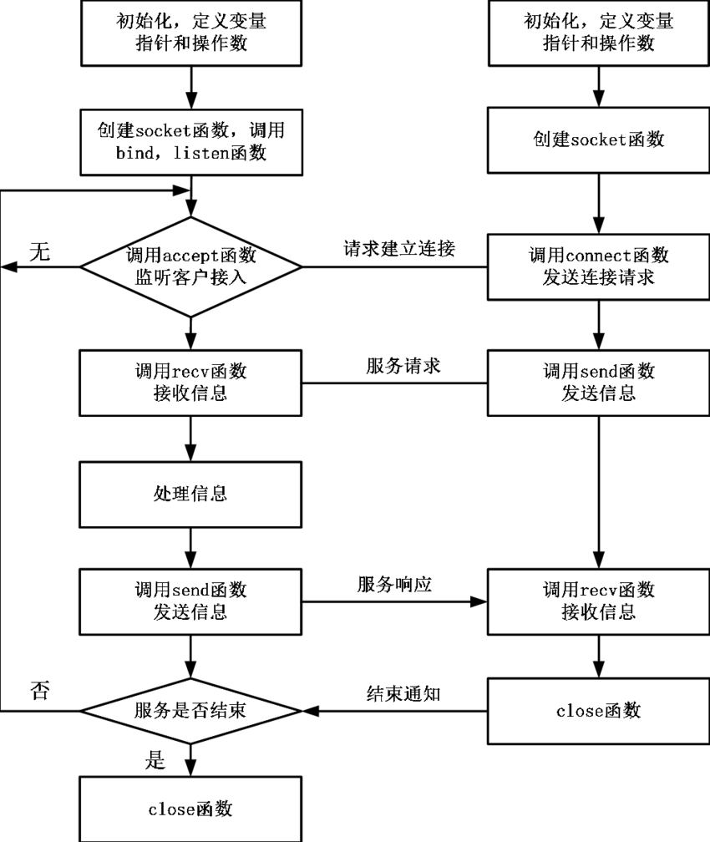
TCP/IP VISUAL ELEMENTS
TCP/IP communication flow chart
TCP/IP的通讯流程图

Slide 11
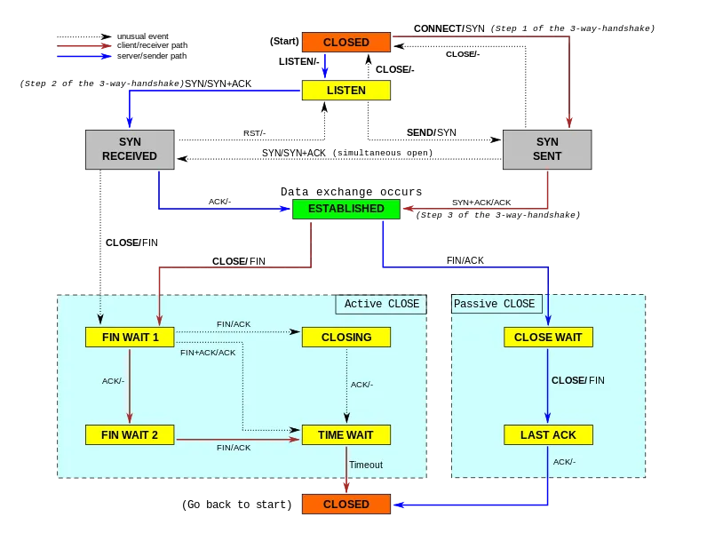
Starting from the CLOSED state, the server enters the LISTEN state, waiting for the client to connect
2. The client sends a SYN (synchronization) packet and enters
the SYN SENT (synchronization sent) state
3. The server receives SYN, replies SYN-ACK, and
enters the SYN RECEIVED (synchronous received) state.
4. The client receives SYN-ACK, replies ACK (confirmation),
and enters the ESTABLISHED state.
5. The server receives ACK and enters the ESTABLISHED
state, and the connection is established.

Slide 12
REAL – LIFE TCP/IP USE CASE
Browsing the web (HTTP/HTTPS over TCP/IP)
Real-world scenario: You type "baidu.com" in the Chrome browser on your phone or computer and press Enter.
（现实场景：你在手机或电脑上的 Chrome 浏览器输入 “baidu.com”，按下回车）
What happens behind the scenes（背后发生的事）:
The browser first resolves the IP address of baidu.com through DNS (based on UDP or TCP);
（浏览器首先通过 DNS（基于 UDP 或 TCP）解析 baidu.com 的 IP 地址）
Then establishes a connection with Baidu's server through TCP (three-way handshake);
（然后通过 TCP 建立与百度服务器的连接（三次握手））
Finally, HTTP or HTTPS is used to download the web page content and present it in the browser.
（最后使用 HTTP 或 HTTPS 下载网页内容并在浏览器中呈现出来）
Send/receive emails (SMTP, IMAP, POP3 over TCP/IP)
Real-world scenario: You use Apple Mail, Outlook, or 163 Mail App to send or receive emails.
（现实场景：你用 Apple Mail、Outlook 或 163 邮箱 App 发送或接收邮件）
What happens behind the scenes（背后发生的事）:
When sending emails, the client establishes a connection with the email server via TCP and uses the SMTP protocol to send emails
（发邮件时，客户端通过 TCP 与邮件服务器建立连接，使用 SMTP 协议发送邮件）
When receiving emails, use the IMAP or POP3 protocol to synchronize with the server or download email content via TCP.
（收邮件时，使用 IMAP 或 POP3 协议通过 TCP 与服务器同步或下载邮件内容。）

Slide 13
REAL – LIFE TCP/IP USE CASE
Video/Voice Calls (Zoom, Skype, WeChat Calls, etc.)
Real-world scenario: You are having a meeting on Zoom or making a voice call on WeChat.
（现实场景：你在用 Zoom 开会，或用微信打语音电话）
What happens behind the scenes（背后发生的事）:
Audio and video call data is transmitted using UDP (faster but may lose packets)
（音视频通话数据使用 UDP 进行传输（更快但可能丢包））
Call establishment and parameter negotiation usually use TCP (to ensure reliability)
（通话建立和参数协商通常使用 TCP（确保可靠性））
The actual voice/video data runs on UDP via RTP (Real-time Transport Protocol) to ensure low latency
（实际语音/视频数据通过 RTP（实时传输协议）运行在 UDP 上，保证低延迟）
Online games (such as Honor of Kings and Genshin Impact)
Real-world scenario: You play games on your phone or computer
（现实场景：你在手机或电脑上打游戏）
What happens behind the scenes（背后发生的事）:
The game client and server establish communication through TCP or UDP
（游戏客户端与服务器通过 TCP 或 UDP 建立通信）
UDP is mainly used to transmit real-time action/location information that allows packet loss
（UDP 主要用于传输实时但允许丢包的动作/位置信息）
TCP is used for login, map loading, ranking acquisition and other parts that require reliable transmission
（TCP 用于登录、加载地图、获取排行榜等需要可靠传输的部分）

Slide 14
REAL – LIFE TCP/IP USE CASE
Remote work (SSH, VPN, remote desktop)
Real-world scenario: You are remotely connected to the company computer or access intranet resources at home.
（现实场景：你在家中远程连接公司电脑或访问内网资源）
What happens behind the scenes（背后发生的事）:
Use SSH to log in to the Linux server securely
（使用 SSH 安全登录 Linux 服务器）
Or establish an encrypted channel through VPN (such as OpenVPN, WireGuard)
（或通过 VPN（如 OpenVPN、WireGuard）建立加密通道）
All connections and data transmission rely on TCP/IP protocol to ensure secure and reliable communication.
（所有连接和数据传输都依赖 TCP/IP 协议，确保通信安全可靠）
File transfer (such as Baidu Netdisk, SFTP)
Real-world scenario: You download movies, upload data, or transfer work files.
（现实场景：你下载电影、上传资料或传输工作文件）
What happens behind the scenes（背后发生的事）:
The protocol used may be HTTP, HTTPS, FTP, or SFTP
（使用的协议可能是 HTTP、HTTPS、FTP 或 SFTP）
These protocols are based on TCP, ensuring that each file data packet is transmitted to the other party in full and in the correct order
（这些协议基于 TCP，确保每一个文件数据包都完整、顺序正确地传输到对方）

Slide 15
TCP/IP Current trends or challenge​
Current Trends
Function: Replace IPv4, provide more network addresses, mobile phones, IoT devices, etc.
（作用：取代IPv4，提供更多网络地址， 手机，物联网设备等等）
IPv6 is more common
IPv6更普遍​
Importance: TCP needs to be adjusted to support IPv6 to ensure speed and stability
（重要性：TCP需调整以支持IPv6，保速度和稳定）
Data: IPv6 accounted for only 15% in 2019, and 40% of global network traffic will use it in 2024
（数据：2019年IPv6仅15%，2024年全球40%网络流量使用​）
Example: Google and AWS have fully used IPv6, and web pages load 20% faster
（例子：Google，AWS已全面使用IPv6，网页加载快20%​）

Slide 16
TCP/IP Current trends or challenge​
Current Trends
Function: 5G video streaming requires ultra-fast networks, and TCP is being improved (such as the BBR algorithm).
（作用：5G的视频流需要超快网络，TCP在改进（如BBR算法））
IFaster connection
更快连接​
Importance: If TCP is not accelerated, it will be replaced
（重要性：TCP若不加快，会被取代）
Data: In 2024, QUIC (a TCP-like rival) accounts for 30% of network traffic, and TCP efficiency is improved by 15%.
（数据：2024年，QUIC（类似TCP的对手）占30%网络流量，TCP效率提高15%。​​）
Example: Nextflix uses QUIC, and video freezes are reduced by 30%
（例子：Nextflix使用QUIC，视频卡顿减少30%​）

Slide 17
TCP/IP Current trends or challenge​
Current Trends
Function: AI helps adjust TCP, predict network congestion, and reduce data loss
（作用：AI帮忙调整TCP，预测网络堵塞，减少数据丢失​）
AI optimization
AI优化
Importance: Make the network smoother, suitable for cloud services and big data
（重要性：让网络更顺畅，适合云服务和大数据​）
Data: In 2024, AI will increase TCP efficiency by 15% - 20%
（数据：2024年，AI使TCP效率提升15% - 20%​​）
Example: Cisco uses AI to optimize enterprise networks, and data transmission is 10% faster
（例子：Cisco用AI优化企业网络，数据传输快10%​）

Slide 18
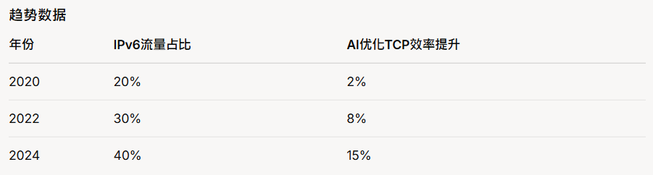
Current Trends Data Sheet

Slide 19
TCP/IP Current trends or challenge​
Challenge
Problem: TCP is vulnerable to hacker attacks (DDOS), paralyzing websites
（问题：TCP容易被黑客攻击（DDOS），瘫痪网站​​）
Many network attacks
网络攻击多
Impact: Additional encryption is required, increasing costs and delays
（影响：需要额外加密，增加成本和延迟​​）
Data: DDOS attacks accounted for 20% in 2019 and 35% in 2024
（数据：2019年DDOS攻击20%，2024年DDOS攻击35%​​​）
Example: In 2023, Danske Bank was shut down for 24 hours due to an attack, with a loss of approximately $750,000
（例子：2023年丹麦银行因攻击停服24小时，损失约75万美元）

Slide 20
TCP/IP Current trends or challenge​
Challenge
Problem: Smart devices (refrigerators, light bulbs, etc.) are too simple to run TCP
（问题：智能设备（冰箱，灯泡等等）太简单，跑不动TCP​​​）
IoT is not adaptable
物联网不适应​
Impact: TCP may be squeezed out of the IoT market by lightweight protocols
（影响：TCP可能会被轻量协议挤出物联网市场​​​）
Data: TCP accounted for 50% of IoT devices in 2019 and 30% in 2024
（数据：2019年TCP在物联网设备占50%，2024年占30%​​​）
Example: Smart homes switch to MQTT, saving up to 50% of electricity
（例子：智能家居改用MQTT，省电高达50%）

Slide 21
TCP/IP Current trends or challenge​
Challenge
Problem: The future 6G network is super fast, and TCP will become a drag if it is not improved
（问题：未来6G网络超快，TCP不改进就变成拖后腿​​​​）
Speed ​​cannot keep up
速度跟不上
Impact: Slow transmission of large files affects the cloud and gaming experience
（影响：大文件传输慢，影响云端和游戏的体验​​​​）
Data: In 2024, TCP speed will only reach 60% of the theoretical speed
（数据：2024年，TCP速度只达到了理论上的60%​​​​）
Example: Data center has 15% more transmission delay due to slow TCP
（例子：数据中心因TCP慢，传输数据延迟多15%）

Slide 22
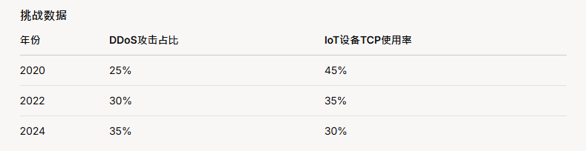
Current Trends Data Sheet

Slide 23
Summary and conclusion（总结）
TCP/IP
A set of communication protocols for interconnecting network devices over the Internet or a local network
（一套用于在互联网或本地网络上互连网络设备的通信协议）
Key points
Layered collaboration: TCP/IP is modularized through layered design, and each layer has a clear division of labor.
（分层协作：TCP/IP通过分层设计实现模块化，各层分工明确。）
TCP reliability: three-way handshake, four-way handshake, sequence number, confirmation mechanism, retransmission and flow control ensure reliable transmission.
（TCP可靠性：三次握手、四次挥手、序列号、确认机制、重传和流量控制确保可靠传输）
IP flexibility: connectionless routing, adapting to complex network environments.
（IP灵活性：无连接路由，适应复杂网络环境。）
Encapsulation mechanism: adding/stripping headers layer by layer to ensure data transmission between different layers.
（封装机制：逐层添加/剥离头部，保证数据在不同层之间的传递。）

Slide 24
Summary and conclusion（总结）
Data transmission process（数据传输流程）
（Use TCP/IP four-layer architecture and protocols）
(使用四层的构架和协议)
How TCP/IP works
TCP connection management（TCP连接管理）
Three-way handshake (establishing a connection) and four-way handshake (closing the connection)
（三次握手（建立连接）和四次挥手（关闭连接））
IP routing（IP路由）
Finally reach the destination according to the routing process
（根据路由过程最终到达目标）
Error handling（错误处理）
TCP: handles errors through retransmission, checksum (verify data integrity).
（TCP：通过重传、校验和（验证数据完整性）处理错误。）
IP: packets may be lost or out of order, TCP is responsible for correction.
（IP：可能丢包或乱序，TCP负责纠正。）

Slide 25
Summary and conclusion（总结）
Faster connections
（更快连接）
IPv6 is more common
（IPv6更普遍）
TCP/IP Current trends
AI Optimization
（AI优化）

Slide 26
Summary and conclusion（总结）
IoT is not adaptable（物联网不适应）
Many cyber attacks
（网络攻击多）
TCP/IP Challenge
Speed ​​cannot keep up（速度跟不上）

Slide 27
Reference（衔接）
What is tcp/ip model
https://www.cloudflare.com/zh-cn/learning/ddos/glossary/tcp-ip/
https://www.techtarget.com/searchnetworking/definition/TCP-IP
https://www.ibm.com/docs/en/aix/7.1?topic=management-transmission-control-protocolinternet-protocol
tcp/ip model
https://www.fortinet.com/resources/cyberglossary/tcp-ip-model-vs-osi-model
https://www.avg.com/en/signal/what-is-tcp-ip
https://www.youtube.com/watch?v=2QGgEk20RXM&ab_channel=TechTerms (video)
Real-life use case
https://www.quora.com/What-are-real-life-examples-of-TCP-IP
https://www.youtube.com/watch?v=3kfO61Mensg&ab_channel=NetworkChuck （video）
Current Trends
1）https://www.google.com/intl/en/ipv6/statistics.html#tab=ipv6-adoption​
3） https://blogs.cisco.com/developer/using-the-power-of-artificial-intelligence-to-augment-network-automation
Challenge​
1） https://www.sohu.com/a/630009938_121124365
2） https://yanjingang.com/blog/?p=3469
3） https://www.cbre.com/insights/reports/european-data-centres-overview%5B​​​

