Slide 1
Design and Analysis of Algorithm Seminar
Group no.- 09
Presented by –
U19CS070 Shubham Kumar Jayswal
U19CS069 Akkaladevi Shreyas
U19CS017 Chakka Vasudev
U19CS094 Shaik R Irshad Areez Ahmmad

Slide 2
Topic-
Minimum number of squares that can be cut from a given rectangle

Slide 3
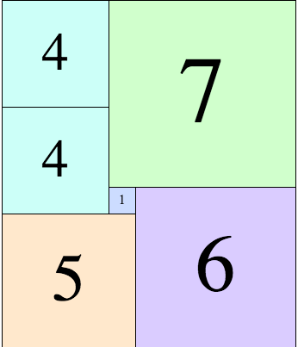
Selling your idea
Given a rectangle of size A x B where A and B are positive integers. Our task is to find the minimum number of squares that can be cut from this rectangle and side length of square should be integer only.
Problem Statement

Slide 4


Examples
Input : 36 x 30 Output : 5 Explanation : 3 (squares of size 12x12) + 2 (squares of size 18x18) Input : 13 x 29 Output : 9 Explanation : 2 (squares of size 13x13) + 4 (squares of size 3x3) + 3 (squares of size 1x1)=9

Slide 5
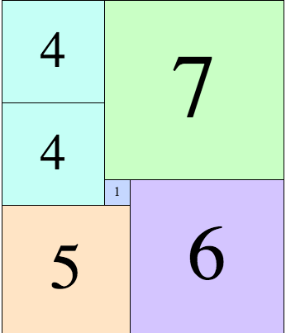
11
13

Slide 6
Different approach for solving the problem

Slide 7
Greedy approach
First, we try to cut the square having maximum possible side from the given rectangle.
Side length of this square is equals to the length of minimum side (either height or length) of the given rectangle.

Slide 8
a
a
b
Side length of the square = minimum( a, b)

Slide 9
Then, we repeat previous two steps for remaining part of the rectangle again and again until we small side of the rectangle is greater than Zero.
5
4 X 4
1 X 1
1 X 1
4
1 X 1
1 X 1

Slide 10
Algorithm
minimumSquare(a, b) :
Result = 0
Rem = 0
// swap if a is small size side .
if (a < b) :
swap(a, b)
// Iterate until small size side is greater then 0
while (b > 0) :
Result = Result + floor(a/b)
Rem = a % b
a = b
b = Rem
return Result
O(1)
O(max(a,b))
= O(n)

Slide 11
Best case – When a and b are equal that means given rectangle is a square. Time complexity = O(1) Because while loop will run once then b will become 0.
Worst case – When either a or b is equals to 1 in the given rectangle.
Time complexity = O(n)

Slide 12
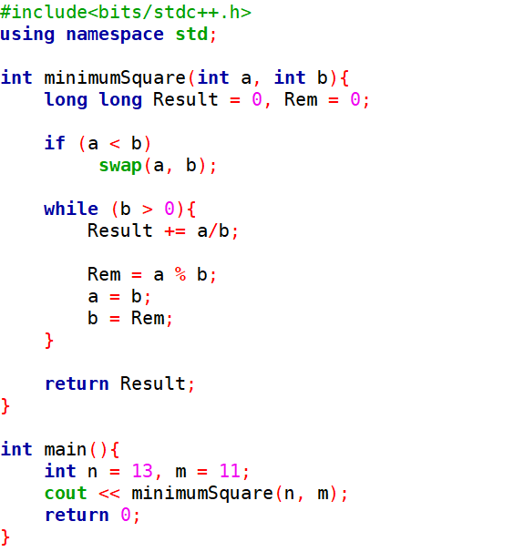
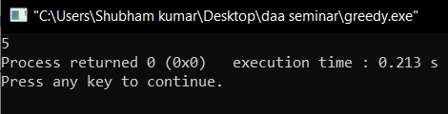
Implementation in C++

Slide 13
Important Point -
There is a major issue with this algorithm-
For some values of a and b, we will get wrong Result.
E.g.- If input : a=13 , b=11 then
Using Greedy algorithm, Output = 8
Explanation- Squares 1 ( 11 X 11 ), 5 ( 2 X 2 ), 2 ( 1 X 1 )
But Minimum number of squares, we can cut from this rectangle is 6.

Slide 14


Slide 15
Dynamic Programming
Recursive Solution
Top-down with memoization
Bottom-up Approach

Slide 16
Recursive Solution

Slide 17
Algorithm
minimumSquare (m, n)
vertical_min = ∞
horizontal_min = ∞
if( (n==11 and m==13) or (m==11 and n==13)) return 6
if (m == n)
return 1
for ( i = 1 to i<= m/2 )
horizontal_min = min(minimumSquare(i, n) +
minimumSquare(m-i, n), horizontal_min)
for ( j = 1 to j<= n/2)
vertical_min = min(minimumSquare(m, j) +
minimumSquare(m, n-j), vertical_min)
return min( vertical_min, horizontal_min)
Special case
DP answer is 8
Already a square
Calculating the minimum answer for the rectangles with width=n and length<m
The rectangle is cut horizontally and vertically into two parts and the cut with minimum value is found for every recursive call.
Calculating the minimum answer for the rectangles with width<n and length=m

Slide 18
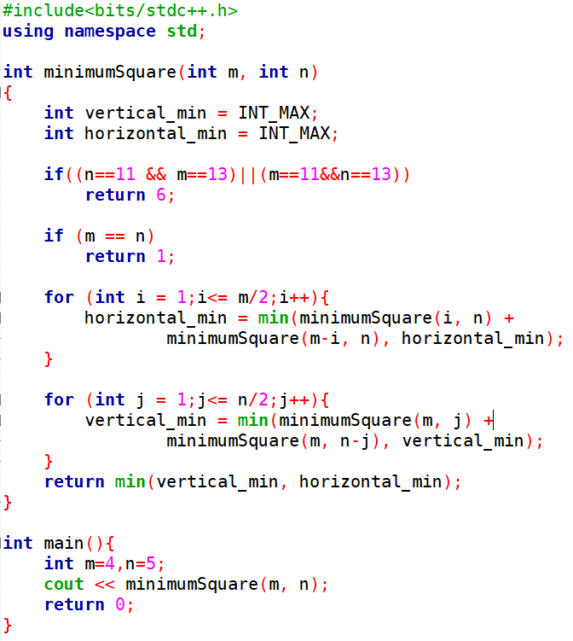
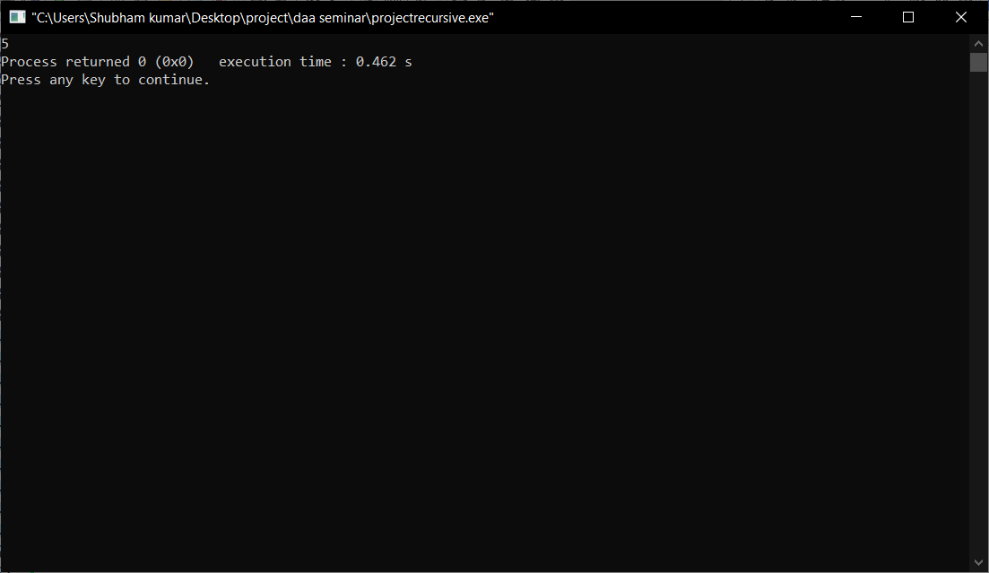
Implementation in C++

Slide 19
Top-down with memoization

Slide 20
Algorithm
minimumSquare (m, n,dp[][])
vertical_min = ∞
horizontal_min = ∞
if( (n==11 and m==13) or (m==11 and n==13)) return 6
if (m == n)
return 1
if (dp[m][n]!=0) return dp[m][n]
for ( i = 1 to i<= m/2 )
horizontal_min = min(minimumSquare(i, n,dp) +
minimumSquare(m-i, n,dp), horizontal_min)
for ( j = 1 to j<= n/2)
vertical_min = min(minimumSquare(m, j,dp) +
minimumSquare(m, n-j,dp), vertical_min)
return dp[m][n]=min(vertical_min, horizontal_min)
If already calculated

Slide 21
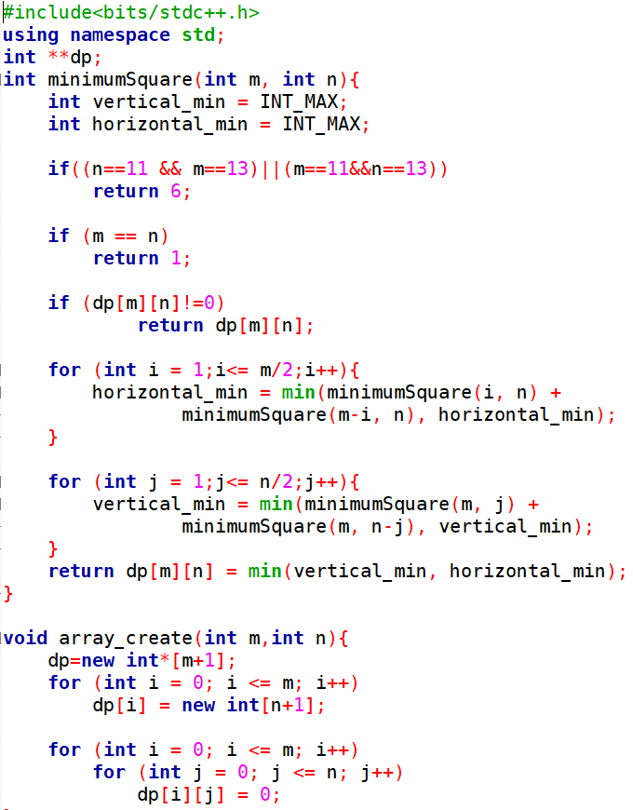
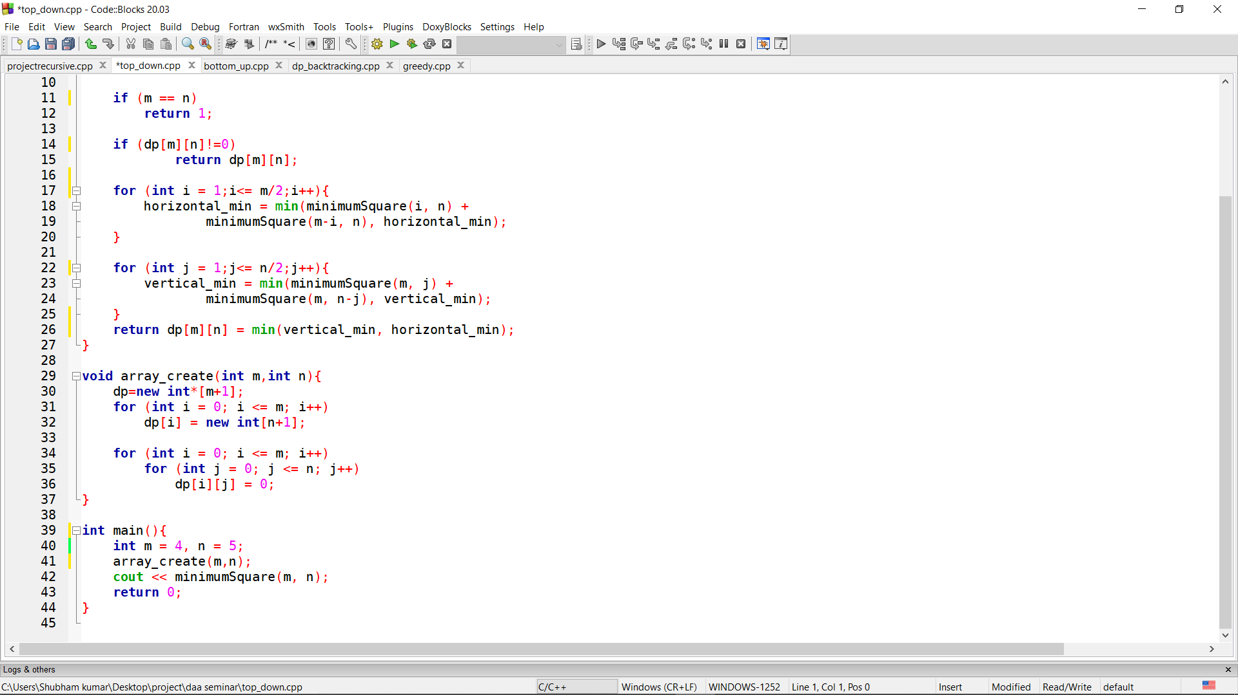
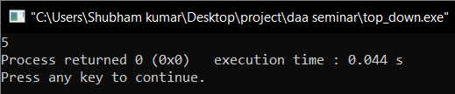
Implementation in C++

Slide 22
Bottom-up Approach

Slide 23
Algorithm
minimumSquare (m, n,dp[][])
if ((n == 11 && m == 13) || (m == 11 && n == 13))
return 6
Declare dp[m + 1][n + 1]
for( i=0 to i<=m)
dp[i][0]=0
for( i=0 to i<=n)
dp[0][i]=0
for (int i = 1; i <= m; i++)
for (int j = 1; j <= n; j++)
if (i == j)
dp[i][j] = 1
continue
dp[i][j] = i * j
for (int k = 1; k <= i / 2; k++)
dp[i][j] = min(dp[i][j], dp[i - k][j] + dp[k][j])
for (int k = 1; k <= j / 2; k++)
dp[i][j] = min(dp[i][j], dp[i][j - k] + dp[i][k])
return dp[m][n]

Slide 24
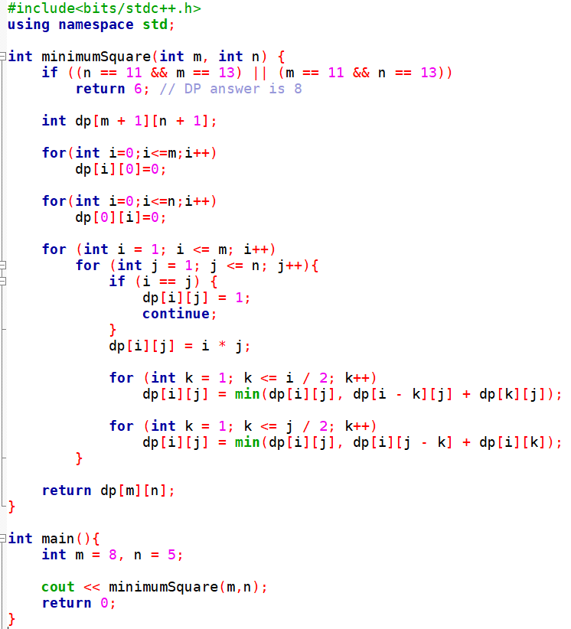
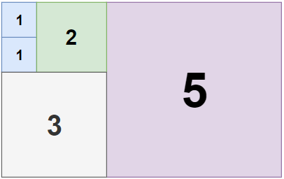

Implementation in C++

Slide 25
Time Complexity: O(mn * max(m, n))
Space Complexity: O(mn)

Slide 26
Important Point -
Like Greedy Solution, in DP solution also, DP solution will not give right output for some input pair.
But count of these input pairs will be less compared to Greedy approach.

Slide 27


Slide 28
DP – Backtracking Solution

Slide 29

We use DFS / backtracking and start stacking squares from any of the four corners- Pruning 1: Try largest possible squares first to prune DFS. Pruning 2: Use results generated by DP discussed above as smaller upper bounds of true answers

Slide 30
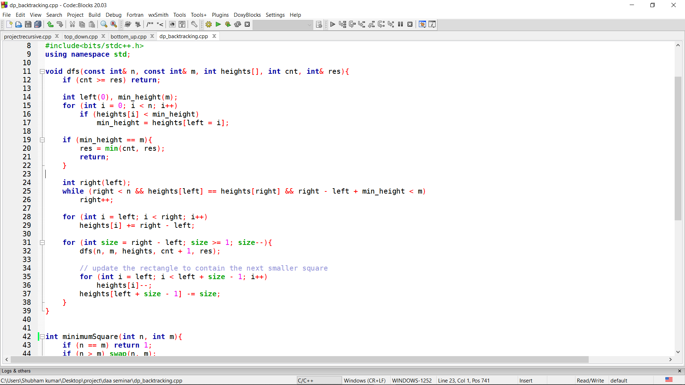
Implementation in C++
Backtracking
Plot the biggest possible square to the rectangle

Slide 31
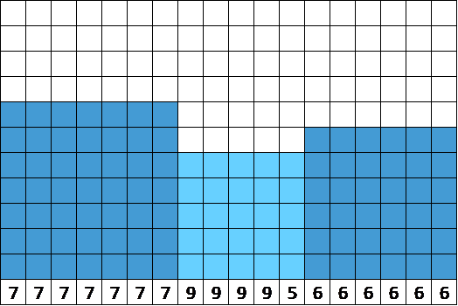
Visualization of heights

Slide 32
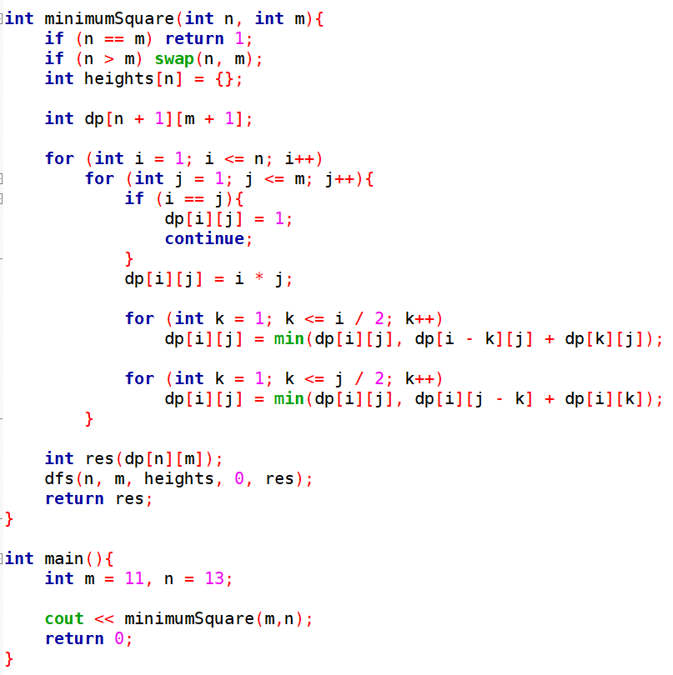
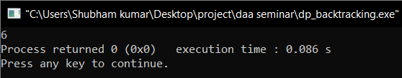
Implementation in C++
Dynamic programming solution

Slide 33
Time Complexity: O(m^n)
Space Complexity: O(n)

Slide 34

Thank you.

