Slide 1

A
Ali Wholesale SaaS
AI-Powered Sales and Delivery Platform for Wholesale Food Distribution
Transforming a manual wholesale operation into an automated lead-to-delivery pipeline using AI voice agents, real-time credit checking, and territory-based logistics.

Slide 2

BUSINESS CONTEXT
Ali's Business Problem Demands Automation, Not More Headcount
Ali is a wholesale food distributor selling bulk ingredients to bakeries in Western Long Island. His current operation is constrained by manual cold-calling (10-15 calls/day), no systematic follow-up on leads who say "not now," and disconnected sales-to-delivery handoffs. The solution is not hiring more salespeople — it is building an AI-assisted platform that handles the routine 80% of calls while keeping Ali in control of the strategic 20%.
SERVICE REGION
TARGET CUSTOMERS
15-mile geofence around Mineola, Long Island
Bakeries, bagel chains, industrial bakeries
PRODUCTS
PRIMARY GOAL
Bulk seeds, nuts, spices, dried fruits, chilies
Scale from 10-15 manual calls/day to 50-100 AI-assisted calls/day

Slide 3
SOLUTION OVERVIEW
The MVP Focuses on Three Core Capabilities
The system combines AI sales automation, CRM pipeline management, and logistics orchestration into a single dashboard. This is not a full platform build — it is a focused MVP that addresses Ali's three biggest bottlenecks.
AI Sales Engine
VAPI AI VOICE AGENT
Automated outbound calling with real-time transcript streaming and keyword extraction.
CRM + Pipeline
SUPABASE (POSTGRESQL + POSTGIS)
Lead tracking, drip campaigns, credit checking, and human escalation workflows.
Logistics
GOOGLE MAPS ROUTING API
Territory-based route grouping with truck capacity management and stop optimization.

Slide 4
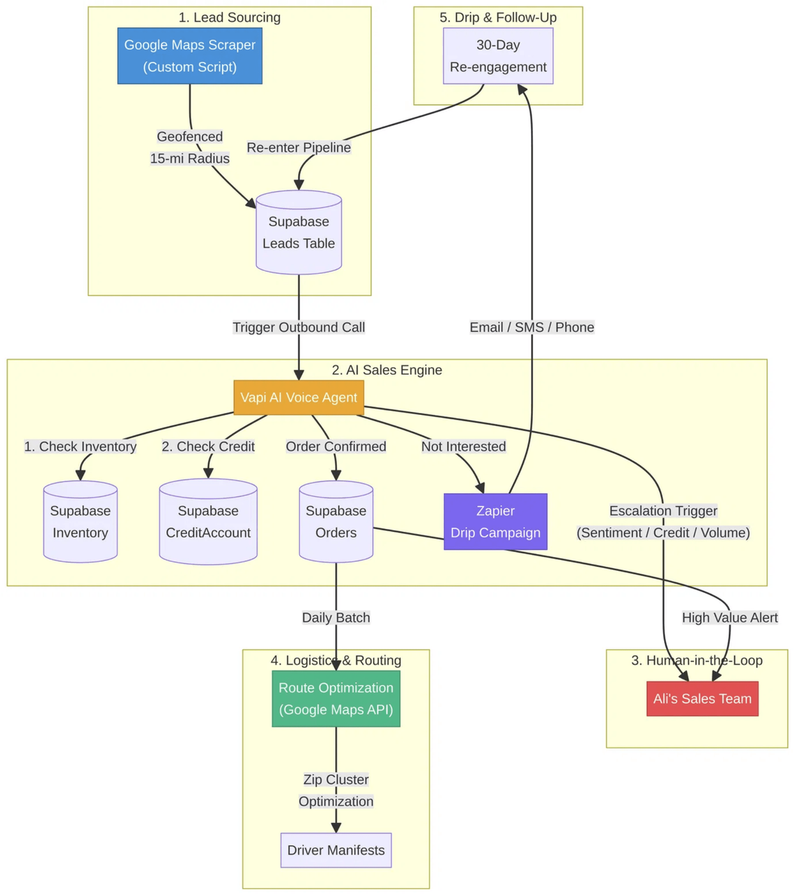
System Architecture Connects Five Subsystems Through Supabase
The architecture flows from lead sourcing through AI sales to either fulfillment or follow-up, with human-in-the-loop escalation at every critical decision point. Supabase serves as the central data layer, providing PostgreSQL with PostGIS for geofencing, real-time subscriptions, and edge functions.
1
Lead Sourcing: Google Maps scraper with 15-mile geofence.
2
AI Sales Engine: Vapi with real-time inventory and credit checks.
3
Human-in-the-Loop: Escalation for sentiment, credit, and volume triggers.
4
Logistics & Routing: Google Maps API with zip cluster optimization.
5
Drip & Follow-Up: Zapier for 30-day re-engagement cycles.

Slide 5
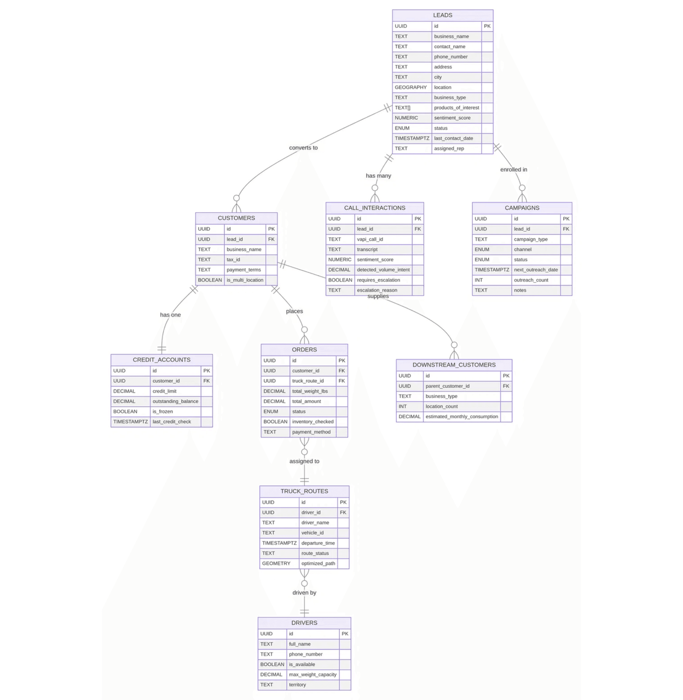
DATA ARCHITECTURE
Nine Database Entities Model the Complete Lead-to-Delivery Lifecycle
The data model uses PostgreSQL with PostGIS and covers all eight required entities plus a bonus Downstream Customers table. Key design decisions include PostGIS GEOGRAPHY columns for O(log N) geofence queries, PostgreSQL arrays for products_of_interest, and separate Leads vs Customers tables to track the full conversion funnel.
SALES & CRM
AI & AUTOMATION
Leads
Customers
CallInteractions
Campaigns
CreditAccounts
DownstreamCustomers
LOGISTICS
Orders
TruckRoutes
Drivers

Slide 6

AI SALES ENGINE
Call Progression
1. CONNECTING
2. STREAMING
3. CALCULATING
4. SUMMARY
2s telephony delay
Real-time transcript & keywords
Credit check & order estimation
Outcome card & action buttons
Branching Outcomes
AI Calls Follow a Four-Phase Workflow with Real-Time Validation
ORDER PLACED + CREDIT OK
ORDER PLACED + CREDIT EXCEEDED
→
Accept Order → Stage in Fulfillment → Generate Routes
→
Inline Credit Blocked card with Override / Decline buttons
Every outbound call progresses through four visible phases in the dashboard. The AI agent performs real-time validation against Supabase during the call — checking inventory availability and credit limits before confirming any order.
NOT INTERESTED
NEGATIVE SENTIMENT DETECTED
→
Enroll in 30-day drip campaign
→
AI: "Transferring to my manager" → Live Transfer → Take Over Call

Slide 7

HUMAN-IN-THE-LOOP
Five Escalation Triggers Keep Ali in Control of Sensitive Situations
The system uses inline real-time interrupts instead of a separate escalation queue. When the AI detects a problem mid-call, Ali sees action buttons directly in the Vapi HUD — no tab-switching, no delay. The customer stays on the line while Ali decides.
TRIGGER
DETECTION METHOD
UI RESPONSE
Negative Sentiment
Real-time keyword analysis (angry, upset, cancel)
AI: "Transferring to my manager" → Live Transfer → Take Over Call button
CRITICAL
Credit Exceeded
outstanding + order > limit
Inline Credit Blocked card → Override / Decline buttons
FINANCIAL
Volume > 500 lbs
Detected volume intent
High value alert to Ali
STRATEGIC
Strategic Client
Multi-location flag
Flag for human review
STRATEGIC
"AI handles the routine 80%, Ali focuses on the strategic 20%."
Complex Pricing
Custom tier request
Route to sales team
OPERATIONAL

Slide 8

PROTOTYPE DEMO
All Five Business Scenarios Work End-to-End in the Prototype
The working prototype demonstrates every scenario with a live interactive dashboard.
SCENARIO A
Interested Lead
SCENARIO B
Drip Enrollment
Sunrise Artisan Bakery → AI call → keyword highlight → credit verified → Accept Order → staged.
Old World Bakery → "not now" → auto 30-day drip → appears in Drip tab.
SCENARIO C
Angry Customer
SCENARIO D
Credit Exceeded
The Rolling Pin → "angry" detected → AI: "transferring to my manager" → Live Transfer → Take Over Call.
Bellmore Bread House → $375 over limit → inline Credit Blocked card → Override / Decline.
SCENARIO E
Delivery Routing
Staged orders → Generate Routes → territory grouping → nearest-neighbor stops → Refresh.

Slide 9

LOGISTICS & ROUTING
Routing Workflow
Territory-Based Routing Optimizes Deliveries for Long Island Geography
0. Accept Order → Staged
Orders staged in Fulfillment tab
Instead of complex vehicle routing optimization, the system uses a pragmatic territory-based approach that delivers 80% of the optimization benefit at 10% of the complexity. Orders are grouped by city into territory loops (e.g., Mineola Loop, Garden City Loop), checked against truck capacity (2,500 lbs), ordered by nearest-neighbor within each loop, and then optimized via Google Maps API to minimize Long Island Expressway (LIE) idle time.
1. Generate Routes
Group staged orders by territory
2. Capacity Check
Verify total weight < 2,500 lbs
3. Stop Ordering
Nearest-neighbor assignment
4. Refresh
SCALING CONSIDERATIONS
This approach scales to new cities by simply adding territory definitions. As volume grows, PostGIS enables automatic spatial clustering via ST_ClusterKMeans when manual territory definition becomes impractical.
Recalculate when new orders added

Slide 10

IMPLEMENTATION PLAN
Months 1-2
Foundation
Set up Supabase with full schema. Build Google Maps scraper for lead sourcing. Configure PostGIS geofencing with 15-mile radius.
The 6-Month Roadmap Prioritizes Revenue-Generating Features First
Month 3
AI Sales Engine
Script Vapi AI agent with dynamic tool-calling. Implement real-time transcript streaming, sentiment detection, and HITL triggers.
Month 4
Automation
Set up Zapier workflows for drip campaigns. Implement automated order processing from call confirmation to Supabase.
Month 5
Logistics
Integrate Google Maps Routing API for batch route optimization. Implement zip cluster grouping and driver manifest generation.
KEY SCALING CONSIDERATIONS
>100 calls/day: Synchronous processing breaks. Solution: Add BullMQ/Redis queue.
Month 6
Operations
City #2 Expansion: Single-territory routing breaks. Solution: Territory management module.
Build Ali's Command Center dashboard with inline real-time interrupts, AI Sales Agent panel, and staged fulfillment workflow. End-to-end testing with Ali's team.
>500 active campaigns: Zapier breaks. Solution: Custom email service.

Slide 11

ENGINEERING STRATEGY
Technical Tradeoffs Favor Speed-to-Value Over Perfection
Every technical decision was made to maximize speed-to-value for Ali's business while keeping the architecture extensible.
DECISION
CHOICE
TRADEOFF
Database
Supabase (managed PostgreSQL)
Vendor lock-in, but open-source base enables future migration.
AI Voice
Vapi (managed agent)
Per-minute cost, but saves 2-3 months vs custom Twilio build.
Routing
Territory grouping
Not mathematically optimal, but delivers 80% benefit at 10% complexity.
"Build the simplest thing that works, but design the data model for the complex thing that comes later."
Frontend
Next.js dashboard
More work than CLI, but Ali needs a visual operations tool.
Processing
Synchronous for MVP
Won't scale past 100 calls/day, but queue-ready schema makes upgrade easy.

Slide 12

The Fastest ROI Comes from AI Outbound Calling
What Remains Human-Led
Angry Customers
Requires human empathy and relationship preservation.
1. AI CALLING SCALE
Ali currently makes 10-15 manual calls per day. With Vapi, the system can make 50-
Credit Overrides
100 calls per day at roughly $0.10-0.15 per minute.
Financial risk requires business judgment.
$1,000-$2,000/day new revenue from a system costing $50-$100/day to operate (assuming 10% conversion at $200 avg order).
Large Deals (>500 lbs)
Requires custom pricing negotiation.
Multi-Location Chains
Complex, multi-stakeholder sales cycles.
2. DRIP CAMPAIGN COMPOUNDING
The second-highest ROI comes from drip campaigns. Every "not now" lead that would previously be forgotten is automatically re-engaged in 30 days. Over 6 months, this compounds into a significant pipeline of warm leads that cost nothing to re-contact.
"AI handles volume; Ali handles value."

