Slide 1


Ray Tracing Data Interpolation
Seongjoon, kang

Slide 2
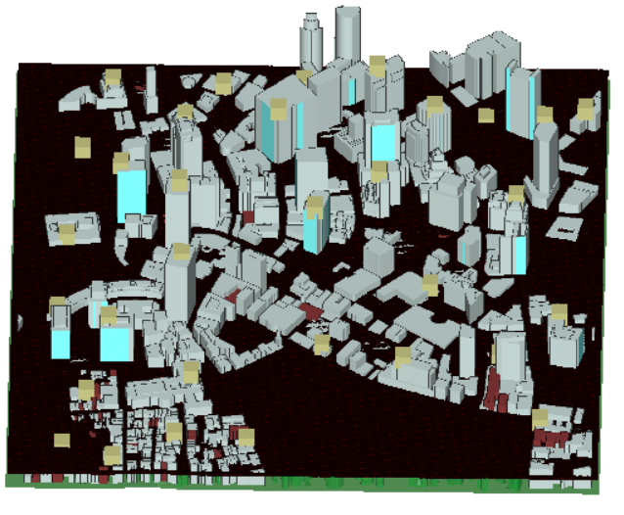
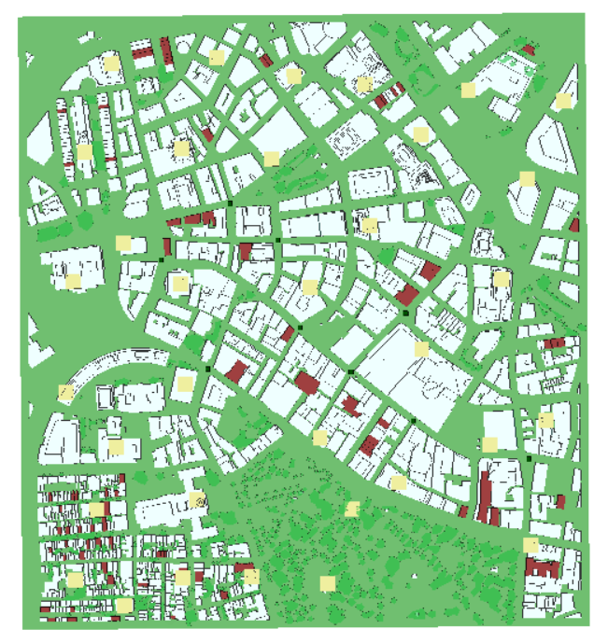

Data Generation
Network area: 1120m $×$ 1200m
Number of BSs with 200m ISD : Area $×$ 4/ ($π×ISD^{2}$) = 43
UAVs are located in rectangular grids with 2m intervals at 30m height
Run Remcomm raytracer
It takes more than one week
Deployment of UAVs
Deployment of BSs

Slide 3
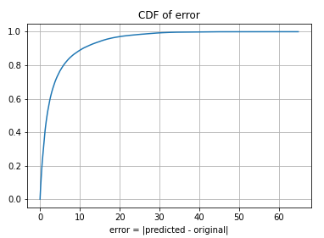
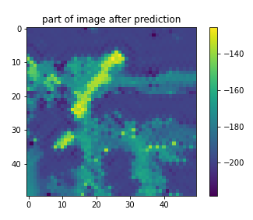
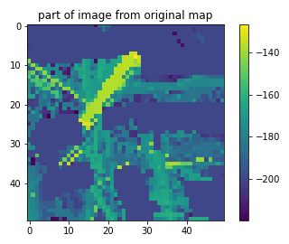
Interpolation with Gaussian Process
Error = |predicted value – original value|
Part of image after prediction
Part of original image
Error of CDF

Slide 4
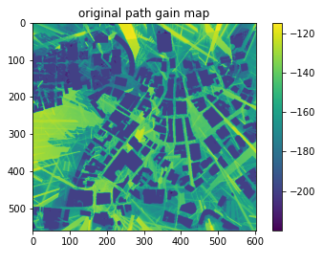

Interpolation with Gaussian Process
Original path gain map
Predicted path gain map

Slide 5
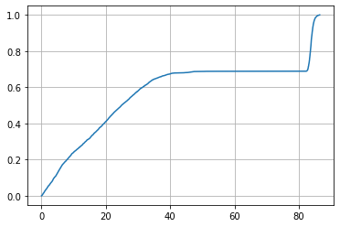
Interpolation with Neural Networks
When inputs are displacement vectors and pathloss values
Dimension of input vector is 12 if 4 points are chosen
d = [[1,1], [-1,1], [1,-1], [-1,-1]]
Or
d = [[1,1], [-1,1], [3,-1], [3,1]]
NN
Nearest displacement vectors
Corresponding pathloss values
Path Loss (dB)
Error = |predicted value – original value|

Slide 6
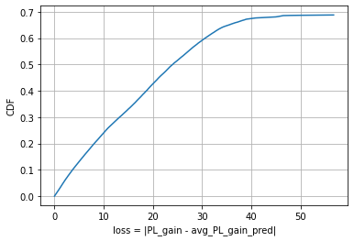
Interpolation with Neural Networks
Error = |predicted value – original value|
When inputs are RX locations
Dimension of input vector is 2
NN
X, Y of RX positions
Path Loss (dB)

Slide 8
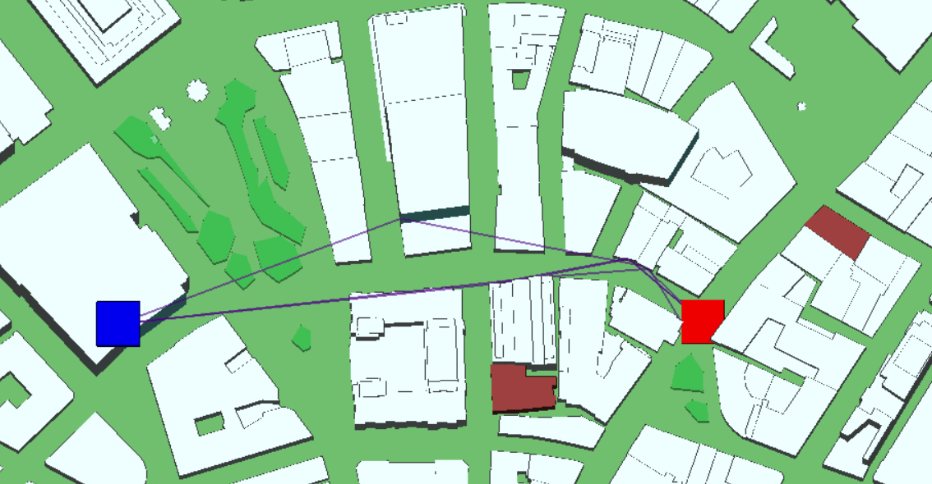
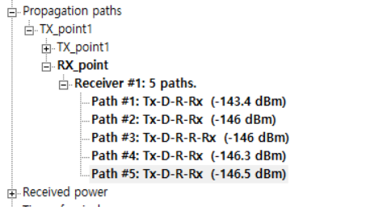

Slide 9
Path Interpolation
interpolation of LOS paths
TX – RX
TX - Reflection – RX
TX - Deflection - RX

Slide 10





Generative Model
Conditional W-GAN with Gradient Penalty
Capture $P \left(H | d_{1}, d_{2}, d_{3}, …, d_{k}\right)$
H: channel parameters
$d_{i}:$ 2-d distance at time I
Different positions of transmitters ?
$$d_{1}, d_{2}, d_{3}, …, d_{k}$$
$$z \sim N(0,1)$$
LSTM
Generator
$$d_{1}, d_{2}, d_{3}, …, d_{k}$$
$$x_{k}$$
LSTM
Critic

Slide 11




Input =${ X}_{i}$
Conv 1-1
Series of inputs = ${\{Y}_{i}, Y_{i+1}, …, \}$
Conv 1-2
$$H_{1}^{1}, H_{2}^{1}, …$$
…
Conv 2-1
LSTM cell 1
LSTM cell 5
Conv 2-2
$$C_{1}^{1}, C_{2}^{1}, …$$
…
Conv 3-1
FC 1
FC 1
FC 2
FC 2
Output
Output
CNN
Conv-LSTM

Slide 12
