Slide 1
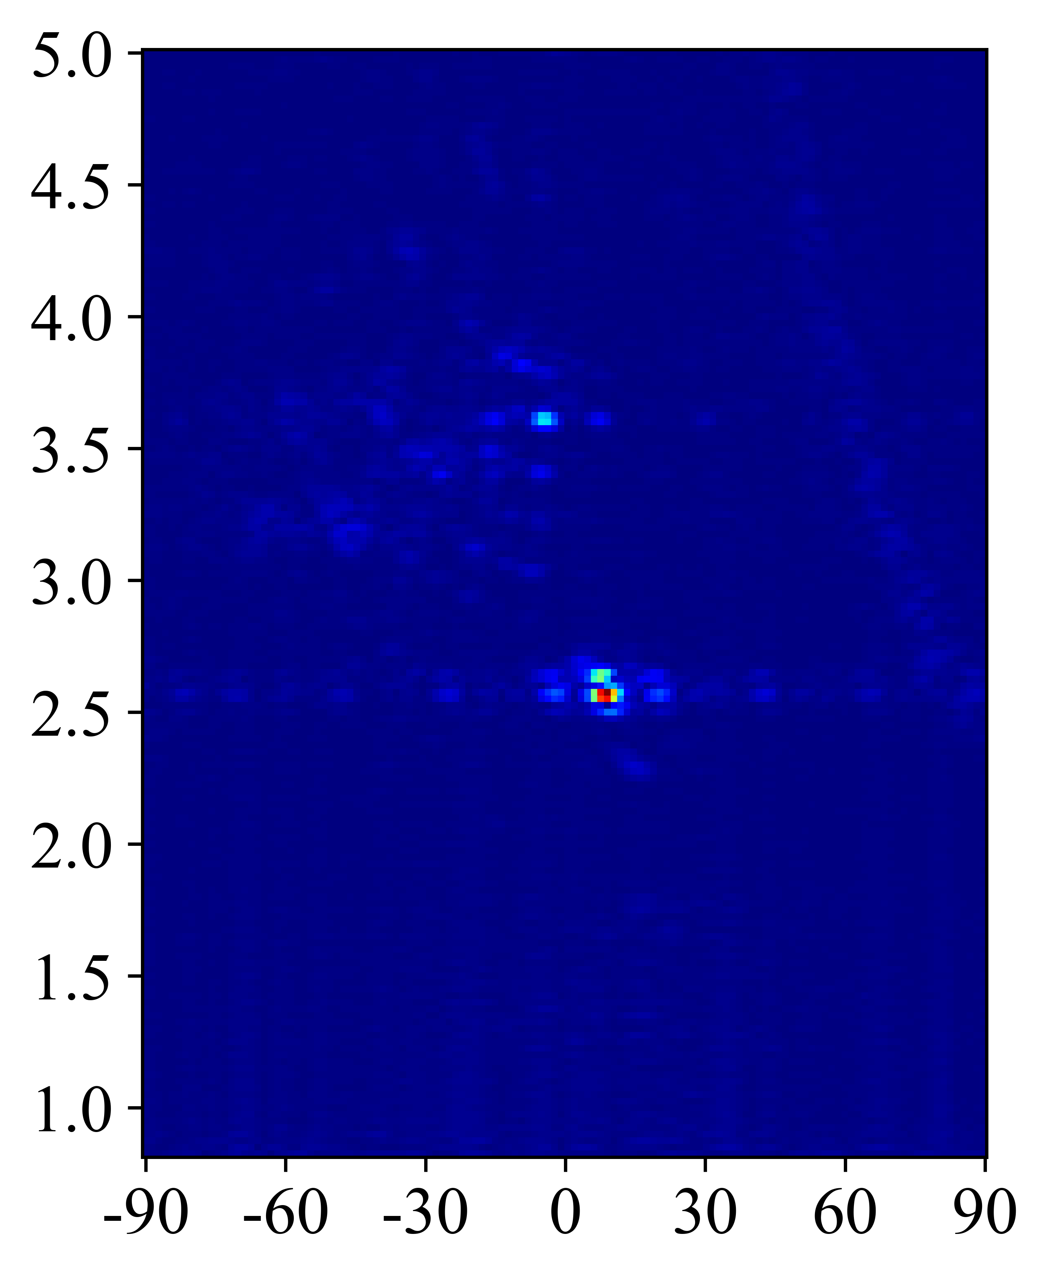
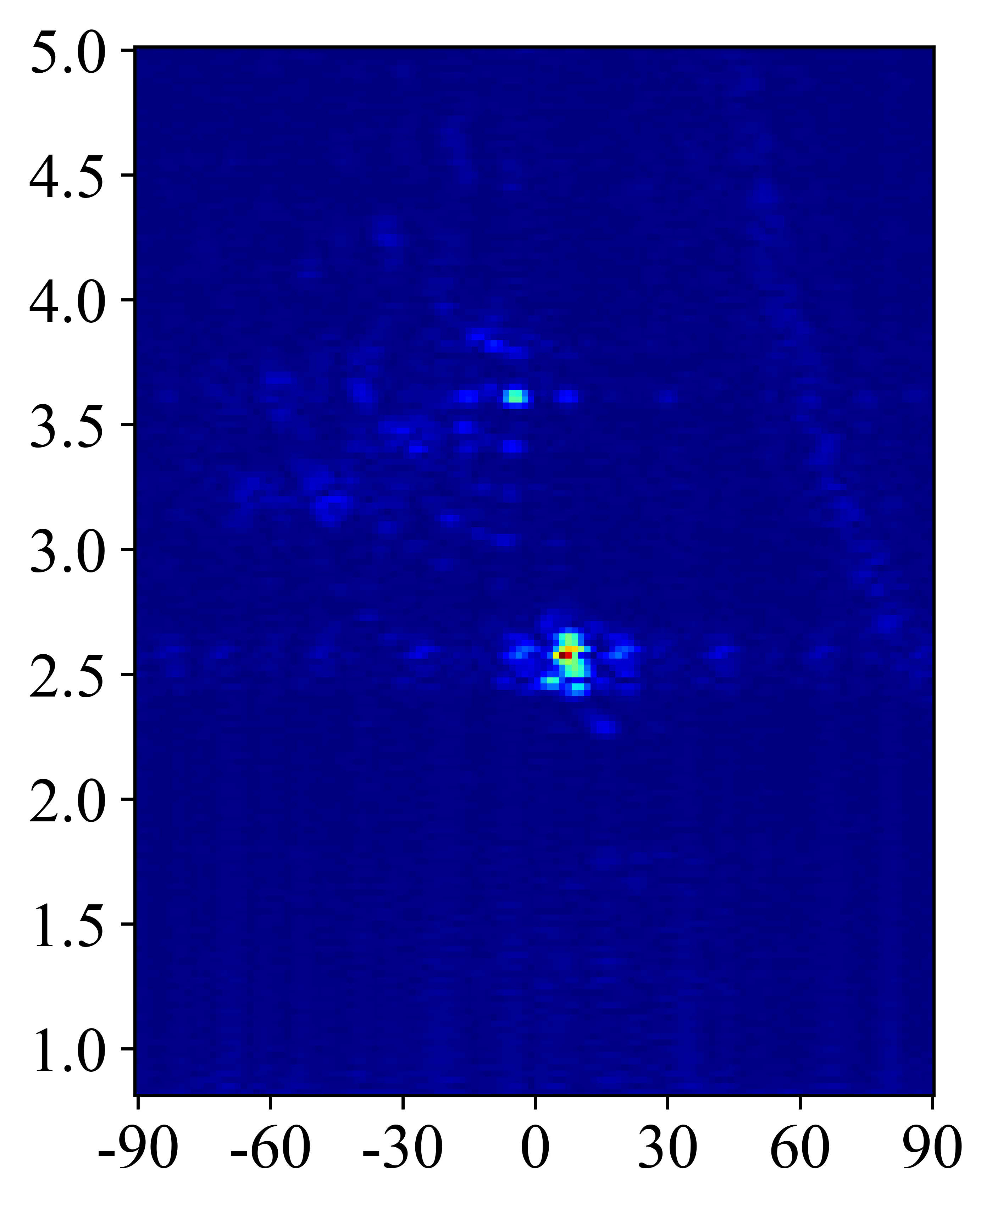
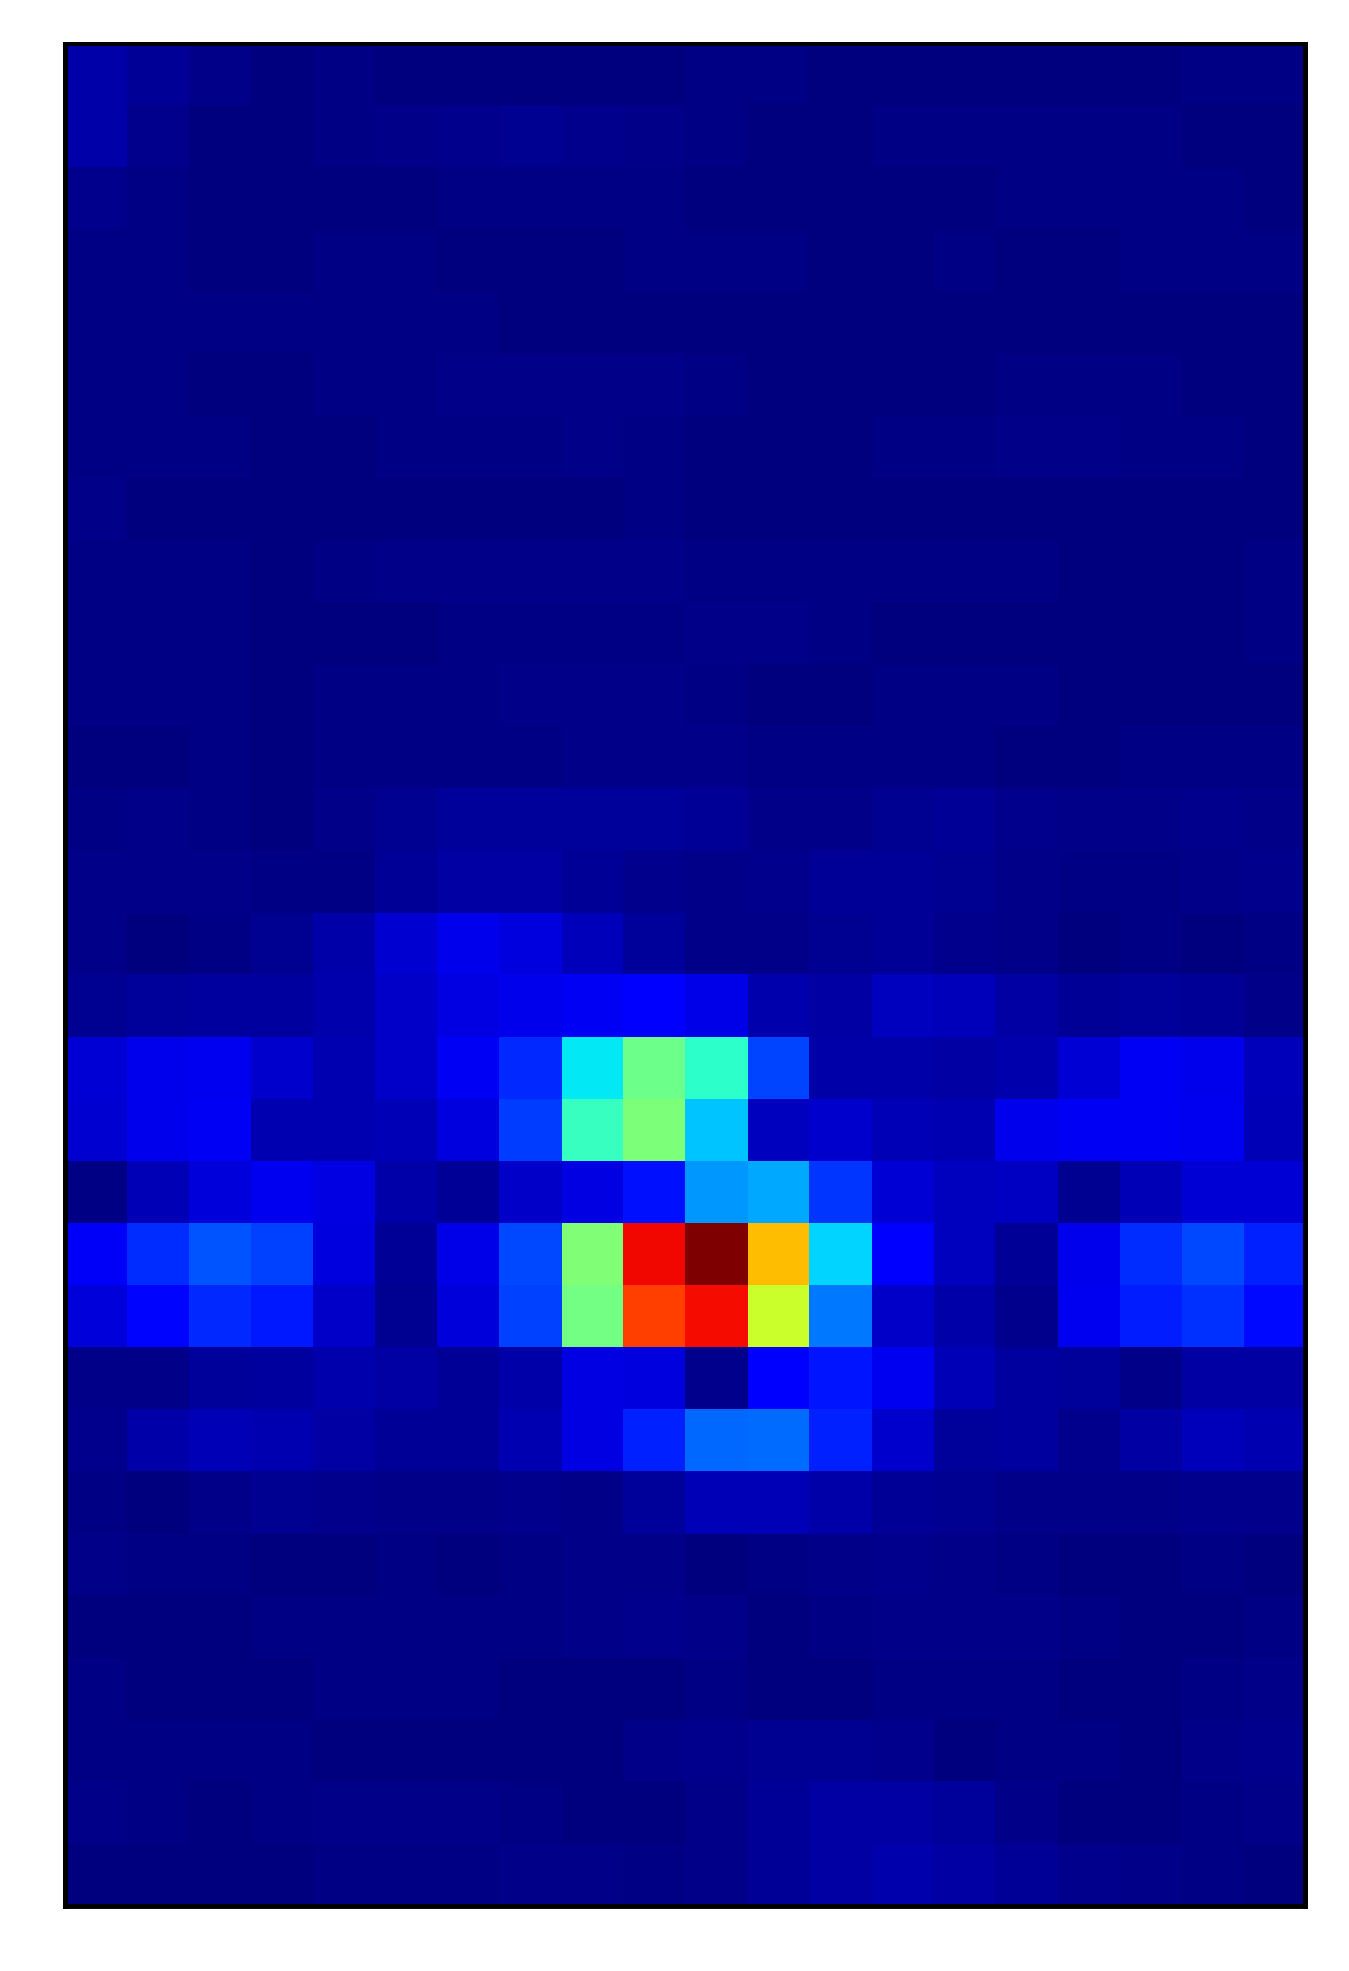
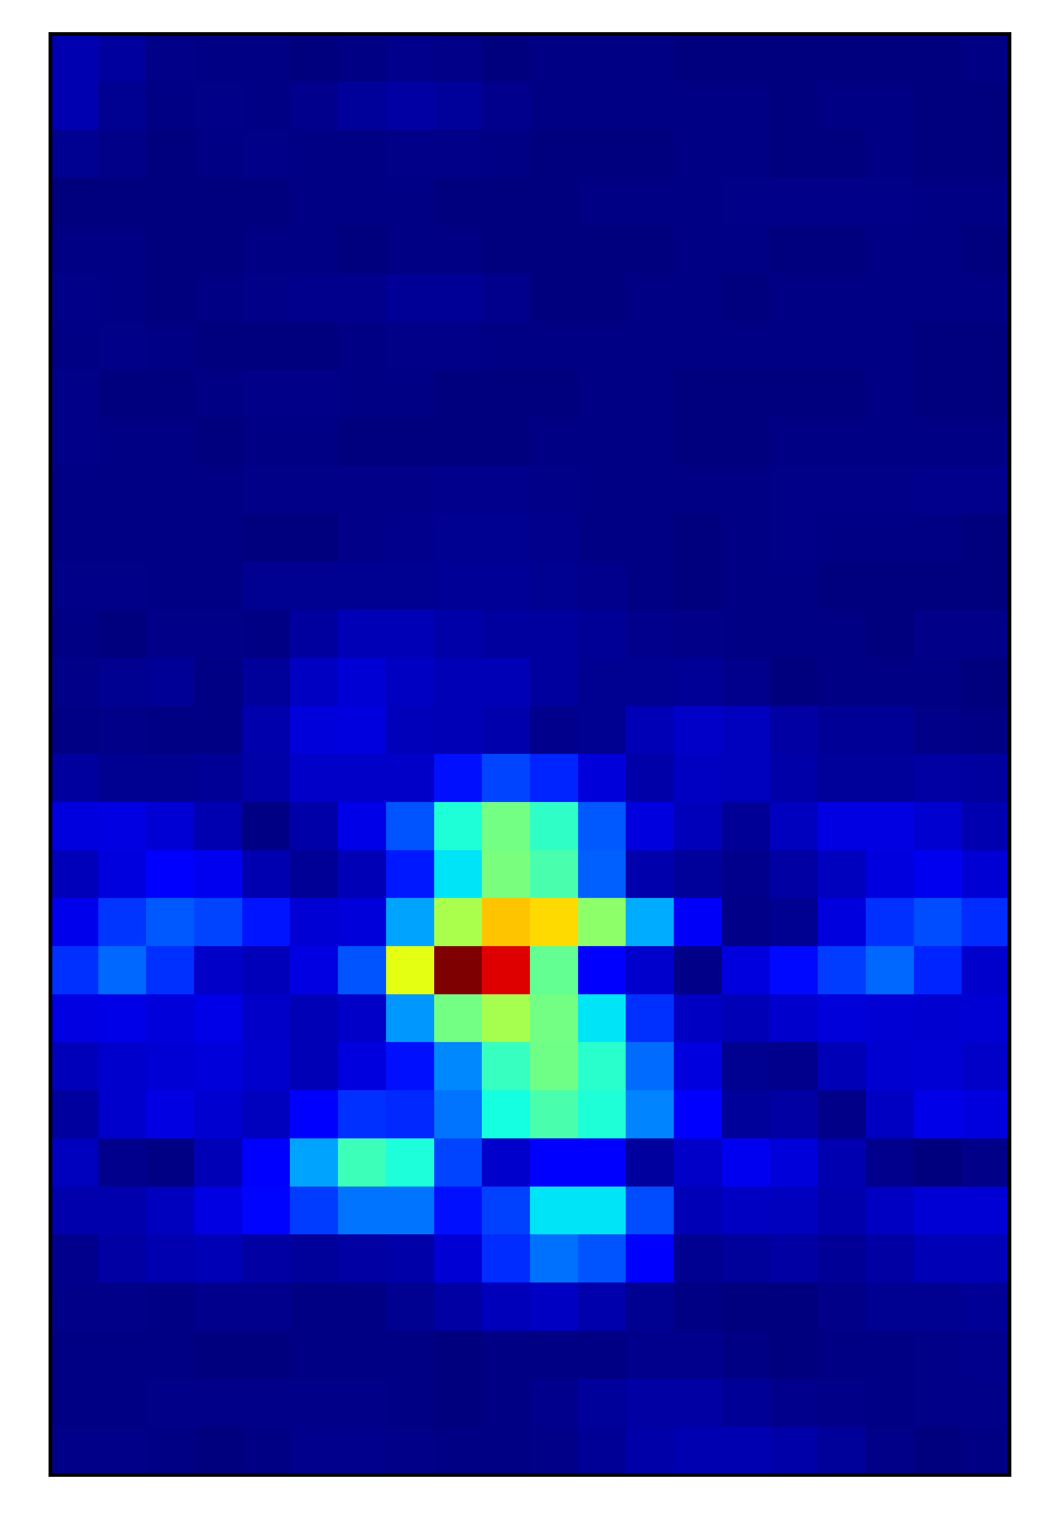

Bionic bird
DJI mavik
Distance [m]
Angle [$°$]

Slide 2
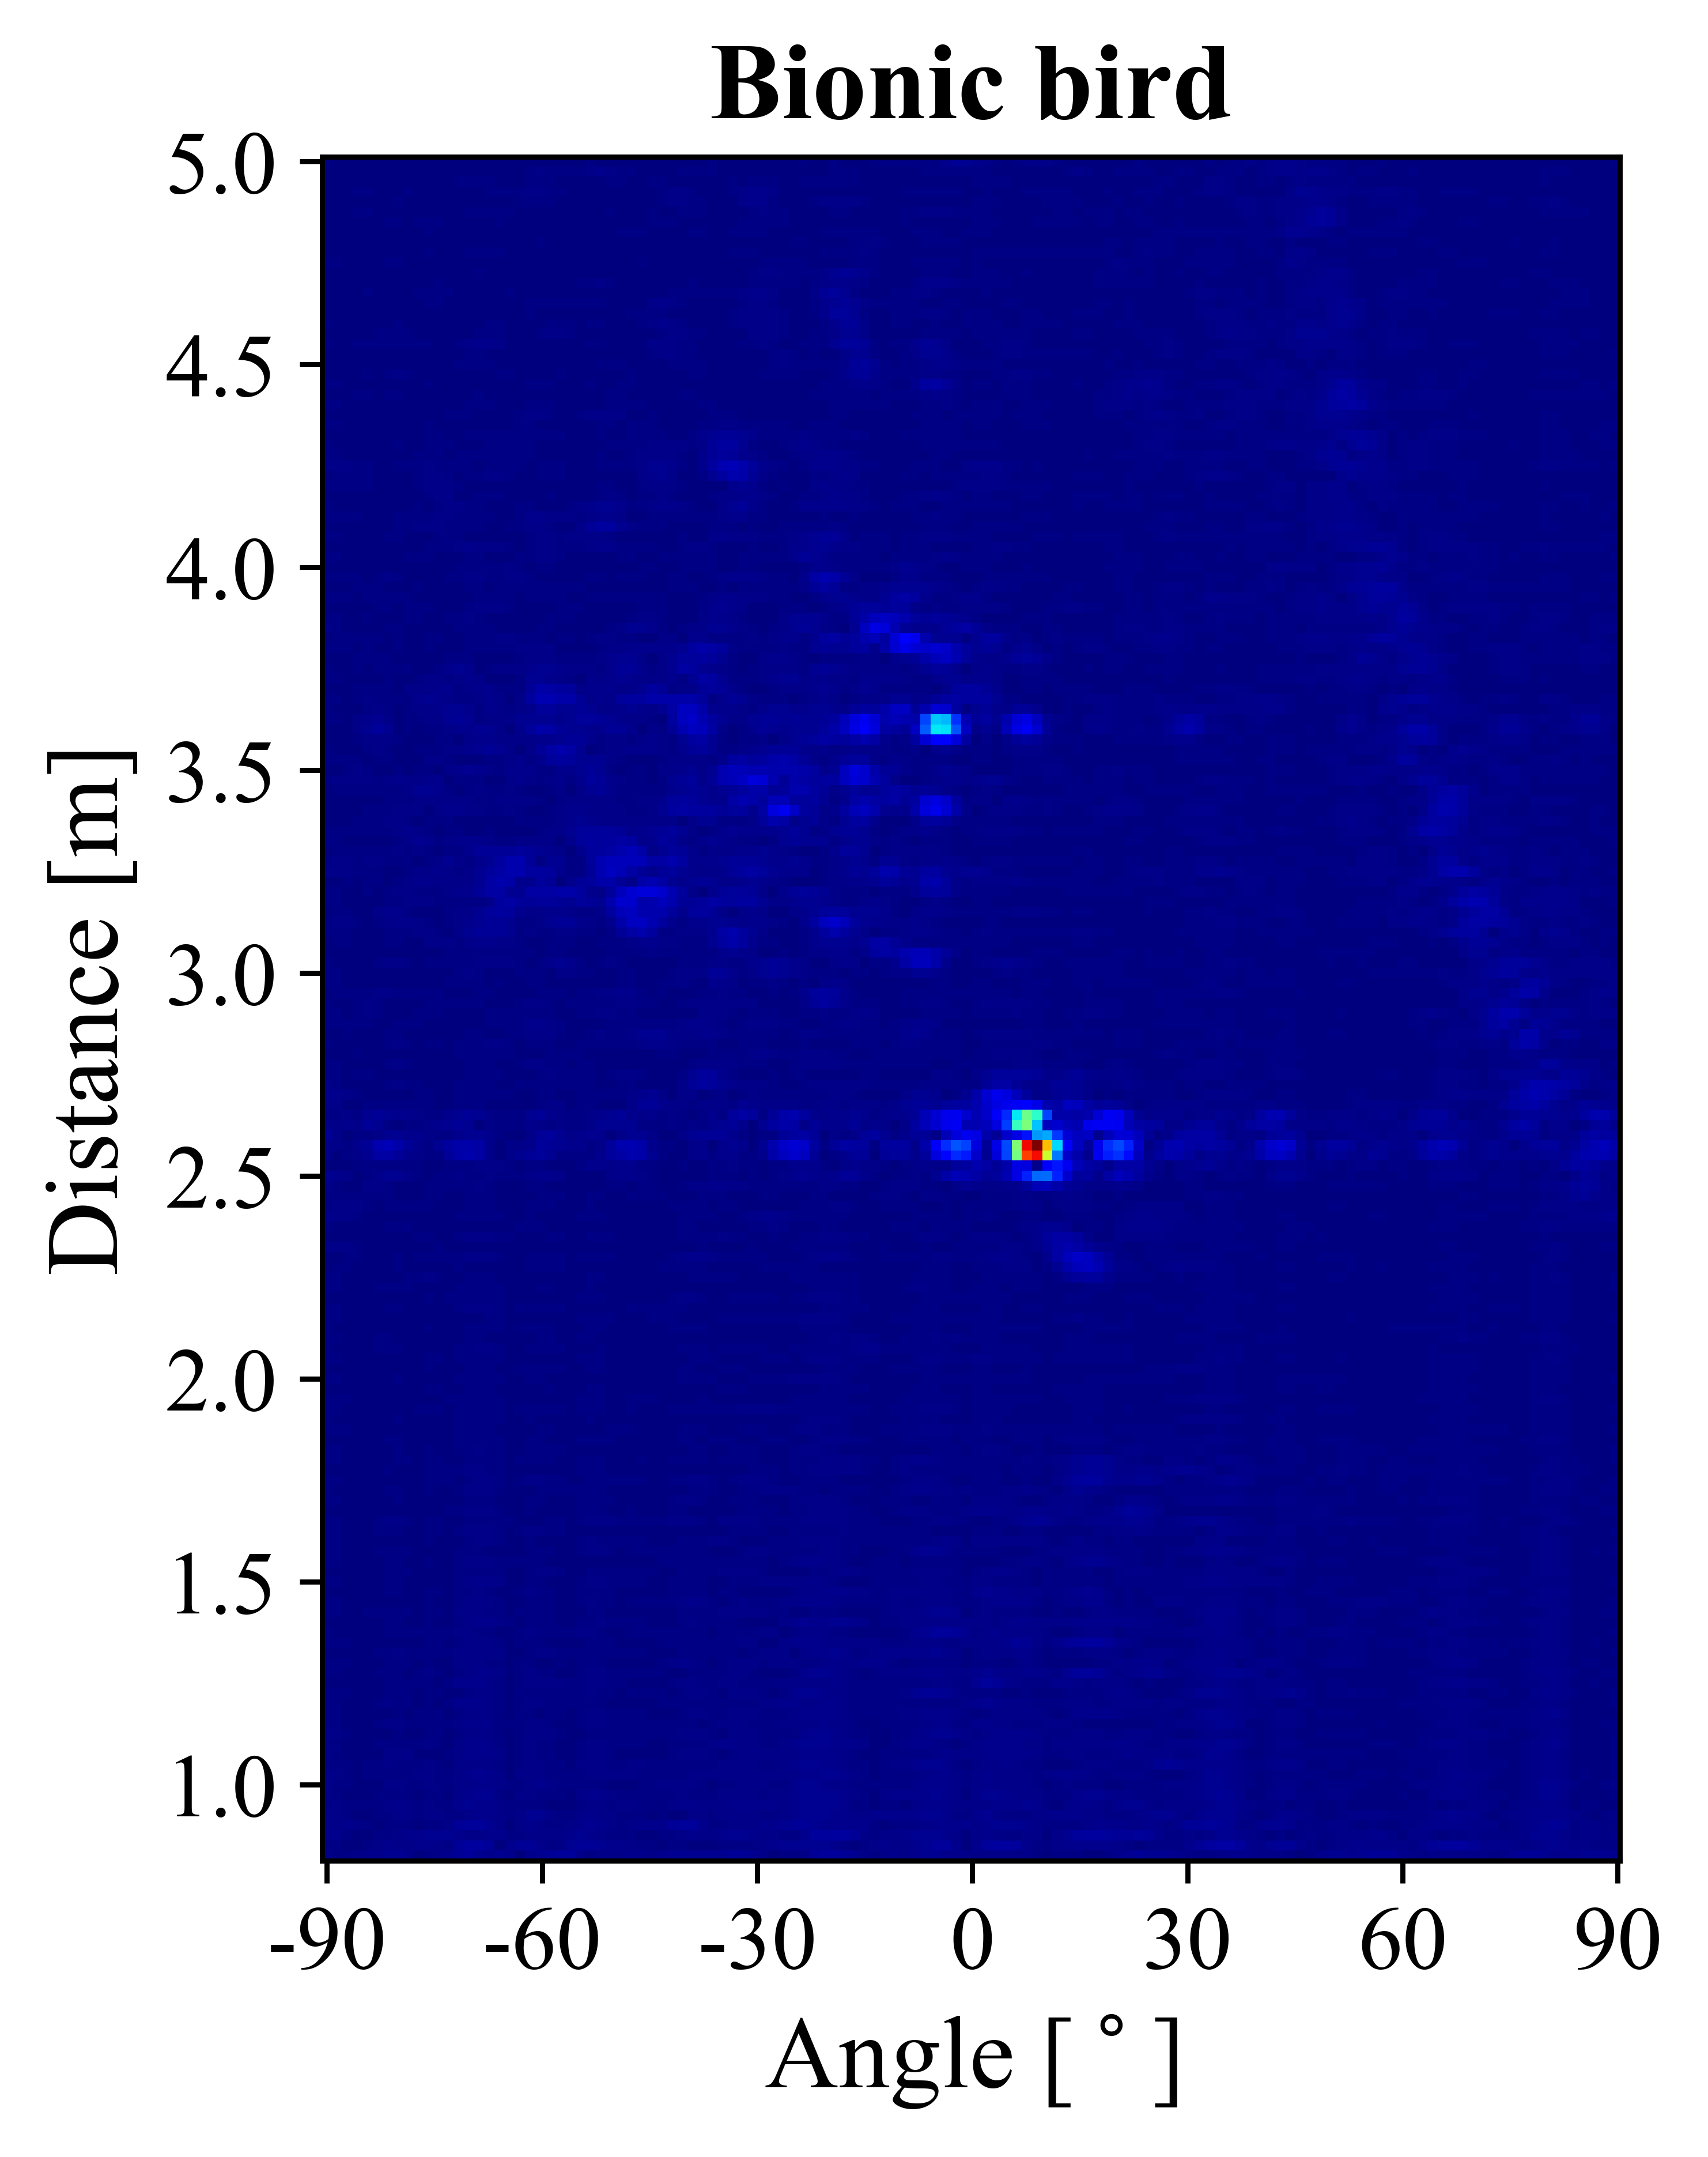
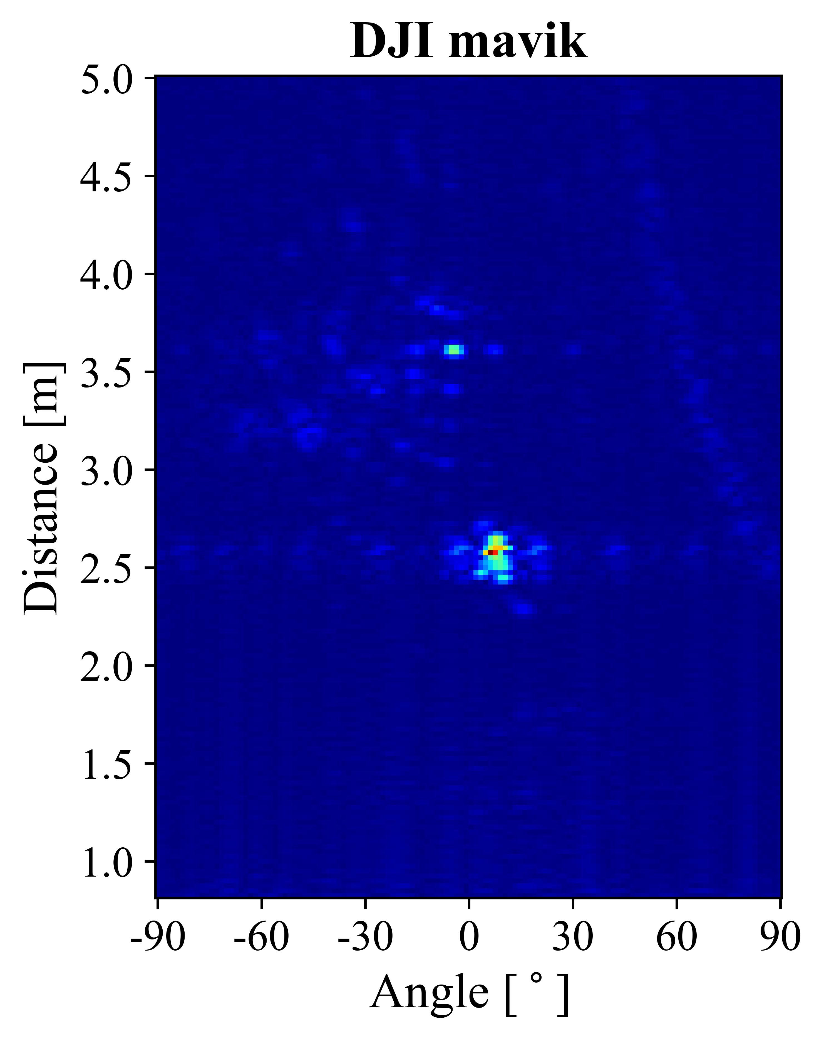
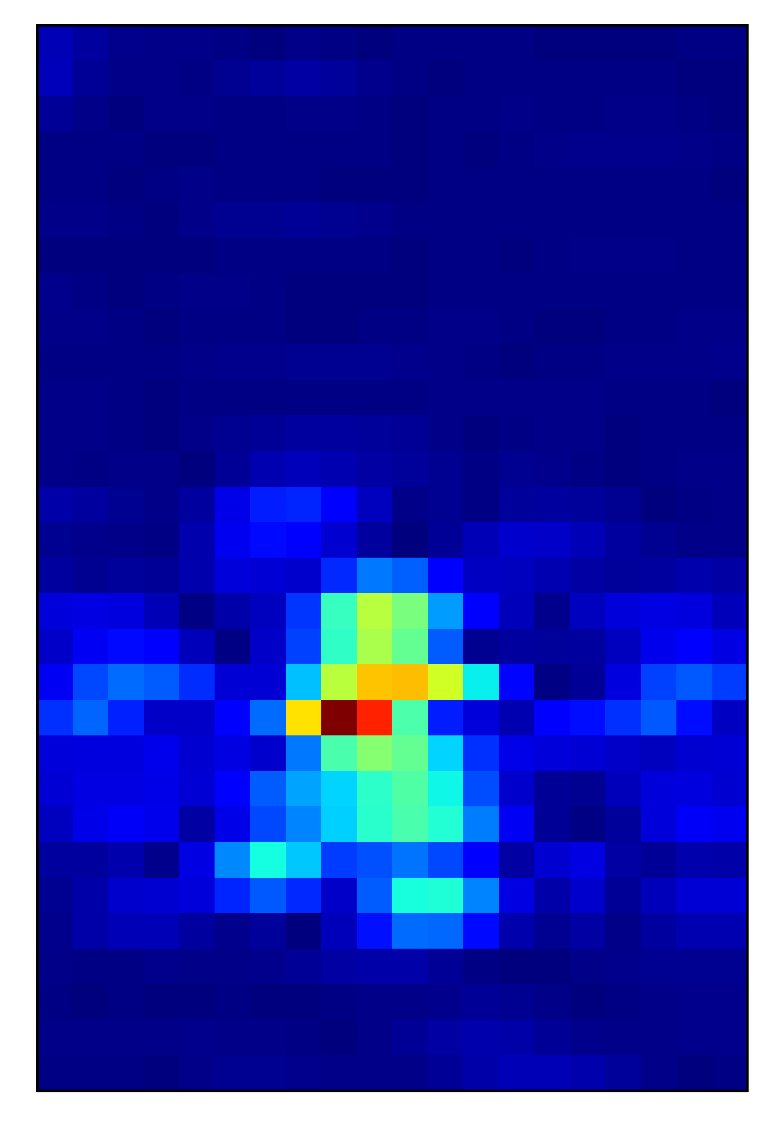
Angle

Slide 3




Input =${ X}_{i}^{a}$
Input sequence = ${\{X}_{i}^{p}, X_{i+1}^{p}, …, \}$
Conv 1-1
Conv 1-2
$$H_{1}^{1}, H_{2}^{1}, …$$
…
Conv 2-1
LSTM cell-1
LSTM cell-5
$$C_{1}^{1}, C_{2}^{1}, …$$
…
Conv 2-2
Conv 3-1
FC 1
FC 1
FC 2
FC 2
Output
Output
Conv-LSTM
CNN

Slide 4

Input =${ X}_{i}^{a}$
Conv block 1
Conv block 2
Conv block 3
FC
Output
CNN

Slide 5

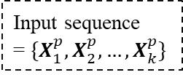






$${\{H}_{1}^{1}, H_{2}^{1}, …,H_{k}^{1}\}$$
$${\{H}_{1}^{2}, H_{2}^{2}, …,H_{k}^{2}\}$$
$${\{H}_{1}^{n}, H_{2}^{n}, …,H_{k}^{n}\}$$
$$H_{k}^{n}$$
…
LSTM cell-1
LSTM cell-2
LSTM cell-n
FC
$$H_{i}^{1}, C_{i}^{1}$$
$$H_{i}^{2}, C_{i}^{2}$$
$$H_{i}^{n}, C_{i}^{n}$$
Output
= {drone, bird}
Input sequence
= ${\{X}_{1}^{p}, X_{2}^{p}, …,X_{k}^{p}\}$

