Slide 1
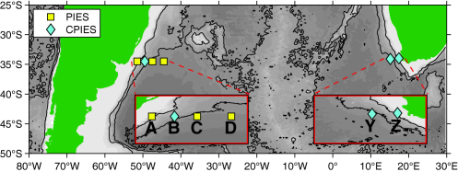
Temporal variability of the meridional overturning circulation at 34.5°S: Results from two pilot boundary arrays in the South Atlantic
Journal of Geophysical Research: Oceans Volume 118, Issue 12, pages 6461-6478, 3 DEC 2013 DOI: 10.1002/2013JC009228 http://onlinelibrary.wiley.com/doi/10.1002/2013JC009228/full#jgrc20464-fig-0001
Notes:
Locations of the two boundary arrays. The names of each site are indicated by bold letters, while the type of instrument is noted in the legend. Bottom topography from Smith and Sandwell [] is denoted by gray shading with the 2000 and 4000 dbar isobaths highlighted as black contours.
IF THIS IMAGE HAS BEEN PROVIDED BY OR IS OWNED BY A THIRD PARTY, AS INDICATED IN THE CAPTION LINE, THEN FURTHER PERMISSION MAY BE NEEDED BEFORE ANY FURTHER USE. PLEASE CONTACT WILEY'S PERMISSIONS DEPARTMENT ON PERMISSIONS@WILEY.COM OR USE THE RIGHTSLINK SERVICE BY CLICKING ON THE 'REQUEST PERMISSIONS' LINK ACCOMPANYING THIS ARTICLE. WILEY OR AUTHOR OWNED IMAGES MAY BE USED FOR NON-COMMERCIAL PURPOSES, SUBJECT TO PROPER CITATION OF THE ARTICLE, AUTHOR, AND PUBLISHER.

