Slide 1
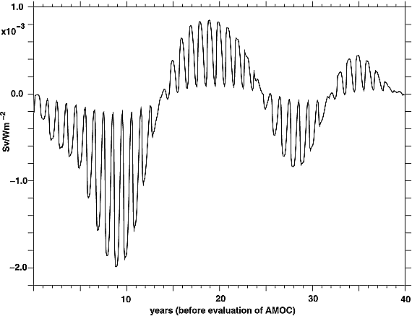
Oscillatory sensitivity of Atlantic overturning to high‐latitude forcing
Geophysical Research Letters Volume 37, Issue 10, L10601, 19 MAY 2010 DOI: 10.1029/2010GL043177 http://onlinelibrary.wiley.com/doi/10.1029/2010GL043177/full#grl27045-fig-0001
Notes:
Time series of the linear sensitivity of the AMOC at 27°N to surface heat fluxes averaged over the subpolar gyre. The sensitivities ∂Ψ_{27°N}/∂Q_{net} [Sv/Wm⁻²] are to a surface heat flux anomaly applied for one month and are integrated from 45°N to 70°N and 90°W to 10°E. A negative sensitivity means that cooling results in an increase in the AMOC. For example an additional cooling of 1 Wm⁻² for one month over the given area at the minimum around 8.75 years would increase the overturning by 2 × 10⁻³ Sv, 8.75 years later. The net induced AMOC variability is the integral over space and time of the sensitivities multiplied by heat flux anomalies. Note that linearity fails after 15–20 years (Figure 4).
IF THIS IMAGE HAS BEEN PROVIDED BY OR IS OWNED BY A THIRD PARTY, AS INDICATED IN THE CAPTION LINE, THEN FURTHER PERMISSION MAY BE NEEDED BEFORE ANY FURTHER USE. PLEASE CONTACT WILEY'S PERMISSIONS DEPARTMENT ON PERMISSIONS@WILEY.COM OR USE THE RIGHTSLINK SERVICE BY CLICKING ON THE 'REQUEST PERMISSIONS' LINK ACCOMPANYING THIS ARTICLE. WILEY OR AUTHOR OWNED IMAGES MAY BE USED FOR NON-COMMERCIAL PURPOSES, SUBJECT TO PROPER CITATION OF THE ARTICLE, AUTHOR, AND PUBLISHER.

