Slide 1
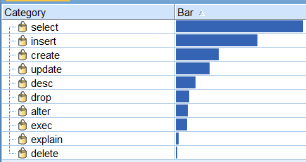
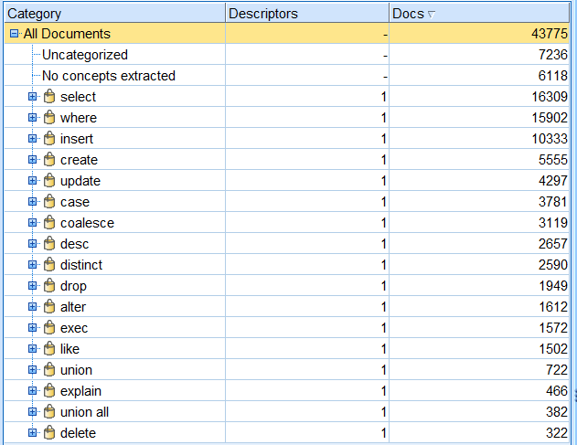
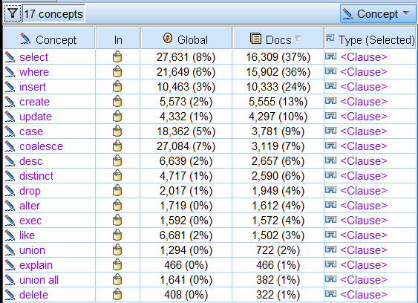
Observation on Types of Query
SELECT appears only in 16,309 out of 43,775 total records
INSERT / CREATE / UPDATE / DELETE have a pretty good share
Note: If we are trying to analyze END USER query (primarily SELECT), then we need to filter out Power User / Administrators / Developers queries out of this set. It can be done based on User details.

Slide 2
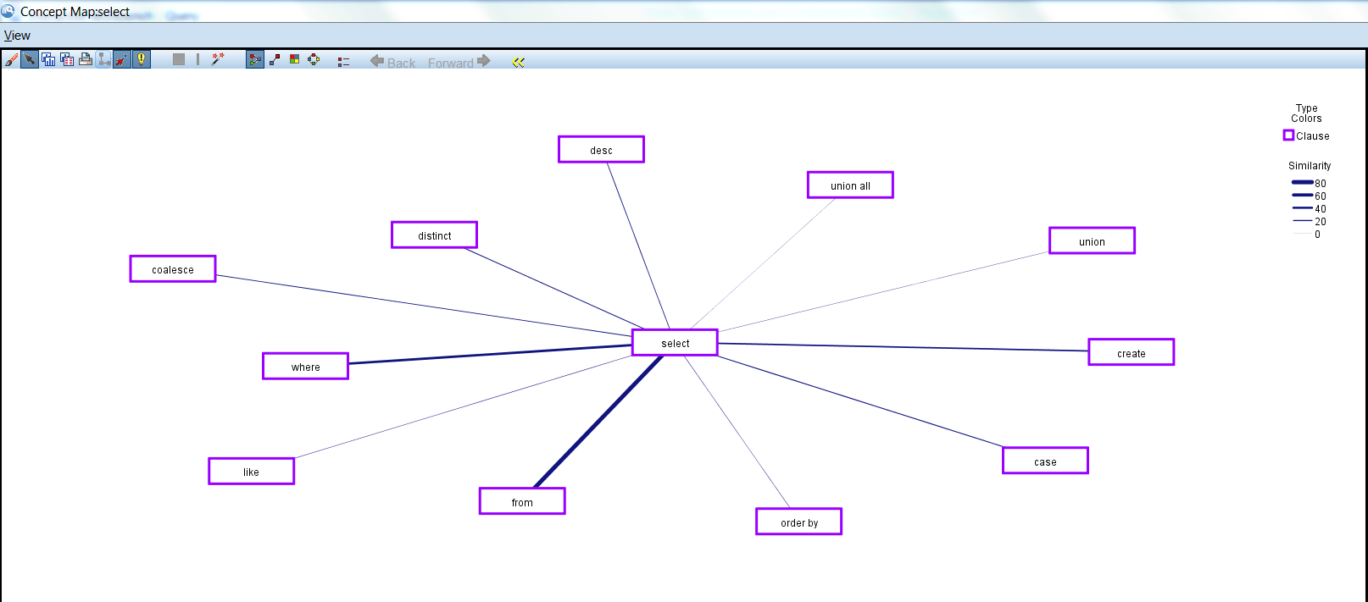
Observation on “Select” concept
SELECT has largest association with FROM and WHERE
UNION and UNION ALL are NOT much in use with SELECT
Sorting or ORDER BY shows week association with SELECT
4. Use of CASE is high
5. Use of DISTINCT is also high. Is the TABLE design appropriate?
6. COALESCE indicates outer join. Why use Outer Join?

Slide 3
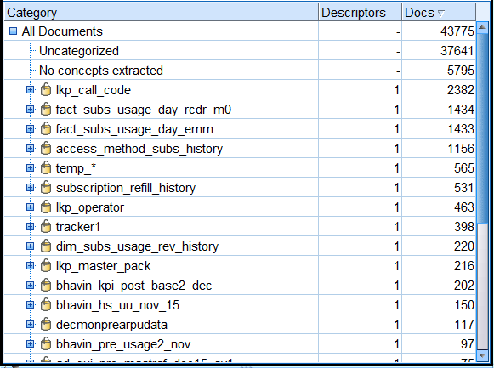
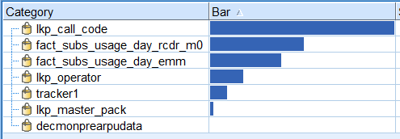
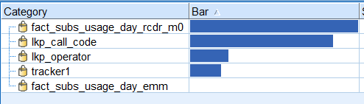
Observation on TABLES
“lkp_call_code” is the highest used table
The 2nd and 3rd most used tables are fact tables
“temp_*” tables have been used quite a lot!
4. Only 6 other tables have been used with “lkp_call_code”
5. The 2nd most used table is “fact_subs_usage_day_rcdr_m0”
6. Shouldn’t these “Queried Together” tables be stored side-by-side?

Slide 4
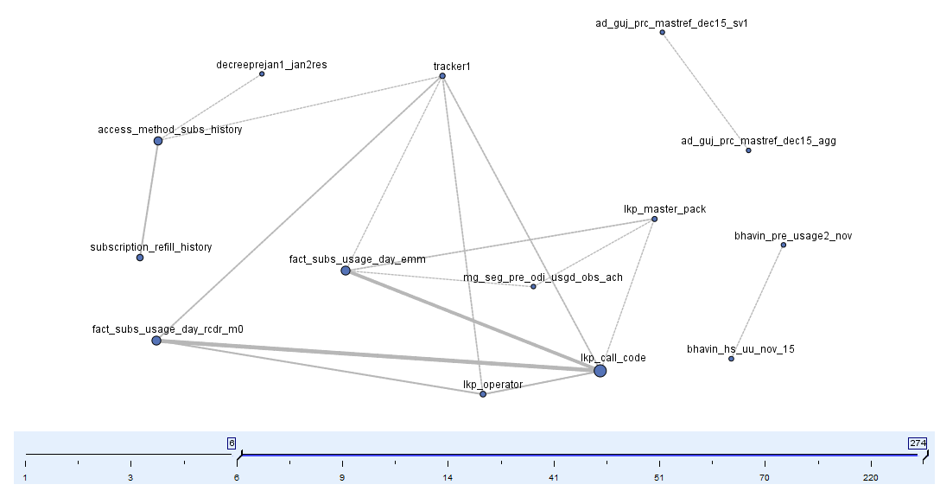
Observation on TABLES strongly connected
Filtering and exploring relationships among tables will help organize storage and tuning of the parameters more effectively.

Slide 5
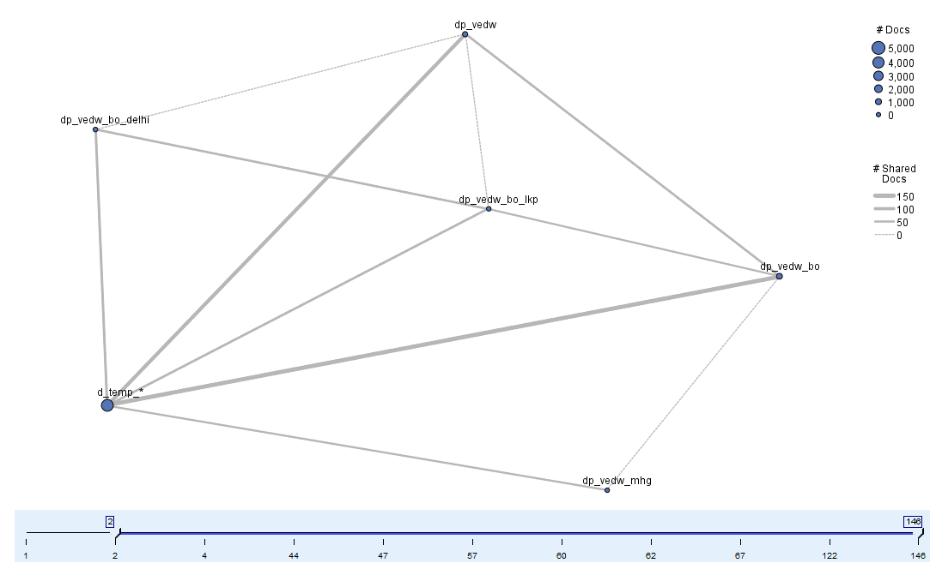
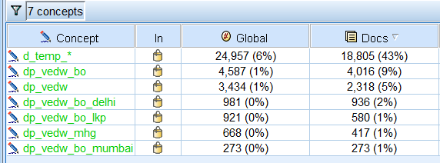
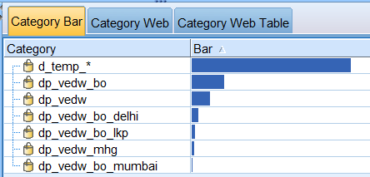
Observation on SCHEMA
“d_temp_*” is the highest used table. Are we using temp arrangements too much?
Examine what this schema is mostly used for?

Slide 6
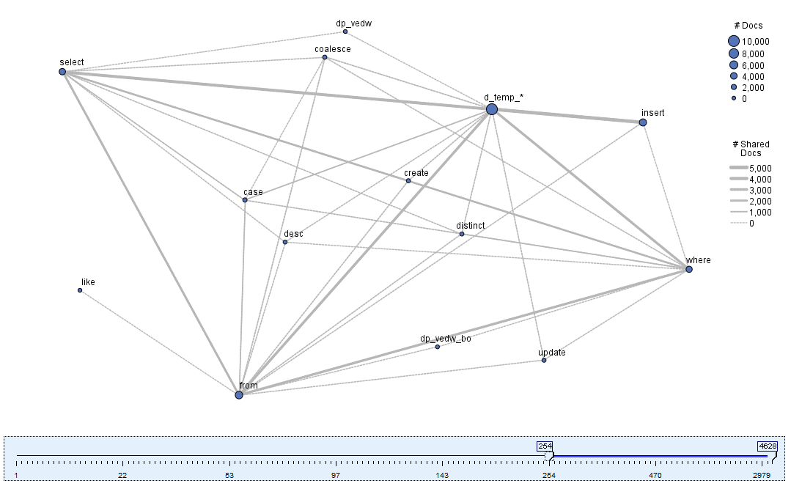
Observation on “d_temp_*” SCHEMA
Note strongest association among “INSERT”, “SELECT”, and “d_temp_*”
“d_temp_*” schema is mostly used for Insert / Select type of statement. What necessitates such a frequent use of a temp schema? Review your ETL policy to address it.

Slide 7
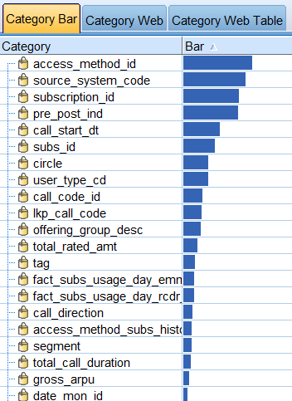
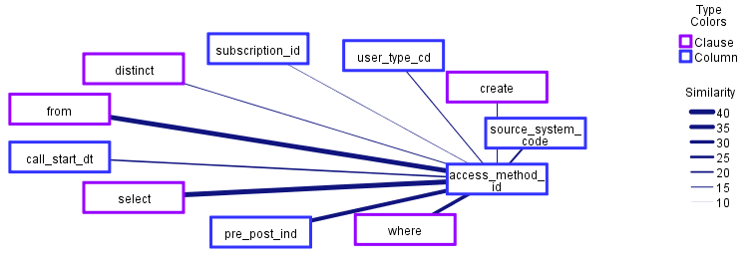
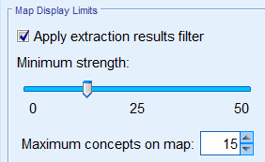
Observation on Columns
“access_method_id” is the most used column. It has been used in conjunction with “WHERE” clause and “pre_post_ind” column pretty often.
Can it be the “Distribution Key” if Netezza is the database?

Slide 8
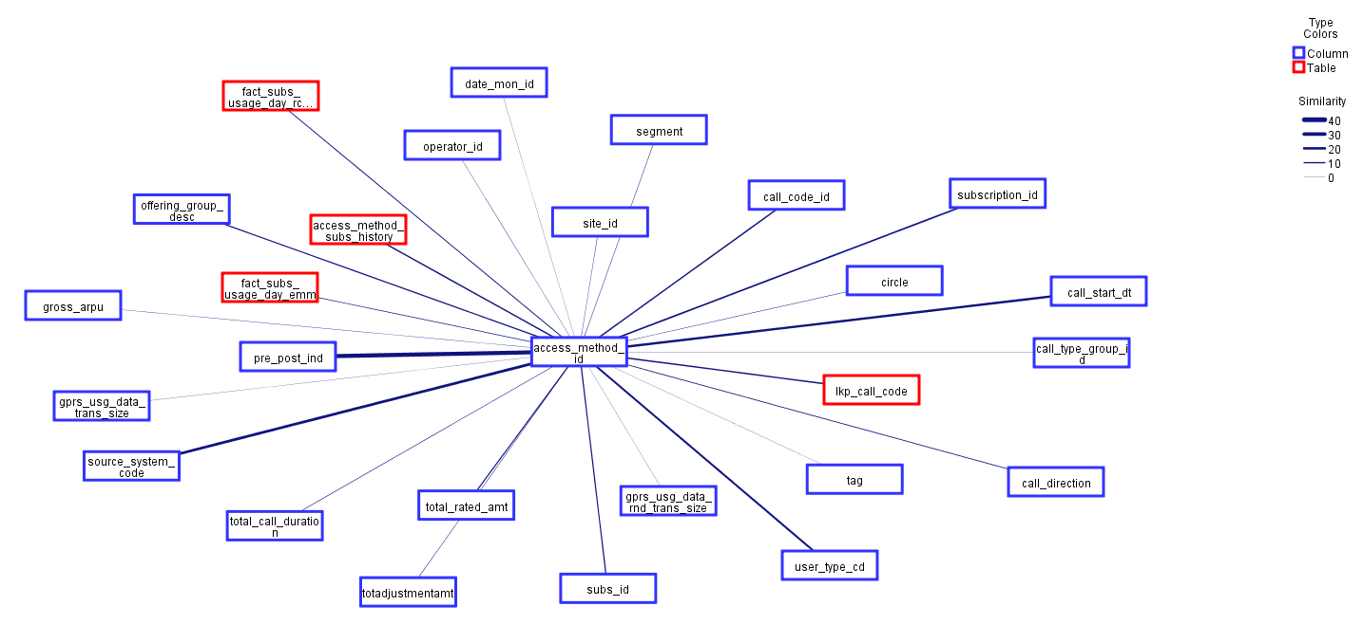
Observation on Table-Column combination for the most used column “access …”
As is evident, there are 4 tables connected with this column
This column has the strongest link with “pre_post_ind”, “source_system_code”, “call_start_dt” etc.

Slide 9
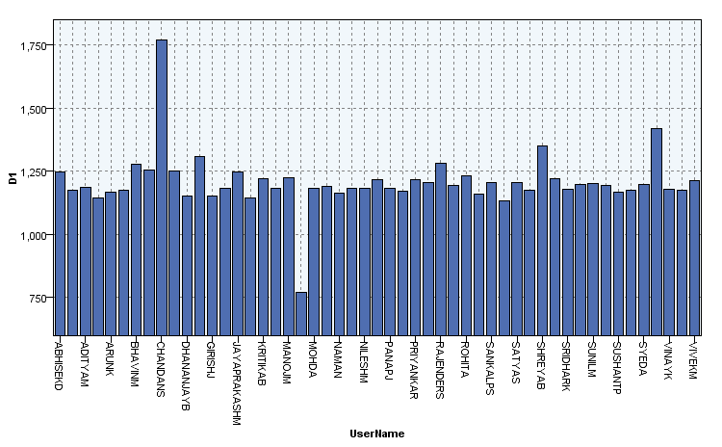
Can frequently used Tables and Columns be used to determine use of similar Query?
A sample that shows the SAME query per a defined criteria was fired by these user with frequency.

