Slide 1
Covariance Models for RNA Analysis
Bioinformatics & Computational Biology
Larry, Davis, Shane K. Dooley, Zach Lozier, Colleen Yanarella

Slide 2
Outline
RNA background
Function
Finding RNA families
Covariance model
RNA ordered trees
EM algorithm

Slide 3
Intro

Slide 4
Covariance Models
Variable | Definition
P | Symbol Emission probabilities
T | State transition probabilities
M | Number of states

Slide 5
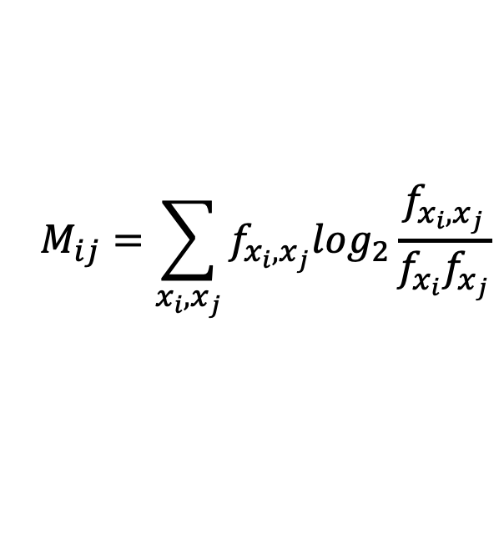
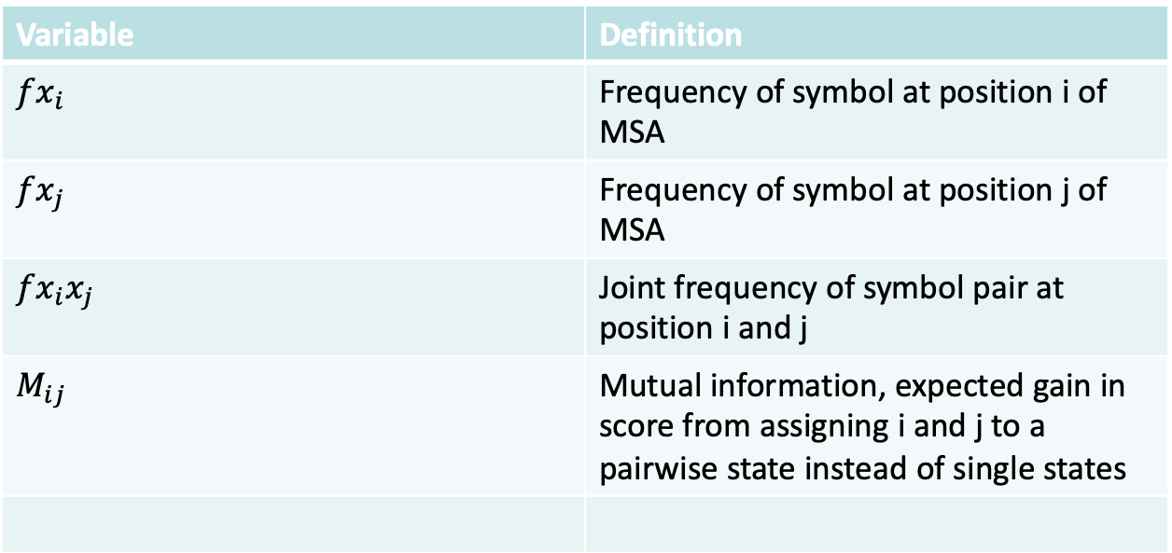
Covariance Models
Variable | Definition
$$fx_{i}$$ | Frequency of symbol at position i of MSA
$$fx_{j}$$ | Frequency of symbol at position j of MSA
$$fx_{i}x_{j}$$ | Joint frequency of symbol pair at position i and j
$$M_{ij}$$ | Mutual information, expected gain in score from assigning i and j to a pairwise state instead of single states
$$M_{ij}=\sum_{x_{i},x_{j}}{f_{x_{i},x_{j}}\log_{2}\frac{f_{x_{i},x_{j}}}{f_{x_{i}}f_{x_{j}}}}$$

