Slide 1
Solar Brightness Temperature
Using previously measured PED data
Madzivhandila, Makhozanele, Mokalane, Sithole, Tshilande
3 July 2009

Slide 2
Contents
Problem Statement
Data Calibration
Antenna Temperature Measurements
Angular Sizes and Gaussian fits
Brightness Temperature Computation
Summary

Slide 3
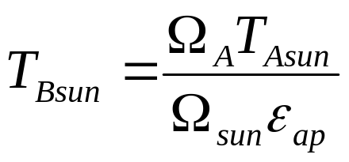
Problem Statement
Compute the brightness temperature of the Sun
Use provided data capture from an earlier PED observation
Use the brightness temperature equation:

Slide 4
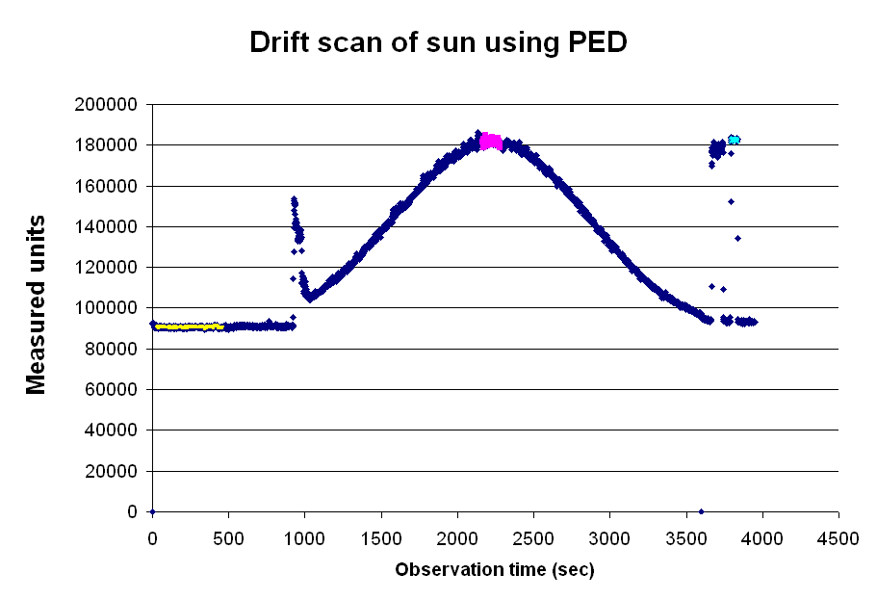
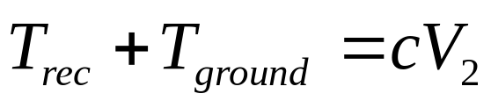
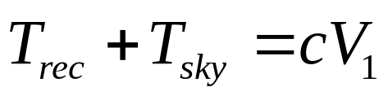
Data Calibration

Slide 5
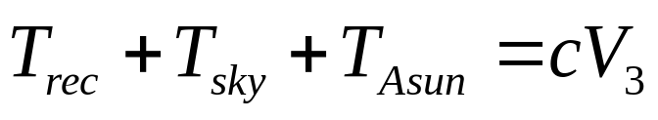
Antenna Temp of the Sun

Slide 6
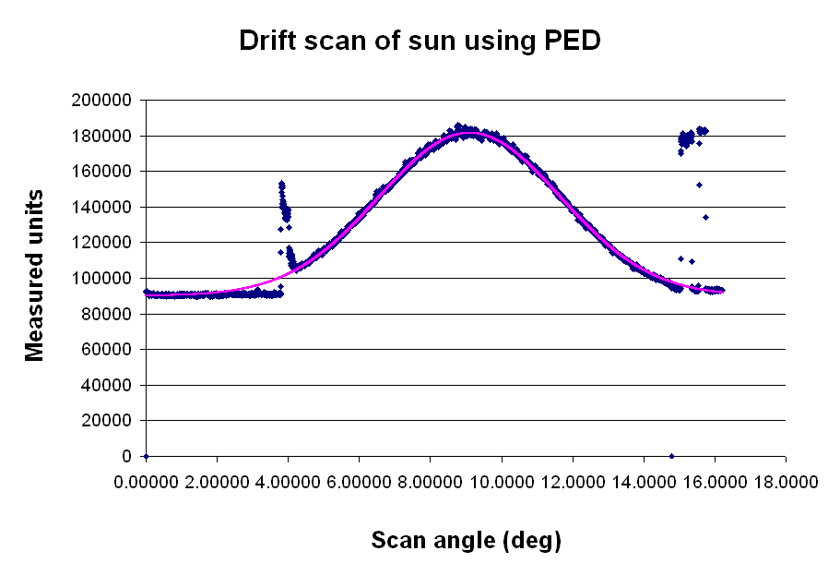
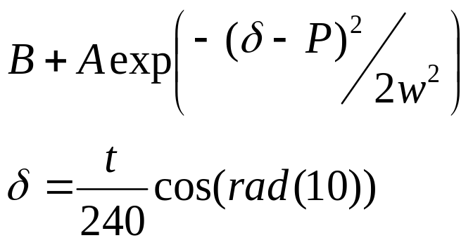
Angular sizes (Gaussian fit)
A
w
B
P

Slide 7

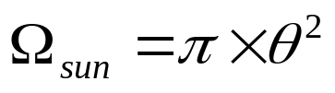
Angular sizes
HPBW

Slide 8
Brightness Temp Computation
Expected Values
  V₁ = 90000 units
  V₂ = 182626 units
  V₃ = 181500 units
  c = 0.003 K/unit
  T_{rec} = 266.99 K
  T_{Asun} = 279.065 K
  Ω_{A} = 0.01245 sr
  Ω_{sun} = 8.6e-5 sr
  T_{Bsun} = 80717.4278 K
Avg Measured Values
  V₁ = 90892 units
  V₂ = 176178 units
  V₃ = 180772 units
  c = 0.0032 K/unit
  T_{rec} = 295 K
  T_{Asun} = 297.84K
  Ω_{A} = 0.02 sr
  Ω_{sun} = 8.6e-5 sr
  T_{Bsun} = 79380 K

Slide 9
Summary
Aim: Compute the brightness temperature of the Sun using existing data.
Careful consideration of the same data allow approximation of true values without observations, which was prevented by bad weather.
Results obtained are close to expected values showing this approach to be a valid analysis method.
Results improve if we smooth the data first using a Gaussian fit to the data.
Aperture efficiency moves measurements away from true values, but can be characterized and corrected for.

