Slide 1
Observational Techniques in Radio Astronomy
Emission Mechanisms and the Extragalactic Source Population
Tom Mauch
September 2014

Slide 2
Lecture 2
The Radio Source Population
Overview:
What are the properties of the continuum sources commonly measured by radio telescopes.
Section 5F : Extragalactic Sources of the Essential Radio Astronomy course
Two main galaxy populations:
- Star-Forming Galaxies
- Active Galactic Nuclei (AGN)
Radio surveys and the radio source population:
- Introduction to some major all-sky surveys
- Properties of the radio source population as measured by the surveys

Slide 3
Acknowledgements and References
Again we will loosely follow the ERA course (Section 5-F)
I will also add more up-to-date information from other sources:
- Mike Garrett's (from ASTRON in Holland) radio astronomy course notes:
https://www.astron.nl/~mag/dokuwiki/doku.php?id=radio_astronomy_course_description
- Slides from Matt Jarvis (UWC/Oxford) and Cormac Reynolds (ICRAR)
Some good academic papers/reference books:
(Go to http://adsabs.harvard.edu/ads_abstracts.html if you want to download papers)
An Introduction to Radio Astronomy
Bernard F. Burke, Francis Graham-Smith
Jim Condon., Annual. Rev. Astron. Astrophys. 1992. 30: 575-611
“Radio Emission from Normal Galaxies”
Gianfranco de Zotti et al., The Astronomy and Astrophysics Review, 2010. 18: 1-65
“Radio and millimeter continuum surveys and their astrophysical implications”
Antonucci, Robert, Astronomical & Astrophysical Transactions, 2012. 27: 557-602
“A panchromatic review of thermal and nonthermal active galactic nuclei”

Slide 4
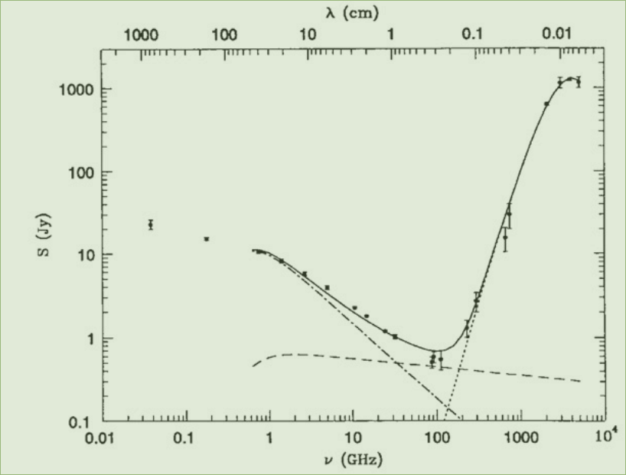
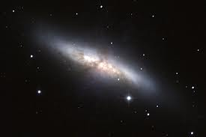
Where were we?
Spectrum of M82
3 components:
- Dust
- Thermal
Bremsstrahlung
-Synchrotron radiation
All 3 present in a single galaxy

Slide 5
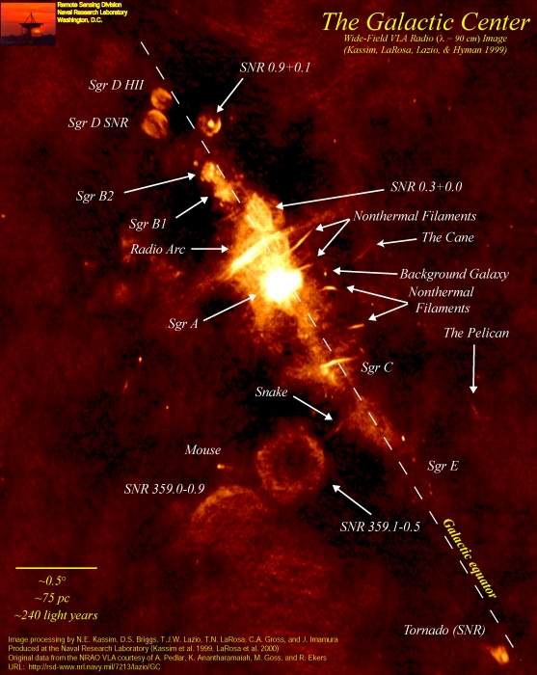
Radio Emission from the Milky Way Galaxy
We can separate individual regions powered by thermal and non-thermal processes in our own galaxy.
In all but a few hundred of the most nearby galaxies this is impossible, and radio sources are some (unknown) combination of all of the processes.
Therefore, instead of classifying radio sources by their emission mechanism, we classify a galaxy itself by the main physical process responsible for its radio emission.

Slide 6
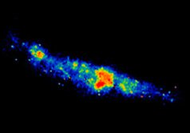
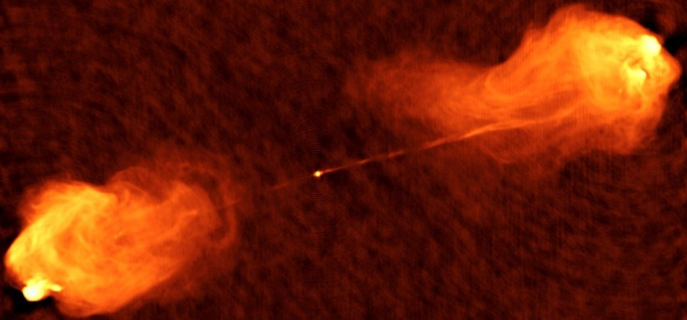
Types of Extragalactic Radio Source
Radio emitting galaxies are broadly classed into two main types- with different physical process responsible for their radio emission:
Star-Forming Active
Thermal Emission:
From HII regions and heated dust
Non-Thermal Emission:
From Supernova remnants and from diffuse relativistic electrons in the galaxies magnetic field.
Thermal emission:
From the hot core- heated by extreme processes close to a black hole.
Non-Thermal emission:
Synchrotron radiation from electrons accelerated in jets into the surrounding medium by a black hole.

Slide 7
Star-Forming Galaxies (1)
Radio emission of galaxies dominated by star-formation is made up of 3 main components: diffuse steep spectrum synchrotron continuum ~ 80%, discrete steep spectrum synchrotron SNe/SNR ~10%, and extended flat spectrum (free-free) HII regions ~10%.
To ionize the HII regions and to accelerate the synchrotron electrons requires massive stars (M > 15M☉ for the HII regions and M > 8M☉ for the synchrotron electrons).
Stars more massive than ~8M☉ have main-sequence lifetimes less than 3 x 10⁷ years, approximately 3 orders of magnitude less than the age of a typical galaxy (the Milky-Way Galaxy is > 10¹⁰ years old). The diffuse synchrotron electrons in a typical interstellar magnetic field also have lifetimes of of less than 10⁸ years.
Radio emission from these galaxies is therefore a tracer of recent (<10⁷⁻⁸ years) star-formation – uncontamiated by events involving older stars.
Radio emission is roughly coextensive with the locations of star-formation seen in other wavelengths, spanning the stellar disks of spiral galaxies.
Radio emission from star-forming galaxies is (almost) free from the effects of dust extinction, which plagues measurements of star forming galaxies at other wavelengths.

Slide 8
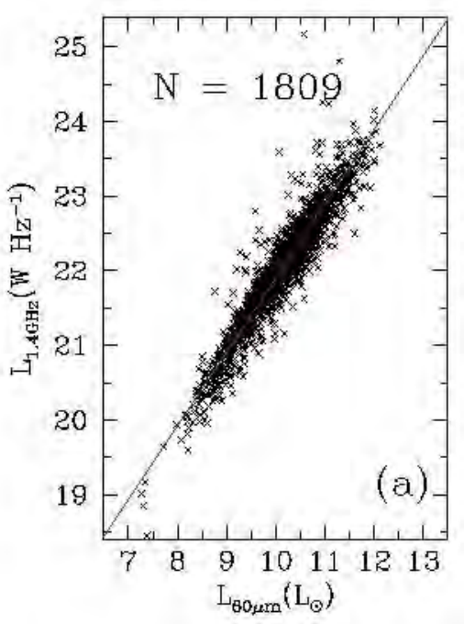
Star-Forming Galaxies (2)
The Far-Infrared Radio Correlation
Plotting radio luminosity vs FIR luminosity for star forming galaxies in the local universe has presented us with one of the strongest correlations in astronomy – this is called the Far-Infrared Radio correlation (Left)
The correlation holds over nearly six orders of magnitude in radio and FIR luminosity!
Why??

Slide 9
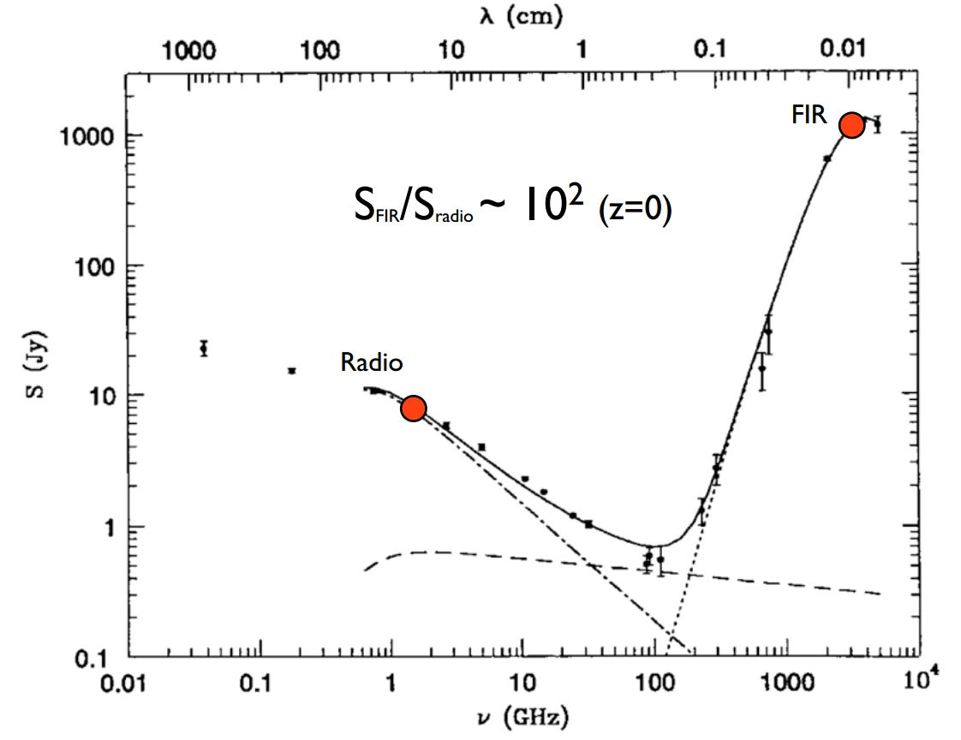
Star Forming Galaxies (3)

Slide 10
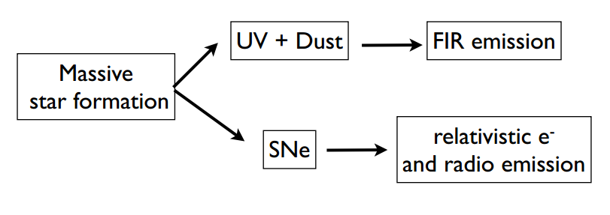
Star Forming Galaxies (4)
Detailed physical understanding of why the correlation is so tight is still a “work in progress”.
It seems that the SED of a star forming galaxy in the radio and FIR domain, appears to be very
robust over a large range of different environments/physical conditions & luminosities.
Lots of uncertainty in this model, in particular in predicting the rate of relativistic electrons and their diffusion into the ISM from the rate of SNe.

Slide 11
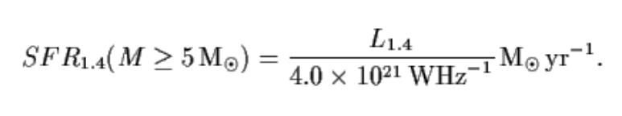
Star Forming Galaxies (5)
Star formation rate:
The FIR-radio correlation suggests that both radio and FIR measurements are sensitive to the star formation rate in star forming galaxies.
For the radio continuum the radio luminosity of a star forming galaxy is associated with the acceleration of electrons via supernova shock mechanisms and is therefore directly proportional to the SNe rate associated with massive stars.
Condon (1992) calibrated the relation between radio luminosity and SN rate by using values for
the Milky Way i.e. L_{1.4GHz} ~ 2.3 x 10²² W/Hz and ν_{SN} ~ 1/43 per yr. He provides us with the following relation:
Nearly all SFR indicatiors (radio --> uv) are only sensitive to massive star formnation. To get the total SFR we have to extrapolate down to low mass stars based on an assumed IMF (Initial Mass Function). A commonly used (Salpeter- outside the scope of this lecture) IMF gives SFR(Total) ~ 5.5 x SFR( M > 5M_{sun})

Slide 12
Active Galactic Nuclei (1)
AGN are the other main class of radio source. They are morphologically very different from Star Forming galaxies, and are distinguished by a central core of radio emission located in the nucleus of the host galaxy and thin symmetric jets terminating in large lobes.
By far the dominant emission mechanism in these sources is synchrotron radiation, electrons are accelerated to relativistic speeds by a super-massive black hole in the core and are shot out in jets, which terminate at the lobes.
Cygnus A

Slide 13
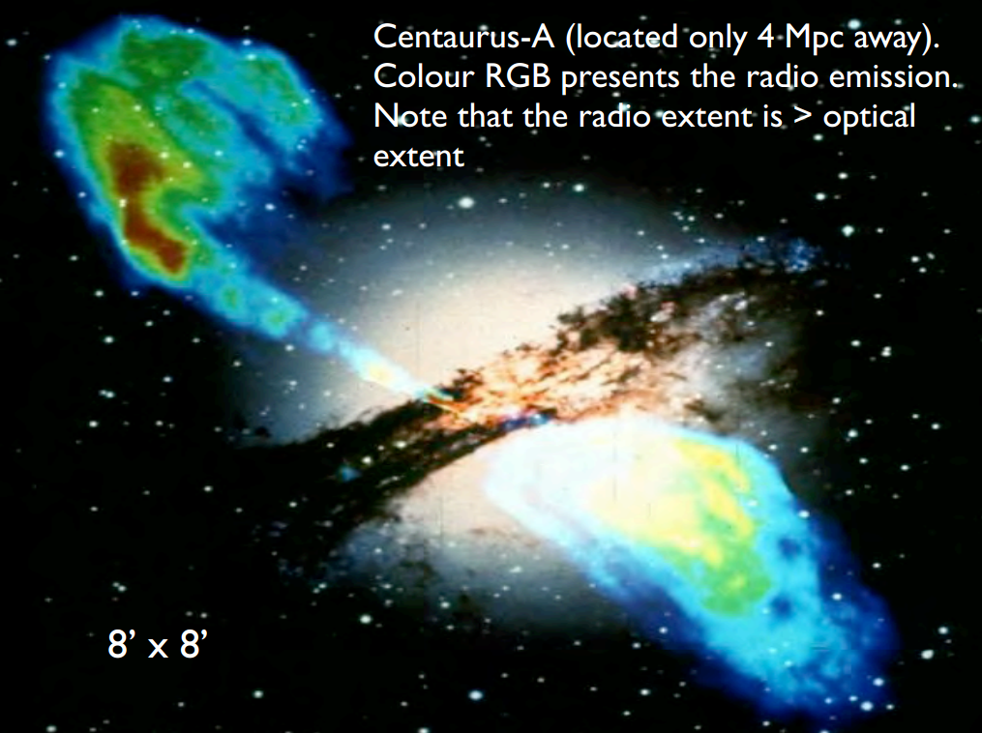
Active Galactic Nuclei (2)

Slide 14
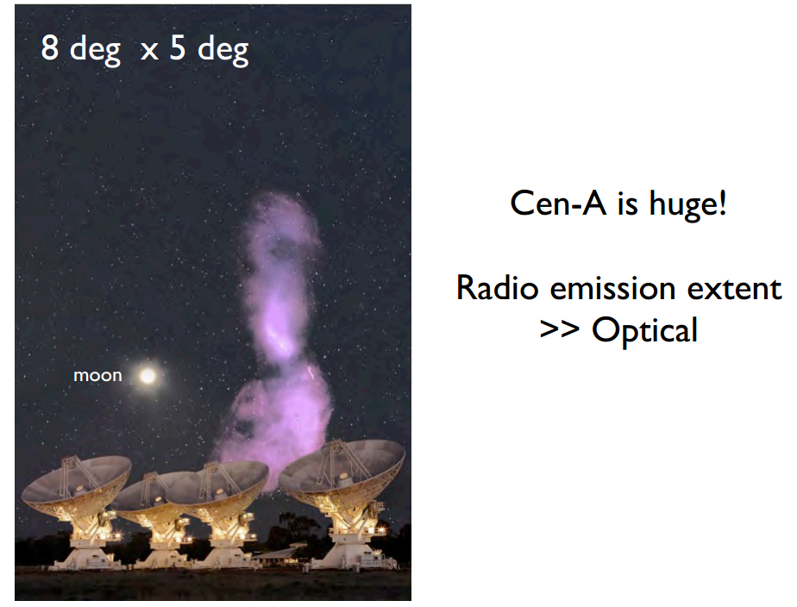
Active Galactic Nuclei (3)

Slide 15
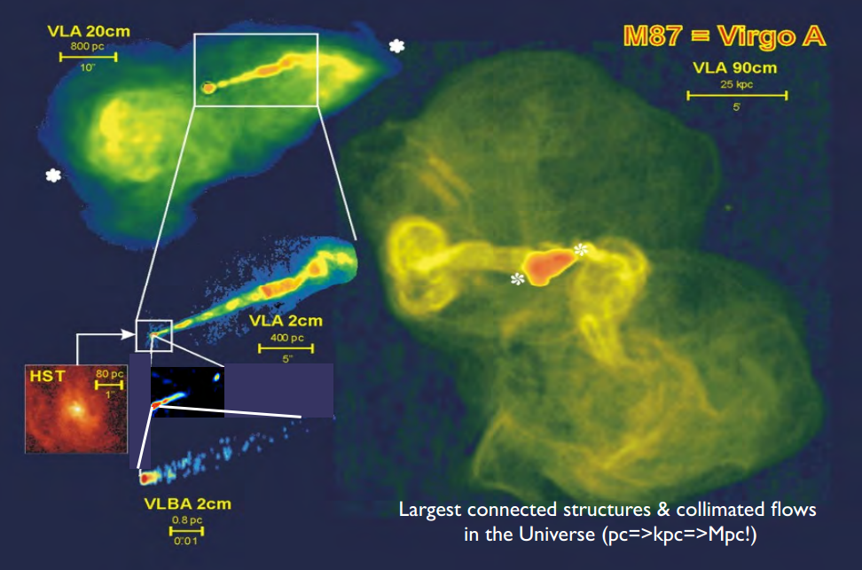
Active Galactic Nuclei (4)

Slide 16
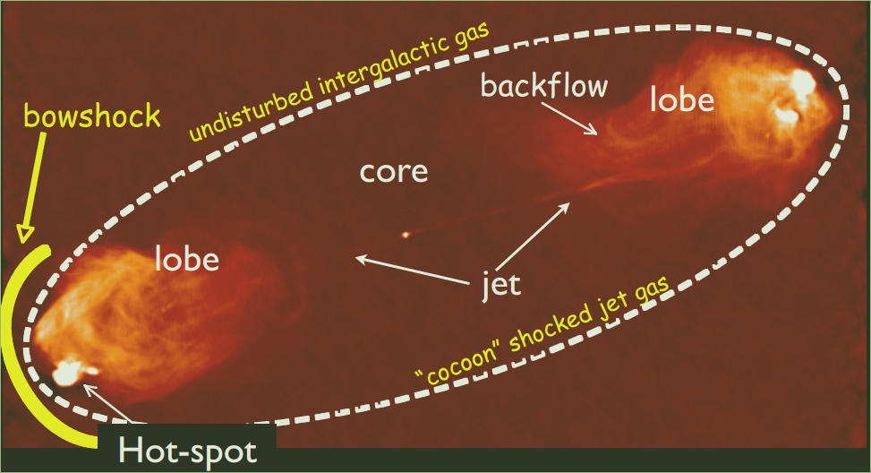
Active Galactic Nuclei (5)
Proto-typical radio galaxy (belmw). Note that this basic morphology is seen in radio sources on all scales - from parsecs to Mega-parsecs. The jets are actively pumping energy into the lobes; the hot spots mark bow shocks where the jets interact with the surrounding medium, where they deposit all their energy.

Slide 17
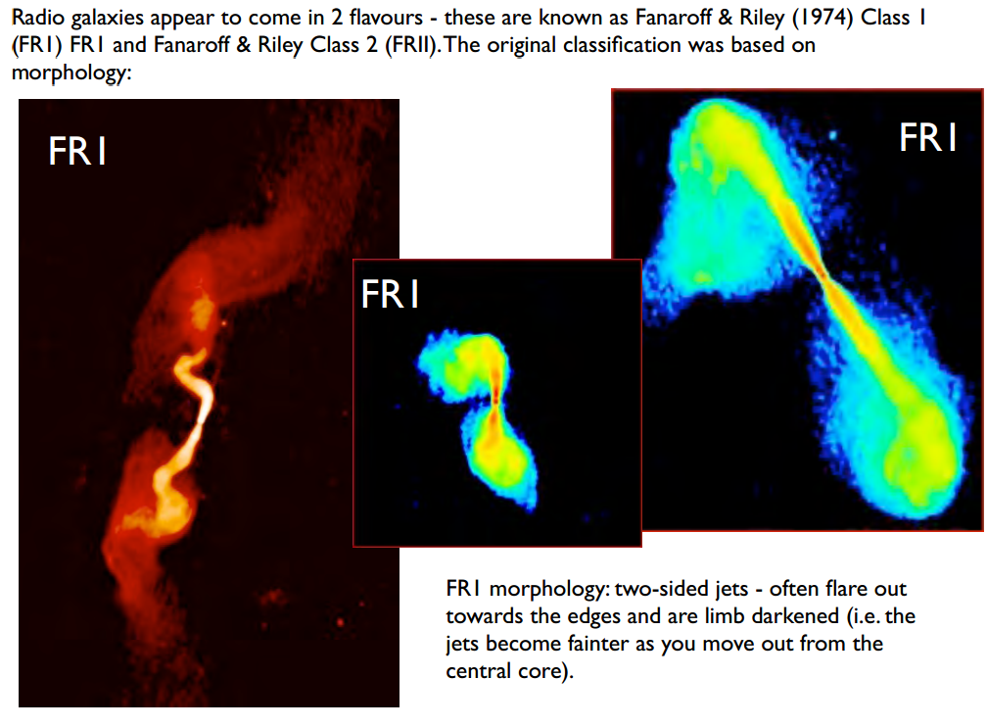
Active Galactic Nuclei (6)

Slide 18
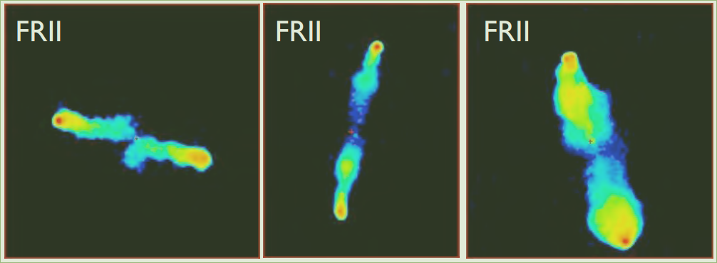
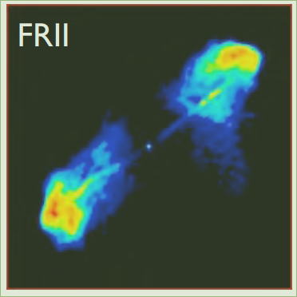
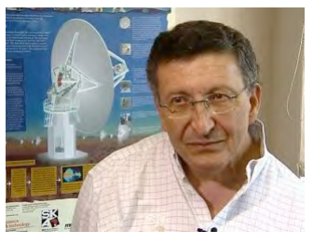
Active Galactic Nuclei (7)
FRII morphology – usually narrower and straighter jets than FRI. Jets are “edge brightened” - ie. They are brighter at the ends.
Jets often have a “Hotspot” at the end.

Slide 19
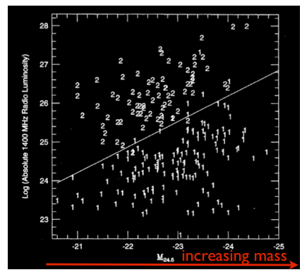
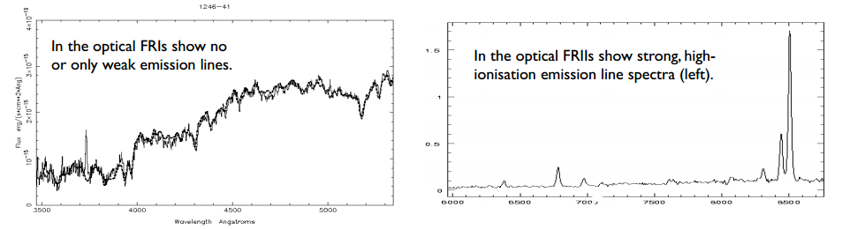
Active Galactic Nuclei (8)
The reason why FRI's and FRII's appear different is still an area of active research.
- Initially FRII sources were found to be intrinsically more luminous than FR1. The 2 classes divide out around 10²⁵ W/Hz (Fanaroff).
- It is thought that the jet velocity is higher in FRII's. In FRI's the jets have lower velocities, and fade out and dissipate before they reach the ends of the lobes. Without the steady supply of energy, the lobes are of lower luminosity and are compressed and disrupted by the surrounding medium, with
which they are in pressure balance.
- The luminosity divide between FR1s and FRIIs depends on the host galaxy magnitude: jets more easily disrupted in more massive galaxies?
- Environment may play a role?
- Accretion mode? (Below)

Slide 20
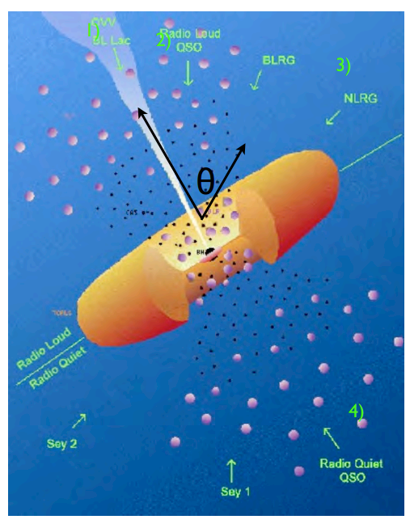
Active Galactic Nuclei (9)
Different classes of optical AGN are believed to be just dependent on observers viewing angle. Radio fits into this scheme as well:
1) If we look down the barrel of a relativistic jet
(θ=few degrees) we see broad-band synchrotron continuum cpt at all wavelengths - this dominates the overall SED e.g. BL Lac show no optical spectral lines.
2) At larger view angles we observe a symmetrical radio galaxy. For large values of θ (~ 75-90 deg) the central AGN and in particular the BLR is obscured - only see narrow spectral lines e.g. Type-2 quasars.
3) Most AGN are NOT “radio loud” (bottom half of diagram) - no jet or very faint jet - so no BL Lac, radio loud qso or radio galaxies. Sy2 (narrow lines only) and Sy1 galaxies (broad and narrow) also depend on viewing angle.

Slide 21
The (extragalactic) Radio Sky
What can we say about the overall population of radio sources across the sky?
In order to understand the global population of radio sources, astronomers use “all-sky” surveys (usually only half the sky in reality).
All sky surveys have been conducted since the early days of radio astronomy through to the present:
Name | Frequency | Flux Limit | Resolution | Year | Array
3C | 178 MHz | 9 Jy | 25 arcmin | 1960's | Cambridge
4C | 178 MHz | 9 Jy | 25 arcmin | 1970's | Cambridge
MRC | 408 MHz | 3 Jy | 49 arcmin | 1970's | Molonglo
PKS | 2.7 GHz | 0.7 Jy | 5 arcmin | 1980's | Parkes
NRAO | 1.4-5 GHz | 0.8 Jy | 5 arcmin | 1980's | Green Bank
NVSS | 1.4 GHz | 2.5 mJy | 45 arcsec | 1998 | VLA
SUMSS | 843 MHz | 6 mJy | 45 arcsec | 2003 | Molonglo
WENSS | 325 MHz | 20 mJy | 20 arcsec | 1997 | WSRT
FIRST | 1.4 GHz | 1 mJy | 5 arcsec | 1996-2011 | VLA

Slide 22
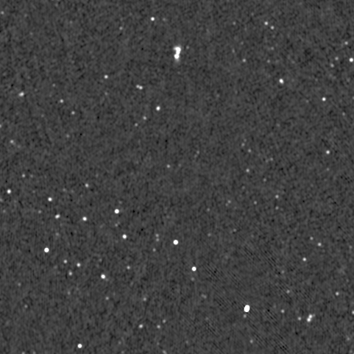
The (Extragalactic) Radio Sky (2)
The current generation of radio surveys conducted at ~arcsecond resolution are dominated by discrete sources.
2deg. by 2deg. Image from the NVSS survey (I picked a random patch of sky):

Slide 23
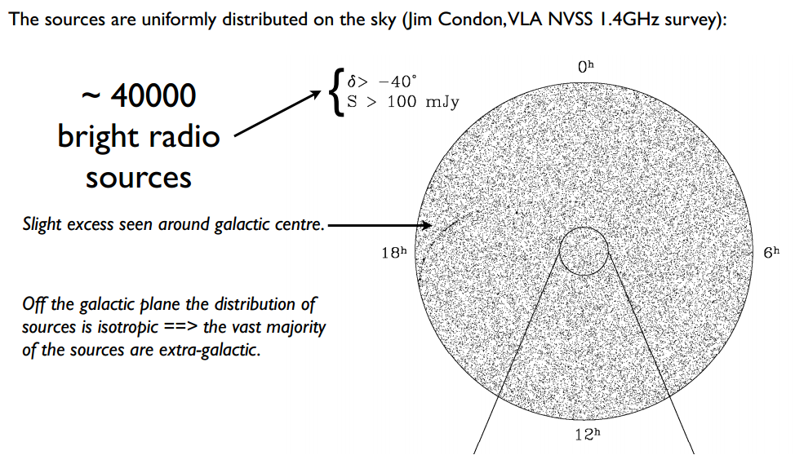
The (Extragalactic) Radio Sky (3)

Slide 24
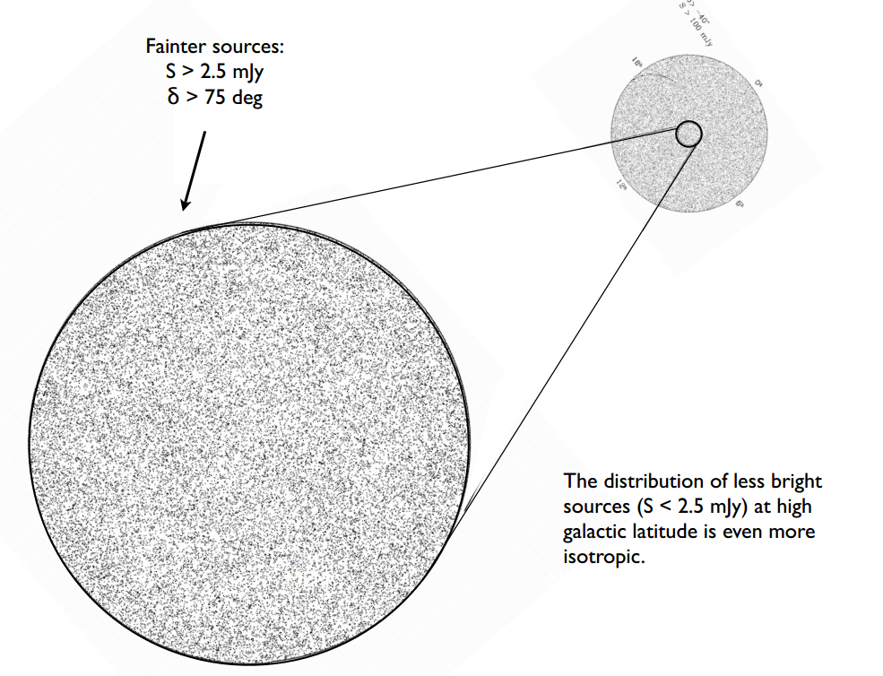
The Extragalactic Radio Sky (4)

Slide 25




Source Counts
The simplest way to understand the properties of a population of objects in astronomy is to plot their source counts.
The source counts are merely a histogram of the number of sources found as a function of their flux density in a survey. They actually contain a lot of information about the nature of a source population.
Source counts are traditionally plotted in a normalised form:
Assume a class of uniformly distributed objects with a luminosity L which are detectable to some limiting flux density, S, out to a distance r. The observed number, N is then proportional to the Volume:
The flux density observed from a source at a distance r follows the inverse-square law:
S ∝ r⁻² =>
Putting our expression for r³ into the first equation above gives:
← Normalisation for integral source count
Differentiating this gives:
← Normalisation for differential source count

Slide 26
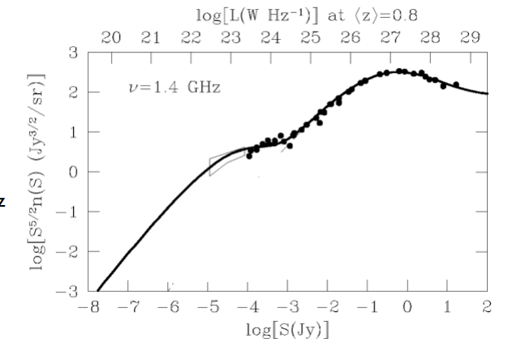
Source Counts (2)
In constructing the normalisation:
we have assumed that sources are
uniformly distributed in a static Euclidean space (This normalisation is often called a Euclidean normalisation). By plotting the normalized source counts as a function of S we should get a horizontal line is sources are uniformly distributed in Euclidean space.
The normalised 1.4GHz source counts are plotted on the left.
The universe is neither static nor Euclidean → we know this now, but back when people first made these figures, this was an important discovery!

Slide 27
Source Counts (3)
Where are the populations of Star-Forming galaxies and AGN in the radio source counts?
To answer this question we need to classify each source as either a star-forming galaxy or an AGN.
This is not trivial just using radio data as most radio sources just look point like in radio images.
Instead, by cross-matching the radio data with all-sky optical (spectroscopic) surveys we can then classify the radio sources.

Slide 28
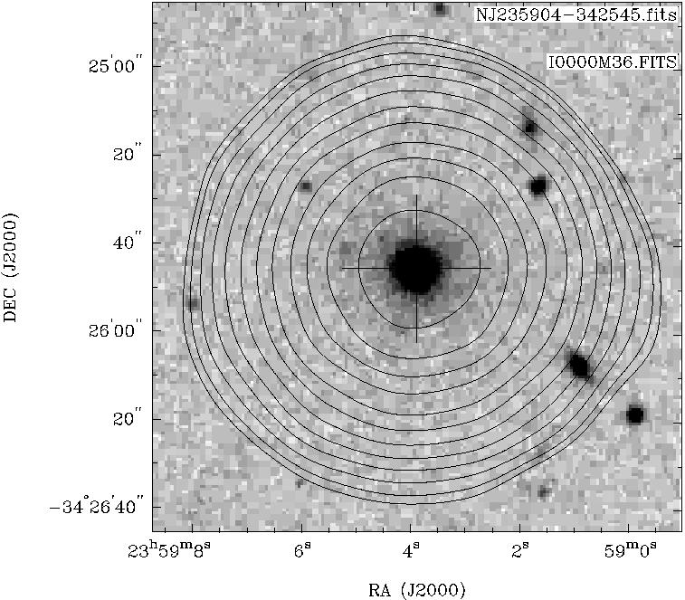
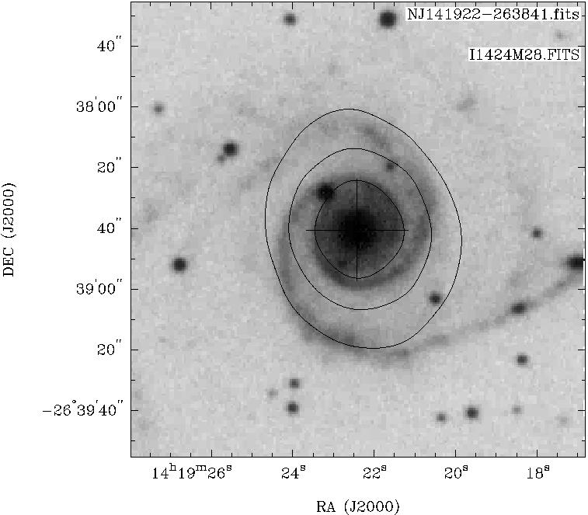
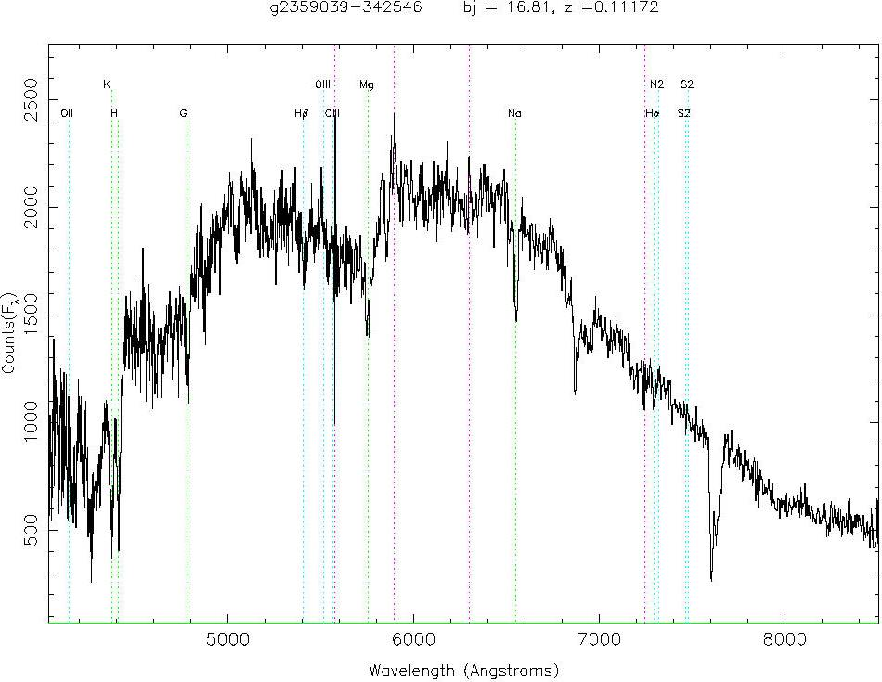
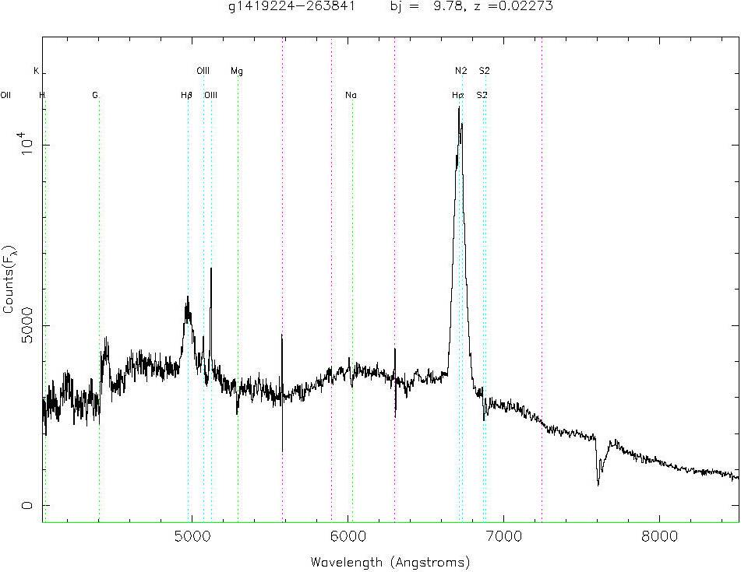
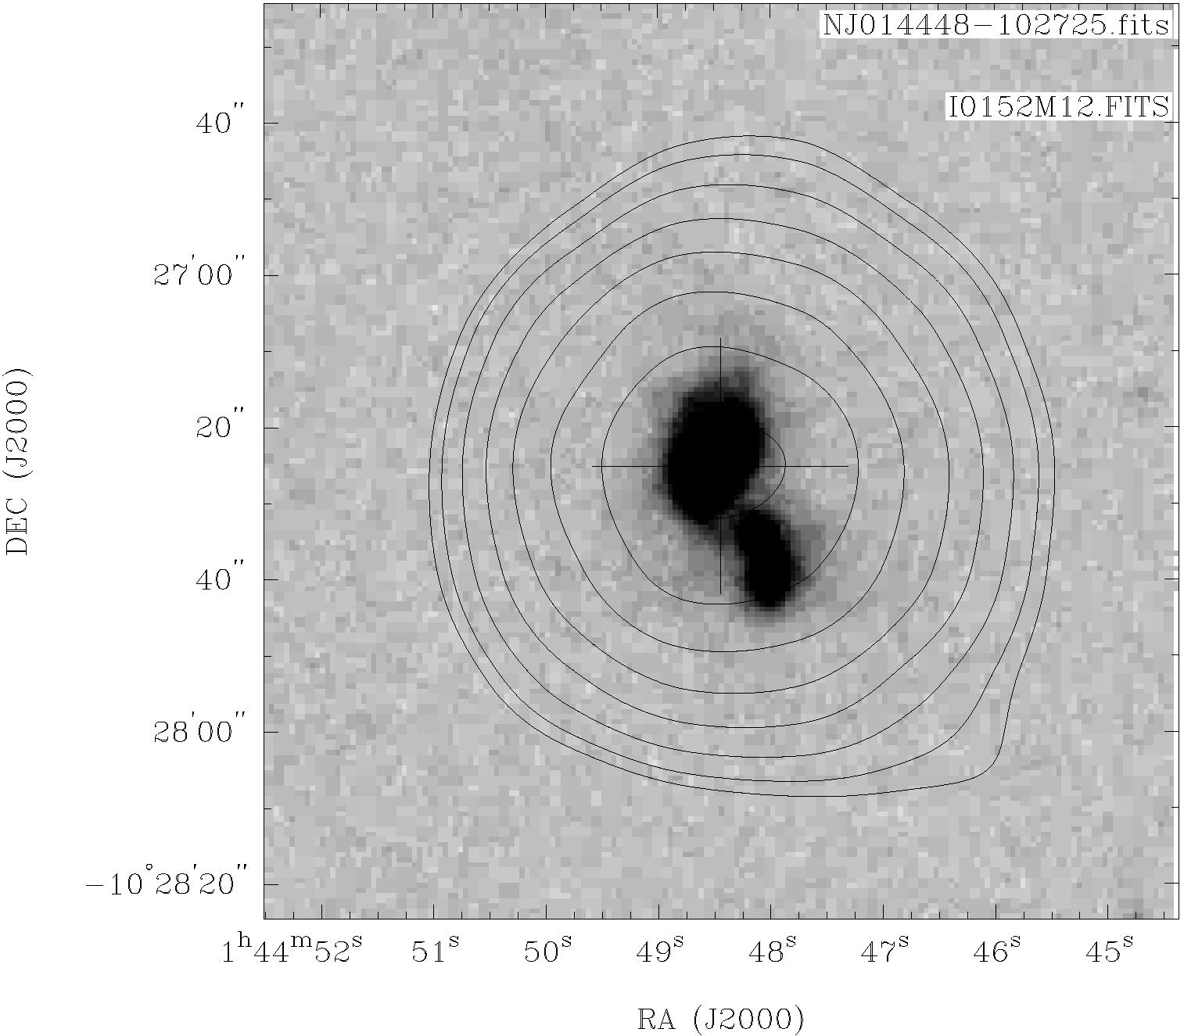
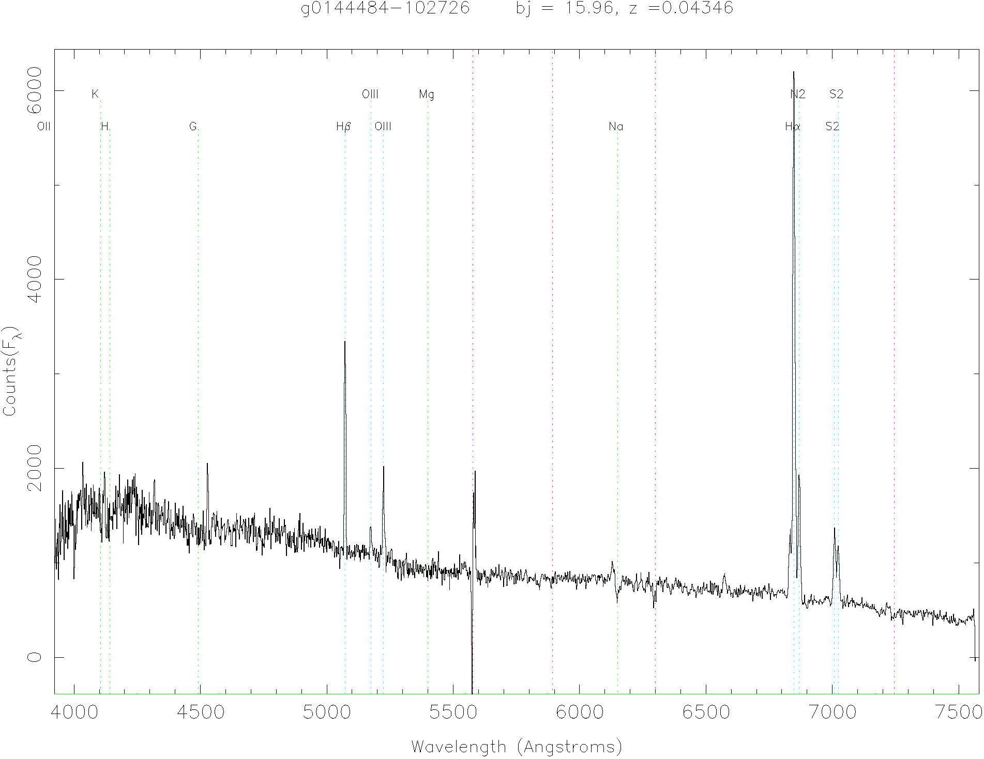
Optical Spectra of SF galaxies and AGN
Radio-loud AGN can have either purely absorption lines – or strong emission lines
Star-forming galaxies have optical spectra with moderately strong emission lines indicating the presence of HII regions.

Slide 29
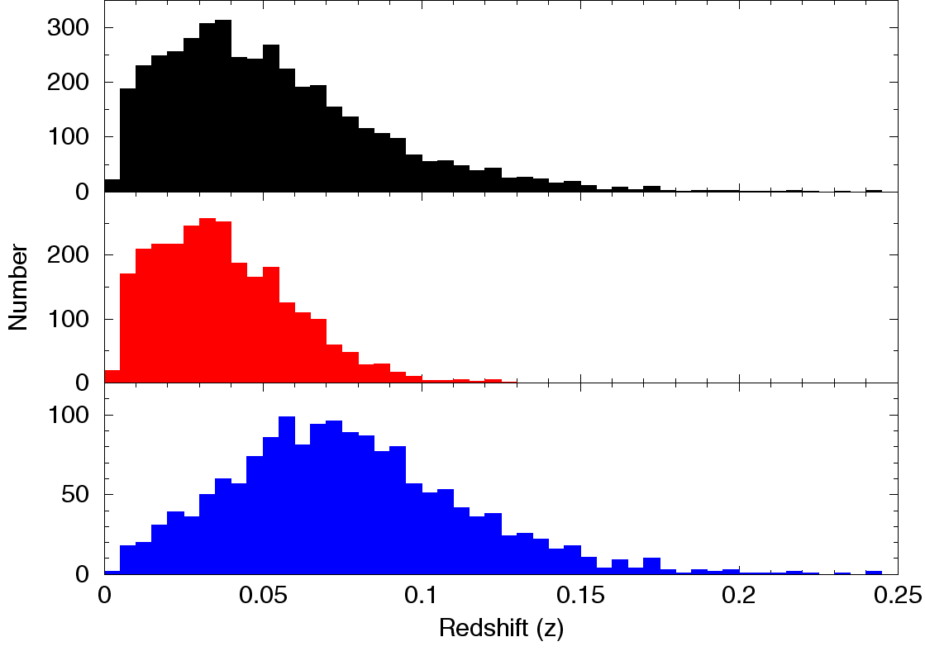
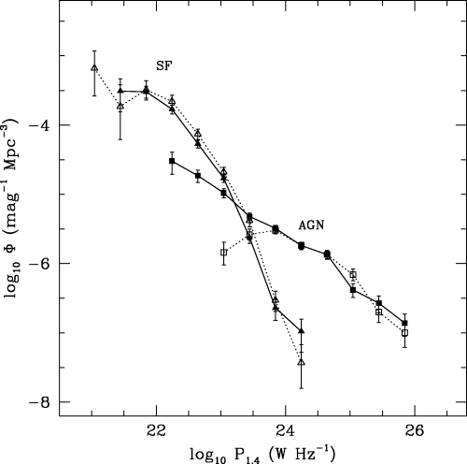
The Radio Luminosity Function
Samples of radio sources classified by their optical spectra only fill a very narrow shell in redshift- ie. Only a very small fraction of all of the sources in a given radio survey get classified.
To extrapolate to the complete population of radio sources we first compute the radio luminosity function in the redshift range sampled.
The radio luminosity function shows the “space density” of a population (Ie. How many sources per volume of space) as a function of their luminosity (derived from the redshift of the optical spectrum and the radio flux density)

Slide 30
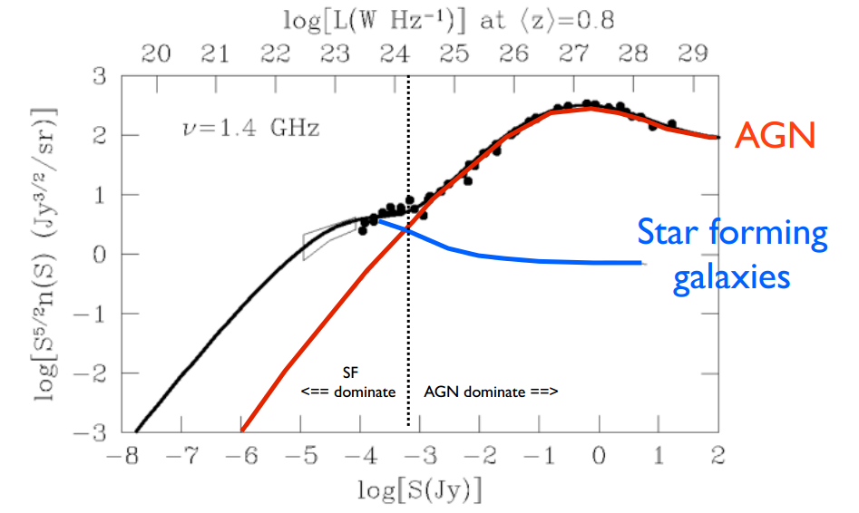
Source counts of SF and AGN
Now that we know the distribution in radio luminosity of radio sources in a narrow redshift shell, we can extrapolate in redshift/distance (in reality we leave the evolution of the population with redshift as a free parameter in our model) and fit each population to the distribution in flux density (the source counts):
AGN dominate the bright end of the source counts, star formers the faint end. The star formers make their presence felt with the unexpected flattening of the source counts at the faintest flux densities (< 1mJy).

Slide 31
The AGN and SF population
The fits of the AGN and SF galaxies to the source counts yield some surprising properties of the radio source population:
- The median redshift of the bright AGN population is z~0.8
- The median redshift of the fainter SF galaxy population is z~0 at the brightest flux
density and moves slowly higher as we move to fainter flux density (cf. Optical
galaxies)
- Bright radio surveys tell us about cosmology! We probe a distant “cosmological”
population with only modest observing time
As we move fainter in flux density in the radio, we are actually moving to a population that is more nearby (lower z). ie. The fainter a radio source is- the closer it is likely to be!

Slide 32
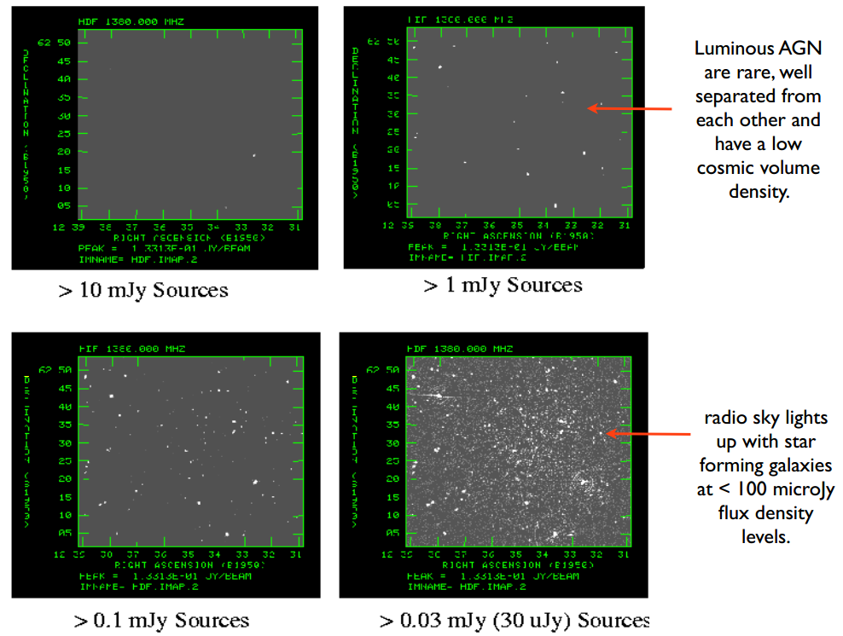
The AGN and SF Population
<z> ~ 1.0
<z> ~ 0.8
<z> ~ 0.5
<z> ~ 0.6

