Slide 1
Observational Techniques in Radio Astronomy
Emission Mechanisms and the Extragalactic Source Population
Tom Mauch
September 2014

Slide 2
Structure
2 Lectures:
  Lecture 1 is today
    Emission Mechanisms
  Lecture 2 on Monday 29th September
    Radio surveys and radio source populations
1 Tutorial on Tuesday 30th September
  Look at some real radio survey data

Slide 3
Structure II
We will broadly follow the online Essential Radio Astronomy course from Jim Condon and Scott Ransom at NRAO:
http://www.cv.nrao.edu/course/astr534/ERA.shtml
Lecture 1 will cover Sections 4: Thermal Emission and 5: Nonthermal Emission (Up to Extragalactic Sources)
Lecture 2 will cover the last part of section 5 (Extragalactic Sources) and I will add some further up-to-date topics related to SKA and MeerKAT science at the end.
This section of the course moves away from radio telescope design and technical considerations and into the physics of radio emission from the sky. ie. The things that radio telescopes actually measure
Sections 4 & 5 of the ERA course are very maths heavy! My plan is to largely avoid the equations and explain the main concepts. Do not expect complex maths in this part of the course – If you understand the ideas you will be fine for the exam!

Slide 4
Lecture 1
Emission Mechanisms
Overview:
What are the primary physical processes responsible for the (continuum) radio emission measured by telescopes.
Thermal Emission (Section 4 of Essential Radio Astronomy):
- HII Regions
- Thermal Bremsstrahlung
Nonthermal Emission (Section 5 of Essential Radio Astronomy):
- Magnetobremsstrahlung
- Synchrotron Emission

Slide 5
Acknowledgements and References
Apart from the ERA course I have also borrowed extensively from other places:
- Mike Garrett's (from ASTRON in Holland) radio astronomy course notes:
https://www.astron.nl/~mag/dokuwiki/doku.php?id=radio_astronomy_course_description
- Slides from Matt Jarvis (UWC/Oxford) and Cormac Reynolds (ICRAR)
Some good general reference books on radio astronomy (In any university library) :
Interferometry and Synthesis in Radio Astronomy, Second Edition
A. Richard Thompson, James M. Moran, George W. Swenson, Jr.
Synthesis Imaging in Radio Astronomy II
Taylor, G. B.; Carilli, C. L.; Perley, R. A.
An Introduction to Radio Astronomy
Bernard F. Burke, Francis Graham-Smith

Slide 6
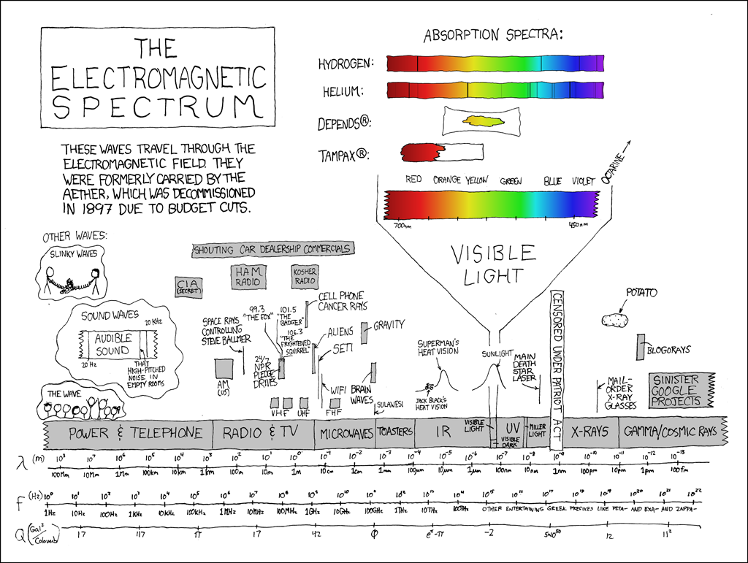
The electromagnetic spectrum
Larmor's formula:
Electromagnetic radiation with power P is produced by accelerating an electrical charge q

Slide 7
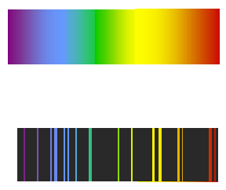
Cosmic Radio Sources – emission mechanisms
First of all lets consider the general physical processes that can give rise to radio emission.
Electromagnetic emission is produced by the acceleration of charged particles (both thermal
and non-thermal processes).
Emission can be broadly divided into 2 types:
(i) continuum emission – emission over a very broad frequency range – usually due to the acceleration of charged particles moving with a wide range of energy
(ii) line emission – emission over a very narrow frequency range – usually due to the discrete (quantised) transitions of the energy states of atoms or molecules.
Sources of continuum emission can be further broken-down into thermal and non-thermal
processes.

Slide 8
Overview of common continuum radiation processes in the radio spectrum and their environment
At wavelengths longer than ~1mm
  Thermal Bremsstrahlung (free-free emission) – HII regions
  Synchrotron Radiation – Jets in radio Galaxies, pulsars, shocks in supernovae, cosmic ray electrons in the magnetic fields of normal galaxies etc., acceleration of electrons in stellar and planetraty systems
  Thermal emission from dust – cold, dense gas
At wavelengths shorter than ~1mm
  Thermal emission – warm dust

Slide 9
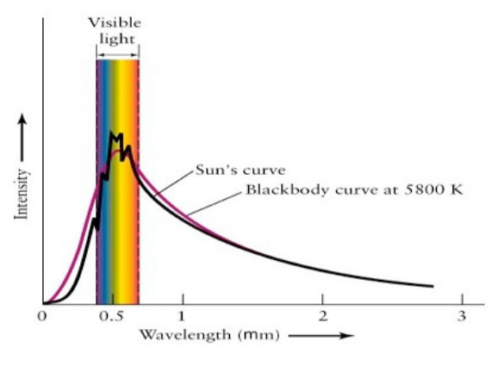
Thermal Emission
The atoms/molecules of all objects with temperatures above 0 kelvin are constantly in motion - charged particles with a very wide-range of energy are being accelerated.
Idealised analytically by an isothermal perfect blackbody that is in thermal equilibrium.
The emission depends only on the temperature of the body (and not its microscopic properties!!!)
Perfect blackbodies:
- emit some energy at all wavelengths,
- the higher the temperature the more energy emitted (Stefan-Boltzmann law: F = σ T⁴) i.e. the area under the BB curve increases,
- the higher the temperature the higher the frequency at which the maximum energy is emitted (Wiens law) i.e. the peak of the BB curve becomes narrower,

Slide 10
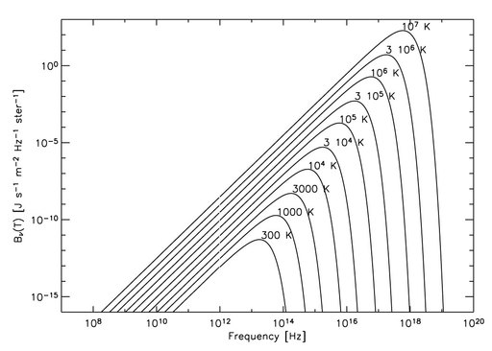
Thermal Emission (2)
From Wien’s law:
λ_{max} ~ 3 x 10⁻³/T (metres)
e.g. the CMB (T~3 Kelvin) produces its maximum energy at λmax = 0.001metres (300 GHz).
Radio astronomy is cool! Thermal emitters that produce radio waves at cm wavelengths are VERY cool < 10 Kelvin! e.g. cold and dark dust clouds in the Milky Way.
However, radio waves also probe somewhat warmer emitters e.g. dust in high-z galaxies with T ~ 50 Kelvin that is redshifted from the Far-IR to the radio (sub-mm) domain.

Slide 11
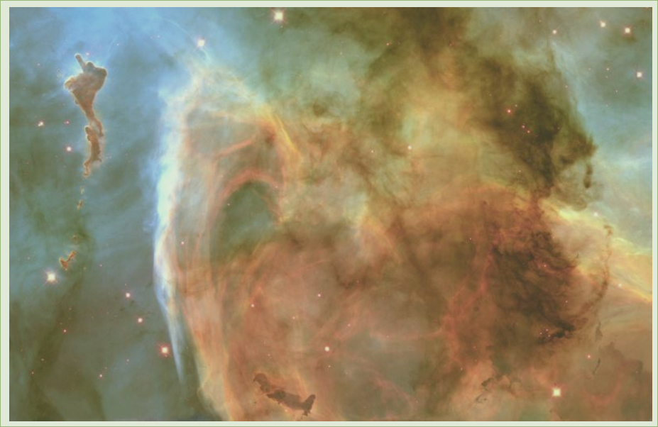
HII Regions
Regions containing predominantly
ionised H and are detected across
the electromagnetic spectrum.
The dominant ionisation process is
photoionisation where the photon
energy > 13.6 eV.
That corresponds to photons with
λ<91.2 nm (Lyman continuum photons).
Collisions with other particles
(though rare) can also excite or ionise
the atom.
Photoionisation by Lyman continuum photons leads to emission of the Balmer,
Paschen, etc. series in the Optical/IR. This is one of the main processes that
makes gaseous nebulae visible.
In describing a nebula we can talk about 2 types:
1) Radiation bounded
2) Matter bounded

Slide 12
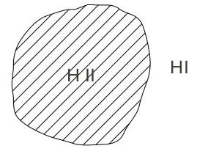
HII Regions (2)
Radiation Bounded HII region
Here the gas cloud containing the HII region is sufficiently dense and extensive that
the number of recombinations balances the number of ionisations. The gas cloud is
“optically thick” to Lyman continuum radiation.
Typically there is a sharp transition between the HII and HI region. The shape is often
roughly spherical.

Slide 13
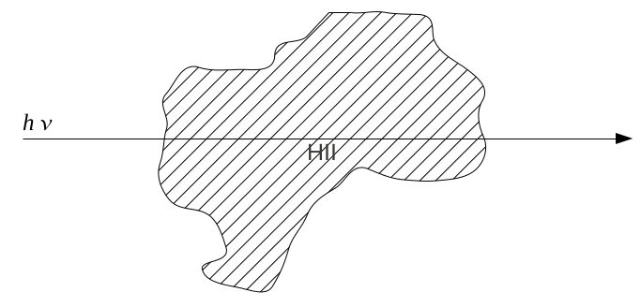
HII Regions (3)
Matter Bounded HII Region
In the case of matter bounded, the cloud is optically thin to the Lyman continuum
photon and some of them are able to pass straight though the region. Here the visible
shape of the HII region is just that of the cloud itself which is often complex and
irregular.

Slide 14
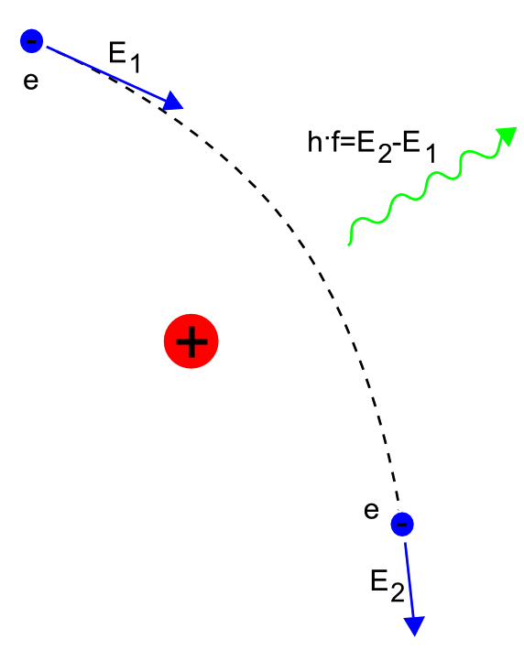
Bremsstrahlung
Much of the visible universe is a diffuse, hot (i.e.
10e4 Kelvin) ionised plasma (HII region) – so diffuse that photons are not frequently absorbed and scattered. Such regions cannot be considered a blackbody.
The ability of a source to absorb radiation is
described by its optical depth, such that the flux
density travelling through an absorber is reduced by a factor e^{-τ} where τ is known as the “optical depth” of the source.
It is these diffuse hot plasmas, with low values of τ that produce the bremsstrahlung emission in the radio.
Thermal bremsstrahlung from ionised hydrogen (HII region) is called free-free emission. It occurs when free electrons scatter off ions in the thermal plasma. Hence the name 'free-free', the electrons are free before they are captured and they are free afterwards.

Slide 15
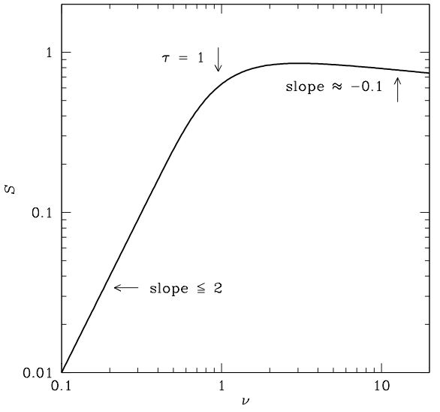
Bremmstrahlung (2)
The spectrum of free-free emission in a lightly absorbing (optically thin), diffuse ionised gas is only weakly dependent on frequency.
In particular the opacity is: τ α ν^{−2.1}
And one can write S α ν^{−0.1}
(See ERA)
The spectrum slope from a diffuse region of ionised hydrogen is therefore approximately flat. We call such sources “flat spectrum” sources- later we will see another type of source called a “steep spectrum” source.
Note that at low frequencies the assumption that τ<<1 no longer holds and the spectrum becomes similar to a thermal source. This happens at lower
frequencies where the radiation cannot directly escape (the source is optically thick).

Slide 16
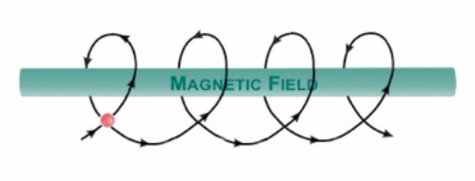
Non-thermal Emission
Non-thermal emission is produced when charged particles (we think usually electrons) spiral
around weak magnetic field lines. It is sometimes called magnetobremsstrahlung.
Since the electrons move in a helical path
they are being accelerated, and therefore
radiate e-m radiation. This mechanism was
first observed (as a nuisance) in particle
accelerators in the 1940’s. Thus the name:
Cyclotron emission
Electron cyclotron frequency in MHz is: ν_{e} ~ 2.8B
For a magnetic field typical of the Interstellar Medium (ISM) in our own galaxy (B ~ microGauss)
=> ν_{e} ~ 3 Hz. !
Since the radiation field varies with the same frequency as the gyro-frequency, such cyclotron
radiation in the Interstellar Medium (ISM) does not generate observable radio emission.
Places where the magnetic fields are strong enough to produce observable radio emission from the gyro-cyclotron process include compact objects with strong magnetic fields e.g. pulsars

Slide 17
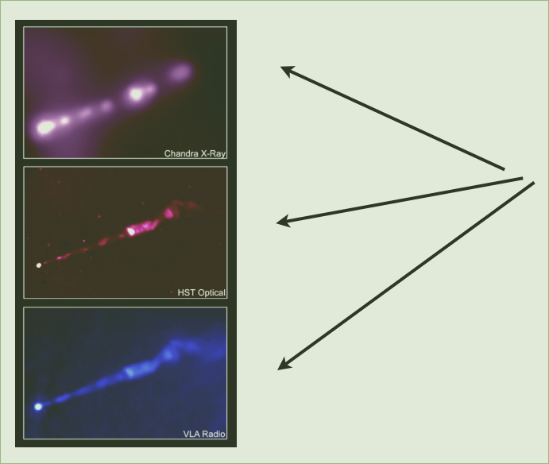
Synchrotron Emission
Synchrotron emission is associated with the acceleration of relativistic and ultra-relativistic electrons in a weak magnetic field.
If the electrons are relativistic, then the energy emitted does not depend only on the magnetic field but also on the energy of the electrons themselves. Synchrotron emission is not only important at radio frequencies but it is observed in AGN at IR, optical, UV and even X-ray wavelengths.
The images to the left show synchrotron emission observed in the galaxy M81 at X-Ray, optical and radio wavelengths.
Note that the source looks the same at all 3 wavelengths.

Slide 18
Synchrotron Emission (2)
For synchrotron emission we no longer deal with the rest mass of the electron, but instead must consider its relativistic mass (as v ~ c). Relativistic mass is defined as:
m = γ m_{e}
And energy defined as:
E = m_{e}γ c²
Where γ is the Lorentz factor defined as:
γ = (1 – (v/c)²)^{-1/2}
Such that γ is >>1 as v approaches c and is ~1 for non-relativistic velocities.
A detailed discussion of synchrotron emission is beyond the scope of this course, it requires some knowledge of special relativity and a lot of maths! You can see some of the treatment in the ERA course notes.
There are some general properties of synchrotron radiation that are important. I will summarise a few of them in the next few slides.

Slide 19
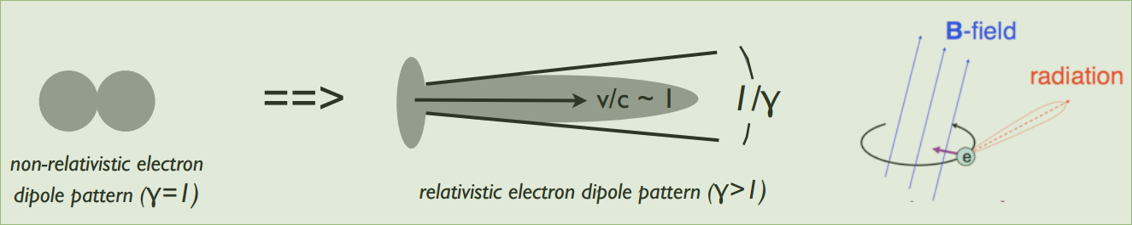
Synchrotron Emission (3)
When the electron is relativistic, the normal dipole power pattern of the electron becomes
beamed in the direction of motion:
The radiation is relativistically beamed (squashed) in the direction of the observer into a narrow
cone of angular width 1/γ.
In addition, the frequency of the radio emission is no longer independent of energy and becomes concentrated into a narrow frequency range at a characteristic frequency ν_{max} where it radiates most of its energy:
ν_{max} = ν_{e}γ²
Since γ >> 1 this boosts the emission frequency of synchrotron emission into the radio domain.

Slide 20
Synchrotron Emission (4)
Energetics of Synchrotron electrons:
The radiated power of a single electron is given by:
P_{e} ~ 2γ²U_{mag} where U_{mag} is the magnetic energy density = B²/8π
Since ν_{max} = ν_{e}γ² and ν_{e}~ B:
ν_{max} α E²B
And also since P = dE/dt:
dE/dt α E²B²
==> Increasing B causes particles to radiate at higher frequencies and to lose energy more quickly.
==> Higher energy electrons lose energy more quickly.

Slide 21
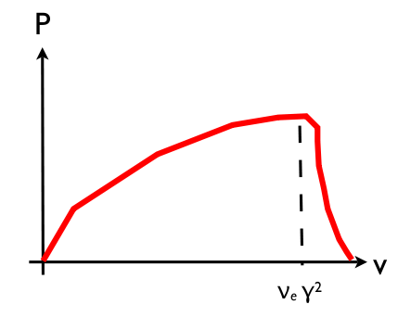
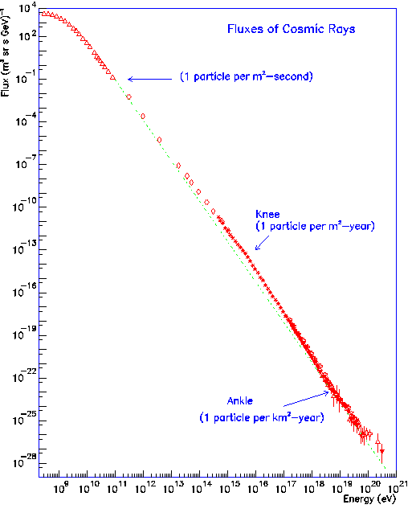
Synchrotron Emission (5)
The synchrotron spectrum of a single electron has a logarithmic slope of 1/3 at low frequencies, a broad peak near the critical frequency v_{max}, and falls off sharply at higher frequencies.
If all electrons had the same velocity (energy distribution) the synchrotron spectral energy distribution would look something like this (log plot - right).
In practice, the electrons have a wide range of energies. Like cosmic rays, the energy distribution of electrons radiating in synchrotron sources also appears to follow a power-law:
N(E) α E^{-β} where β = 5/2 from figure to right
A synchrotron source containing any arbitrary distribution of electron energies has spectrum that is the superposition of the spectra of many single electrons

Slide 22
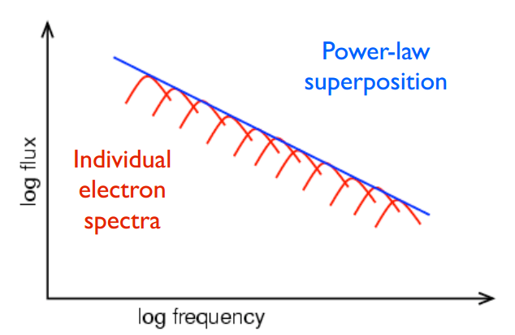
Synchrotron Emission (6)
The total power from an ensemble of relativistic electrons P(γ) is proportional to:
P(γ) α P_{e}(γ)Ν(γ) Note that: P_{e}(γ) α γ² and Ν(γ) α γ^{−β}
P(γ) α γ^{2−β}
To see how the total power is related to observables (e.g. observing frequency):
P(ν) = P(γ) dγ/dν
α γ^{1−β} dγ/dν ∼ γ⁻¹
α ν^{(1−β)/2} γ ∼ ν^{1/2}
Since the Flux Density S is proportional to P:
S(ν) α ν^{(1−β)/2}
Then, for the power-law distribution of electron
Energies in the previous slide:
S(ν) α ν^{−0.75}

Slide 23
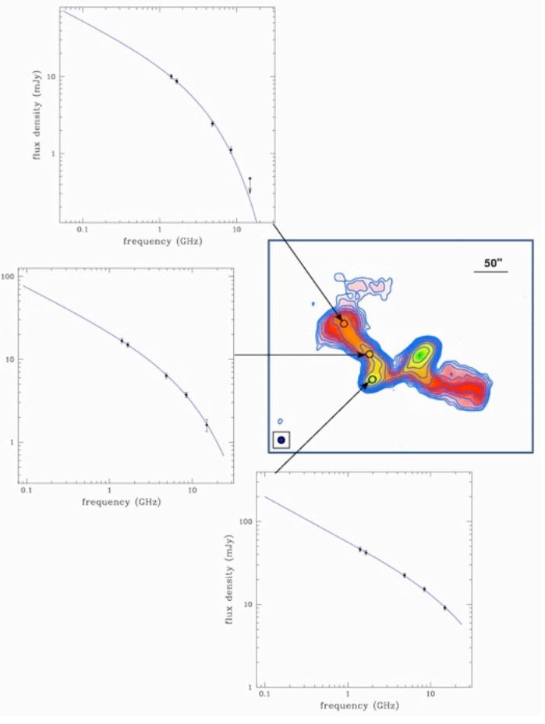
Synchrotron Emission (7)
Radio spectra sometimes curve downward at higher frequencies (i.e., the spectral index α increases - becomes steeper - as ν increases). The basic reason for this is that the electrons radiate at frequencies proportional to their energy E, and the rate at which they lose energy is proportional to E². Thus, the highest-energy electrons radiate away their energy the most rapidly, thus depleting the emitted spectrum at the high-frequency end first, if no replenishment of the high-energy electrons occurs.
Left: Radio image of the galaxy NGC 326 and radio spectra of selected regions in the source. The total intensity is plotted as blue contours. The colour coding refers not to the intensity of the radio emission but to its spectral index (red indicates very steep spectral index, green flatter spectral index). The different curvatures of the spectra can be used to infer the different ages of the various parts of the radio galaxy: stronger curvature indicates older radio emitting material. Note that outer regions are, as expected, older than the inner parts

Slide 24
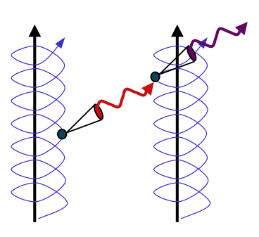
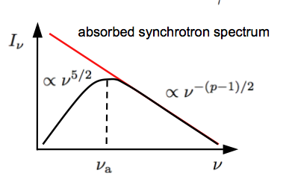
Synchrotron Self Absorption
Following the principle of “detailed balance”, any mechanism that can produce radiation can also absorb it. Thus the synchrotron mechanism can also be an absorption mechanism.
From the equations describing the synchrotron spectrum it might appear that at low frequencies the flux density of synchrotron radio source will increase without limit.
However, as the intensity of the synchrotron radiation within a source becomes sufficiently high, the spiralling electrons begin to reabsorb the low-energy photons. In particular, this can occur in radio sources which are very compact (e,g. AGN with size << 1 kilo-parsec) and have very high synchrotron electron densities i.e. they become optically thick at lower frequencies.

Slide 25
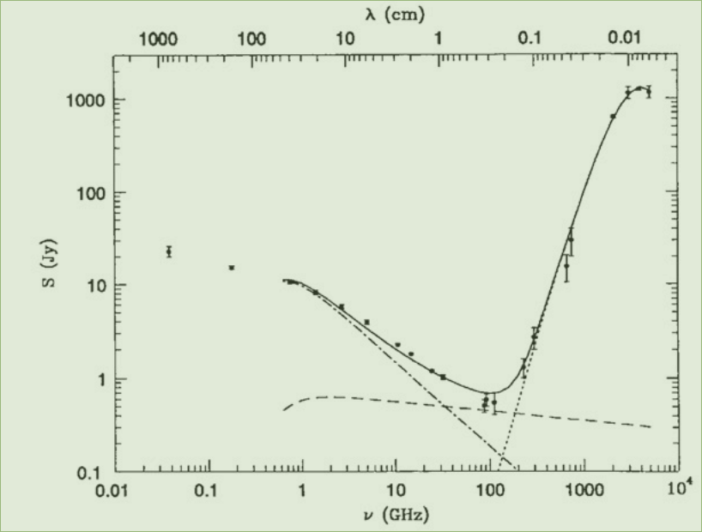
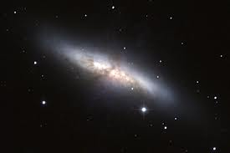
Radio emission from M82
These basic radiation processes: (i) thermal emission,
(ii) synchrotron emission/absorption and
(iii) thermal bremstralung (free-free) emission
provide a basic explanation for the continuum spectra of most galactic and extra-galactic sources observed in the radio domain. A good example to look
at is the radio spectrum of a “normal” star forming galaxy like M82. M82 is a starburst galaxy with some similarities to our own Milky Way Galaxy.

Slide 26
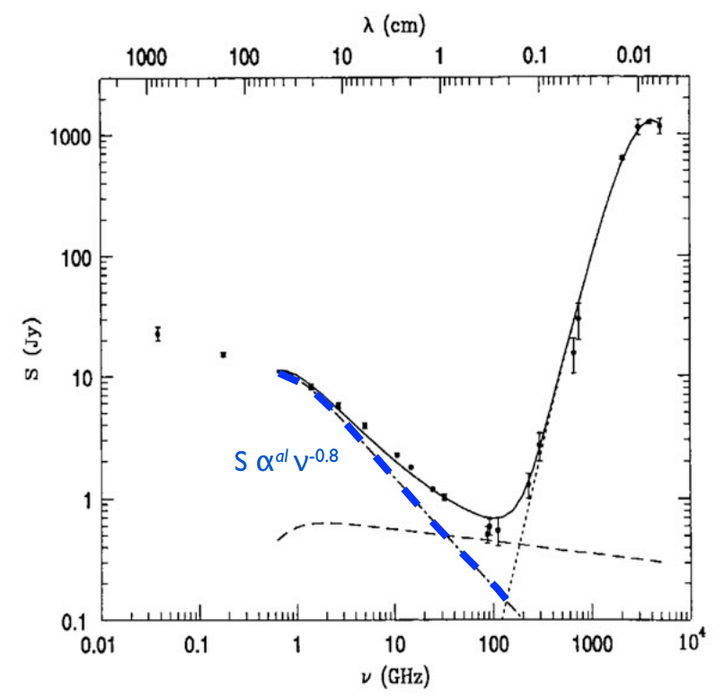
M82 - Synchrotron
Dashed (blue) line is steep spectrum synchrotron emission (S α ν^{-0.8}) - mostly from cosmic-ray electrons accelerating in M82's magnetic field – the source of the electrons is believed to be shocks from supernovae – massive stars that exploded into the ISM. The supernova events themselves accelerate electrons to relativistic speeds and also produce short lived synchrotron emission.
Note the Synchrotron self absorption at lower frequencies.

Slide 27
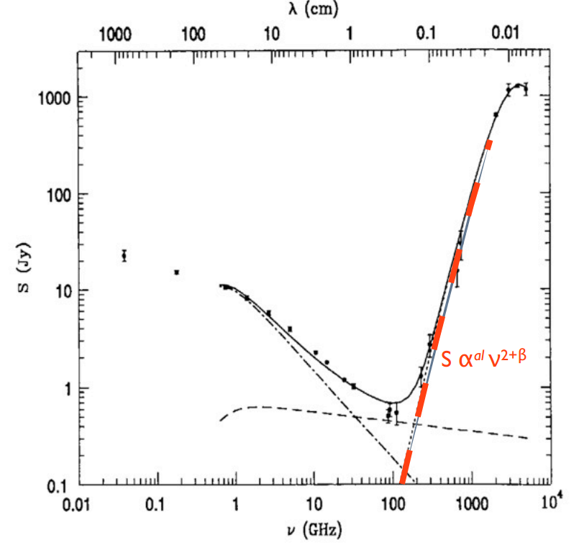
M82 Dust
The dashed orange line is thermal blackbody emission from dust that has been heated up by uv- photons from the same massive stars that produced the supernovae that fuel the synchrotron emission. The dust absorbs the uv-photons, heats up, and re-emits in the Far-Infrared. N.B. For sources at high redshift, the FIR peak get redshifted into the radio domain.

Slide 28
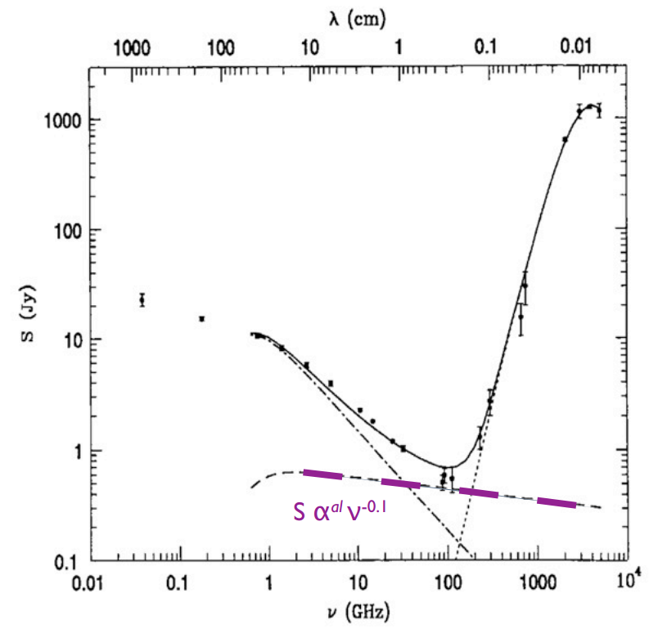
M82 Bremsstrahlung
The dashed (purple) line is thermal free-free emission
(S α ν^{-0.1}) from hot, ionised and tenuous HII regions that are common in star-forming regions that contain young massive stars (again the same massive stars that produced the supernovae that fuel the synchrotron emission, and that heat the dust to produce thermal emission!).
In the next lecture we'll look at how the total radio emission from galaxies like M82 tell us about the rate of formation of massive stars within them.

Slide 29
Lecture 1 Summary
What to take away:
There are two primary types of radio emission:
1. “thermal” - produced in hot plasmas (ie HII regions) and via blackbody radiation from dust
2. “non-thermal” - produced when relativistic electrons spiral in magnetic fields (synchrotron radiation)
The spectra (variation of measured intensity as a function of measurement frequency) of the different types of emission are very distinct. Bremsstrahlung has a “flat” spectrum and synchrotron emission has a “steep” spectrum.
Typical radio sources in distant galaxies have spectra that show a combination of these various emission processes.
Next lecture we will look at the population of radio sources in the Universe that are measured via all sky radio surveys and talk about some of the science which is done with these surveys.

