Slide 1
E-Notice Board
1st progress presentation
For
MINI PROJECT – I
(2016-17)
Under the guidance of: Submitted By:
Mr. K. G. Sharma Shubh Ketan Agarwal,
& B. Tech III (CSE), 141500404.
Mr. Vivek Sharma shubh.agarwal_cs14@gla.ac.in
Prakhar Singh,
B. Tech III (CSE), 141500270.
prakhar.singh_cs14@gla.ac.in.S

Slide 2
The idea!
The idea of the project is that to provide a notice board on LAN that can be accessed by anyone at any time to upload or go through a notice, with a promise to keep it active as long as the LAN is up and running.

Slide 3
Need?
Do we need to switch to a notice board when we already have an email for that?
Yes, we do.
Why do we need to switch to a notice board when we have a mail for sharing information? We need to switch for the simplest of reasons-this is better than a mail where you to spend time to mention your audience and subject.

Slide 4
Restrictions?
It is a nice way to express yourself with, giving you the control to reveal your identity or keep it anonymous.
Thus, it doesn’t really any compulsory restrictions. It’s all about the section you post in that will decide how seriously people decide to take the posted information.

Slide 5
The slides ahead are in the order in which the frames are placed at the moment (maybe changed as per further developments).

Slide 6
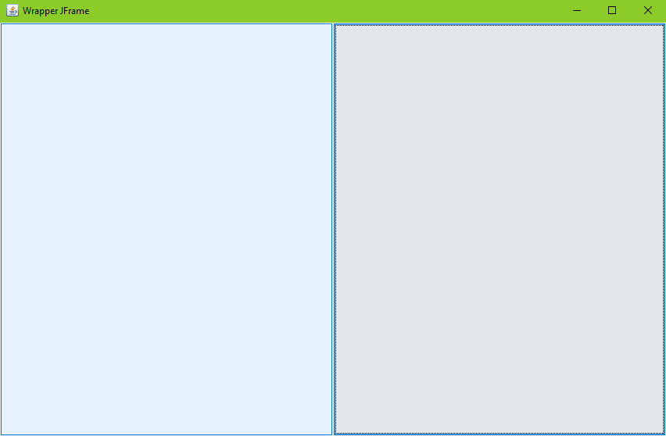
Read
Upload

Slide 7
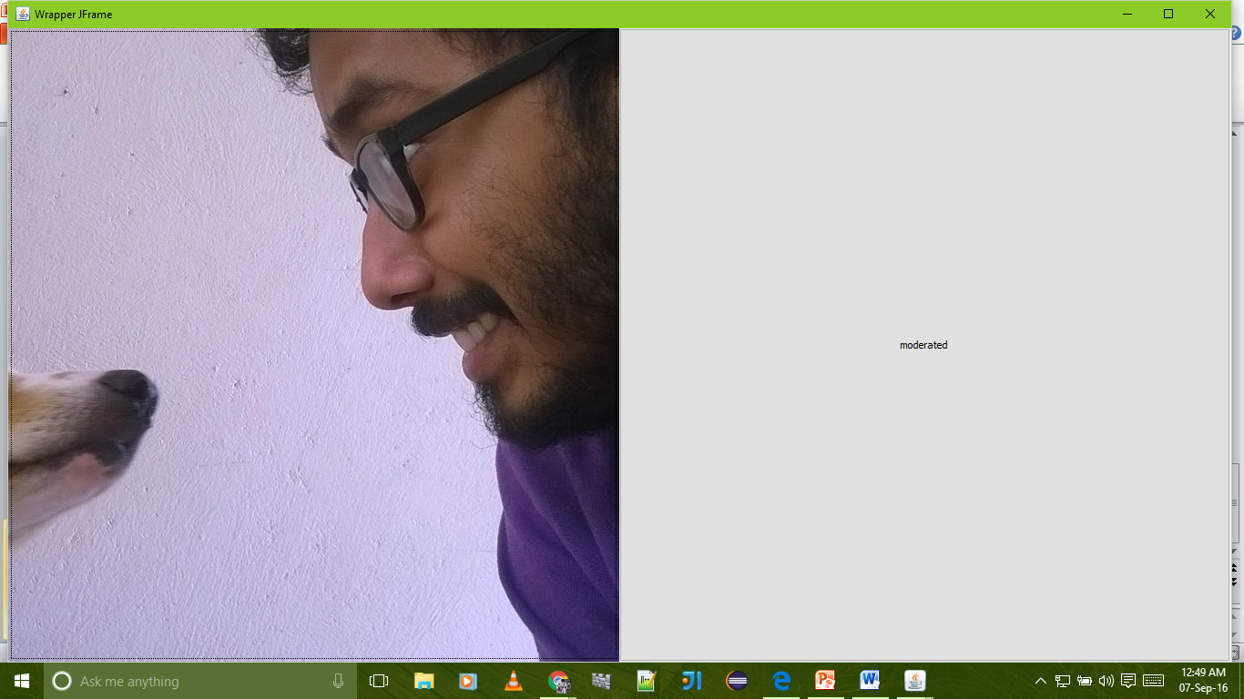
Un-moderated section
Moderated section

Slide 8
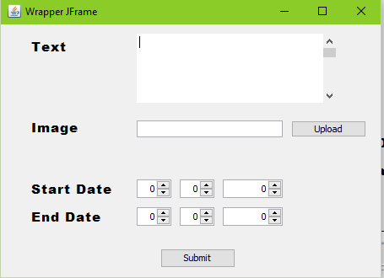
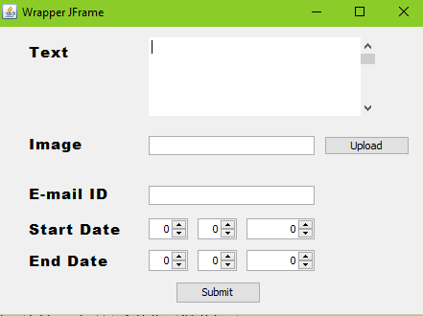
Moderated
Un-moderated

Slide 9
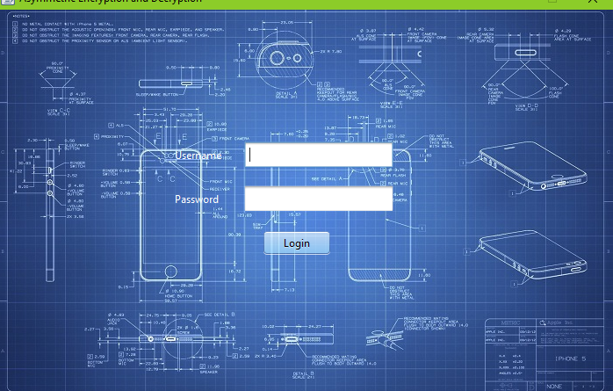
Moderated section Login

Slide 10
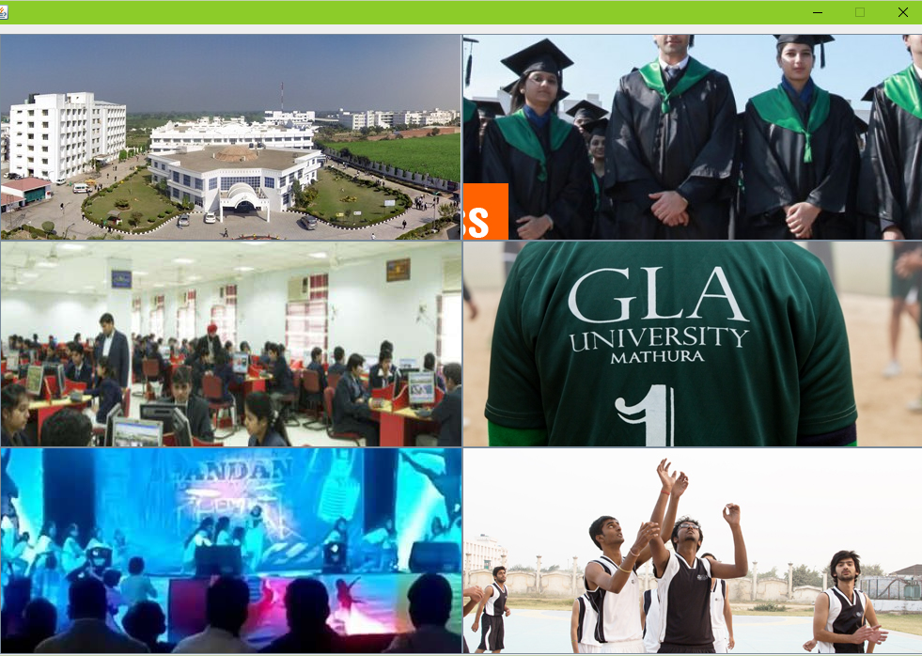

Slide 11
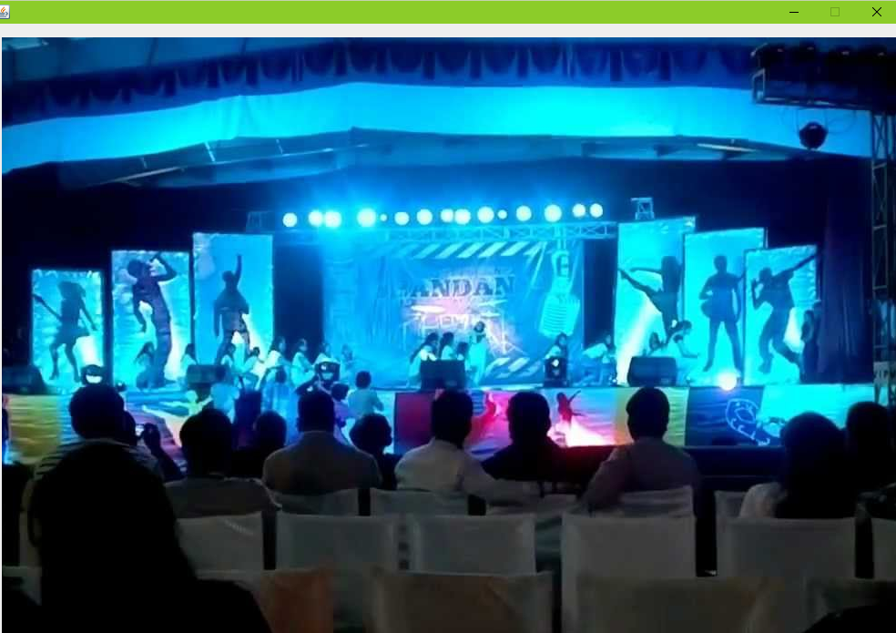
Gesture pane
Content goes here

