Slide 1
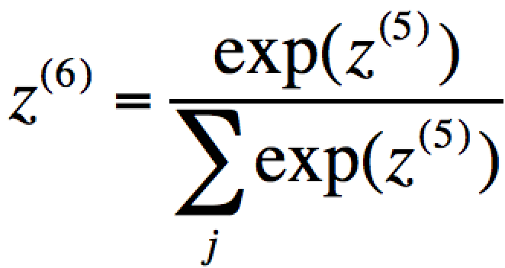
z⁽¹⁾ = w⁽⁰⁾ z⁽⁰⁾
z⁽³⁾ = w⁽²⁾ z⁽²⁾
z⁽⁵⁾ = w⁽³⁾ z⁽⁴⁾
z⁽⁰⁾ = x
z⁽²⁾ = r(z⁽¹⁾)
z⁽⁴⁾ = σ (z⁽³⁾)
z⁽⁰⁾
z⁽¹⁾
z⁽²⁾
z⁽³⁾
z⁽⁴⁾
z⁽⁵⁾
Soft
max
z⁽⁶⁾ = y
x
1
w⁽⁰⁾
ReLU(r)
w⁽²⁾
σ
w⁽⁴⁾
δ⁽⁰⁾ = w^{(2)T} δ⁽¹⁾
δ⁽²⁾ = w^{(2)T} δ⁽³⁾
δ⁽⁴⁾ = w^{(4)T} δ⁽⁵⁾
δ⁽¹⁾ = r’(z⁽²⁾)⊙δ⁽²⁾
δ⁽³⁾ = σ’(z⁽³⁾)⊙δ⁽⁴⁾
δ⁽⁵⁾ = y - t
Grad update:
▽w⁽⁰⁾= z⁽⁰⁾ ⊙ δ⁽¹⁾
Grad update:
▽w⁽²⁾= z⁽²⁾ ⊙ δ⁽³⁾
Grad update:
▽w⁽⁴⁾= z⁽⁴⁾ ⊙ δ⁽⁵⁾
Note that this actually the combined error from both the softmax activation function and the cross entropy error!

