Slide 1
FASHION E-COMMERCE
WITH AUCTION SYSTEM
MCA Final Project – Viva Presentation
STUDENT
ROLL NO
SHEIK ABDULLA S
24SPCA043
INSTITUTION
GUIDE
VHNSN College, Virudhunagar
Mrs. P. MURUGESWARI
ORGANISATION
DATE
DCE Technology, Virudhunagar
April 2026

Slide 2
TABLE OF CONTENTS
Overview of all sections covered in this presentation
01
Introduction & Organisation
Slides 1–3
08
Data Model (ER, Data Dictionary)
Slides 24–28
02
Problem Definition
Slides 4–5
09
Process Model (DFD L0–L3, Use Case)
Slides 29–35
03
Existing & Proposed System
Slides 6–7
10
Algorithms & Logic
Slides 36–38
04
System Requirements
Slides 8–9
11
Implementation (Frontend + Backend)
Slides 39–48
05
System Architecture
Slides 10–11
12
Testing
Slides 49–51
06
Technology Stack & Modules
Slides 12–13
13
Performance, Limitations, Future
Slides 52–55
07
Module Deep Dive
Slides 14–23
14
Conclusion & References
Slides 56–60
Fashion E-Commerce with Auction System ● Sheik Abdulla S ● 24SPCA043 ● VHNSN College ● April 2026

Slide 3
ORGANISATION PROFILE
Industry Training Partner — DCE Technology, Virudhunagar
DCE TECHNOLOGY
SPECIALISATIONS
CEO:
Mr. S. KARTHIKEYAN
▸ Custom software & web application development
▸ Mobile applications & cloud-based systems
Team Lead:
Mr. S. STHIYAMOORTHI
▸ Agile development methodology
▸ Scalable, user-friendly architecture
Location:
Virudhunagar, Tamil Nadu
▸ Real-time systems & digital commerce solutions
Domain:
Software Development
INSTITUTION
College:
VHNSN College, Virudhunagar
Focus:
Web + Real-Time Systems
Affiliation:
Madurai Kamaraj University
Role:
Industry Training Partner
Accreditation:
NAAC 'A+' Grade (5th Cycle)
Guide:
Mrs. P. MURUGESWARI
Fashion E-Commerce with Auction System ● Sheik Abdulla S ● 24SPCA043 ● VHNSN College ● April 2026

Slide 4
ABSTRACT
Project Overview — Fashion E-Commerce with Auction System
Unified Platform
Core Features
Web-based app combining fixed-price shopping with real-time live auction for fashion products.
Product browsing, cart, wallet operations, digital payments, and competitive live bidding.
Dual-Mode Selling
MERN Stack
Standard fixed-price items PLUS live auction rooms for premium and limited-edition fashion.
MongoDB, Express.js, React.js, Node.js with Socket.IO for real-time bid synchronization.
Role-Based System
Business Value
Dedicated interfaces for Administrators, Vendors, and Customers across 82 frontend routes.
Improves user engagement, enables dynamic price discovery, and supports flexible selling.
Fashion E-Commerce with Auction System ● Sheik Abdulla S ● 24SPCA043 ● VHNSN College ● April 2026

Slide 5
PROBLEM DEFINITION
Static Pricing
No Live Bidding
Fixed prices fail to capture true market value of premium/limited fashion items
No built-in real-time bidding or auction room management in existing platforms
Low Engagement
Fragmented Systems
Users browse and buy with no live participation model, reducing platform stickiness
Separate auction portals cause split identity, payment flow, and inventory control
No Price Discovery
No transparent mechanism for competitive price discovery on high-demand items

Slide 6
EXISTING SYSTEM
How It Works Today
Drawbacks
Products listed with fixed prices
Customers browse → cart → checkout flow
No competitive engagement or live events
Cannot adjust price based on real-time demand
Low customer excitement and platform stickiness
No auction room or bidding system
Static pricing ignores demand-driven value
No real-time auction room management
Administrative control over live events is absent
Separate systems needed for auctions & shopping
No bid validation or synchronized bid updates
Winner declaration must be handled manually

Slide 7
PROPOSED SYSTEM
1
2
3
Unified Platform
Real-Time Bidding
Wallet Integration
One platform for fixed-price shopping AND live auction bidding
Socket.IO-powered room-based synchronization for live bid updates
Wallet-driven participation with balance validation before bidding
4
5
6
Role-Based Dashboards
Integrated Modules
Winner Settlement
Admin, Vendor, and Customer each get a dedicated interface
Catalog, cart, payment, order, and auction all in one system
Automated winner declaration with bid tracking and notification

Slide 8
SYSTEM REQUIREMENTS – HARDWARE
Hardware Environment
Component | Specification
Processor | Intel Core i5 / AMD Ryzen 5 or above
RAM | 8 GB minimum — 16 GB recommended
Storage | 256 GB SSD or above
Display | 1366 x 768 resolution or above
Network | Reliable broadband internet connection

Slide 9
SYSTEM REQUIREMENTS – SOFTWARE
Software | Version / Purpose
Operating System | Windows 10 / 11 or equivalent development platform
Code Editor | Visual Studio Code
Database | MongoDB (NoSQL document database)
Runtime | Node.js – server-side JavaScript runtime
API Testing | Postman
Browser | Google Chrome / Microsoft Edge/FireFox
Version Control | Git

Slide 10
SYSTEM ARCHITECTURE – N-TIER OVERVIEW
PRESENTATION TIER
React 19 + Vite
Customer, Admin, Vendor, Auction Pages
82 Routes | Role-Based UI
REST API + Axios
APPLICATION TIER
Node.js + Express.js
REST APIs | JWT Auth | Socket.IO
19 Modules | Middleware | Services
Socket.IO Events
DATA TIER
MongoDB + Mongoose
19 Collections | Persistent Storage
Products, Orders, Auctions, Bids, Wallets

Slide 11
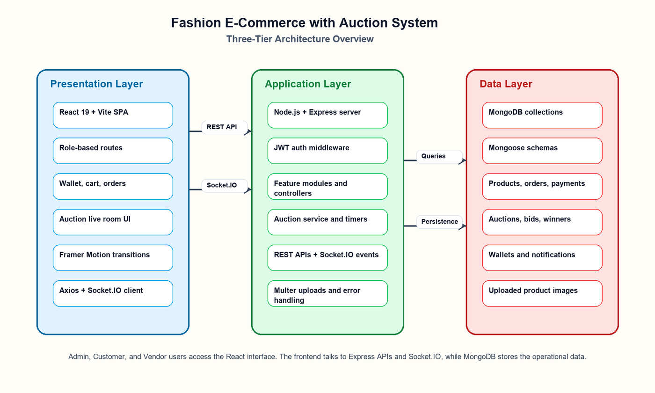
ARCHITECTURE DIAGRAM
Visual representation of the N-Tier implementation
Fig 5.2.1 — Three-tier architecture: React 19 → Express/Node.js → MongoDB, with Socket.IO real-time layer
Fashion E-Commerce with Auction System ● Sheik Abdulla S ● 24SPCA043 ● VHNSN College ● April 2026

Slide 12
TECHNOLOGY STACK
Layer | Technology | Purpose
Client | React 19 + Vite | SPA frontend for customer, admin, vendor & auction pages
Communication | Axios + Socket.IO Client | REST API calls & real-time bid updates
Server | Node.js + Express.js | API execution, business logic, middleware
Real-Time | Socket.IO | Auction room synchronization — join, bid, fold, chat events
Database | MongoDB + Mongoose | Persistent storage for all entities and references
Authentication | JWT + Role Middleware | Secure access control for Admin, Vendor, Customer
File Uploads | Multer | Image upload handling for product records

Slide 13
MODULES OVERVIEW
Admin
Customer
Vendor
Product
Admin login, user mgmt, approvals
Registration, login, profile, bank account
Onboarding, profile, product management
Catalog, analytics, stock, search
Cart
Order
Payment
Wallet
Item selection, quantity maintenance
Placement, tracking, cancellation
Recording & order linking
Cash/chips balance & history
Auction
Bidding
Winner
Notification
Room creation, entry, state, finalization
Bid history & leaderboard
Declaration & winner view
System alerts & unread count

Slide 14
ADMIN MODULE
User Management
Product & Catalog
Auction Control
Register/login as Admin
Manage all customers
Block/unblock customers
Approve vendor accounts
View vendor analytics
View all products
Category management
Low stock monitoring
Product analytics
Top selling/rated items
Create auction rooms
Assign products to rooms
Monitor live bidding
Finalize sold products
Declare winners
View all auction results

Slide 15
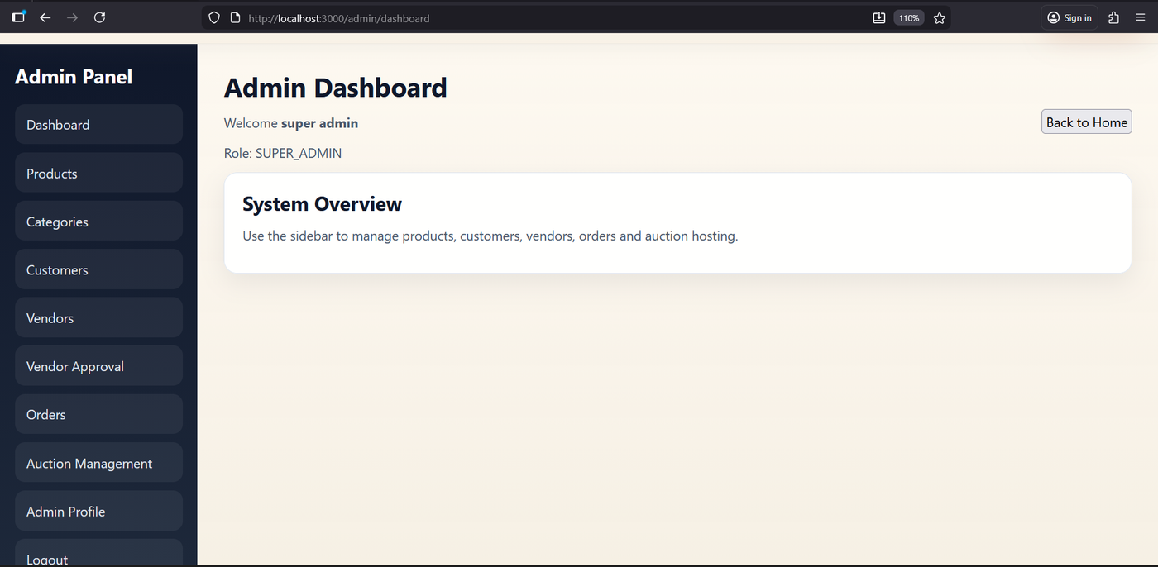
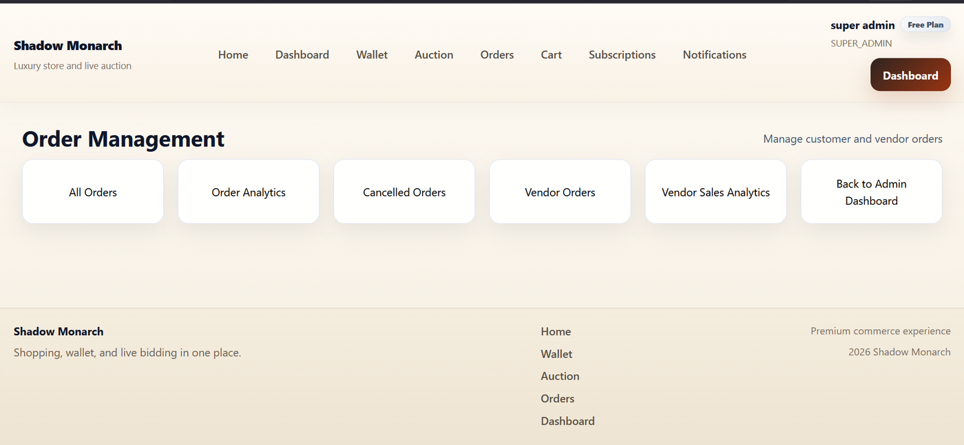
ADMIN MODULE — DASHBOARD SCREENSHOT
Admin control panel implementation view
ADMIN DASHBOARD
ORDER MANAGEMENT
Screenshot 8 — Admin dashboard: products, customers, vendors, auctions, reports
Screenshot 11 — Admin order management screen
Fashion E-Commerce with Auction System ● Sheik Abdulla S ● 24SPCA043 ● VHNSN College ● April 2026

Slide 16
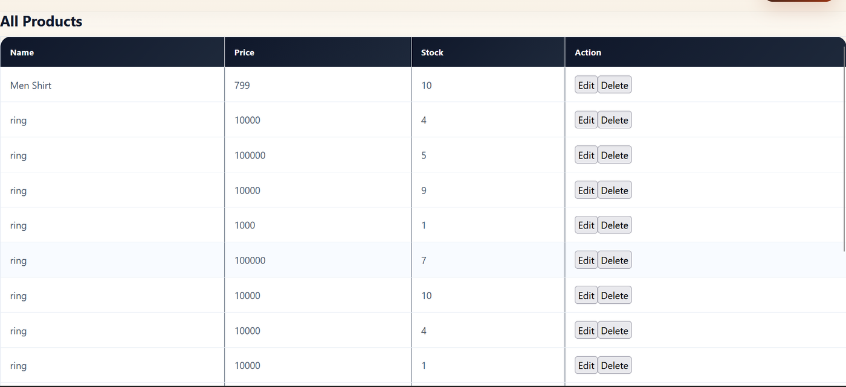
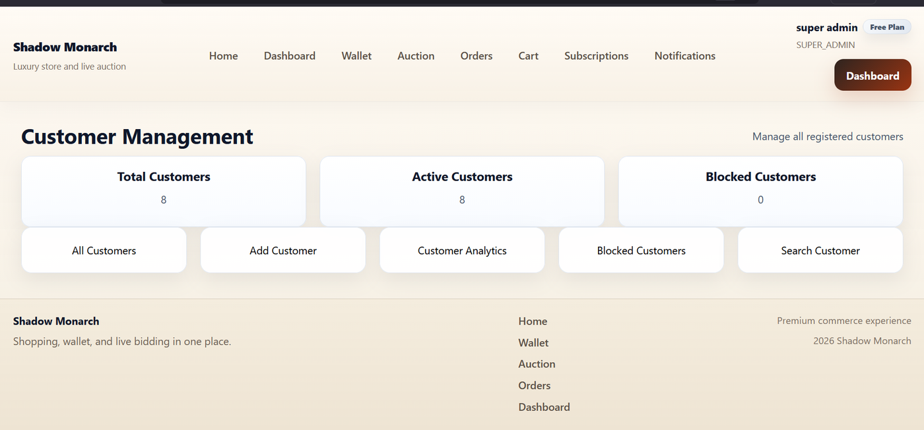
ADMIN MODULE — PRODUCT & CUSTOMER MANAGEMENT
Product catalog control and customer account administration
PRODUCT MANAGEMENT
CUSTOMER MANAGEMENT
Screenshot 9 — Product management with vendor product listings
Screenshot 10 — Customer management panel with user status
Fashion E-Commerce with Auction System ● Sheik Abdulla S ● 24SPCA043 ● VHNSN College ● April 2026

Slide 17
VENDOR MODULE
Vendor Responsibilities
Vendor Workflow
Vendor registration & account creation
Profile management and updates
Add, update, and remove products
Monitor product stock levels
View order details for own products
View sales analytics and performance
1
Register as Vendor
2
Await Admin Approval
3
Login to Vendor Panel
4
Add Fashion Products
5
Manage Inventory
6
Monitor Orders & Sales

Slide 18
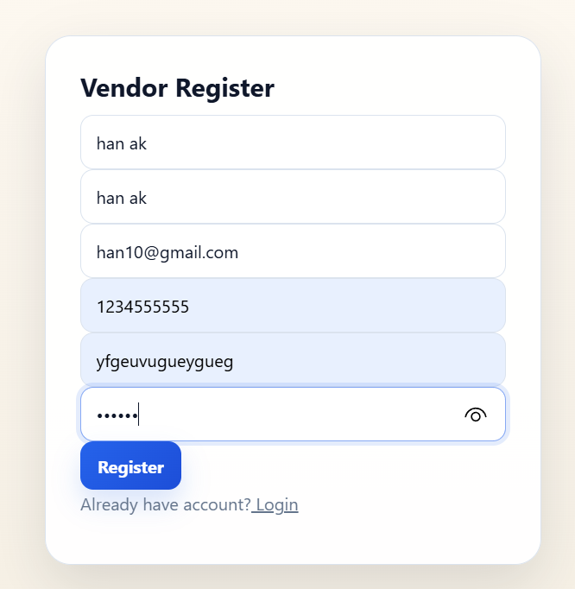
VENDOR MODULE — REGISTRATION & PANEL
Vendor onboarding and product management interface
VENDOR REGISTRATION
VENDOR PANEL FEATURES
▸ Add products with images via Multer upload
▸ Set product price, stock, and category
▸ View and manage incoming orders
▸ Track sales analytics and revenue charts
▸ Manage shop name, email, and status
▸ Participate in admin-created auction rooms
Screenshot 4 — Vendor registration form with shop details and email
Fashion E-Commerce with Auction System ● Sheik Abdulla S ● 24SPCA043 ● VHNSN College ● April 2026

Slide 19
CUSTOMER MODULE
Account
Shopping
Register, login, manage profile & bank account
Browse products, filter by category, add to cart, checkout
Payments
Wallet
Pay for orders using supported payment methods
Add cash to wallet, view balance and transaction history
Orders
Auction
Track orders, view history, cancel if needed
Join live rooms, place bids, fold from rounds, view winners
Reviews
Notifications
Rate and review purchased products
Receive alerts for bids, orders, and auction events

Slide 20
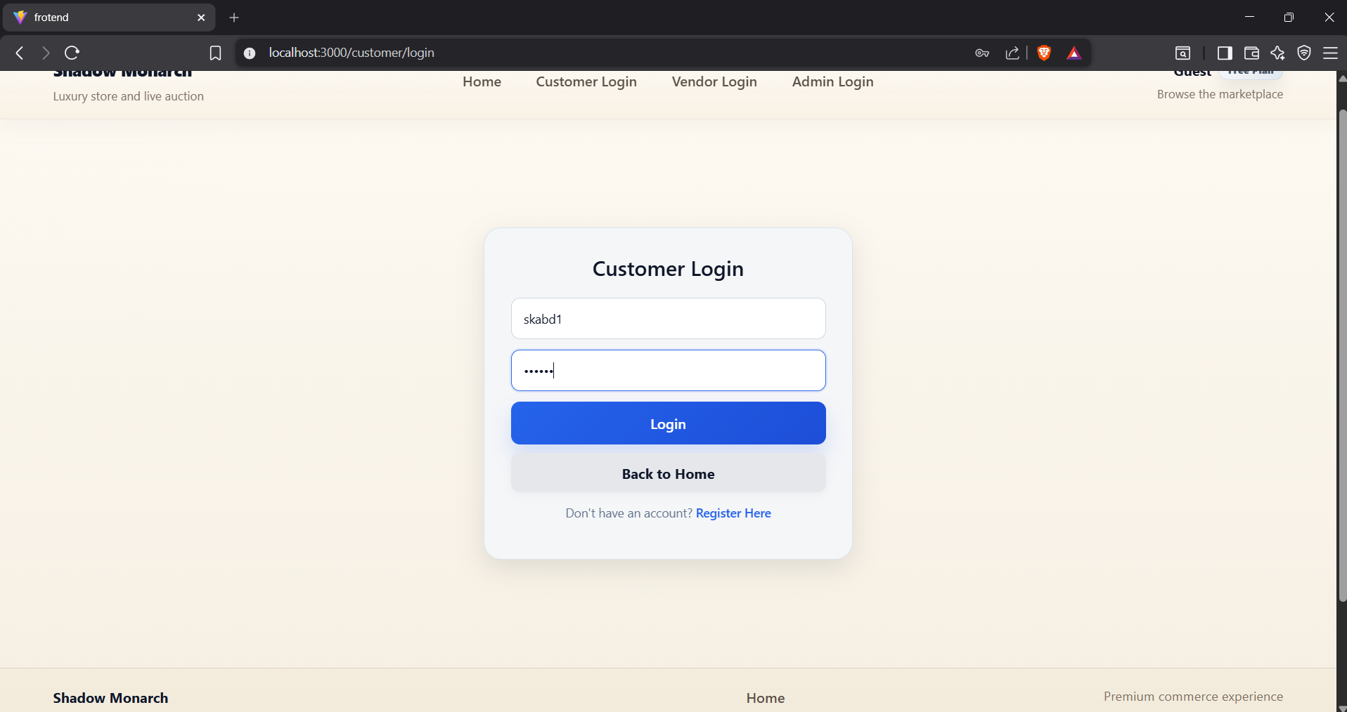
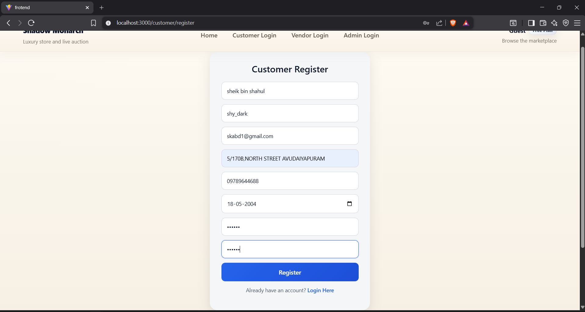
CUSTOMER MODULE — AUTHENTICATION SCREENS
Login and registration implementation
CUSTOMER LOGIN
CUSTOMER REGISTRATION
Screenshot 2 — Login screen with JWT-authenticated access
Screenshot 3 — Registration form with input validation
▸ JWT-based tokens with role-specific secrets
▸ ProtectedRoute prevents unauthorized page access
▸ Role-based redirect after successful login
Fashion E-Commerce with Auction System ● Sheik Abdulla S ● 24SPCA043 ● VHNSN College ● April 2026

Slide 21
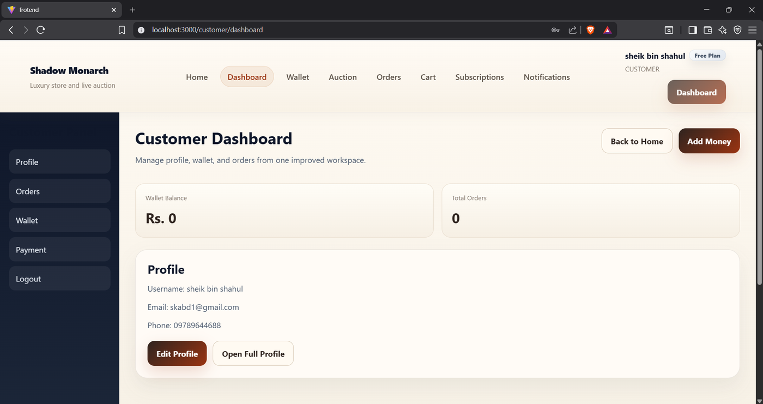
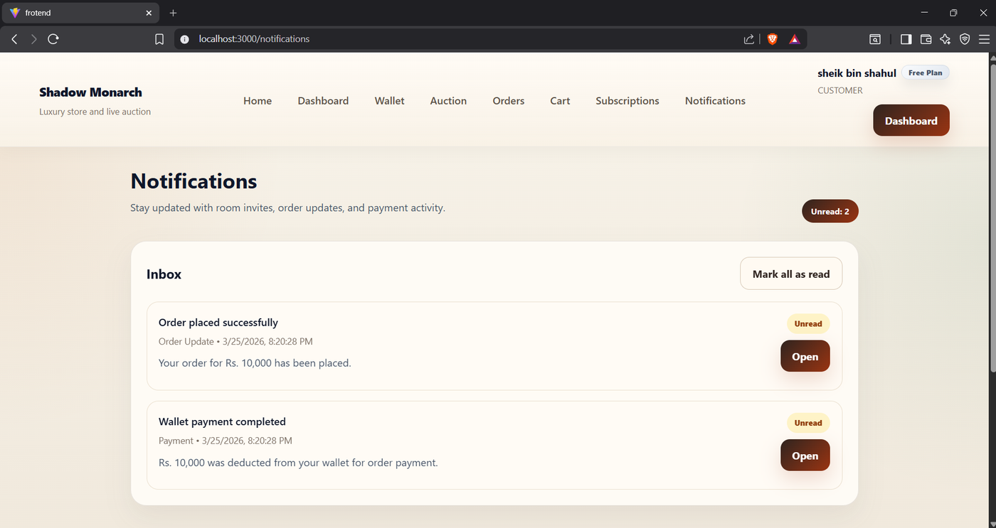
CUSTOMER MODULE — DASHBOARD & NOTIFICATIONS
Customer control panel and real-time notification system
CUSTOMER DASHBOARD
NOTIFICATIONS VIEW
Screenshot 5 — Dashboard: profile, orders, wallet, auction access
Screenshot 6 — Real-time notification panel for bids, orders, auctions
Fashion E-Commerce with Auction System ● Sheik Abdulla S ● 24SPCA043 ● VHNSN College ● April 2026

Slide 22
PRODUCT & AUCTION MODULE
Product Module
Auction Module
Product catalog with vendor reference
Category-based product classification
Search and filter by name/category
Stock monitoring with low-stock alerts
Top-selling and top-rated product lists
Product analytics and performance metrics
Image upload support via Multer
Admin creates room with room code
Products assigned to auction queue
Customers join via room code + entry fee
Wallet balance validated before joining
Live bidding with real-time Socket.IO sync
Bid increment logic enforced server-side
Admin finalizes: SOLD or UNSOLD per product
Winner declared and stored in Winner collection

Slide 23
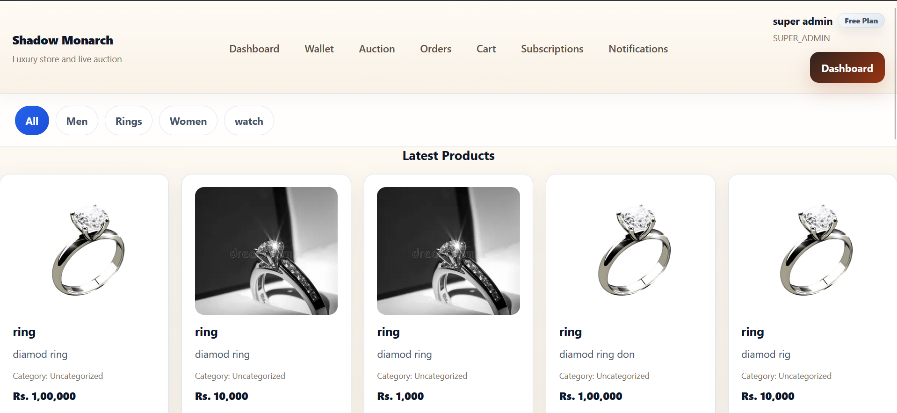
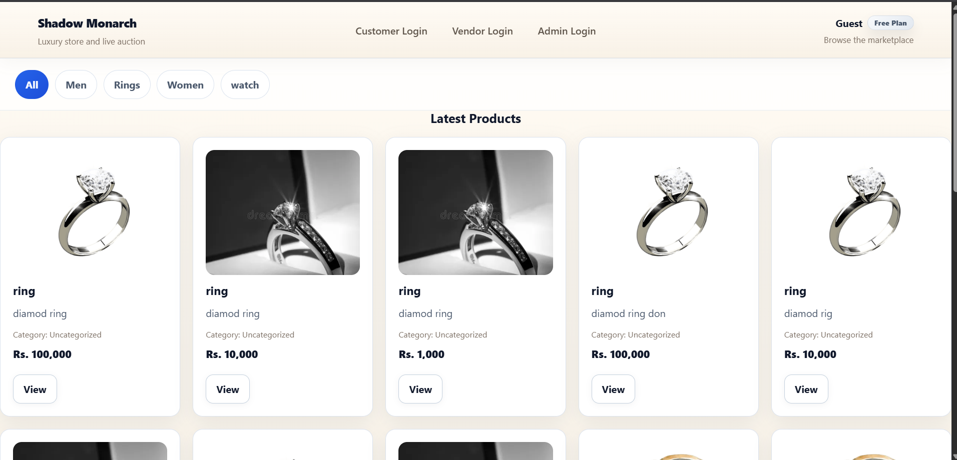
PRODUCT MODULE — HOME PAGE & PRODUCT CATALOG
Customer-facing product browsing experience
HOME PAGE
GUEST BROWSING
Screenshot 1 / Fig 2.3.1 — Featured products, navigation, and main browsing view
Fig 2.3.2 — Guest product browsing with cards before login
Fashion E-Commerce with Auction System ● Sheik Abdulla S ● 24SPCA043 ● VHNSN College ● April 2026

Slide 24
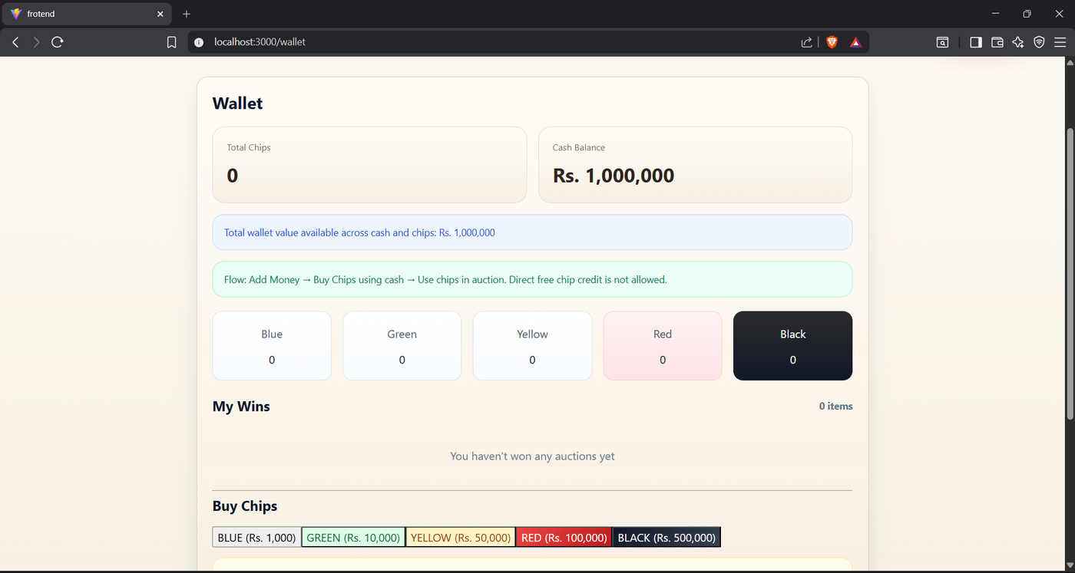
WALLET MODULE
Digital wallet system for purchases and auction bidding
Balance Display: Real-time wallet balance view
Add Money: Top-up via payment gateway
Transaction Log: Full history of credits/debits
Freeze on Bid: Wallet locked during auction
Winner Deduction: Auto-deduct on auction win
Bank Account: Link account for withdrawals
Fig 6.2.3 — Wallet dashboard: cash balance, chip actions, auction wallet flow
Fashion E-Commerce with Auction System ● Sheik Abdulla S ● 24SPCA043 ● VHNSN College ● April 2026

Slide 25
AUCTION WORKFLOW
Admin Side
Customer Side
Create auction room with entry fee
Assign fashion products to queue
Start/open the live auction session
Monitor real-time bidding activity
Finalize product: SOLD or move NEXT
Close room when all products done
Winners automatically declared & stored
Discover active auction rooms
Pay entry fee from wallet chips
Join live room via room code
View current product & timer
Place bid ≥ next required amount
OR fold to exit current product
System removes on low balance
View winner list after finalization

Slide 26
AUCTION MODULE — OVERVIEW
Live auction engine combining admin control and customer participation
ADMIN SIDE
CUSTOMER SIDE
▸ Create auction room with entry fee and room code
▸ Discover active auction rooms by room code
▸ Assign fashion products to auction product queue
▸ Pay entry fee from wallet chips to join
▸ Start and open the live auction session
▸ View current product, timer, and current price
▸ Monitor real-time bidding from all participants
▸ Place bid ≥ next required bid amount
▸ Finalize each product: SOLD or move NEXT
▸ Fold to exit current product round
▸ Close room after all products are processed
▸ System removes on insufficient wallet balance
▸ Winners automatically declared and stored in DB
▸ View winner list after finalization
Fashion E-Commerce with Auction System ● Sheik Abdulla S ● 24SPCA043 ● VHNSN College ● April 2026

Slide 27
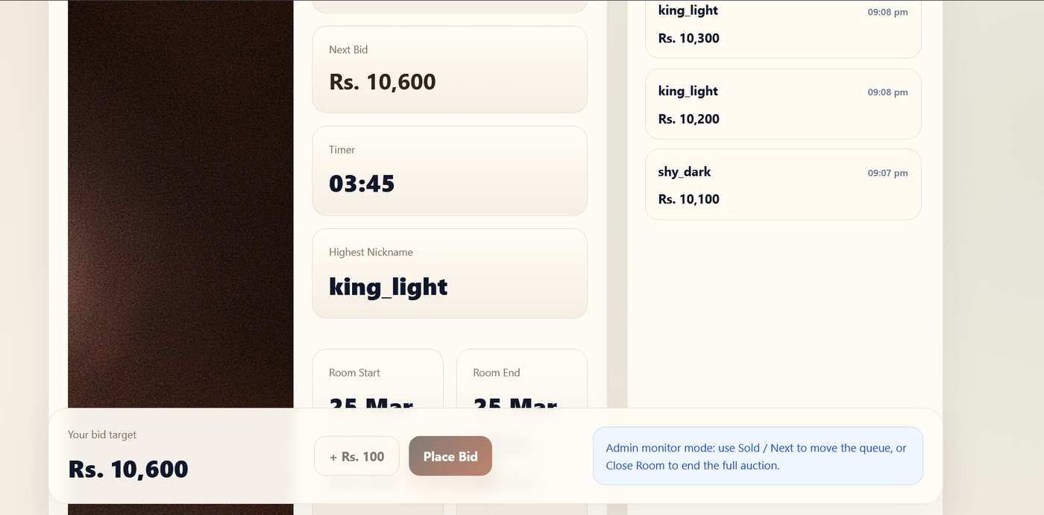
AUCTION MODULE — LIVE BIDDING INTERFACE
Real-time customer auction participation screen
Live Countdown Timer
Current Bid Display
Bid Input + Validation
Bid History Panel
Fold Button
pricePulse Animation
Fig 2.3.3 / Screenshot 15 — Live auction room: timer, current product, bid panel, bid history, fold button
Fashion E-Commerce with Auction System ● Sheik Abdulla S ● 24SPCA043 ● VHNSN College ● April 2026

Slide 28
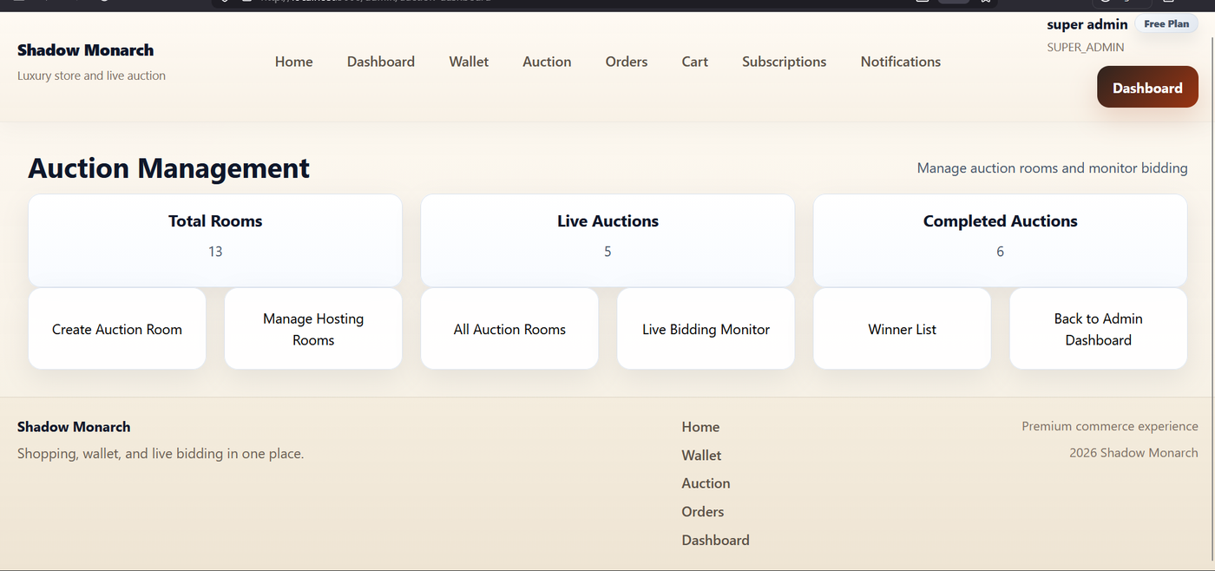
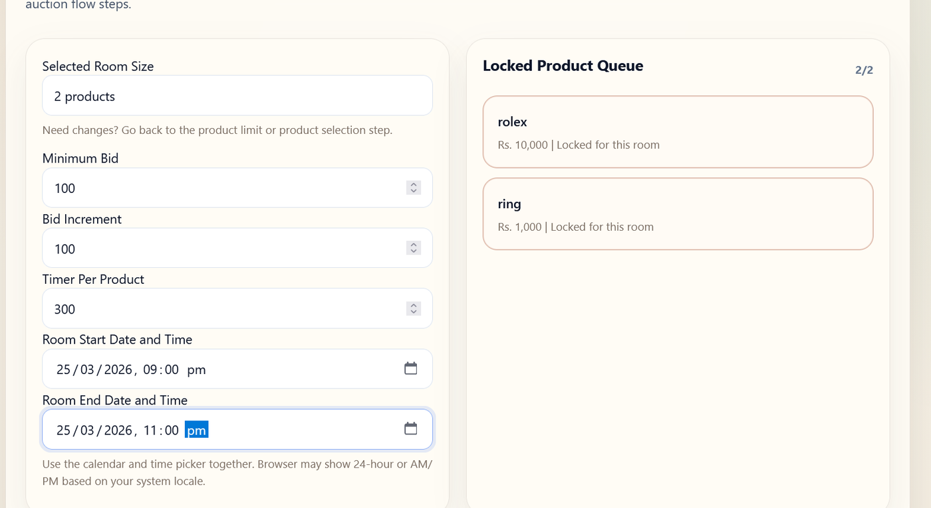
AUCTION MODULE — MANAGEMENT & ROOM CONFIGURATION
Admin auction dashboard and room setup screens
AUCTION MANAGEMENT
ROOM CONFIGURATION
Screenshot 12 — Admin auction management dashboard
Screenshot 13 — Room configuration: product queue, entry fee, room code
Fashion E-Commerce with Auction System ● Sheik Abdulla S ● 24SPCA043 ● VHNSN College ● April 2026

Slide 29
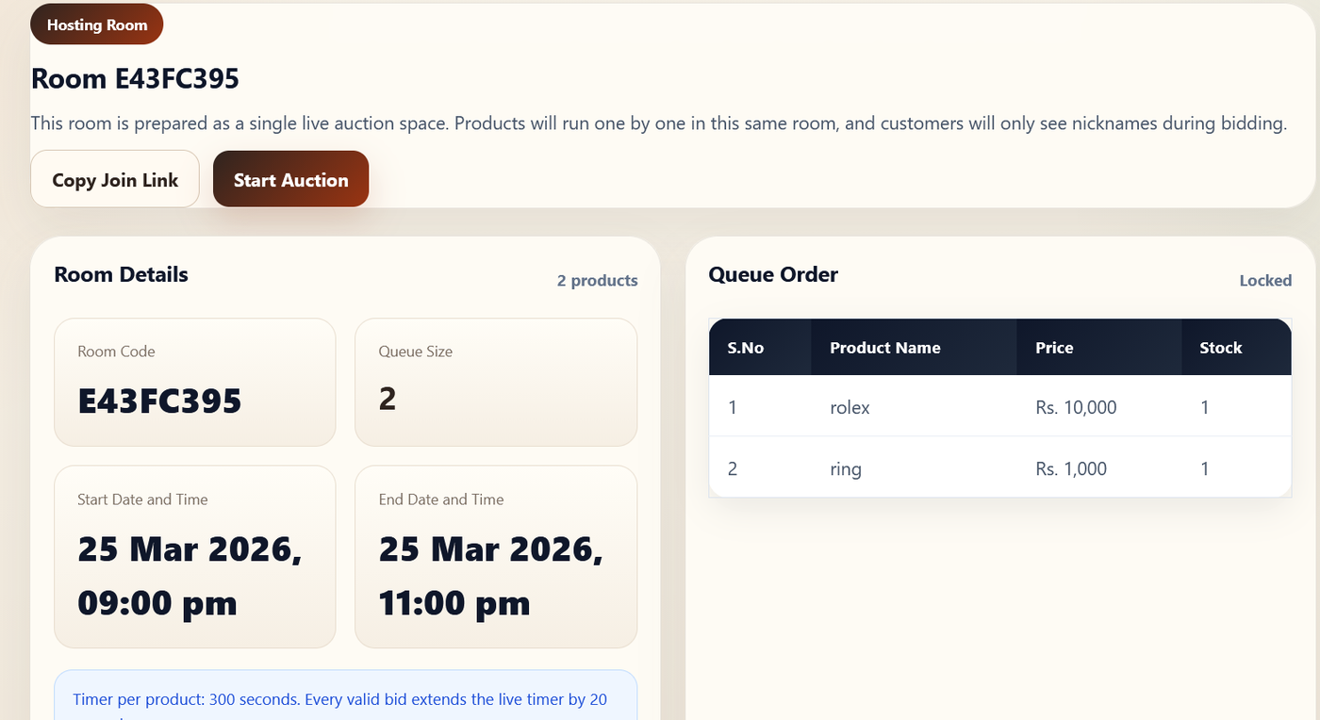
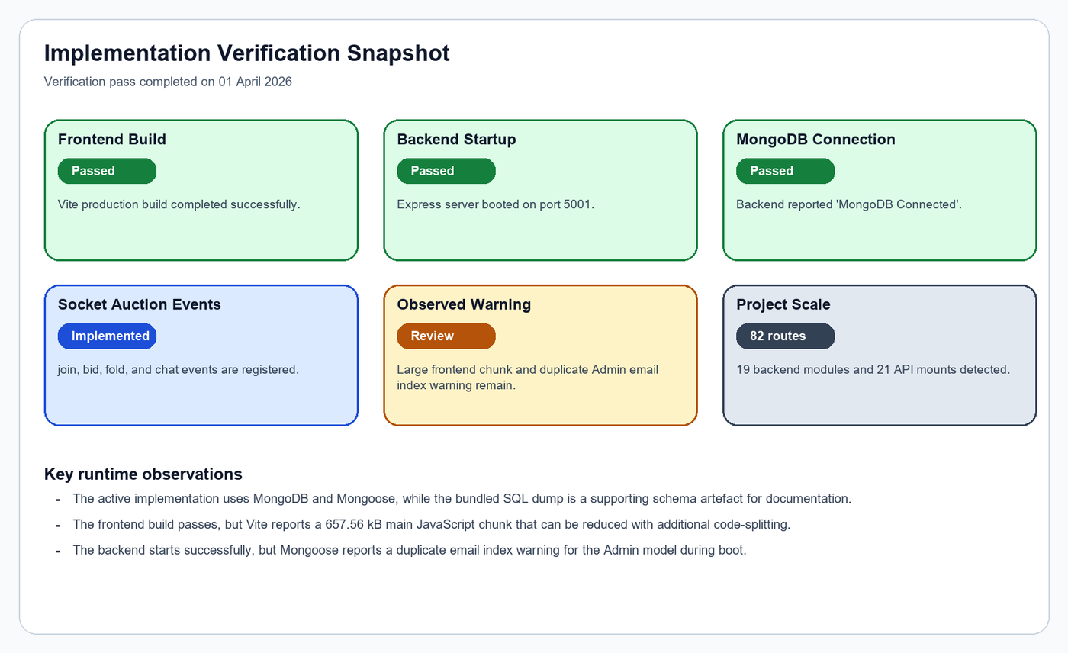
AUCTION MODULE — HOSTING ROOM & WINNER DECLARATION
Live room management and winner announcement screens
HOSTING ROOM DETAILS
BUILD VERIFICATION
Screenshot 14 — Live room management with product queue and controls
Fig 8.1.1 — Build verification: frontend passed, port 5001, MongoDB connected
Fashion E-Commerce with Auction System ● Sheik Abdulla S ● 24SPCA043 ● VHNSN College ● April 2026

Slide 30
SYSTEM FLOW – END TO END
01
Register / Login
Customer, Vendor, or Admin authenticates via JWT
02
Browse Products
Filter by category, search by name, view details
03
Shop or Auction
Add to cart for direct buy OR join auction room
04
Wallet / Payment
Fund wallet or pay via checkout for cart orders
05
Order / Bid Result
Order confirmed OR winner declared in auction
06
Notification
User notified about order status, bid results, alerts

Slide 31
DATA MODEL – CORE COLLECTIONS
Users
Catalog
Commerce
Auction
Support
Admin
Product
Cart
Auction
Notification
Customer
Category
Order
Bid
Wishlist
Vendor
Review
Payment
Winner
Subscription
Wallet
Hosting

Slide 32
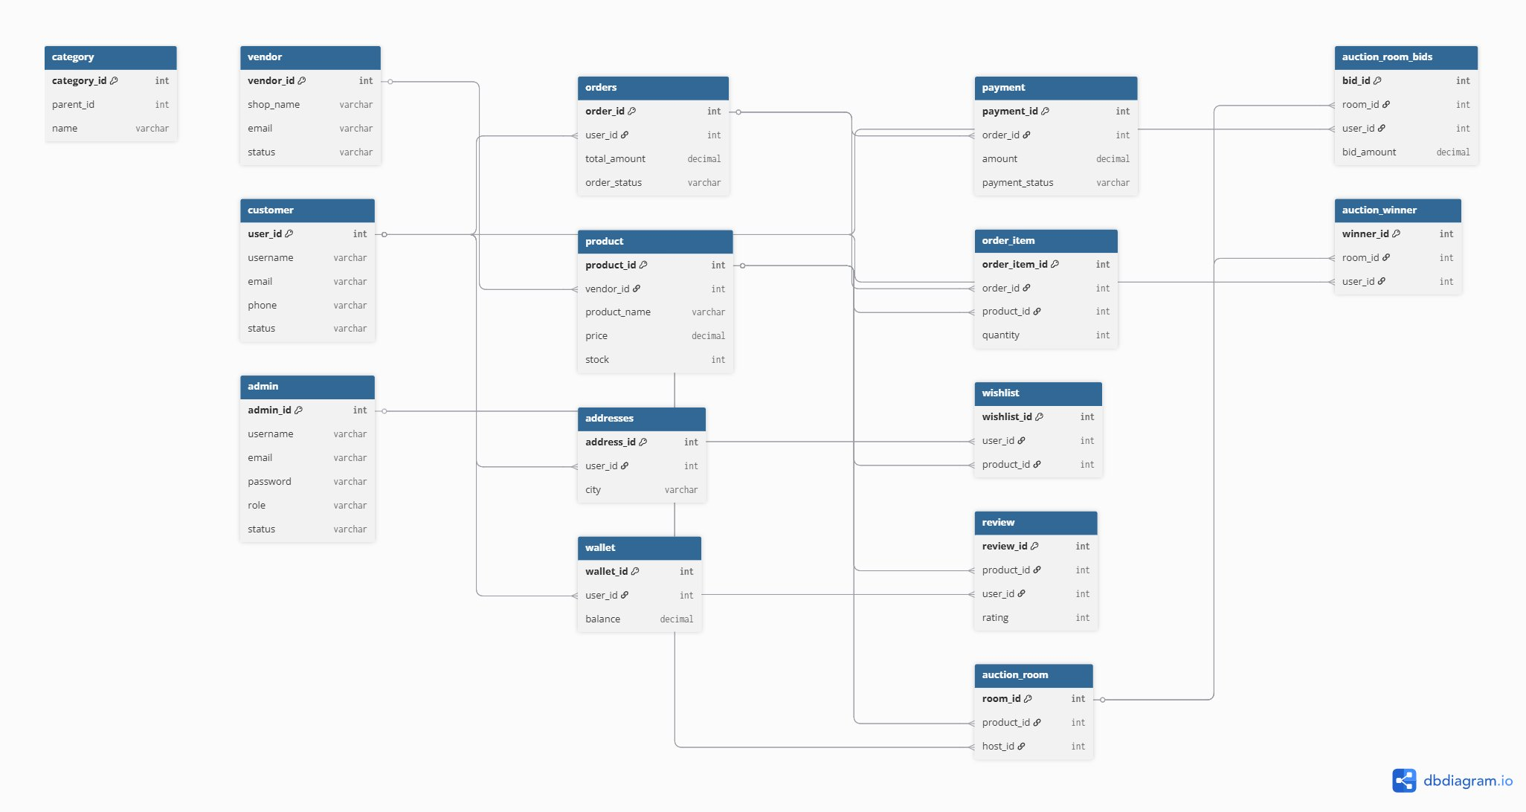
ER DIAGRAM — ENTITY RELATIONSHIPS
Complete database entity relationship diagram
ER Diagram — All 19 entities with primary keys, foreign keys, and inter-collection references
Fashion E-Commerce with Auction System ● Sheik Abdulla S ● 24SPCA043 ● VHNSN College ● April 2026

Slide 33
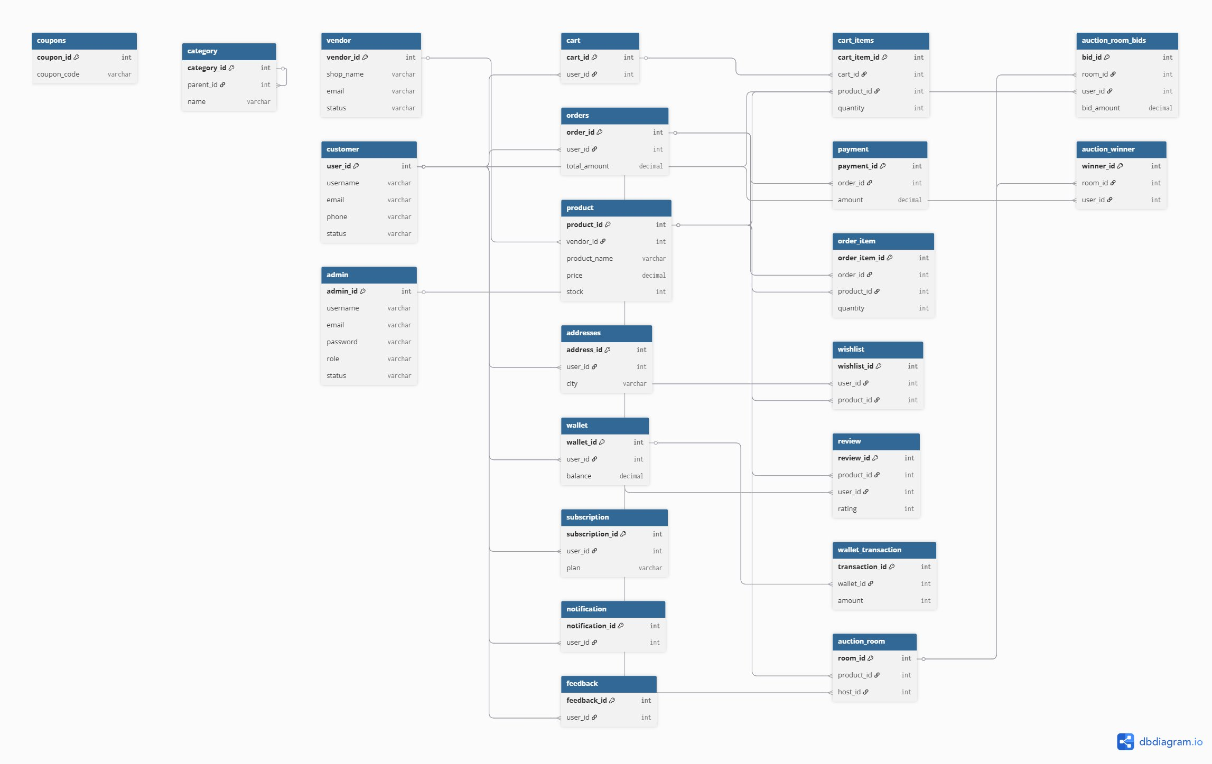
ER DIAGRAM — DETAILED ENTITY VIEW
Key entity fields and relationship mappings
1:N
Vendor → Product
1:N
Customer → Order
1:1
Customer → Wallet
1:N
Order → Payment
1:N
Auction → Bid
1:N
Auction → Winner
Fig 4.1.1 — Detailed ER diagram prepared from the project data model
Fashion E-Commerce with Auction System ● Sheik Abdulla S ● 24SPCA043 ● VHNSN College ● April 2026

Slide 34
ER DIAGRAM – ENTITY RELATIONSHIPS
Parent Entity | Child Entity | Relationship | Description
Vendor | Product | 1 : N | A vendor creates multiple products
Category | Product | 1 : N | A category classifies many products
Customer | Order | 1 : N | A customer places multiple orders
Order | Payment | 1 : N | An order may have multiple payment records
Customer | Cart | 1 : 1 | Each customer has one active cart
Auction | Bid | 1 : N | An auction room contains many bids
Auction | Winner | 1 : N | A room produces winners for each queued product
Customer | Wallet | 1 : 1 | Each customer owns a single wallet record

Slide 35
LOGICAL & PHYSICAL DATA DESIGN
Logical Design
Physical Design
Three-layer separation: Presentation → Application → Persistence
React client gathers user input and renders views
Express validates requests and applies auth/authorization
MongoDB stores entities as flexible document collections
Socket.IO extends the design for time-sensitive auction events
Core collections: Product, Auction, Bid, Order, Payment, Wallet, Customer, Vendor, Winner, Notification
Concrete MongoDB collections with document references
Reference IDs link customers ↔ orders ↔ payments
Vendors ↔ products; Auction rooms ↔ bids ↔ winners
Operational fields: room_status, payment_status, delivery_status
Timestamp fields: created_at, updated_at, start_time, end_time
Index-oriented access on product IDs, room codes, user refs, and time fields for efficient retrieval

Slide 36
DATA DICTIONARY – KEY COLLECTIONS
Collection | Key Fields | Purpose
Product | vendor_id, category_id, product_name, price, stock, status, auction_room_id | Stores product master details
Auction | room_code, products[], current_price, participants[], start_time, end_time, status | Stores live auction room state
Winner | auction_id, product_id, user_id, winner_name, winning_bid, result_type | Stores declared winners
Order | customer_id, items[], total_amount, status, delivery_deadline | Stores shopping orders
Payment | order_id, amount, payment_type, payment_status | Stores payment records
Cart | user_id, items[], total_amount | Stores active cart data
Customer | name, email, password, wallet_balance, orders_count | Stores customer account data

Slide 37
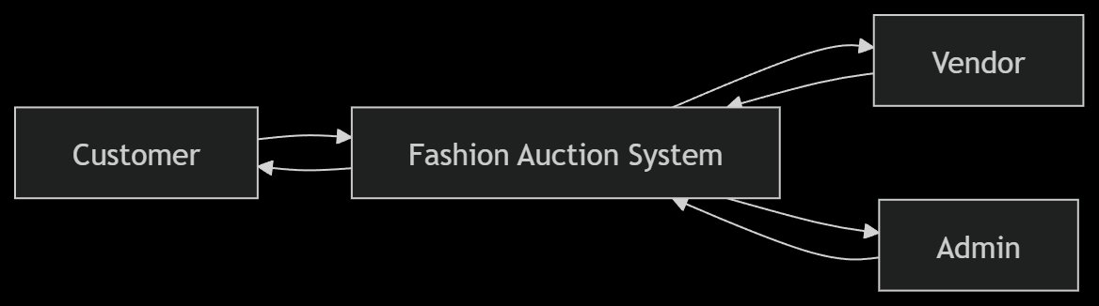
PROCESS MODEL — CONTEXT ANALYSIS (DFD LEVEL 0)
System boundary and actor interactions at the highest level
CUSTOMER
Browse, Cart, Orders, Bids, Wallet, Notifications
VENDOR
Product listing, Inventory, Sales analytics
ADMIN
Platform control, User mgmt, Auction management
PAYMENT GW
DFD Level 0 — Context diagram: Customer, Vendor, Admin interact with the Fashion Auction System
Process payments, Send confirmations
Fashion E-Commerce with Auction System ● Sheik Abdulla S ● 24SPCA043 ● VHNSN College ● April 2026

Slide 38
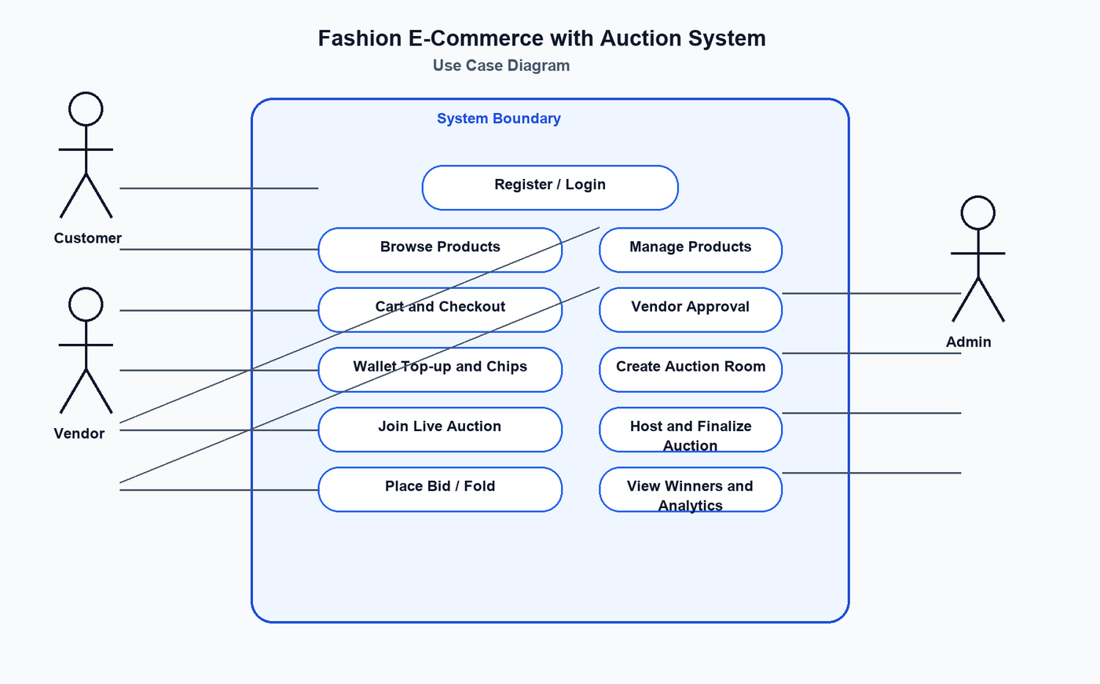
USE CASE DIAGRAM — ACTOR INTERACTIONS
System use cases mapped to actors
UC-01
Register & Login
Customer/Vendor/Admin
UC-02
Manage Products
Admin/Vendor
UC-04
Add to Cart
Customer
UC-06
Make Payment
Customer
UC-08
Create Auction
Admin
UC-10
Place Bid
Customer
UC-11
Finalize Product
Admin
Fig 4.2.2 — Use case diagram for admin, vendor, and customer actors
UC-12
View Winners
All
Fashion E-Commerce with Auction System ● Sheik Abdulla S ● 24SPCA043 ● VHNSN College ● April 2026

Slide 39
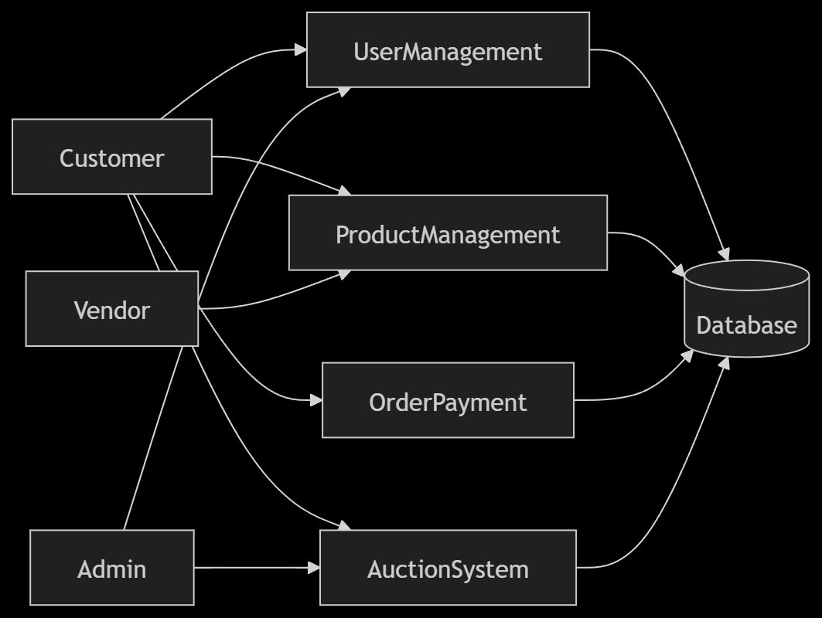
PROCESS MODEL — DFD LEVEL 1
First decomposition: core process modules of the system
P1 — Authentication
Register, Login, JWT Token issue
P2 — Product Mgmt
Catalog, CRUD, Search, Stock
P3 — Order & Payment
Cart, Checkout, Payment, History
P4 — Wallet
Top-up, Balance Check, History
P5 — Auction Engine
Room, Bidding, Winner, Socket.IO
P6 — Notifications
Alerts, Unread Count, Events
DFD Level 1 — Six core processes: Authentication, Product Mgmt, Order/Payment, Wallet, Auction Engine, Notifications
Fashion E-Commerce with Auction System ● Sheik Abdulla S ● 24SPCA043 ● VHNSN College ● April 2026

Slide 40
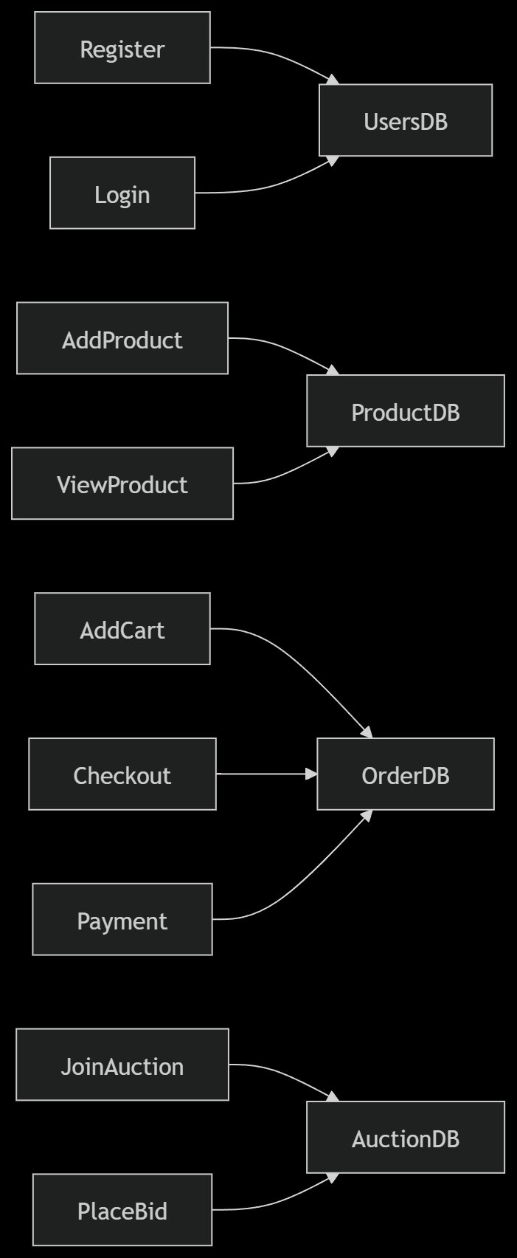
PROCESS MODEL — DFD LEVEL 2
Auction sub-process decomposition
DFD Level 2 — Detailed auction sub-processes: Room Creation, Entry, Live Bidding, Fold, Finalization, Winner Declaration
Fashion E-Commerce with Auction System ● Sheik Abdulla S ● 24SPCA043 ● VHNSN College ● April 2026

Slide 41
PROCESS MODEL — DFD LEVEL 3
Detailed bid placement operational flow
DFD Level 3 — Detailed flow: JoinAuction → ValidateUser → FreezeWallet → PlaceBid → CompareBids → Winner → NotifyUser
JoinAuction
→
ValidateUser
→
FreezeWallet
→
PlaceBid
→
CompareBids
→
Winner
→
NotifyUser
Fashion E-Commerce with Auction System ● Sheik Abdulla S ● 24SPCA043 ● VHNSN College ● April 2026

Slide 42
DECISION TREE & TABLE — AUCTION BID LOGIC
Conditional logic for bid acceptance or rejection
DECISION TREE — BID FLOW
DECISION TABLE
Is user authenticated as Customer?
Condition | YES | NO
Authenticated? | Proceed to room check | Reject access
Room LIVE? | Proceed to wallet check | Show unavailable
Wallet sufficient? | Proceed to bid check | Fold / Block bidder
Bid amount valid? | Accept & broadcast bid | Reject bid
YES → Is auction room LIVE?
YES → Is wallet balance sufficient?
YES → Is bid ≥ next bid amount?
YES → ✅ BID ACCEPTED
NO → ✗ Bid Rejected
NO → Customer Folded/Blocked
NO → Room unavailable
NO → Access Rejected
Fashion E-Commerce with Auction System ● Sheik Abdulla S ● 24SPCA043 ● VHNSN College ● April 2026

Slide 43
TABLE RELATIONSHIPS
1 : N
Vendor → Product
A vendor can own multiple fashion products
1 : N
Category → Product
A category classifies many products
1 : N
Customer → Order
A customer can place multiple orders
1 : N
Order → Payment
An order may have related payment records
1 : N
Auction → Bid
An auction room contains many bids
1 : N
Auction → Winner
A room produces winners for multiple queued products
1 : 1
Customer → Wallet
Each customer owns a single wallet record

Slide 44
PROCESS MODEL – CONTEXT ANALYSIS
Administrator
Payment
Gateway
Manage rooms,
users, auctions
Process payments,
confirmations
Fashion E-Commerce
With Auction System
Vendor
Manage products,
view orders
MongoDB
Customer
Persistent data
storage
Browse, bid,
buy, wallet

Slide 45
USE CASE DIAGRAM – ACTOR INTERACTIONS
ID | Use Case | Actor | Description
UC-01 | Register & Login | Customer/Vendor/Admin | User authenticates into the system
UC-02 | Manage Products | Admin / Vendor | Create, update, search, and remove products
UC-03 | Manage Categories | Admin | Create and maintain product categories
UC-04 | Add to Cart | Customer | Add product and update quantity
UC-05 | Place Order | Customer | Checkout selected cart items
UC-06 | Make Payment | Customer | Pay for an order using supported methods
UC-07 | Add Wallet Money | Customer | Credit wallet balance for future use
UC-08 | Create Auction Room | Admin | Prepare auction room and assign items
UC-09 | Join Auction | Customer | Enter active room and view room state
UC-10 | Place Bid | Customer | Bid on live auction product
UC-11 | Finalize Product | Admin | Mark current product sold or move to next
UC-12 | View Winners | Customer / Admin | Display winner list and winning bid

Slide 46
DATA FLOW DIAGRAM – LEVEL 0 (CONTEXT LEVEL)
Admin
Fashion E-Commerce
With Auction System
P0
Customer
MongoDB
Data Store
Vendor
→ Registration, Browse, Orders, Bids, Wallet
← Product data, Order status, Auction state, Notifications

Slide 47
DATA FLOW DIAGRAM – LEVEL 1 (PROCESS DECOMPOSITION)
P1
Authentication
P2
Product Management
P3
Order & Payment
Register, Login, JWT Token Issue
Catalog, CRUD, Search, Stock
Cart, Checkout, Payment, History
P4
Wallet Management
P5
Auction Engine
P6
Notifications
Top-up, Balance Check, History
Room, Bidding, Winner, Socket.IO
Alerts, Unread Count, Events

Slide 48
DFD LEVEL 2 & LEVEL 3 – AUCTION DEEP DIVE
Level 2 – Auction Sub-Process
Level 3 – Bid Placement Flow
P5.1 – Room Creation: Admin creates room + assigns products
P5.2 – Room Entry: Customer joins with wallet validation
P5.3 – Live Bidding: Bid submission, validation, broadcast
P5.4 – Fold Action: Participant marks as folded
P5.5 – Finalization: Admin marks SOLD / UNSOLD
P5.6 – Winner Declaration: Winner stored in DB
Customer submits bid via Socket.IO 'auction:bid' event
Server validates customer is authenticated
Server confirms room is LIVE
Server checks wallet balance ≥ bid amount
Server validates bid ≥ next_bid_amount
Bid stored in Bid collection
current_price updated in Auction document
Server emits 'auction:state' to all room participants

Slide 49
DECISION TREE & DECISION TABLE – AUCTION LOGIC
Decision Tree – Bid Participation
Decision Table
Is user authenticated as Customer?
YES → Is auction room LIVE?
YES → Is wallet balance sufficient?
YES → Is bid amount ≥ next bid?
YES → BID ACCEPTED ✓
NO → Bid Rejected
NO → Customer Folded/Blocked
NO → Room unavailable message
NO → Access Rejected
Condition | YES → Action | NO → Action
Authenticated? | Proceed to room check | Reject access
Room LIVE? | Proceed to wallet check | Show unavailable
Wallet sufficient? | Proceed to bid check | Fold/Block bidder
Bid amount valid? | Accept & broadcast bid | Reject bid

Slide 50
N-TIER ARCHITECTURE – LAYER DETAILS
1. Presentation Tier
Files: App.jsx, pages/*, components/*
UI rendering, user interaction, navigation, lazy loading, protected routes
2. Business Logic Tier
Files: controllers/, services/, middleware/, socket handlers
Validation, workflow control, role checks, JWT authentication, Socket.IO events
3. Persistence Tier
Files: models/*.js — MongoDB with Mongoose ODM
Schema definition, document storage, indexing, reference-based relationships
4. Real-Time Layer
Files: server.js + socket.io-client
Live bid synchronization, room state updates, auction events: join, bid, fold, chat

Slide 51
ALGORITHMS – AUCTION, ORDER, WALLET
Auction Bid Algorithm
Order Checkout Algorithm
Wallet Top-Up Algorithm
1. Receive bid via socket 'auction:bid'
2. Verify CUSTOMER role & auth token
3. Fetch room → check status = LIVE
4. Validate wallet balance ≥ bid amount
5. Validate bidAmount ≥ next_bid_amount
6. Store bid in Bid collection
7. Update room's current_price & highest_bidder
8. Emit 'auction:state' to all room participants
1. Fetch cart items by user_id
2. Check cart is not empty
3. Calculate grand total of selected items
4. Create Order record with PENDING status
5. Process payment (amount, type)
6. IF success: mark Order = PAID, reduce stock
7. ELSE: mark payment = FAILED
8. Send order confirmation notification
1. Receive user_id and top-up amount
2. Validate amount > 0
3. Fetch wallet by user_id
4. IF not exists: CREATE new wallet record
5. Increment cash balance by amount
6. Append CREDIT entry to transaction history
7. Return updated wallet with new balance

Slide 52
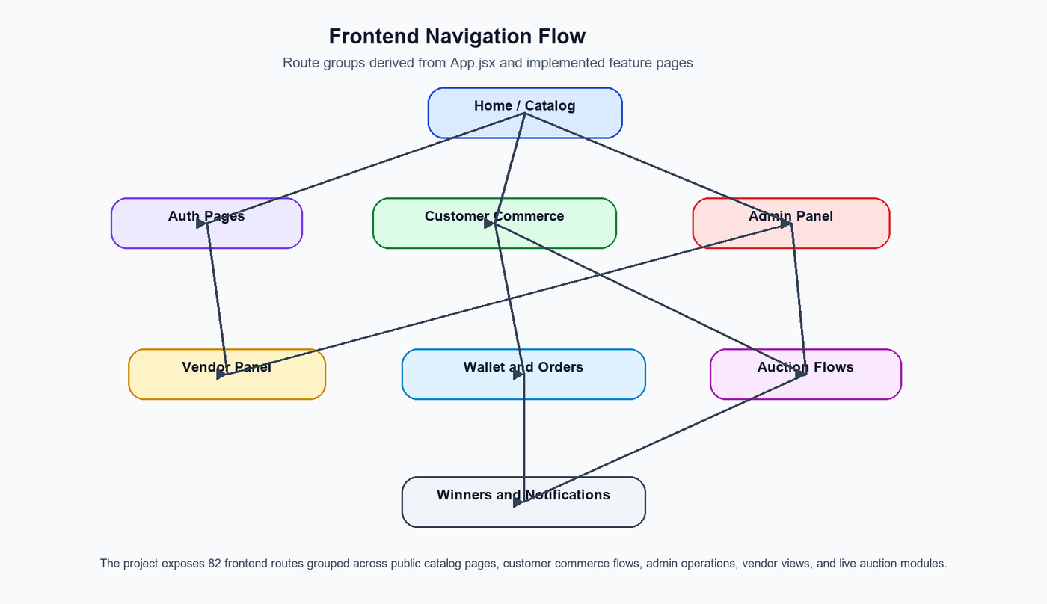
IMPLEMENTATION — NAVIGATION FLOW DIAGRAM
React Router SPA route map across all modules
Fig 6.1.1 — High-level navigation flow: 82 routes across Customer, Admin, Vendor, Auction, Wallet modules
Fashion E-Commerce with Auction System ● Sheik Abdulla S ● 24SPCA043 ● VHNSN College ● April 2026

Slide 53
IMPLEMENTATION – FRONTEND (REACT)
Frontend Architecture
Key Pages & Sections
React 19 with Vite build tool
React Router for SPA route management
82 routes across all modules
Lazy loading with Suspense for performance
ProtectedRoute guards for auth-only pages
PageTransition & RouteAnimator for UX
Axios for REST API calls
Socket.IO client for real-time events
Customer:
Register, Login, Dashboard, Profile
Products:
All Products, Details, Analytics, Search
Cart/Order:
Cart, Checkout, Orders, Cancel, Tracking
Wallet:
Balance, Add Money, History, Bank Account
Admin:
Dashboard, Customers, Vendors, Orders
Vendor:
Panel, Products, Orders, Sales Analytics
Auction:
Dashboard, Join Room, Live Bidding, Winners

Slide 54
IMPLEMENTATION – BACKEND (NODE.JS + EXPRESS)
Backend Architecture
REST API Endpoints
Node.js runtime with Express.js framework
19 feature modules with route/controller/service/model
21 API route mounts in server.js
JWT authentication with role-specific secrets
CORS enabled for React frontend connection
Multer for product image file uploads
Mongoose ODM for MongoDB schema & validation
Error handler middleware for consistent responses
POST
/api/admin/register
Register admin
POST
/api/customer/register
Register customer
GET
/api/product
Fetch all products
POST
/api/cart/add
Add product to cart
POST
/api/order
Create order
POST
/api/wallet/add-money
Add wallet funds
POST
/api/auction/create-room
Create auction room
GET
/api/auction/room/:id/state
Get room state
GET
/api/winner/:auction_id
Get winner details

Slide 55
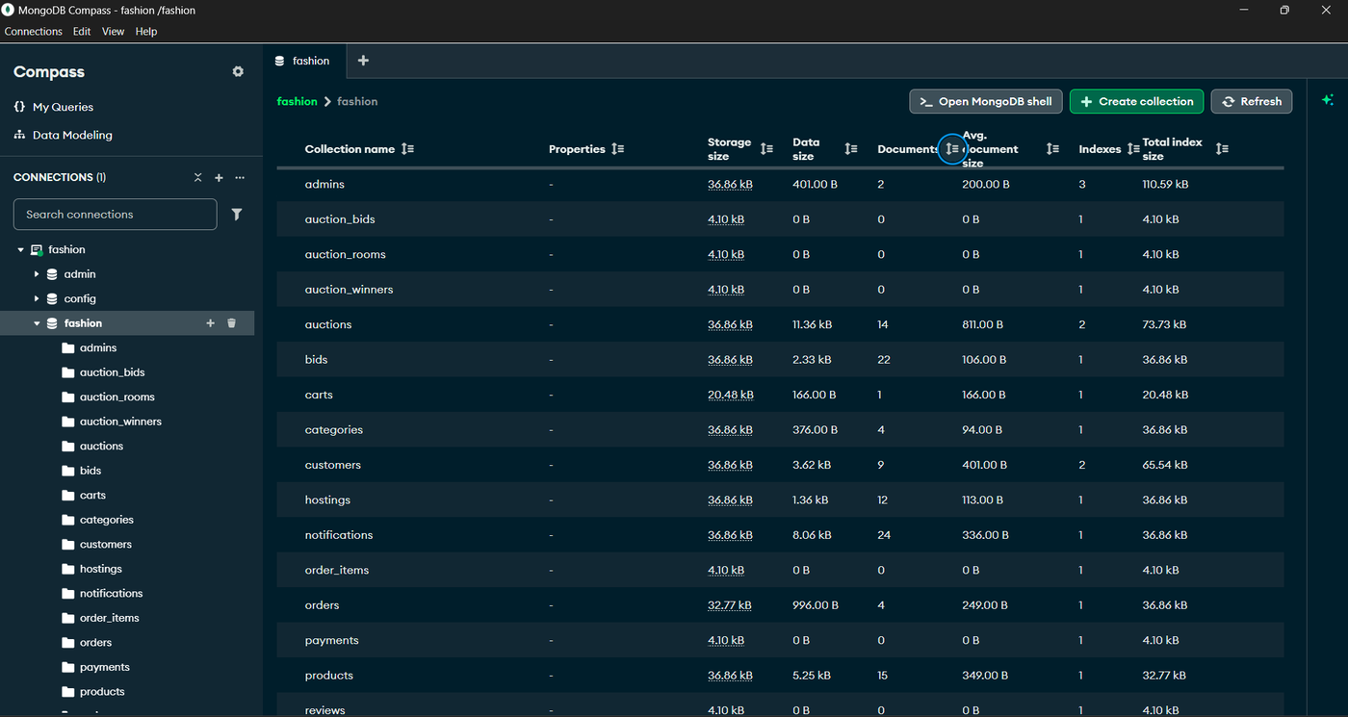
IMPLEMENTATION — DATABASE (MONGODB COMPASS)
Live database verification with active collections
Fig 7.1.1 — MongoDB Compass: active collections auctions, bids, carts, cart_items, customers, orders, products, wallets, and 11 more
Collections: auctions · bids · carts · cart_items · customers · orders · order_items · payments · products · wallets · wallet_transactions · vendors · admins · addresses · subscriptions · notifications · reviews · wishlist · feedbacks
Fashion E-Commerce with Auction System ● Sheik Abdulla S ● 24SPCA043 ● VHNSN College ● April 2026

Slide 56
REAL-TIME AUCTION – SOCKET.IO INTEGRATION
Socket Events
LiveAuctionRoom Component
auction:join
Connects to server via io() from socket.io-client
Authenticates with JWT token on connect
Emits auction:join → receives full room state
Polls REST API every 2 seconds for fallback sync
Displays: current product, timer, current price, next bid
Shows recent bid history with bidder names and amounts
Handles: fold button, bid input with validation
Animates price change with 'pricePulse' visual feedback
Customer or Admin joins auction room
auction:bid
Customer places a bid with amount
auction:fold
Customer exits current product round
auction:chat
Customer sends message in auction room
auction:state
Server emits updated room state to all
auction:bid-placed
Server notifies all of new highest bid

Slide 57
TESTING – TEST CASE SUMMARY
Test IDs | Module | Scenarios Covered | Result
TC01-TC05 | Authentication | Customer login valid/invalid, Vendor & Admin login | All Pass
TC06-TC09 | Product | Fetch all products, search, add/view categories | All Pass
TC10-TC13 | Cart & Order | Add to cart, remove item, create order, cancel order | All Pass
TC14-TC15 | Payment & Wallet | Direct payment, wallet top-up, view history | All Pass
TC16-TC22 | Auction | Create room, join room, socket join, valid bid, low bid, fold, close room | All Pass
TC23-TC24 | Winner & Notifications | View winner list, unread notification count | All Pass
TC25-TC26 | Security & Real-Time | Protected route without token, bid broadcast via socket | All Pass

Slide 58
PERFORMANCE & MERITS OF THE SYSTEM
Unified Platform
Combines direct sales and live auction in a single application
Real-Time Engagement
Socket.IO pushes bid updates — no manual refresh needed
MERN Scalability
Modular Express routes + MongoDB enables horizontal scaling
Wallet-Driven Bidding
Wallet balance controls bidding eligibility, preventing fraud
Role-Based Access
Admin, Vendor, Customer each get secure, dedicated dashboards
Verified Build
Frontend build passed (April 2026), backend started on port 5001, MongoDB connected

Slide 59
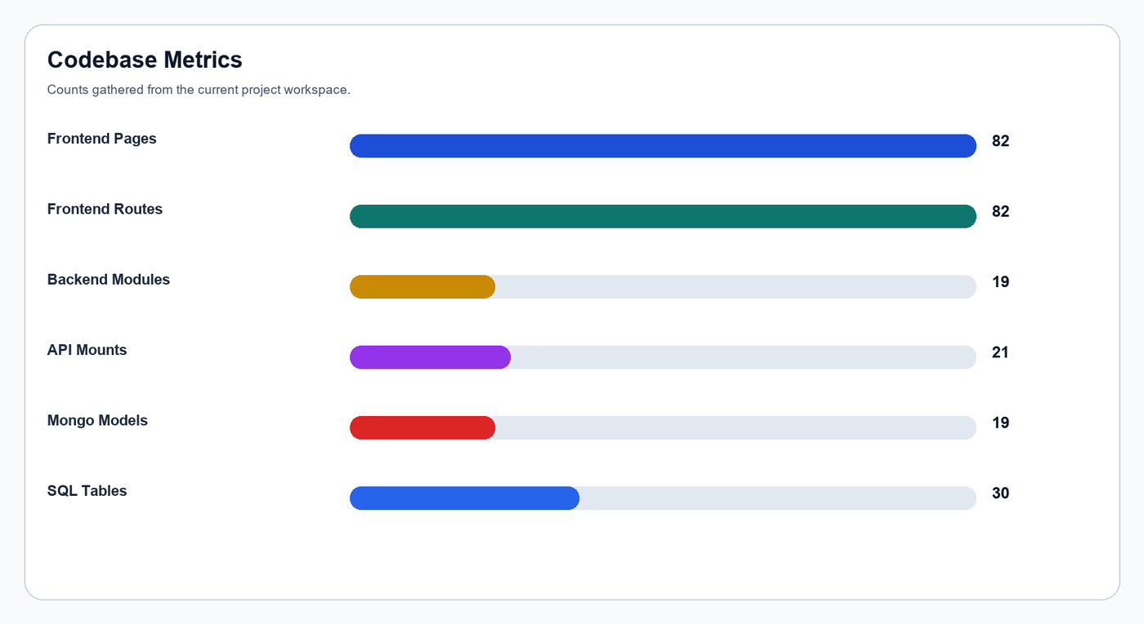
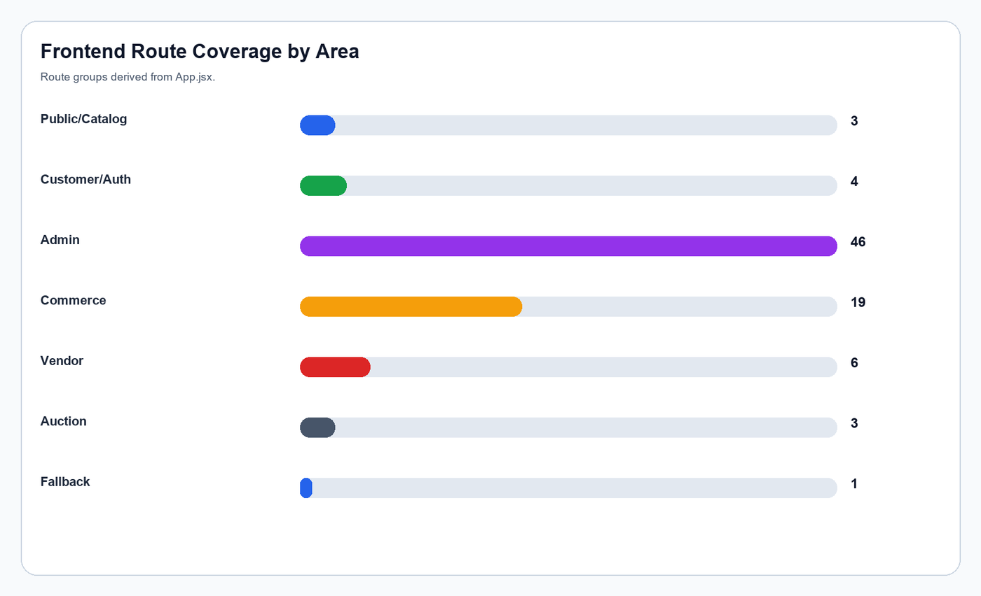
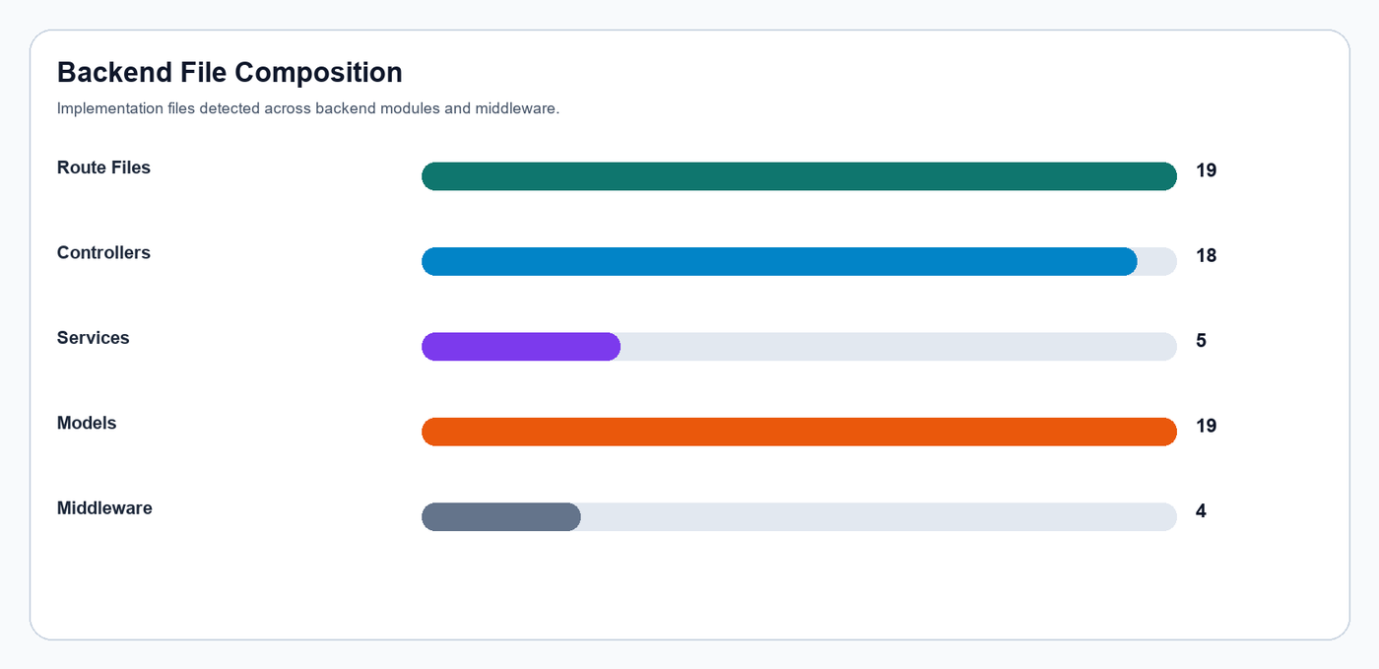
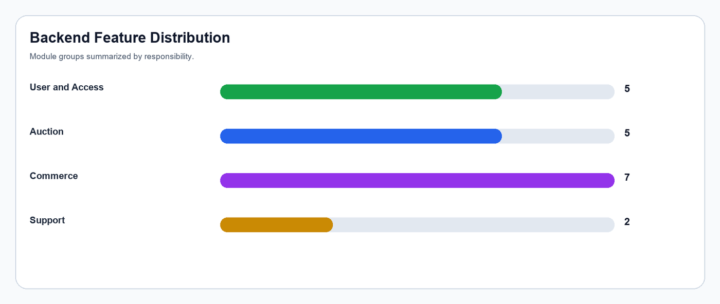
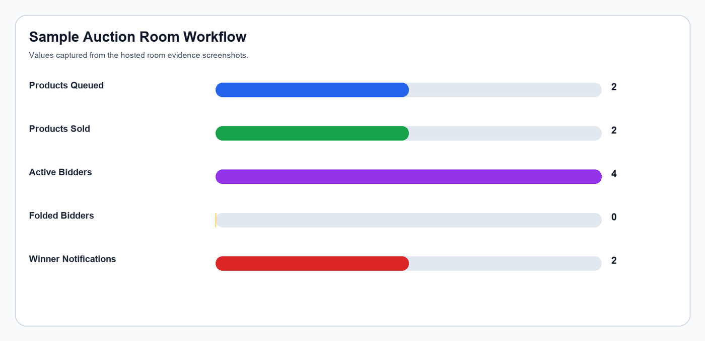
PROJECT ANALYSIS — CODEBASE METRICS
CODEBASE METRICS
Quantitative analysis of the system build
ROUTE COVERAGE
BACKEND COMPOSITION
FEATURE DISTRIBUTION
AUCTION WORKFLOW
Chart 1 — Size, files, structure
Chart 2 — Frontend route distribution
Chart 3 — Backend file breakdown
Fashion E-Commerce with Auction System ● Sheik Abdulla S ● 24SPCA043 ● VHNSN College ● April 2026
Chart 4 — Backend feature distribution
Chart 5 — Auction workflow analysis

Slide 60
LIMITATIONS OF THE SYSTEM
Known Limitations
Real-time auction quality depends on stable network connectivity — poor connections affect bid visibility and timer precision
System relies on application-level logic for bid validation, fold state, and winner declaration — not database transactions
Large concurrent auction participation may require horizontal scaling and load-balancing strategies
Advanced analytics and fraud-detection mechanisms are not yet fully implemented
Frontend main JavaScript chunk is 657 KB — bundle splitting is recommended for production optimization
Duplicate Admin email index warning observed during server boot — schema cleanup needed
No mobile application support currently — browser only

Slide 61
FUTURE ENHANCEMENTS
01
02
03
Machine Learning
Mobile Application
AI Fraud Detection
Product recommendation engine and dynamic pricing based on demand patterns and user behavior
Native Android and iOS apps for seamless mobile shopping and live auction participation
AI-assisted suspicious bidding alerts and anomaly detection to ensure fair auction practices
04
05
06
Live Video Streaming
Advanced Analytics
PWA & Performance
Video stream support for host-led auction sessions — show products in real time to bidders
Comprehensive dashboards for sales trends, bidding behavior analysis, and customer insights
Progressive Web App with bundle splitting, lazy loading improvements, and offline support

Slide 62
CONCLUSION
Project Summary
Successfully developed a full-stack Fashion E-Commerce platform with integrated Live Auction System
MERN stack (MongoDB, Express.js, React.js, Node.js) with Socket.IO enables real-time bidding for all users
Three-tier modular architecture supports scalability, maintainability, and clear separation of concerns
All 26 test cases passed — Authentication, Product, Cart, Order, Payment, Wallet, Auction, Security, Real-Time
82 frontend routes, 19 backend modules, 21 API mounts, and 19 Mongoose models implemented
Combines the best of traditional e-commerce with live digital auction for a modern fashion marketplace

Slide 63
BIBLIOGRAPHY & REFERENCES
[1]
MongoDB Documentation — Schema design, aggregation, and indexing.
[2]
Express.js Documentation — Routing, middleware, and REST API patterns.
[3]
React Documentation — Hooks, Router, lazy loading, and component architecture.
[4]
Node.js Documentation — Runtime, modules, asynchronous patterns.
[5]
Socket.IO Documentation — Events, rooms, namespaces, authentication.
[6]
Mongoose Documentation — ODM schema, models, validation, and references.
[7]
MDN Web Docs — JavaScript, Web APIs, Fetch, and browser standards.
[8]
Vite Documentation — Build tooling, lazy loading, and SPA optimization.
[9]
JWT.io — JSON Web Tokens: structure, signing, and verification.
[10]
Software Engineering & Web Technology lecture materials — MCA curriculum, Madurai Kamaraj University.

Slide 64
THANK YOU
Fashion E-Commerce with Auction System
MCA Final Project Viva — April 2026
Student:
SHEIK ABDULLA S
Roll No:
24SPCA043
Guide:
Mrs. P. MURUGESWARI
Institution:
VHNSN College, Virudhunagar

