Slide 1

GitHub API and Automation
Presenter : Abdur Rahaman

Slide 2
Agenda
1
Abbreviations
2
Introduction to REST API
3
REST API methods
4
Rest API Response Codes
5
GitHub API
6
GitHub API (Private Repository)
7
Tool Features
8
Features Overview
9
Tool Requirements
10
Fetching available Tags and Branches from remote repo
11
Fetch GitHub contents from a remote repo
12
Download NON- LFS File
13
Download Git LFS File
14
Traversal of Repository / Folder download
15
Advantages and References

Slide 3
Abbreviation | Definition
REST | Representational State Transfer
SOAP | Simple Object Access Protocol
API | Application Program Interface
Remote repo | Git repository hosted on the Internet or some other network
HTTPs | Hyper Text Transfer Protocol Secure
LFS | Large File Storage
URL | Uniform Resource Locator

Slide 4
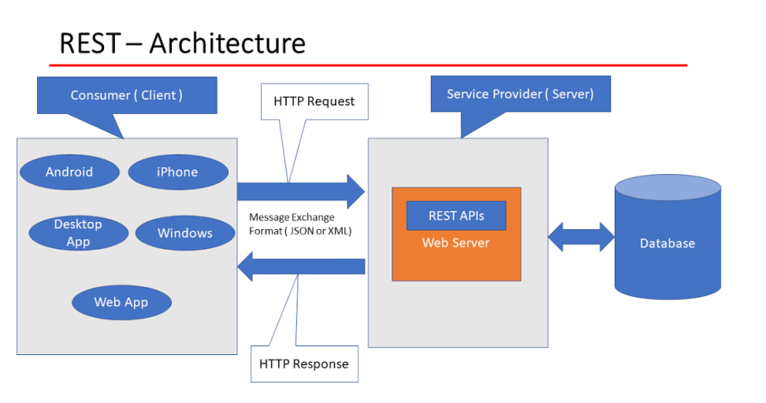
Introduction to REST API
Representational State Transfer (REST) is an architectural style that defines a set of constraints to be used for creating web services. REST API is a way of accessing web services in a simple and flexible way without having any processing.

Slide 5
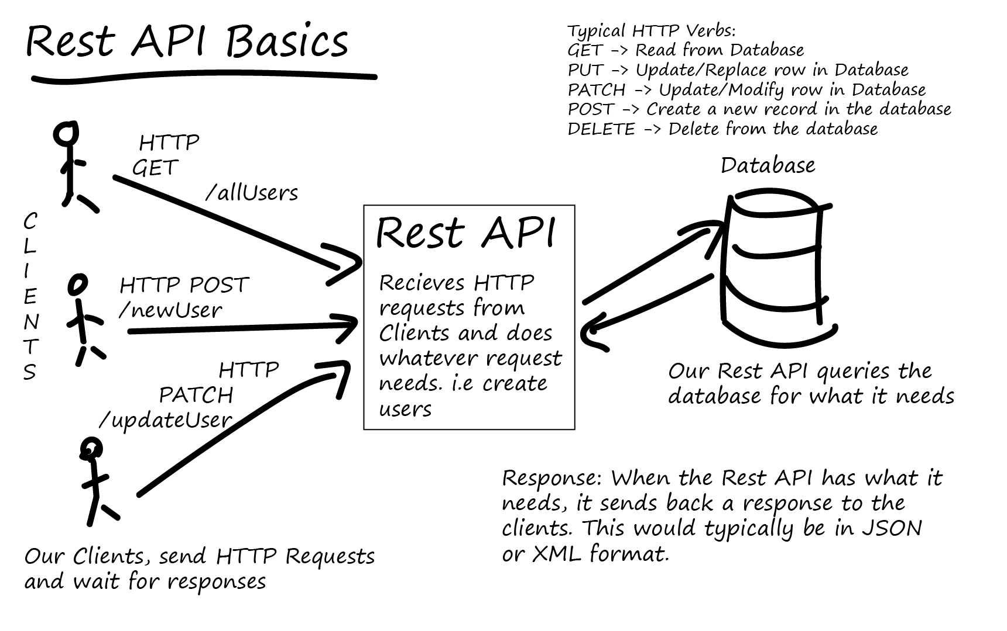
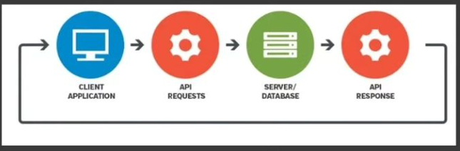
REST uses less bandwidth, simple and flexible making it more suitable for internet usage. It’s used to fetch or give some information from a web service. All communication done via REST API uses only HTTP request.

Slide 6
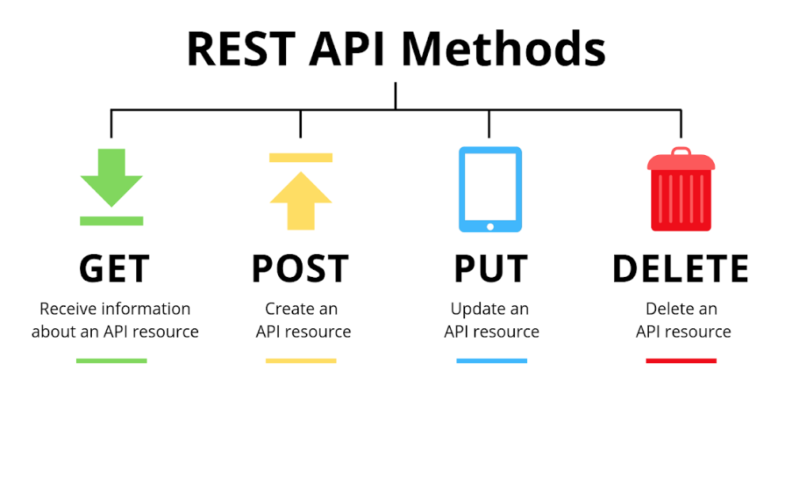
REST API methods
Working: A request is sent from client to server in the form of a web URL as HTTP GET or POST or PUT or DELETE request. After that, a response comes back from the server in the form of a resource which can be anything like HTML, XML, Image, or JSON. But now JSON is the most popular format being used in Web Services.

Slide 7
Rest API Response Codes
#1) 100 Series These are temporary Responses
100 Continue
101 Switching Protocols
102 Processing
#2) 200 Series The client accepts the Request, being processed successfully at the server.
200 – OK
201 – Created
202 – Accepted
203 – Non-Authoritative Information
204 – No Content
205 – Reset Content
206 – Partial Content
207 – Multi-Status
208 – Already Reported
226 – IM Used
#4) 400 Series These are specific to client-side error.
400 – Bad Request
401 – Unauthorised
402 – Payment Required
403 – Forbidden
404 – Not Found
405 – Method Not Allowed
406 – Not Acceptable
407 – Proxy Authentication Required
408 – Request Timeout
409 – Conflict
410 – Gone
411 – Length Required
412 – Precondition Failed
413 – Payload Too Large
414 – URI Too Long
415 – Unsupported Media Type
416 – Range Not Satisfiable
417 – Expectation Failed
418 – I’m a teapot
421 – Misdirected Request
422 – Unprocessable Entity
423 – Locked
424 – Failed Dependency
426 – Upgrade Required
428 – Precondition Required
429 – Too Many Requests
431 – Request Header Fields Too Large
451 – Unavailable For Legal Reasons
#5) 500 Series These are specific to the server-side error.
500 – Internal Server Error
501 – Not Implemented
502 – Bad Gateway
503 – Service Unavailable
504 – Gateway Timeout
505 – HTTP Version Not Supported
506 – Variant Also Negotiates
507 – Insufficient Storage
508 – Loop Detected
510 – Not Extended
511 – Network Authentication Required
#3) 300 Series Most of the codes related to this series are for URL Redirection.
300 – Multiple Choices
301 – Moved Permanently
302 – Found
303 – Check Other
304 – Not Modified
305 – Use Proxy
306 – Switch Proxy
307 – Temporary Redirect
308 – Permanent Redirect

Slide 8
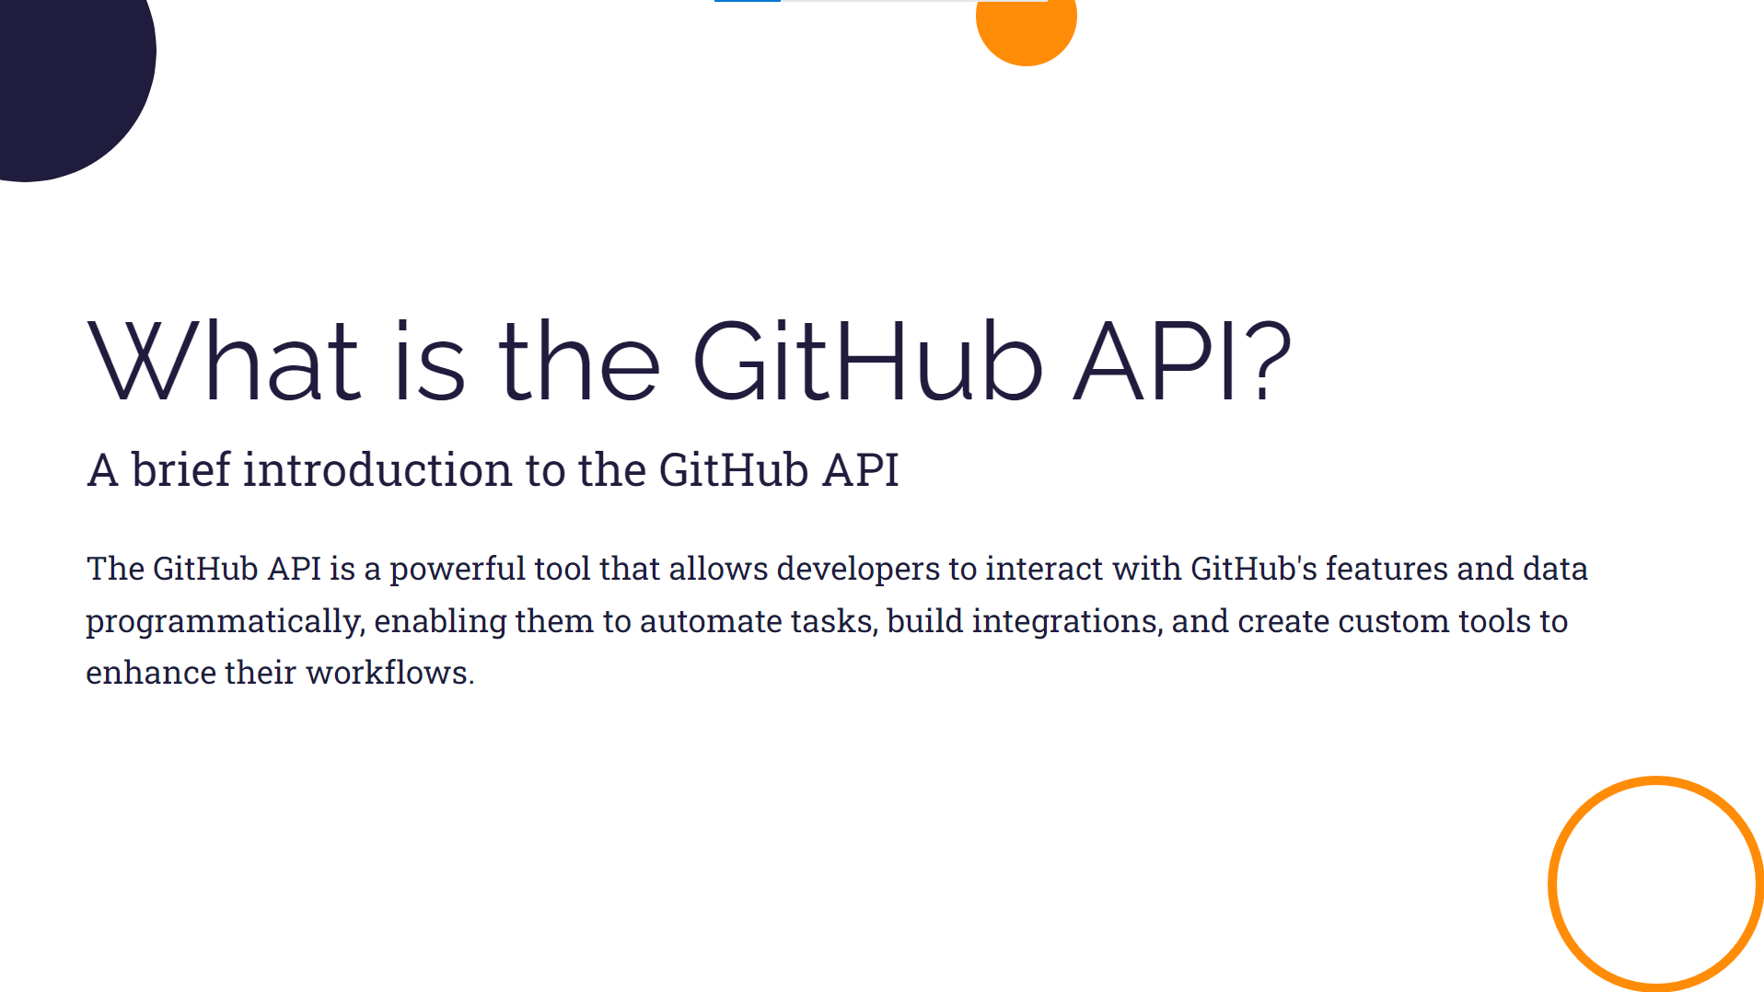

Slide 9
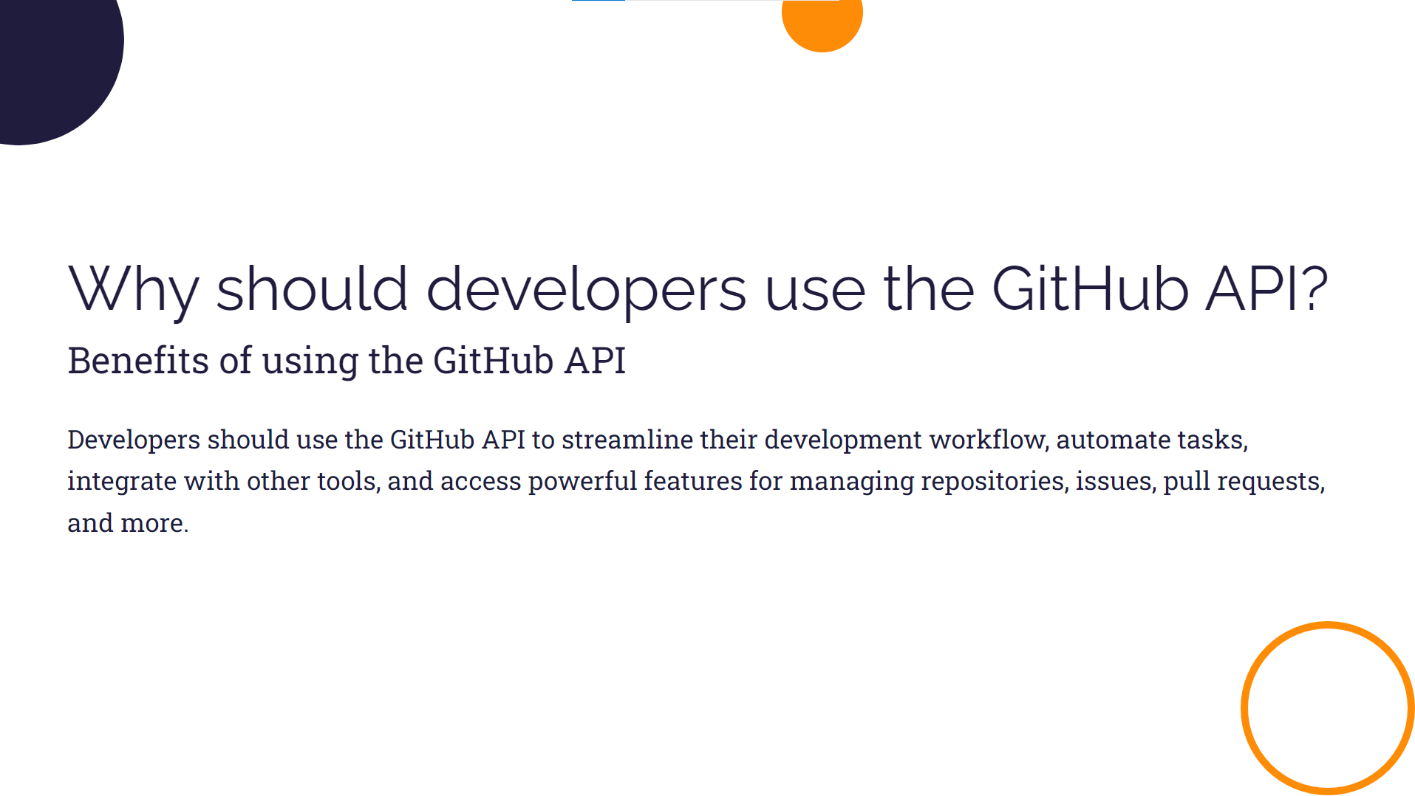

Slide 10
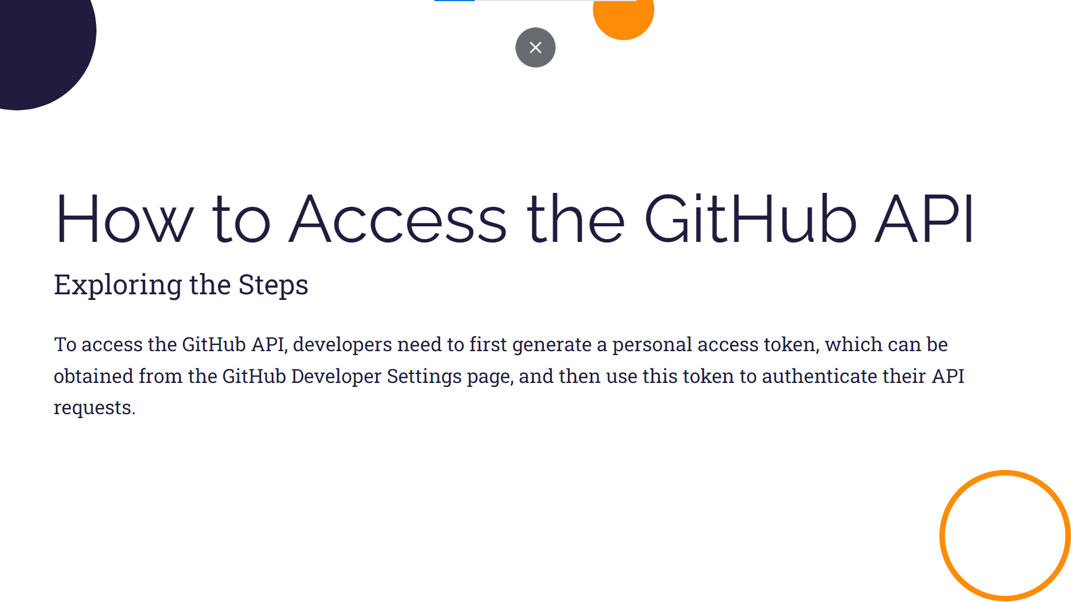

Slide 11


Slide 12
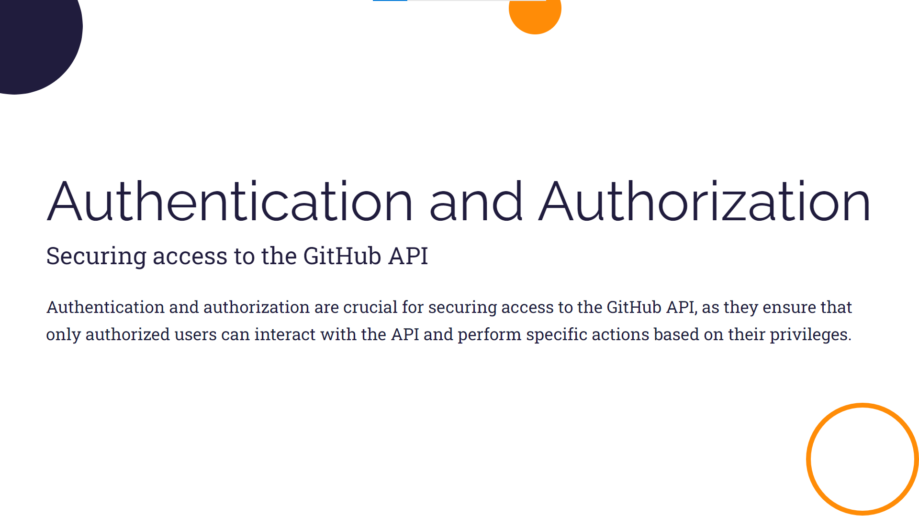

Slide 13
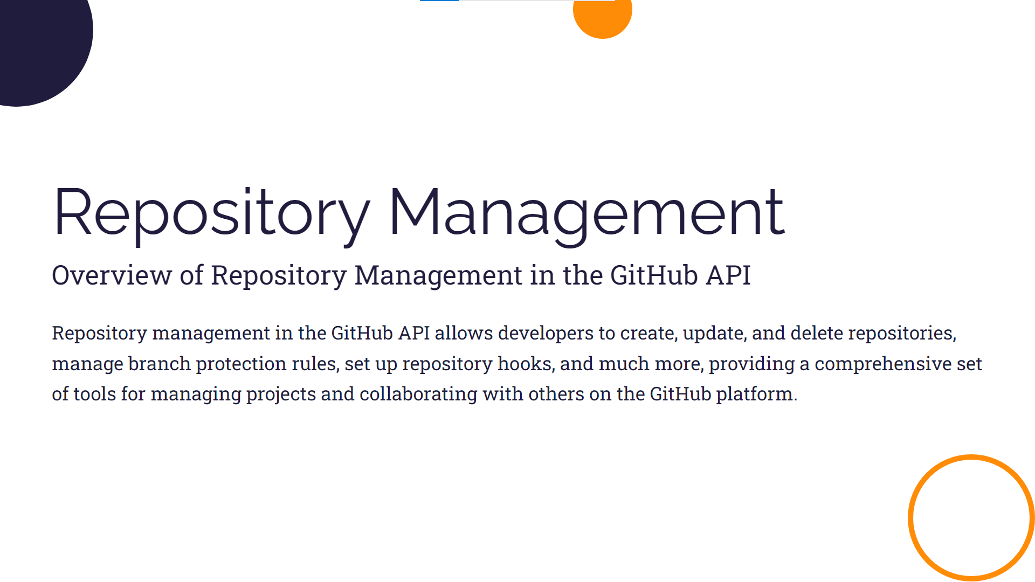

Slide 14
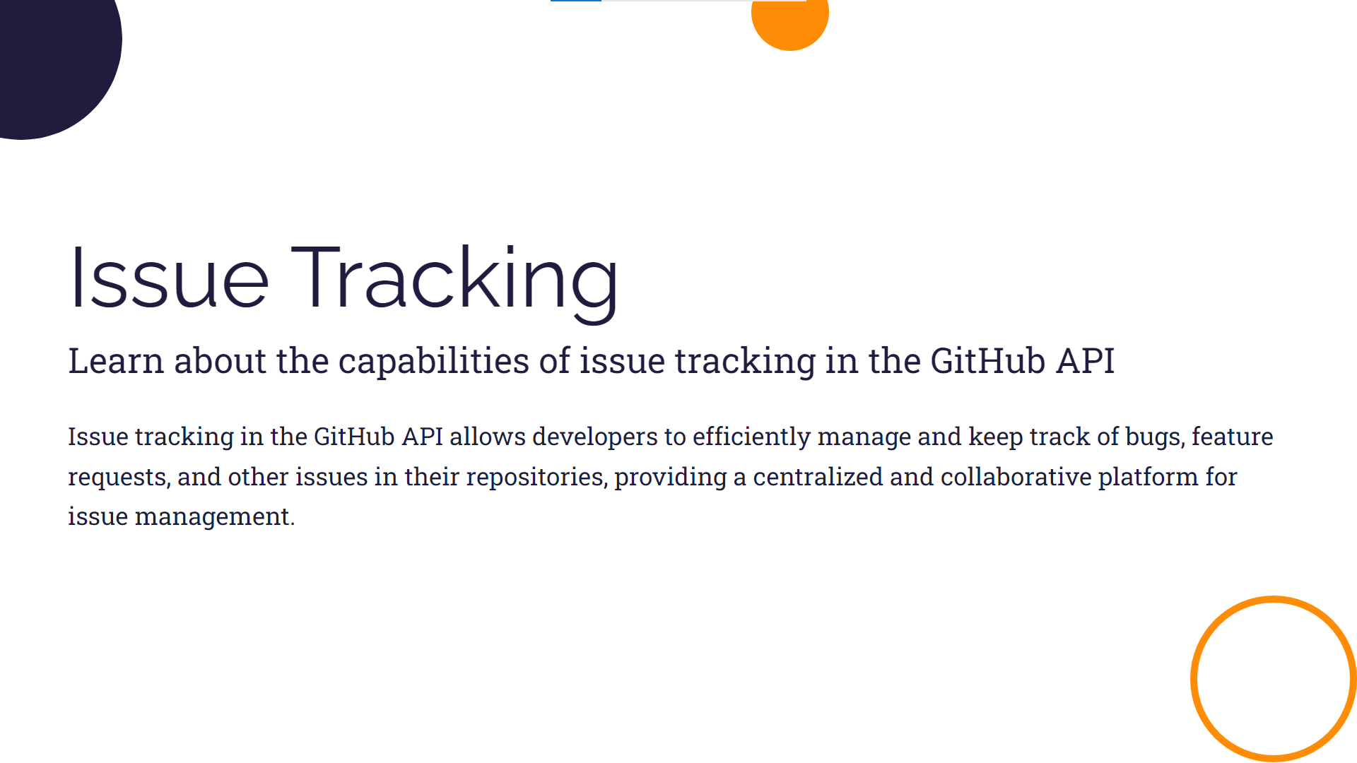

Slide 15
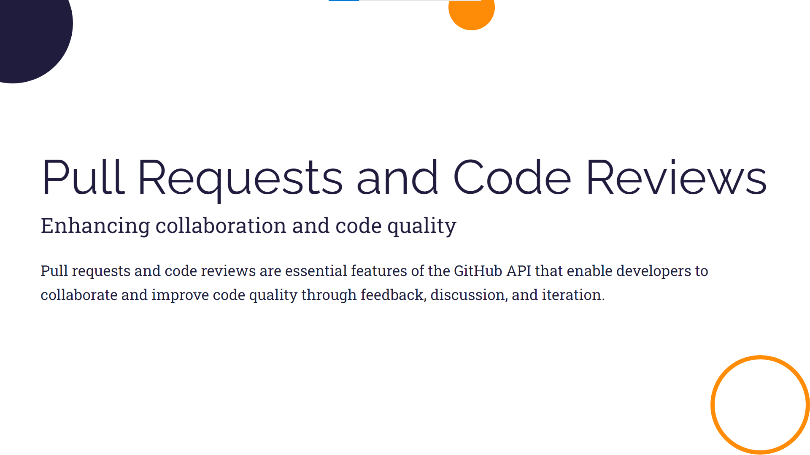

Slide 16
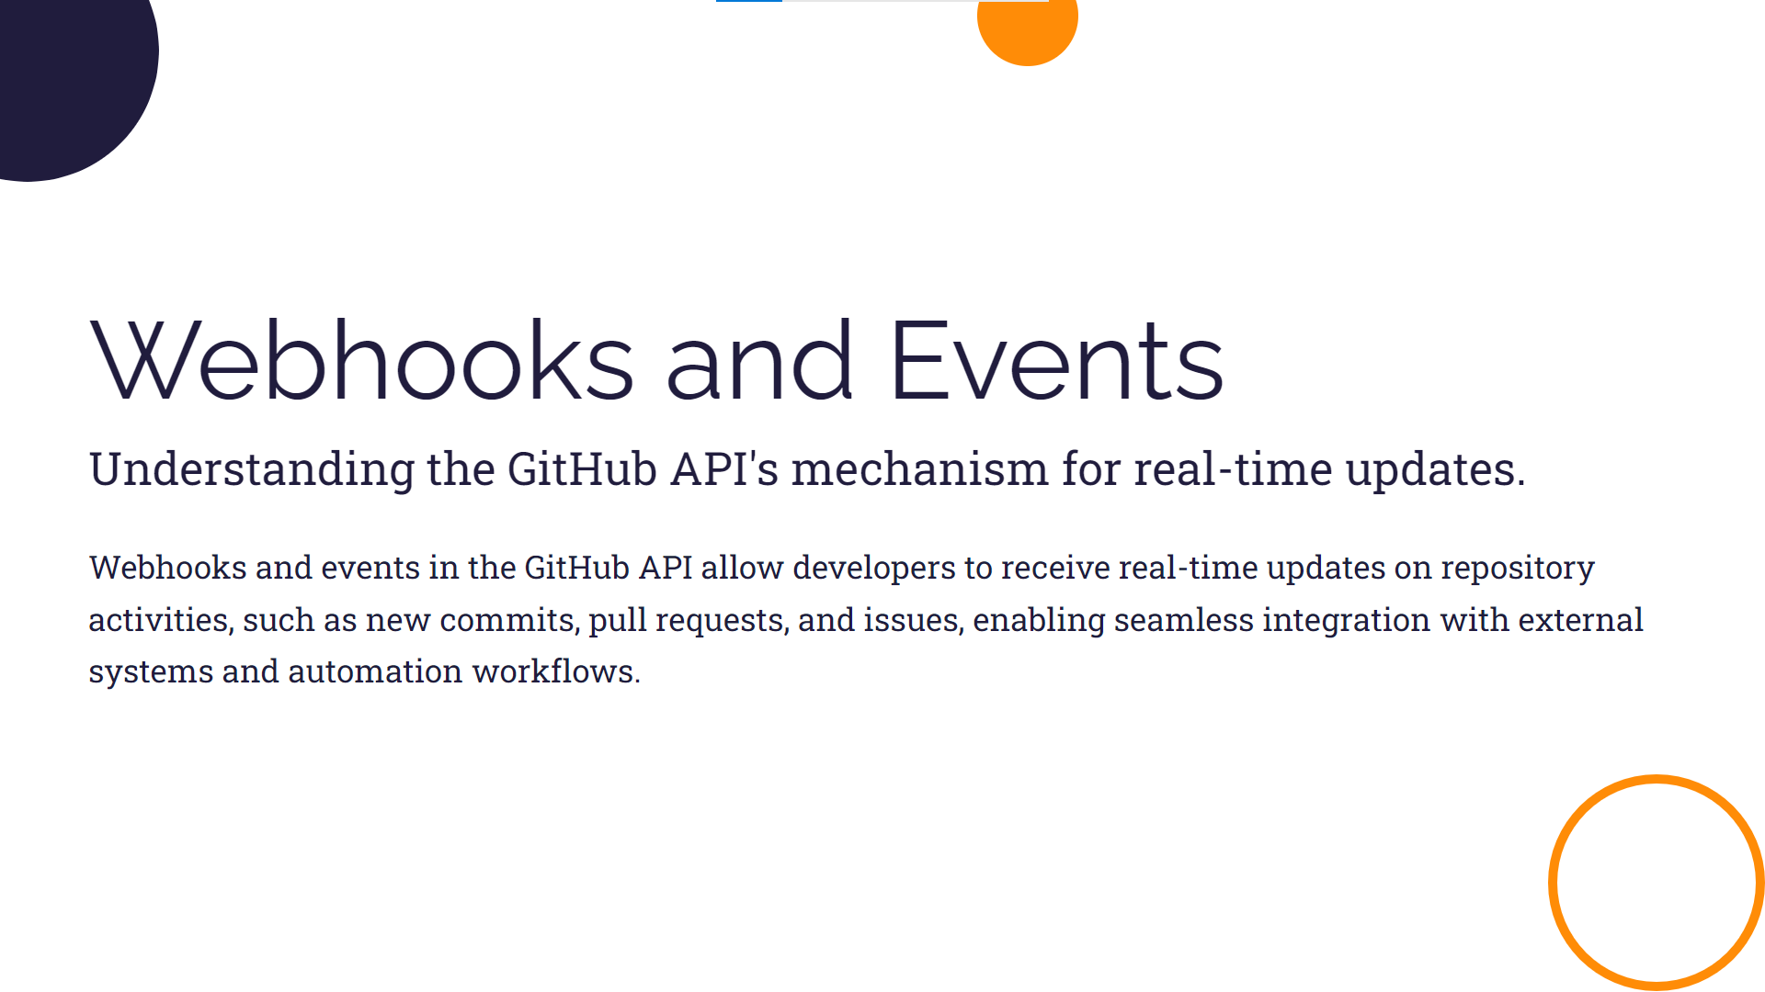

Slide 17
ADVANTAGES
The GitHub API offers a gateway to a new realm of efficient collaborative development. With its power, developers can unlock endless possibilities for creating, managing, and collaborating on projects. By tapping into this API, teams can streamline their workflows, automate tasks, and enhance their productivity. Let's explore how the GitHub API empowers developers to take collaboration to new heights.
To ensure successful utilization of the GitHub API, it's important to follow these best practices:
1. Implement secure authentication methods to protect sensitive data.
2. Leverage webhooks and event-driven workflows for real-time collaboration.
3. Utilize version control effectively to track changes and manage codebase.
4. Integrate with automated testing and continuous integration tools for efficient development.
5. Regularly monitor API usage and performance to optimize workflows.
6. Stay updated with API documentation and community forums for new features and improvements.
7. Foster a culture of collaboration and open-source contribution within your development team.

Slide 18

Leveraging GitHub API Feature
Retrieving Repository information
Managing issue and pull requests programmatically
Working with project boards and milestones
Exploring user and organization management capabilities

Slide 19


GitHub API (Private Repository)
GitHub APIs (or GitHub Rest APIs) are the APIs that you can use to interact with GitHub. They allow you to create and manage repositories, branches, issues, pull requests, and many more. For fetching privately available information (like private repositories, user profiles, etc.), you can call the API using personal access tokens, GitHub apps and Oauth apps.
GitHub

Slide 20
GitHub API
GitHub Desktop
Automation and Integration: The GitHub API allows for programmatic access to GitHub's features. This enables automation of tasks like creating repositories, managing issues, and more. It can be integrated into various tools and services.
Customization: You can build custom workflows and applications tailored to your specific needs. This can be anything from automating the creation of repositories to building complex CI/CD pipelines.
Scalability: It's suitable for managing large-scale projects or organizations where automation and customized workflows are essential.
Access Control: The API provides granular control over permissions, allowing for fine-tuning who can do what within a repository or organization.
Data Extraction and Analysis: You can retrieve detailed data about repositories, issues, pull requests, and more. This data can be analyzed for insights and reporting.
User-Friendly Interface: GitHub Desktop provides an easy-to-use graphical user interface (GUI) for interacting with repositories. This is especially helpful for those who prefer working with a visual interface.
Simplicity for Basic Tasks: It's excellent for simple tasks like creating, cloning, and managing local repositories.
Easy Git Integration: It simplifies the use of Git commands and workflows for users who might not be familiar with Git's command-line interface.
Visual Diffs and Merge: GitHub Desktop provides a visual way to view changes (diffs) and merge branches.
Pull Request Management: It offers a streamlined way to create, review, and merge pull requests.
GitHub

Slide 21
Which One to Use?
The choice between GitHub API and GitHub Desktop depends on your specific needs:
Use GitHub API if:
You need to automate tasks.
You're building custom workflows or integrating with other tools.
You require fine-grained control over permissions and access.
You need to extract and analyze data from repositories.
Use GitHub Desktop if:
You prefer a graphical interface for managing repositories.
You primarily work with basic Git operations and don't require extensive automation.
You find it helpful to visualize changes, branches, and pull requests.
In many cases, developers use a combination of both, leveraging the API for automation and customization, while using GitHub Desktop for day-to-day repository management.
GitHub

Slide 22
Tool Features
Download NON- LFS File
Download Git LFS File
Folder download
Auto Resynchronize File/Folder

Slide 23
Purpose of GitHub Auto Resynchronization Tool
GitHub has become the backbone of collaborative software development, hosting millions of repositories across a myriad of projects. However, as projects evolve and repositories grow, keeping local copies synchronized with the latest changes becomes a challenging task. This is especially true for developers working on multiple machines or teams collaborating across different time zones.
The GitHub Auto Resynchronization Tool is designed with a singular purpose: to simplify and automate the process of managing GitHub repositories. Let's delve into the key purposes this tool serves:
Efficient Repository Synchronization: -
Manually downloading and updating repositories can be a cumbersome process, especially when dealing with numerous files or large projects. This tool automates the synchronization process, ensuring that your local copies are always up to date without the need for manual intervention.
Flexible File and Repository Exploration: -
Whether you need to download a specific file or clone an entire repository, the tool adapts to your requirements. It dynamically fetches available branches and tags, allowing users to select the precise version they want to download. This flexibility is particularly valuable when dealing with projects that have multiple release versions or branches.
Time-Saving Parallel Downloading: -
For repositories with a substantial number of files, parallel downloading can significantly reduce synchronization times. The tool supports concurrent downloading of files, making the process faster and more efficient.
In essence, the GitHub Auto Resynchronization Tool is crafted to empower developers and teams by automating the mundane aspects of repository management.
GitHub

Slide 24
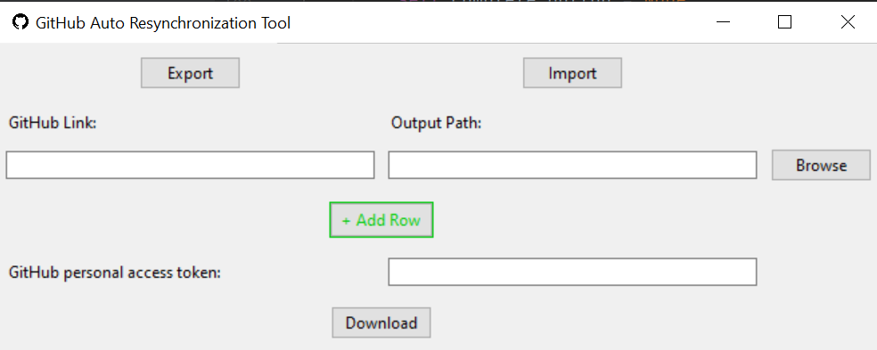
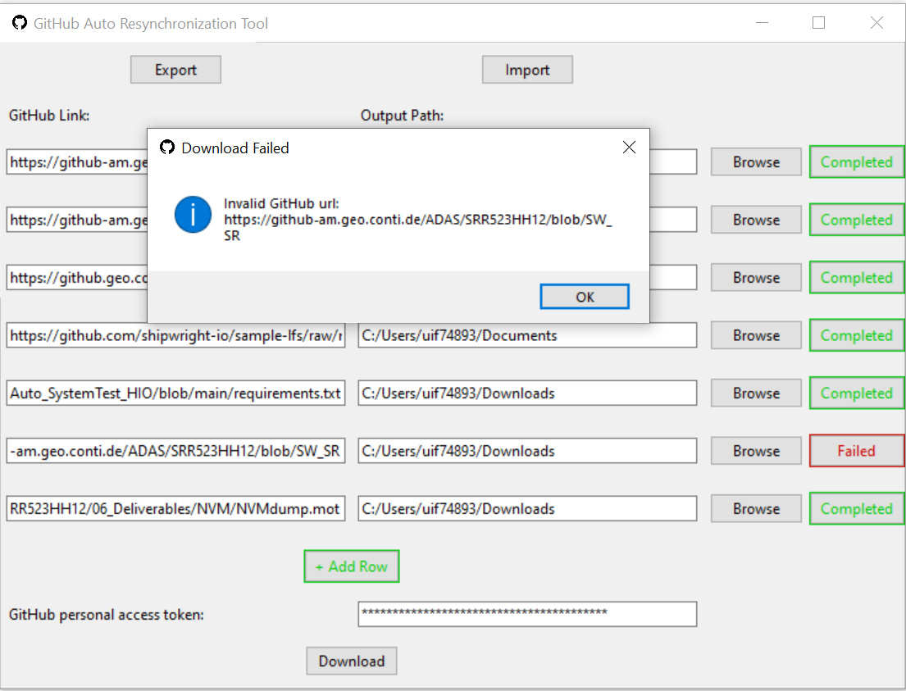
FEATURES OVERVIEW
1. GitHub link entries: - paste your GitHub link of the file or folder of a certain branch you want to download.
2. Output Path entries: - paste your local path where you want to download
3. Browse button: - Instead of pasting local path you can browse your local path using this button
4. Add row button: - clicking the add row button will add new row (GitHub Link entries and browse button), so that user can provide more GitHub link, Output Path for Parallel Downloading.
5. GitHub personal access token: - Provide your GitHub personal access token here for authentication purpose.
6. Download button: - Click it only when all the other fields are filled. After clicking it download will start don’t close the GUI until all downloads are completed. After completing single download, it will show the status (Completed/Failed). You will get a pop-up notification after the whole process.
7. Export Button: - Select a json file, it will save all your entries in json format, so that later user can import the saved json file using import button.
8. Import Button: - Select the exported json configuration it will populate all the entries.
9. Report: - Get total information of the status of individual download as mentioned below.
GitHub

Slide 25
TOOL REQUIREMENTS
Tool Requirements are: -
Python 3
Git
GitHub Account
Python Packages: - os, tkinter, requests, subprocess, json
Your Personal access token is active and had at least read access to that Repository.
GitHub

Slide 26
Fetching available Tags and Branches from remote repo
Command to fetch Tags: - git ls-remote --tags Ex: git ls-remote --tags repository URL
Command to fetch Branches: - git ls-remote – heads Ex: git ls-remote --heads repository URL
Use subprocess package along with the repo URL.
After some extraction of this result, you can get the expected list of Tags/Branches.
result = subprocess.run([ "git", "ls-remote", "--tags", url ], stdout=subprocess.PIPE, text=True)
GitHub

Slide 27
Fetch GitHub contents from a remote repo
Make a GET Request to GitHub API Repository(Private Repo): -
url = f"https://{hostname}/api/v3/repos/{owner}/{repo}/contents/{path}?ref={branch}" headers = {"Authorization": f"token {token}"} response = requests.get(url, headers=headers)
Make a GET Request to GitHub API Repository(Public Repo): -
url_public_repo = f"https://api.{self.hostname}/repos/{self.owner}/{self.repo}/contents/{path}?ref={self.branch}" response_public = requests.get(url_public_repo, verify=False)
Ex: -
https://api.github.com/repos/barchart/portfolio-api-common/contents/lib
Use your Personal access tokens for Authorization in headers of that GET request. As a response you will get a Json containing all the necessary information(Folder/files).
GitHub

Slide 28
Download NON- LFS File
Construct the raw URL: -
raw_url = f"https://{self.hostname}/raw/{self.owner}/{self.repo}/{self.branch}/{file_path}"
Create headers: -
headers = {"Authorization": f"token {self.token}"}
Make a GET Request to GitHub API: -
response = requests.get(raw_url, headers=headers)
If the content of the response is not in the below format :-
version https://git-lfs.github.com/spec/v1
oid sha256:{sha}
size {filesize}
then it is non-LFS file, just write the content in the desired file then
with open(output_path, "wb") as f: f.write(response.content)
GitHub

Slide 29
Download Git LFS File
Git-LFS replaces the large files in the repository with tiny pointers. It means if we have some large files in our repository like any Images, Videos, Graphics, etc. then cloning that repository is a time and space-consuming process. The developer may not need all those large resource files but still, he needs to download them while cloning the repository.
Git – LFS solves this problem. It allows the developers to avoid downloading the large resource files and provides some tiny pointers in the cloned repository. Those pointers point towards the actual file located at the remote servers like GitHub or GitLab, etc.
After sending GET request to the repository (mentioned file path)
https://{self.hostname}/raw/{self.owner}/{self.repo}/{self.branch}/{file_path}
Ex: - https://github.com/shipwright-io/sample-lfs/raw/main/assets/shipwright-logo-lightbg-512.png
If we get the response in the below format, then we can conclude that the file is stored in LFS.
version https://git-lfs.github.com/spec/v1
oid sha256:{sha}
size {filesize}
Using the above information, we have to perform few steps to download the LFS file.
Step 1:
Create JSON Object
json_data = { "operation": "download", "transfer": ["basic"], "objects": [{"oid": sha, "size": size}]} json_str = json.dumps(json_data)
GitHub

Slide 30
operation: Specifies the operation to be performed. In this case, it's set to "download".
transfer: Specifies the transfer protocol. Here, "basic" indicates the basic protocol.
objects: A list of objects to be processed. Each object has an oid (object ID) and size.
Step 2:
Make a POST Request to LFS API
headers = { "Accept": "application/vnd.git-lfs+json", "Content-type": "application/json", "Authorization": f"Bearer {self.token}"} lfs_api_url = f'https://{self.hostname}/{self.owner}/{self.repo}.git/info/lfs/objects/batch' response = requests.post(lfs_api_url, headers=headers, data=json_str)
headers: Contains the HTTP headers required for the request.
Accept: Specifies the accepted response format as Git LFS JSON.
Content-type: Indicates that the content is in JSON format.
Authorization: Includes an authentication token (in this case, a bearer token).
lfs_api_url: Specifies the URL for the LFS API request. It includes the hostname, owner, and repository details.
response: Sends a POST request to the LFS API using the specified URL, headers, and JSON data.
GitHub

Slide 31
Step 3:
In response we will again get a json where download url(href) and RemoteAuth(Authorization) Make a GET Request to download url then open the local file path and write the contents of the response.
download_url = response.json()["objects"][0]["actions"]["download"]["href"] RemoteAuth = response.json()["objects"][0]["actions"]["download"]["header"]["Authorization"] headers = { 'Authorization': RemoteAuth } response = requests.get(download_url, headers=headers) if response.status_code == 200: with open(download_file_path, 'wb') as f: f.write(response.content)
GitHub

Slide 32
Traversal of Repository / Folder download
Traversal of repository using Preorder tree traversal approach: -
Basic algo for preorder tree traversal: -
Preorder(root):
1.Follow step 2 to 4 until root! = NULL
2.Write root -> data
3.Preorder (root -> left)
4.Preorder (root -> right)
5.End loop
Our algo for traversal of repository: -
Preorder(root_repo):
1.Follow step 2 to 4
2.fetch GitHub content (root_repo) (process mention in point 9)
3. if it is file download it
4. else create a folder and visit all the file/folder inside the remote repo folder one by one and call cvc Preorder(child_repo)
5.End loop
GitHub

Slide 33
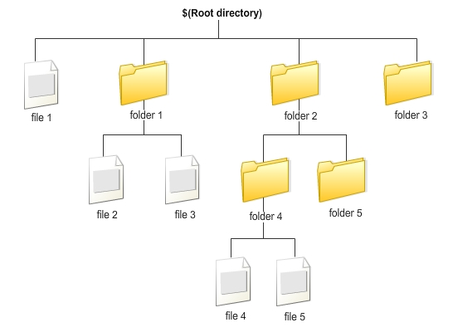
GitHub

Slide 34
ADVANTAGES
Integrating GitHub API with External Applications
Retrieving repository information
Managing issues and pull requests programmatically
Exploring user and organization management capabilities
Utilize version control effectively to track changes and manage codebase.
Integrate with automated testing and continuous integration tools for efficient development.
Efficient usages of space and time using resynchronization instead of cloning.
Automation of repetitive git commands
The tool supports concurrent downloading of files, significantly reducing the time required for synchronizing repositories with a large number of files.
No need to clone the entire repository; you can simply download specific files or folders that you need. This way, we can save a significant amount of space by avoiding unnecessary files and folders, as well as time.
GitHub

Slide 35
REFERENCES
https://docs.github.com/en/enterprise-server@3.8/rest/overview/resources-in-the-rest-api or contact your PMT team.
GitHub REST API documentation - GitHub Docs
clone a specific tag:-
How to clone a specific git tag? - StackTuts
Resources in the REST API - GitHub Enterprise Server 3.8 Docs
Git - git-ls-tree Documentation (git-scm.com)
Git - git-ls-remote Documentation
Automatic token authentication - GitHub Enterprise Server 3.8 Docs
Keeping your API credentials secure - GitHub Enterprise Server 3.8 Docs
https://api.github.com/repos/barchart/portfolio-api-common/contents/lib
Repository tags - GitHub Docs
How to download GIT LFS files · GitHub
https://github-am.geo.conti.de/settings/tokens
Rest API Response Codes And Types Of Rest Requests (softwaretestinghelp.com)
GitHub

Slide 36


Q & A

Slide 37



