Slide 1
Recommending neighborhood options for a leading business workspace developer & manager (ABC) in Bengaluru
Final Assignment – Kabilan Sundararaj

Slide 2
Intro & Interest
ABC is contemplating the decision of selecting neighborhood options for their upcoming workspace development project in Bengaluru, India.
01
2 out of top 10 workspaces in Bengaluru belongs them.
02
Given the success those two business parks enjoy, they are considering choosing a neighborhood very similar to the ones they already developed
03
They firmly believe in that success of their existing workspaces is because of the neighborhood & composition of venues & facilities around them
04

Slide 3
Data requirements & Sources
Requirements:
1. All available boroughs & neighborhood names in Bengaluru
2. Geographical coordinates of the above neighborhoods
3. Borough, neighborhood data of existing ABC workspaces in Bengaluru
4. Venue details, categories & other venue related info
Sources:
https://en.wikipedia.org/wiki/List_of_neighbourhoods_in_Bengaluru
The geographical coordinates were not readily available. Since the number of neighborhoods was less, manually collected the data from web.
Manually googled & found the same
Foursquare venue details to be fetched through the neighborhood names
Data Prep:
Performed web scraping on Wikipedia page for getting neighborhoods
Manually added the coordinates after researching them for each row

Slide 4
Summarized approach/methodology
The venue details for each neighborhood is gathered using foursquare
For each neighborhood the top venue categories are calculated & listed
The above data is fed into a clustering algorithm (preferably KMeans algorithm, as are to find a neighborhood with similar composition of venues)
If both neighborhoods fall under a same cluster then, the average top venue frequency is averaged for both – this later form the weights for ordering the top 5 options under the same cluster
They are ranked based on the sum product of weights with their top venue frequencies which is nothing but similarity scores
The top 5-10 neighborhoods is present as options for them to further choose

Slide 5
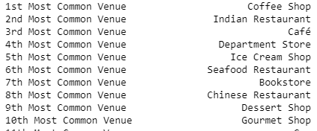
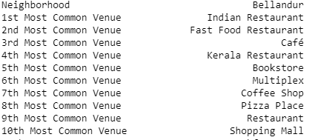
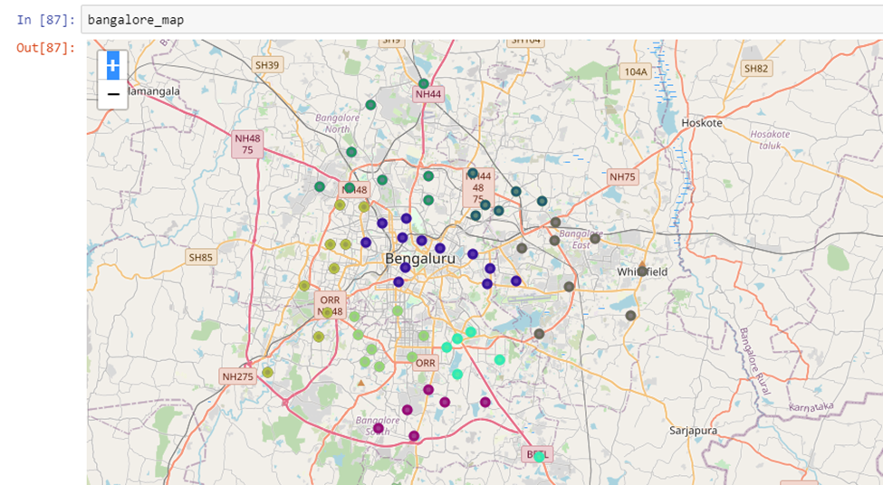
Exploratory analysis – exploring existing workspace neighborhoods
Both of the neighborhoods has 4-5 common venue types which are the most frequently found venues. This insight pointed us forward in the clustering approach

Slide 6
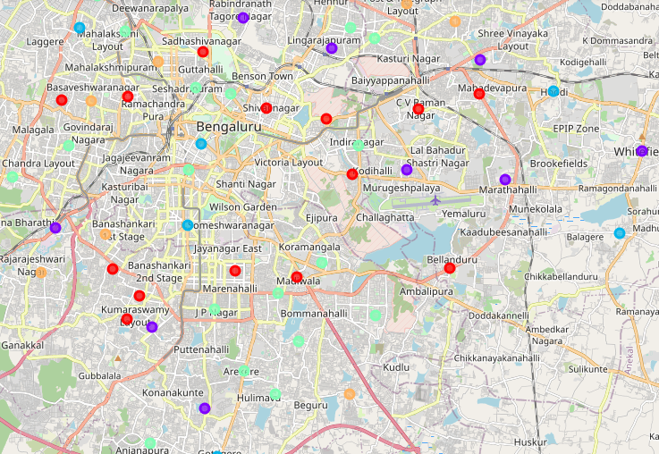
Classifying neighborhoods using Kmeans & cluster insights
Cluster 0 insights:
Both existing workspace neighborhoods falls under same cluster 0, which houses both native & migrant population
Combination of big workspaces, IT hubs & as well as residential places
Cluster 2 insights:
not big on migrant population, so it is mainly dominated by native Karnataka crowd
Cluster 3 insights:
known for the nightlife & youth residential areas, less on office & It spaces
Cluster 1 insights:
flaunts the most mature, modern facilities & venues. The existing workspaces is in cluster 0

Slide 7
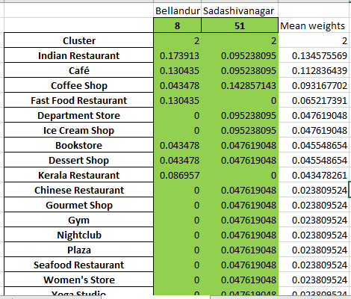
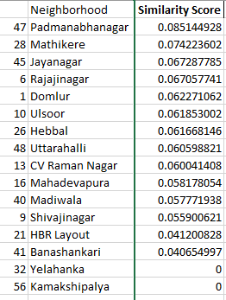
Results
Calculating weights by taking avg of two neighborhoods
Ranking top options based on Similarity Score

Slide 8
THANK YOU!!

