Slide 2
A minimum of 5 variables in your dataset used during your analysis (for help with selecting, the author made his selection on page 6 of your book). Consider what you think could have an impact on your question – remember this is never perfect, so don’t be worried if you miss one (Chapter 1).
Describe what the 5 variables mean in the dataset (Chapter 1).
Include a histogram of each of the 5 variables – in your summary and analysis, identify any outliers and explain the reasoning for them being outliers and how you believe they should be handled (Chapter 2).
Include the other descriptive characteristics about the variables: Mean, Mode, Spread, and Tails (Chapter 2).
Using pg. 29 of your text as an example, compare two scenarios in your data using a PMF. Reminder, this isn’t comparing two variables against each other – it is the same variable, but a different scenario. Almost like a filter. The example in the book is first babies compared to all other babies, it is still the same variable, but breaking the data out based on criteria we are exploring (Chapter 3).
Create 1 CDF with one of your variables, using page 41-44 as your guide, what does this tell you about your variable and how does it address the question you are trying to answer (Chapter 4).
Plot 1 analytical distribution and provide your analysis on how it applies to the dataset you have chosen (Chapter 5).
Create two scatter plots comparing two variables and provide your analysis on correlation and causation. Remember, covariance, Pearson’s correlation, and Non-Linear Relationships should also be considered during your analysis (Chapter 7).
Conduct a test on your hypothesis using one of the methods covered in Chapter 9.
For this project, conduct a regression analysis on either one dependent and one explanatory variable, or multiple explanatory variables (Chapter 10 & 11).

Slide 3
A minimum of 5 variables in your dataset used during your analysis
The below Variables used in my analysis.
SALE_PRC
LND_SQFOOT
TOT_LVG_AREA
Age
Months_old

Slide 4
Describe what the 5 variables mean in the dataset
SALE_PRC : Integer: it’s the sale price of the house
LND_SQFOOT- Integer : Sqft of the house
TOT_LVG_AREA - Integer : Total living are
Age - Integer : Age of the house
HWY_DIST - Integer : Distance From Highway

Slide 5
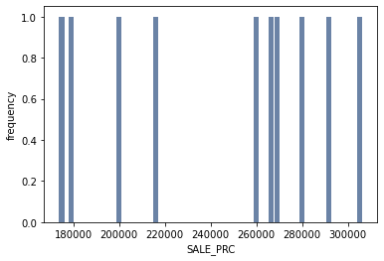
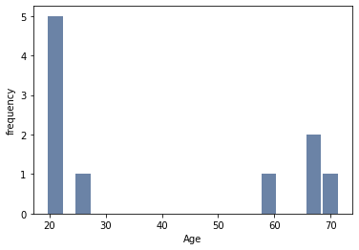
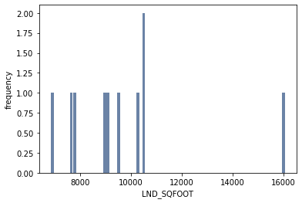
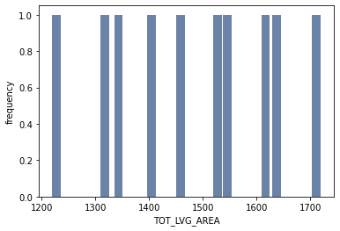
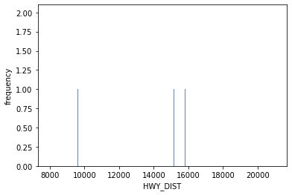
Include a histogram of each of the 5 variables

Slide 6
Mean, Mode, Spread, and Tails
print(df.mean())
LATITUDE 2.572881e+01 LONGITUDE -8.032748e+01 PARCELNO 2.356496e+12 SALE_PRC 3.999419e+05 LND_SQFOOT 8.620880e+03 TOT_LVG_AREA 2.058045e+03 SPEC_FEAT_VAL 9.562493e+03 RAIL_DIST 8.348549e+03 OCEAN_DIST 3.169099e+04 WATER_DIST 1.196029e+04 CNTR_DIST 6.849033e+04 SUBCNTR_DI 4.111505e+04 HWY_DIST 7.723771e+03 age 3.066925e+01 avno60plus 1.492966e-02 month_sold 6.655828e+00 structure_quality 3.513997e+00
print(df.mode())
LATITUDE LONGITUDE PARCELNO SALE_PRC LND_SQFOOT TOT_LVG_AREA \ |  |  |  |  |  |  |  |  |  | SPEC_FEAT_VAL RAIL_DIST OCEAN_DIST WATER_DIST CNTR_DIST SUBCNTR_DI \
0 25.749640 -80.431515 1.312402e+11 250000.0 7500.0 3079.0 |  |  |  |  |  |  |  |  |  | 0 0.0 50.0 13858.2 0.0 14557.6 14557.6
1 25.816591 -80.228887 3.022200e+12 NaN NaN NaN |  |  |  |  |  |  |  |  |  | 1 NaN NaN 15183.3 NaN 25074.0 25074.0
2 25.837536 -80.198387 3.031150e+12 NaN NaN NaN |  |  |  |  |  |  |  |  |  | 2 NaN NaN 21012.0 NaN 43025.9 37728.9
3 25.908080 -80.167954 3.049101e+12 NaN NaN NaN |  |  |  |  |  |  |  |  |  | 3 NaN NaN 22211.5 NaN 48378.1 44362.6
4 NaN NaN NaN NaN NaN NaN |  |  |  |  |  |  |  |  |  | 4 NaN NaN 24820.4 NaN 79187.6 44742.7
5 NaN NaN NaN NaN NaN NaN |  |  |  |  |  |  |  |  |  | 5 NaN NaN 28968.2 NaN 93953.7 45214.2
6 NaN NaN NaN NaN NaN NaN |  |  |  |  |  |  |  |  |  | 6 NaN NaN 33545.3 NaN NaN 60514.7
7 NaN NaN NaN NaN NaN NaN |  |  |  |  |  |  |  |  |  | 7 NaN NaN 34891.0 NaN NaN NaN
8 NaN NaN NaN NaN NaN NaN |  |  |  |  |  |  |  |  |  | 8 NaN NaN 42047.0 NaN NaN NaN
9 NaN NaN NaN NaN NaN NaN |  |  |  |  |  |  |  |  |  | 9 NaN NaN 55025.2 NaN NaN NaN
10 NaN NaN NaN NaN NaN NaN |  |  |  |  |  |  |  |  |  | 10 NaN NaN 61433.2 NaN NaN NaN

Slide 7
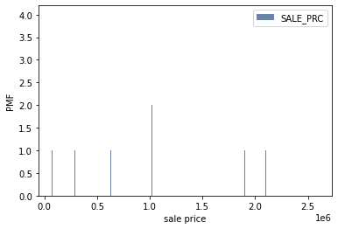
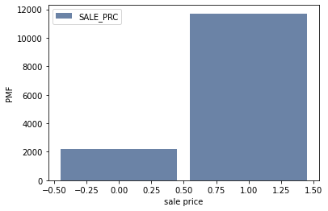
compare two scenarios in your data using a PMF
SALE_PRC_hist = thinkstats2.Hist(df['SALE_PRC'].head(100), label='SALE_PRC')
pmf = SALE_PRC_hist.Copy()
thinkplot.Hist(pmf)
thinkplot.Config(xlabel='sale price', ylabel='PMF')
SALE_PRC_hist = thinkstats2.Hist(df['SALE_PRC']>(200000), label='SALE_PRC')
pmf = SALE_PRC_hist.Copy()
thinkplot.Hist(pmf)
thinkplot.Config(xlabel='sale price', ylabel='PMF')

Slide 8
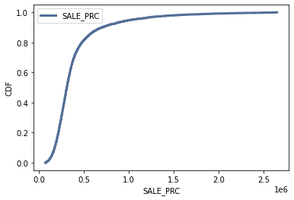
Create 1 CDF with one of your variables
cdf = thinkstats2.Cdf(df['SALE_PRC'], label='SALE_PRC')
thinkplot.Cdf(cdf)
thinkplot.Config(xlabel='SALE_PRC', ylabel='CDF', loc='upper left’)
This shows 90% of the house prices are more then 500k

Slide 9
Plot 1 analytical distribution and provide your analysis

