Slide 1
Leveraging Yahoo Finance Data for Predictive Modeling in the Stock Market

Slide 2
Understanding the Business Problem
The primary goal is to mitigate the inherent risks and uncertainties in stock market investments by predicting future stock prices. Accurate predictions can significantly enhance investment strategies, leading to better risk management and increased investment returns. This problem addresses the need for advanced analytical tools in the investment world, where traditional methods often fall short in accurately predicting market movements.

Slide 3
Exploring Yahoo Finance Data
Data Source: The data is sourced from Yahoo Finance, a reputable platform offering comprehensive financial data.
Features: Key features include historical stock prices (Open, High, Low, Close) and trading volume, providing a quantitative basis for analysis.
Data Prep: Data preparation involved cleaning missing values and creating lag features, such as the previous day's closing price, to serve as predictors for the current day's closing price.
Data Dictionary: A concise reference that defines each feature within the dataset, ensuring clarity and consistency in data interpretation.

Slide 4
Predictive Modeling Approach
•Linear Regression: Utilized as a baseline model to establish a predictive framework based on linear relationships between features and target variables.
•Random Forest Regressor: Employed for its ability to handle non-linear data and provide insights into feature importance, thereby improving model robustness.
•Gradient Boosting Regressor: Explored for its effectiveness in handling complex patterns through sequential learning, aiming for further accuracy improvements.
•Evaluation Metrics: Model performance assessed using Root Mean Squared Error (RMSE) and R-squared (R²) values to quantify prediction accuracy and the proportion of variance explained by the model, respectively.

Slide 5
Key Insights
Feature Importance and Selection:
The analysis underscored the pivotal role of specific features, such as the Relative Strength Index (RSI) and moving averages (e.g., Close_MA10, Close_MA20), in enhancing the model's prediction accuracy. These features, indicative of market momentum and trends, were crucial in refining the models for better performance.
Advanced feature selection techniques, including permutation importance and SHAP (SHapley Additive exPlanations) values, were deployed to identify and quantify the impact of each feature on the model's predictions, leading to more focused model training and improved accuracy.
Model Evaluation and Comparison:
The comparative performance of multiple models (Linear Regression, Random Forest, and Gradient Boosting Regressor) was meticulously assessed using RMSE and R-squared metrics. This rigorous evaluation process facilitated the identification of the most effective model, with Gradient Boosting Regressor emerging as a particularly strong candidate due to its sophisticated handling of complex, nonlinear relationships within the data.
The findings emphasized the importance of not only minimizing RMSE for accuracy but also maximizing R-squared to ensure the model's explanatory power was optimized, reflecting a balance between prediction accuracy and the ability to explain variance in stock prices.
Adjustments for Overfitting:
To combat overfitting, a common challenge in predictive modeling, techniques such as parameter tuning and cross-validation were implemented. These adjustments were critical in enhancing the model's ability to generalize to unseen data, thereby ensuring reliability and robustness in real-world applications.
Implications for Predictive Modeling in Finance:
The insights garnered from this analysis have profound implications for predictive modeling in the financial sector, particularly in the context of stock market forecasting. They highlight the potential for sophisticated machine learning models to capture complex market dynamics and offer predictive insights that can inform investment strategies.

Slide 6
Challenges and Adjustments
Addressed overfitting by tuning model parameters and employing cross-validation techniques to ensure model generalizability.
Explored advanced feature selection methods to enhance model performance and interpretability.
The analysis also pointed towards future research avenues, including the integration of additional predictive features (e.g., market sentiment, macroeconomic indicators) and the exploration of more complex models (e.g., deep learning approaches) that could potentially offer even greater accuracy and insight into stock market movements.
Experiment with Different Models: Beyond linear regression, explore more complex models such as ensemble methods (Random Forests, Gradient Boosting Machines), deep learning networks, and time series forecasting models (ARIMA, LSTM networks). These models can capture nonlinear relationships and patterns not discernible with simpler approaches.
Implement Cross-Validation: Use techniques like k-fold cross-validation to assess how the model performs on unseen data, ensuring that the model generalizes well and is not overfitting to the training data.

Slide 7
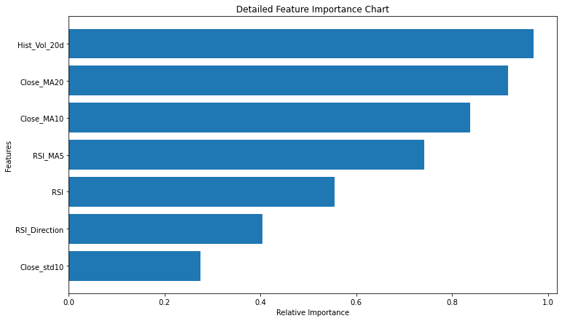
Vizualization
This visualization helps in understanding the relative importance of each feature used in the model.

Slide 8
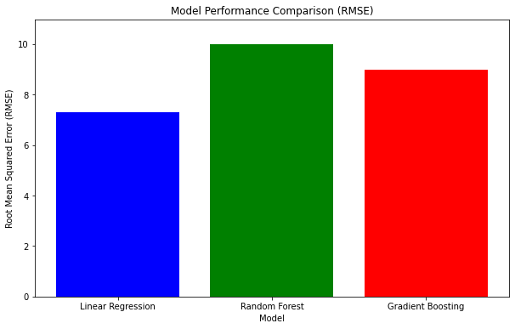
Visualization
This chart compares the performance of three predictive models: Linear Regression, Random Forest, and Gradient Boosting, using Root Mean Squared Error (RMSE) as the metric. A lower MSE value indicates a model with better predictive accuracy.

Slide 9
Conclusion
The predictive model demonstrated a baseline capability to forecast stock prices, suggesting the viability of using historical data for investment decisions. However, the analysis also highlighted the model's limitations, emphasizing the need for more sophisticated methods to better capture the market's complex dynamics.

Slide 10
Thank You

